Slide 1
Project-based learning in post-16 maths
Dave Gale
MathsConf35
Summer 2024
Notes:
Working title.

Slide 2
Biography: @reflectivemaths
Maths teacher since 2001
Advanced Skills teacher
Maths author – Hodder and Stoughton, The Mathematical Association, Integral, Amazon, AQA
Core Maths advocate with the Advanced Maths Support Programme (AMSP)

Slide 3
Objectives
To introduce you to Core Maths and how it’s different.
To encourage you to think about maths teaching in an even more creative way.
To explore how to use a project as a starting point for maths.
To provide an opportunity to ask questions.
To share other starting points and resources.

Slide 4
What’s available for ‘Core Maths’
AQA
Edexcel
OCR/MEI
AQA Certificate Level 3 Mathematical Studies
Two papers
Three variants:
A: Statistical Techniques
B: Critical Path and Risk Analysis
C: Graphical Techniques
Mathematics in Context
(Level 3 Core Maths)
Two papers
Core Maths (MEI) Level 3 Certificate Core Maths
Two papers
Two variants:
A: Critical Maths
B: Statistical Problem Solving
Notes:
‘Core Maths’ is an umbrella term

Slide 5
Core Maths entry requirement
All exam boards have written their courses to be appropriate for students attaining Grade 4 or higher in GCSE Maths.

Slide 6
Core Maths preliminary material
All exam boards release material before the exam so students know what some of the questions will be based on.

Slide 7
Why did I choose AQA 2A?
Why AQA?
Fermi estimation is both fun and a good life skill.
Finance is a significant part, with Income Tax and National Insurance consistently asked.
Critical Analysis is a specific focus.
Why 2A?
I was already comfortable with statistics teaching from A-level Maths.
Psychology, geography and biology are popular at my school.
Notes:
Just notes at this point.

Slide 8
The main selling points of Core Maths
For students and parents:
It is so obviously useful maths.
No more “When will I use this?”
Genuinely supports other A-levels.
For me as a teacher:
A really fresh approach to teaching maths.
It got me thinking about maths in a different way.

Slide 9
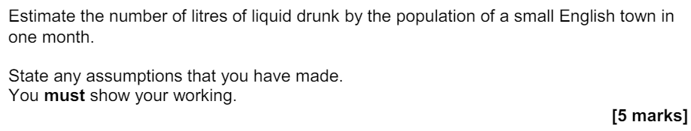
A short fermi question
AQA Certificate Level 3 Mathematical Studies, June 2017, Paper 1, Question 4
Notes:
How do the teachers feel about this kind of question?

Slide 10
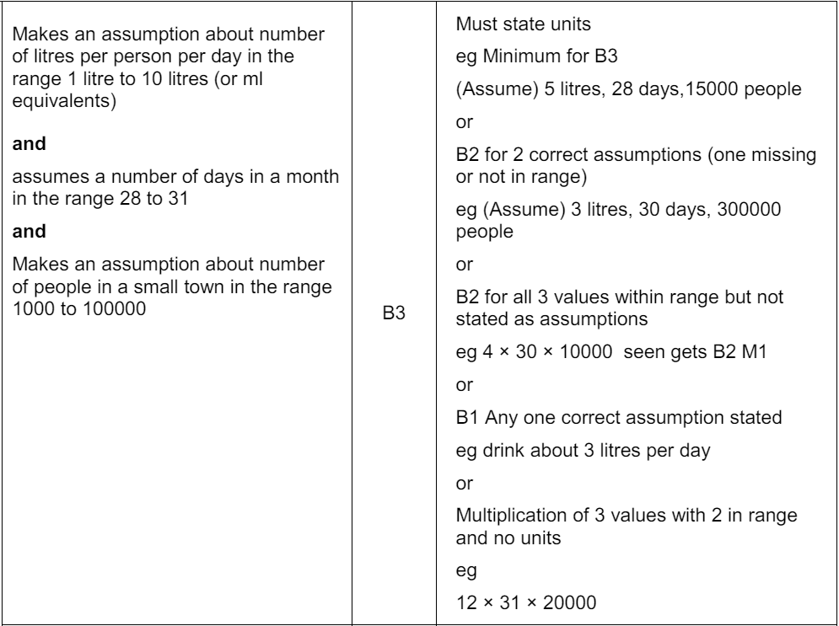
A short fermi question – answer

Slide 11
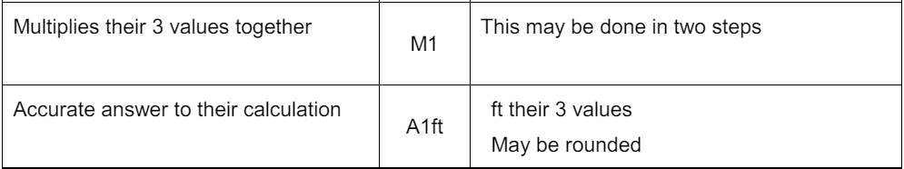
A short fermi question – answer

Slide 12
How to think about maths teaching more creatively
I’m going to give you two themes – one is fairly narrow, one more broad.
I’d like you to mind map some thoughts about areas of maths you could explore based on the given themes.
Try to create as many links as you can!

Slide 13
How to think about maths teaching more creatively
How much do jobs pay?
Festivals
Notes:
Delegates choose one to mind map what maths they could explore within that topic

Slide 14
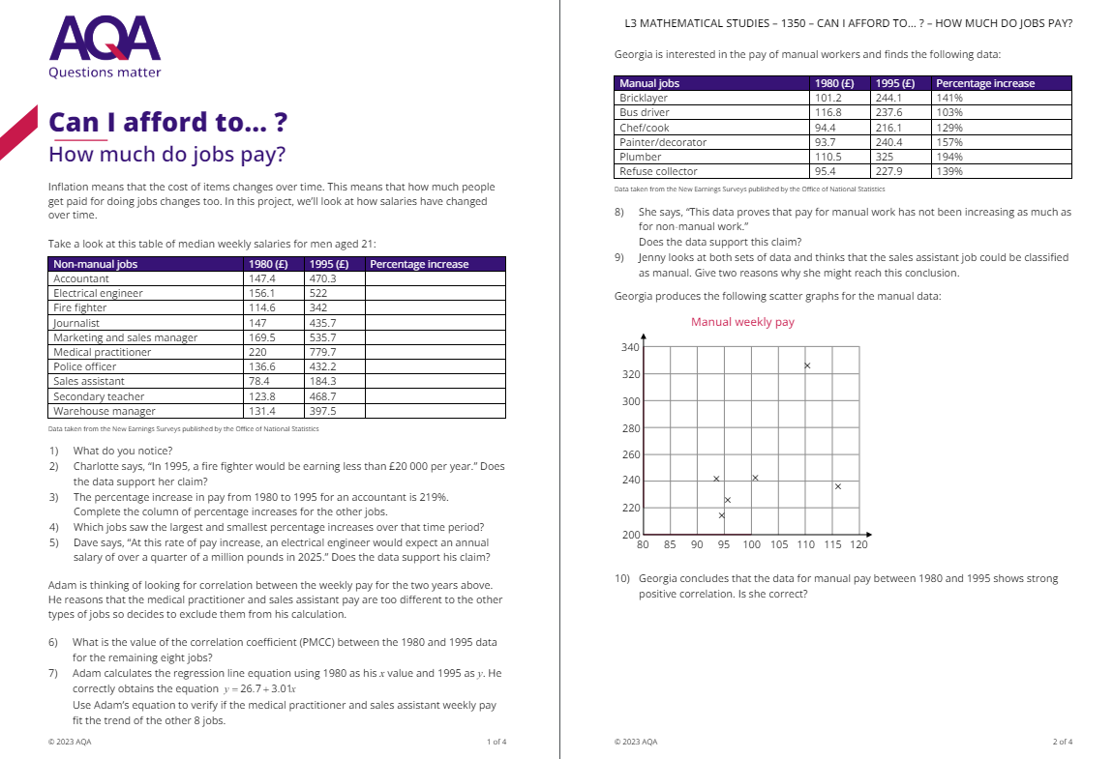
Channelling the ideas: How much do jobs pay?
Notes:
This is a resource I made, available on AQA’s All About Maths website.
Copies available to hand out.
Have a look at what areas of maths are covered.
How would delegates adapt it?
Was it the themes they came up with?
Does it matter if you teach them something that isn’t on the course?

Slide 15
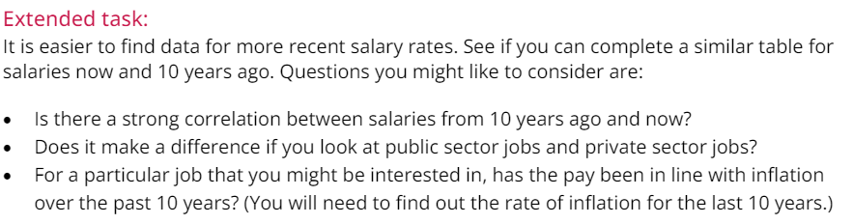
Channelling the ideas: How much do jobs pay?
Notes:
An extended task is offered.

Slide 16
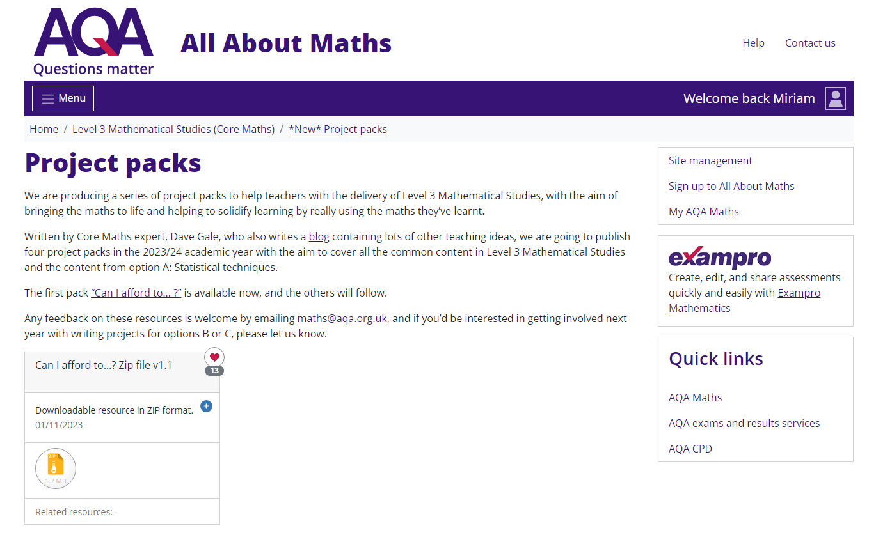
Channelling the ideas: Festivals

Slide 17
How I feel when teaching Core Maths
It’s so much more engaging than GCSE, especially for students who didn’t love algebra.
It feels like I’m really teaching students mathematics and to be mathematicians.
It demonstrates that maths doesn’t have to be hard and/or abstract to be interesting.
Talking to parents is always positive.

Slide 18

Any questions?

Slide 19
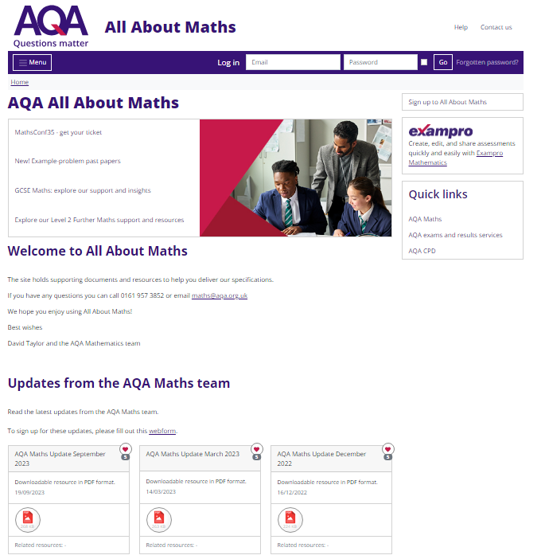
All About Maths
Our dedicated, free, secure mathematics
resources site
Join All About Maths for free using your
school email address
allaboutmaths.aqa.org.uk
Copyright © 2024 AQA and its licensors. All rights reserved.
19
Notes:
Keep it all behind a log in because we don’t want the students getting their hands on all the material you want to use blind.

Slide 20
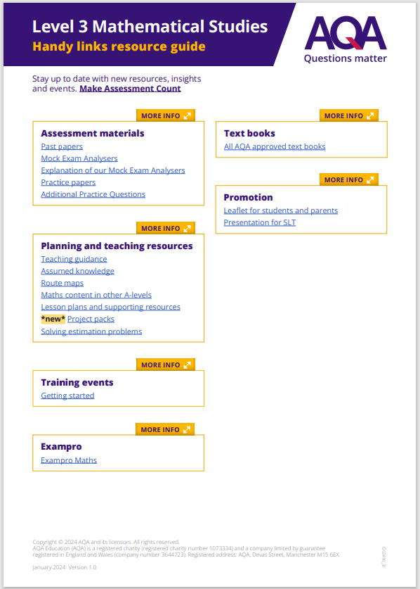
Handy Links Guide
Access all AQA resources from one place
Notes:
Level 3 Mathematical Studies - Handy links resource guide (aqa.org.uk)

Slide 21
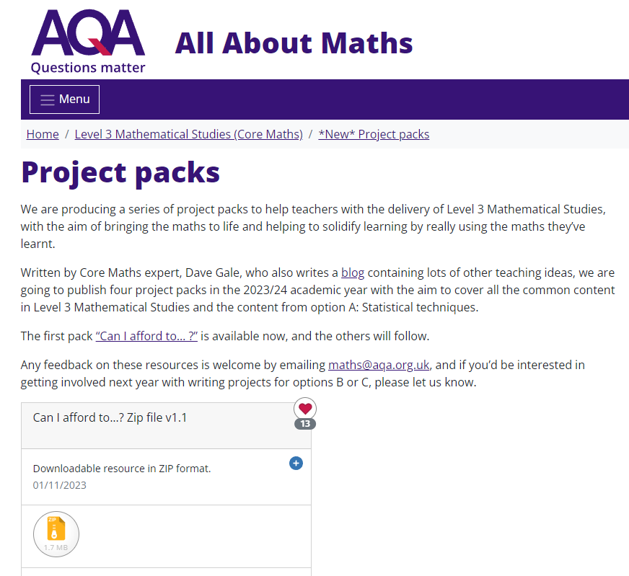
Some resources
Notes:
https://allaboutmaths.aqa.org.uk/1950
This image may change if the Festivals pack is available in time

Slide 22
Some resources
Quibans – questions inspired by a news story
https://quibans.blogspot.com/
Notes:
https://quibans.blogspot.com/

Slide 23
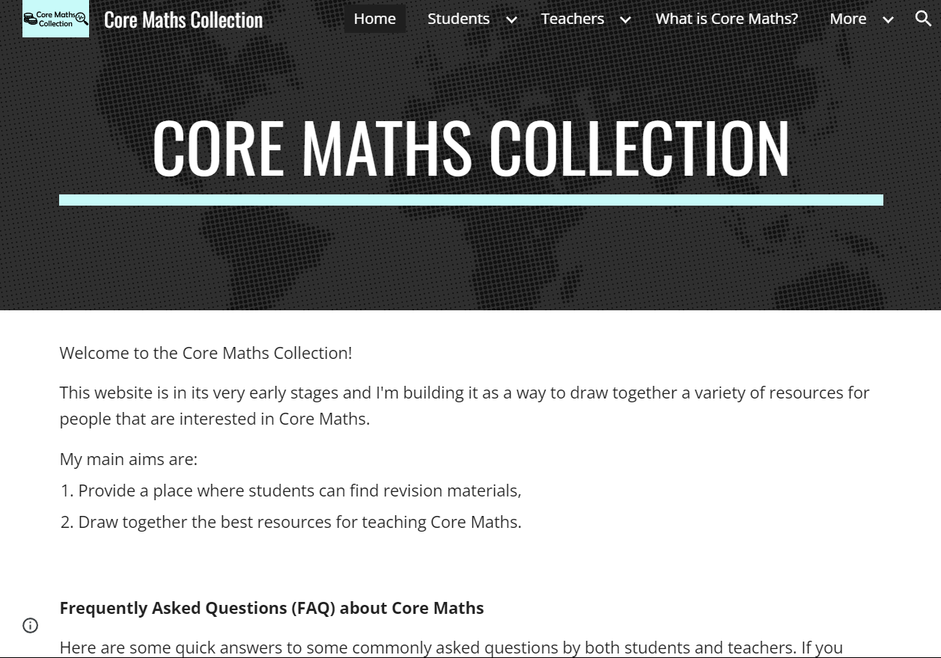
Some resources
© Core Maths Collection
Notes:
https://www.coremaths.co.uk/

Slide 24

Some resources
© Advanced Mathematics Support Programme © 2024 MEI
Notes:
https://amsp.org.uk/
Very useful for exploring the differences between the courses

Slide 25
Getting started with Core Maths
Register for an All About Maths account and browse the AQA resources
Bookmark the Handy Links Guide
Sign up for our mailing list
Make yourself known to the AMSP
On demand Getting Started e-learning course
Notes:
AAM account: AQA | Subjects | Mathematics | Register for AQA All About Maths
Handy links guide: Level 3 Mathematical Studies - Handy links resource guide (aqa.org.uk)
Mailing list: AQA | Subjects | Let us know if you'd like to hear about us
Getting Started: AQA | Professional development | Course details

Slide 26
Get in touch
  Our friendly team will be happy to support you between 8am and 5pm, Monday to Friday.
Tel: 0161 957 3852
Email: maths@aqa.org.uk
X: @AQAMaths
aqa.org.uk

