Slide 1
GCSE Maths:
Reflections on summer
Leeds 2023 – Session 1
Andrew Taylor
MathsConf 33

Slide 2
Welcome

Slide 3
Entries, boundaries and outcomes
Copyright © AQA and its licensors. All rights reserved.
Notes:
This presentation takes you through the grade boundaries and results for GCSE maths this summer. Followed by a reminder of the improvements to papers from this year onwards and what they look like in practice, and how they have improved the exam experience of learners.

Slide 4
2023 entries: AQA GCSE Maths
193900 results awarded for AQA GCSE Maths (+10638 on June ‘22)
  58% Foundation (57% in 2022)
  42% Higher (43% in 2022)
Age 16: 143900 (143900 in 2022): 74.2%
46% Foundation
54% Higher
Age 17+: 49200 (38400 in 2022): 25.4%
93% Foundation
7% Higher
Notes:
You can find Andrew’s results day blog by clicking on the link in the slide. This gives more detail on why the boundaries are higher this year, and why that is a positive. Graham Cumming , former maths lead at Edexcel, agrees and has said so in a number of tweets @MathsNot

Slide 5
Grade boundaries
Results day blog
Tweets by Graham Cumming ( @MathsNot )
Explaining why high boundaries are a good thing
Notes:
You can find Andrew’s results day blog by clicking on the link in the slide. This gives more detail on why the boundaries are higher this year, and why that is a positive. Graham Cumming , former maths lead at Edexcel, agrees and has said so in a number of tweets @MathsNot

Slide 6
Boundaries : Foundation tier
Grade | 5 | 4 | 3 | 2 | 1
Boundary 2023 | 189 | 158 | 117 | 76 | 39
Boundary 2022 | 172 | 135 | 101 | 67 | 33
Boundary 2019 | 157 | 122 | 88 | 57 | 25
Notes:
You can find Andrew’s results day blog by clicking on the link in the slide. This gives more detail on why the boundaries are higher this year, and why that is a positive. Graham Cumming , former maths lead at Edexcel, agrees and has said so in a number of tweets @MathsNot

Slide 7
Boundaries : Higher tier
Grade | 9 | 8 | 7 | 6 | 5 | 4 | 3 (allowed)
Boundary 2023 | 214 | 186 | 158 | 125 | 92 | 59 | 42
Boundary 2022 | 214 | 185 | 156 | 121 | 86 | 51 | 33
Boundary 2019 | 206 | 171 | 136 | 105 | 74 | 43 | 27
Notes:
You can find Andrew’s results day blog by clicking on the link in the slide. This gives more detail on why the boundaries are higher this year, and why that is a positive. Graham Cumming , former maths lead at Edexcel, agrees and has said so in a number of tweets @MathsNot

Slide 8
Boundaries comparison: 2023 boundaries as percentages
Grade | 9 | 8 | 7 | 6 | 5 | 4 | 3 | 2 | 1
AQA F |  |  |  |  | 78.8 | 65.8 | 48.8 | 31.7 | 16.3
Pearson F |  |  |  |  | 75.8 | 61.3 | 45.4 | 29.6 | 13.8
AQA H | 89.2 | 77.5 | 65.8 | 52.1 | 38.3 | 24.6 | 17.5
Pearson H | 84.6 | 72.5 | 60.4 | 46.7 | 32.9 | 19.6 | 12.9
Notes:
Here are AQA’s boundaries as percentages compared to Pearson for this year. AQA is about 5% higher on the higher tier and a little less on Foundation.
This shows that students of the same overall attainment would get more marks with AQA than Pearson this year. That is because we actively worked to make our papers more accessible, making it easier to score marks all over the papers. This gives a more positive experience for all learners and allows them to show more of what they can do.
It does not affect the numbers of students getting each grade. It is no easier or harder to get a grade with one exam board than any other. Grading is strictly statistically controlled by Ofqual. The exam boards’ job is to set boundaries that meet those statistical predictions for their particular cohort of students. It is easier to score marks with AQA than Edexcel, and much easier than OCR but it is no easier or harder to get a particular grade.
Given that the overall results will be the same whatever board you choose, we believe in making the exam experience positive whilst still have appropriately demanding questions so learners are differentiated based on their maths and nothing else. We also go the extra mile to develop mark schemes that are fair and award credit wherever we can.
We think boundaries around this level are right and our challenge going forward is to maintain consistency in the boundaries but to keep improving question quality, marking fairness, clarity and accuracy. We’re proud of what we’ve achieved but we’re not standing still.

Slide 9
Outcomes comparison: Year on year for 16YO
AQA
Year | 7+ | 4+ | 1+
2023 | 21.0 | 72.0 | 98.2
2019 | 20.9 | 71.9 | 98.1
2022 | 24.0 | 75.1 | 98.4
All boards JCQ
Year | 7+ | 4+ | 1+
2023 | 21.1 | 71.7 | 98.0
2019 | 20.2 | 70.8 | 98.0
2022 | 23.9 | 74.6 | 98.2
Notes:
These tables show that AQA’s outcomes (percentage at each grade) are very close to national figures for 16 year olds. Proof that AQA outcomes are in line with everyone else as they have to be! It also shows that AQA’s cohort, like Edexcel’s is pretty representative of 16 year olds across the country because it is differences in the cohort of students that leads to differences in outcomes.
That is why AQA’s outcomes for all entries are lower than others. It is because we have a higher proportion of post 16 resit students than others and this, inevitably, reduces the overall pass rates at 4 and above.

Slide 10
Comparison by tier 2023 (16YO)
Grade | 9 | 8 | 7 | 6 | 5 | 4 | 3 | U
AQA H | 7.2 | 22.6 | 39.2 | 62.1 | 85.9 | 98.0 | 99.5 | 100
Pearson H | 7.5 | 21.3 | 38.7 | 61.9 | 86.2 | 98.7 | 99.8 | 100
Grade | 5 | 4 | 3 | 2 | 1 | U
AQA F | 14.6 | 42.1 | 68.6 | 85.9 | 96.7 | 100
Pearson F | 11.6 | 40.6 | 65.9 | 84.3 | 96.2 | 100
Notes:
Here is a comparison of results at tier level and, as with the last slide, there is little difference between AQA and Pearson at either tier looking just at 16 YO. Foundation grade 5 has AQA up to 3% higher suggesting that more of those who achieve grade 4 can go on to get a 5 with AQA, possibly because of the confidence given by our more accessible papers. Grade 4 is controlled across boards so there won’t be much difference but grade 5 numbers depend on the way marks above the grade 4 threshold are distributed

Slide 11
Question paper performance

Slide 12
Performance across question papers
Foundation tier
 | Mean 2023 |  | Mean 2022
1F | 44.5 | 55.6% | 39.2 | 48.9%
2F | 43.9 | 54.9% | 41.3 | 51.6%
3F | 40.9 | 51.1% | 37.3 | 46.7%
F overall | 129.5 | 54.0% | 117.7 | 49.0%
Notes:
Here are the mean scores for each paper. You can see that the mean has gone up by around 5% and that the papers were consistent with each other with a range of under 4 marks. In tier F, there is often a concern that students will do less well on paper 1 as the non-calc paper. You can see this did not happen and that may, in part, be due to our conscious attempt to keep arithmetic simple where it is not the main focus of the question. Whilst we don’t actively set out to do it, we’re always quite happy when paper 1 performs the best of the three

Slide 13
Performance across question papers
Higher tier
 | Mean 2023 |  | Mean 2022
1H | 45.0 | 56.3% | 46.5 | 58.1%
2H | 47.4 | 59.3% | 51.1 | 63.9%
3H | 50.4 | 63.0% | 48.6 | 60.7%
H overall | 143.1 | 59.6% | 146.2 | 60.9%
Notes:
Again, consistent papers (5 mark range) but a slight drop in the mean from 2019. A range of just 5.4 marks here. More accessible papers and taking AI away seem to have balanced each other out in tier H, especially at the top end. Lower boundaries are somewhat higher to account for the change back to 2019 standards.

Slide 14
Improvements for 2023 and beyond
Notes:
In this section, we’ll remind teachers of the improvements we’ve made using examples from this summer. Together, they show the positive benefits to students in the exam, a better focus on the maths and a real effort (much more we think than others) to ensure marking is fair and accurate.

Slide 15
Rationale for improvement
More positive exam experience for all students.
Every question, in every paper, to be clear and appropriate.
Develop a way of working that maximises forensic use of data and allows teachers to play a key role.
Notes:
This is what we are trying to achieve for 2023 and beyond. As already mentioned, a positive experience for students coming from greater accessibility has to be a good thing, but the consequence is higher boundaries.
The third point here is about using performance data very carefully to plan future papers and to be able to control demand and achieve consistency. That will be our focus for the future.
We wanted greater accessibility which means higher boundaries
We’ve got to that point
We now want to achieve consistency

Slide 16
Improvements
MCQs
Start of the papers
Context and wording
Problem solving
Working lines
Mark schemes
Ramping of questions
Notes:
These are the areas we said we wanted to change, and have. The next slides will show you examples from this year’s papers where we have changed.

Slide 17
Start of the papers
From Summer 23
We’ll start papers with questions expected to have a high facility:
questions will be largely context free and straightforward
no multiple choice at start of papers.
Notes:
This is what we said we’d do to ensure all papers had questions at the start that were accessible to all learners in that tier.

Slide 18
Start of papers

Slide 19
Our promise
An 80% facility for the first 10-15 marks on each Foundation paper.
A 65% facility for the first 10 marks of each Higher paper.
Facility is simply the average score for a question or group of questions expressed as a percentage.
Notes:
This is what we wanted to achieve in performance terms.
So, and 80% facility for the first 10 marks simply means that the average student would get 8 out of 10 for those first marks

Slide 20
How did we do?
Paper | First 10 marks | First 15 marks
1F | 72.0% | 70.2%
2F | 81.5% | 80.0%
3F | 81.5% | 69.8%
Paper | First 10 marks
1H | 77.1%
2H | 77.2%
3H | 78.6%
Notes:
So the start of 1F proved a little bit more difficult than we were aiming for, and marks 11-15 on paper 3 were more of a challenge than expected, but these data are encouraging and reflect the positive comments we had about the start of the papers.

Slide 21
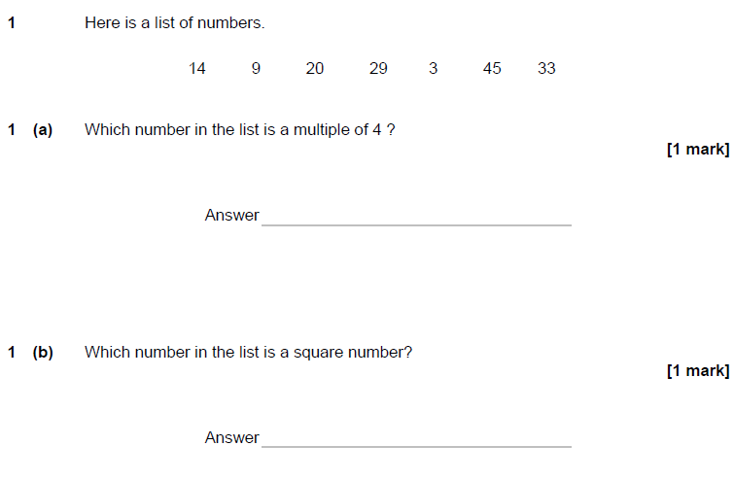
Start of papers
Paper 1F
97% correct
70% correct
Notes:
Here are the first two marks of the first paper this year. Very straightforward recall questions and a little surprising that only 70% of students can recognise a square number from that list

Slide 22
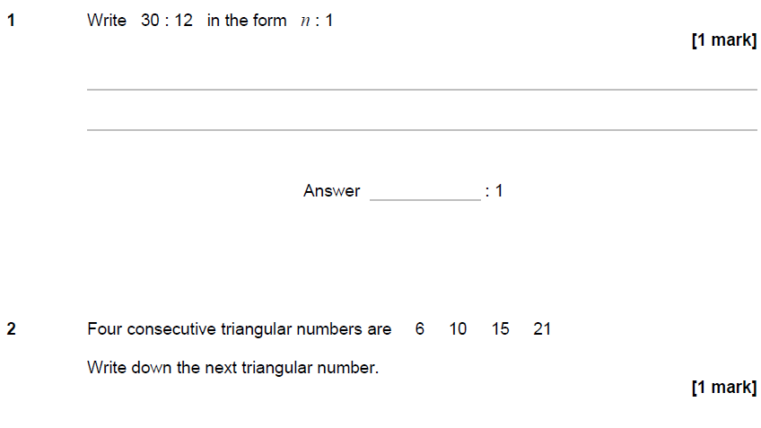
Start of papers
Paper 2H
74% correct
77% correct
Notes:
Start of Higher has to be targeted at grade 4 so we’ll never get as high a facility as foundation because there will be students entered for H who find these first questions a challenge. However, they are nice, straightforward single mark questions that most students can answer successfully

Slide 23
Throughout all papers
Focus on simple language and clear, useful diagrams.
Context only when necessary.
Faint working lines, white space, clear layout.
Mark schemes that reward the first step towards a solution.
Close attention to ramping of demand.
Notes:
A reminder of the other improvements made throughout the papers. We’ll look at some examples of using simple language, using context sparingly and carefully, and developments in mark schemes to make them work better.

Slide 24
Use of context

Slide 25
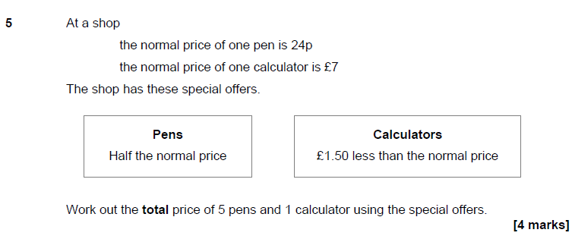
First question in context
1F,Q5, page 7, 15th mark
Facility of 87%
Notes:
15 marks into the exam and this is the first time a question is set in context, and here the money context will be familiar to learners and help them rather than get in the way. 87% facility is very pleasing for this stage in the paper and almost three quarters of students got full marks

Slide 26
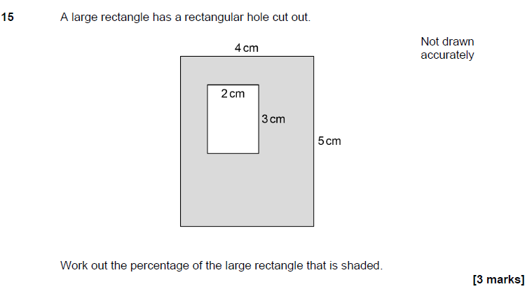
No context
1F, Q15
Facility of 36%
Notes:
In the past, we may have set this by contriving a context such as a flower bed in a garden or a window on a wall but it is neither necessary nor helpful here so we keep it simple. Despite this, and the fact that the content requirement is simple area and percentage, the question did not perform that well but we don’t think that was down to the way it was presented.

Slide 27
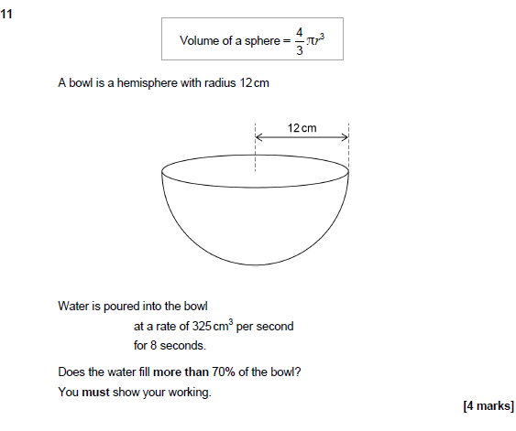
Straightforward context and clear layout
Paper 2H
Facility of 78%
Notes:
A simply expressed, easily understood context for this question, and a pleasing performance with a high facility

Slide 28
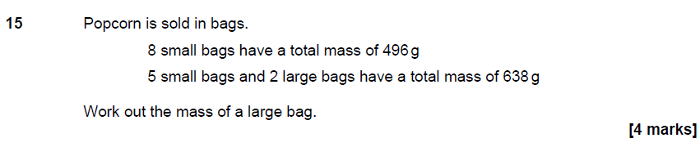
Context to support the maths: an algebra problem without the algebra
Paper 3F
71% achieved full marks
Notes:
We could have presented this question in the abstract as
8x = 496
5x + 2y = 638
Find y
And it would not have been as well done as this version where the simple context helped learners access the question and answer it successfully, which very many did.

Slide 29
Simple language

Slide 30
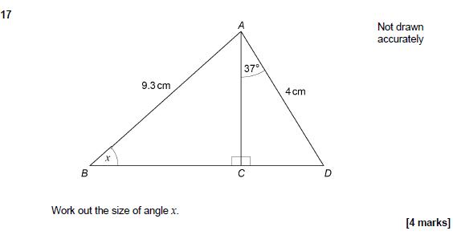
Testing the maths not the language
Paper 2H
Facility of 65%
Notes:
A clear diagram, simply phrased question and no redundancy or repetition. We let the diagram speak for itself where, in the past, we may have repeated all the information in the text eg
AB = 9.3cm, AD = 4cm, angle CAD =37°, BCD is a straight line
All this does is raise the cognitive load for students and we know that they will look at the diagram first and extract information from it, before reading the text. Leaving the text out allows a focus on the diagram which has everything they need clearly marked.

Slide 31
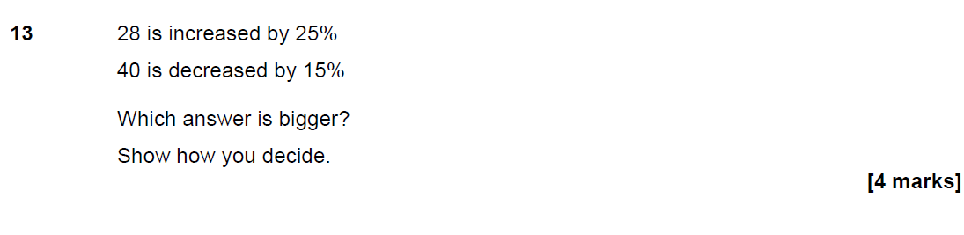
Focus on simple language
Paper 2F
Notes:
Simple language and no context. In the past, we may have used a contrived context to give the problem a ‘reason’ to exist but this would increase the reading requirement without helping the student. Of course, you’ll still see questions like this put into situations sometimes, but less often than in the past or than others may do.

Slide 32
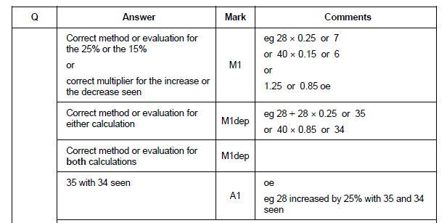
Rewarding different approaches
Paper 2
Mark | % at mark
4 | 49.10%
3 | 2.61%
2 | 12.65%
1 | 8.50%
0 | 19.01%
Notes:
The mark scheme for this question rewards a number of possible first steps of working. You can see that nearly half of tier F students got full marks and a significant further proportion picked up 2 marks, probably for adding 25% to 28 successfully

Slide 33
Using mark schemes to maximise opportunities

Slide 34
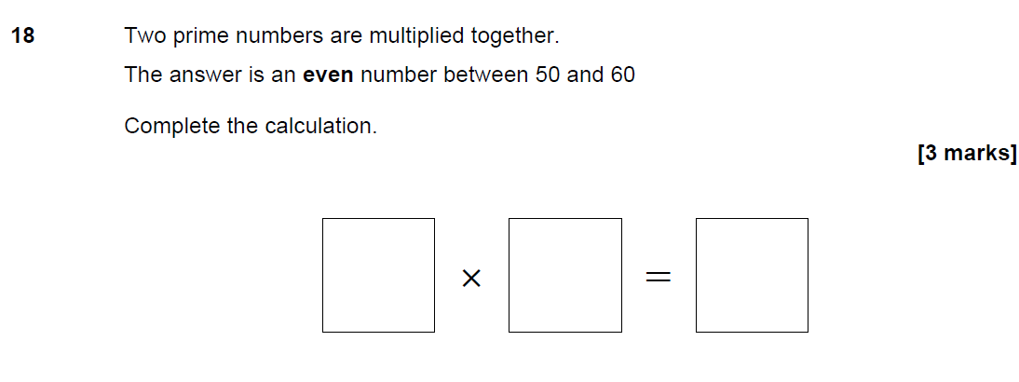
Mark schemes
Paper 1F
Notes:
There are a number of facts that students need to know and combine here
What is a prime number?
Find two numbers with a product between 50 and 60, though note we do not use that term. If we had, I suspect many would have struggled.
What is an even number?
The reasoning is to realise that one of the prime numbers has to be 2 to get an even answer. That understanding is the key to the problem

Slide 35
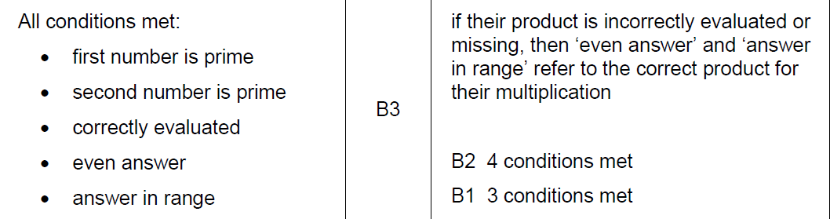
Giving credit
Mark | % at mark
3 | 20.38%
2 | 39.21%
1 | 11.79%
0 | 19.73%
No attempt | 8.90%
Notes:
The fairest mark scheme is to reward students for meeting the conditions set out. This led to good differentiation with decent proportions at each mark, and many getting 2 marks. Understandable when an answer such as
2 X 7 = 14 would be enough for 2 marks as it meets 4 of the 5 conditions

Slide 36
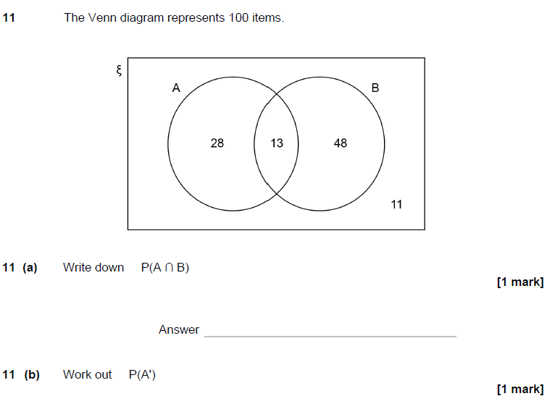


Using special case approach
Paper 1H
25.4% of students got the mark for part (a).
For parts (b) and (c), this improved to over 40% helped by the Special Case.
Notes:
A high number of students could understand the venn diagram and venn notation. But they struggled to give answers as probabilities. For part a, 13 was not accepted but for b and c , correct numbers of students and 13 as the answer to a was given credit so the failure to work in probabilities is only penalised once across the three parts. A good example of how we go the extra mile to be fair to learners

Slide 37
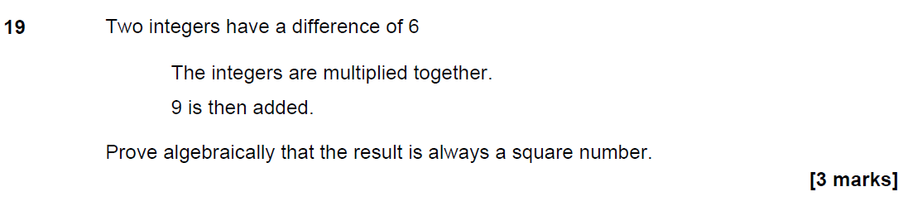
Principles based mark scheme
Paper 3H
Notes:
A high demand proof question, traditionally not well done

Slide 38
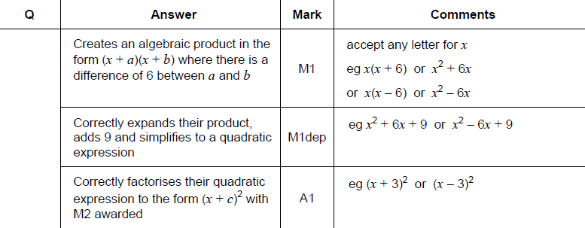
Different ways to get the first mark
Paper 3H
Facility of 32.2%
Notes:
The approach to the scheme here is not to give a specific answer but to articulate the range of allowable responses in a way that any experienced expert marker will understand and can apply

Slide 39
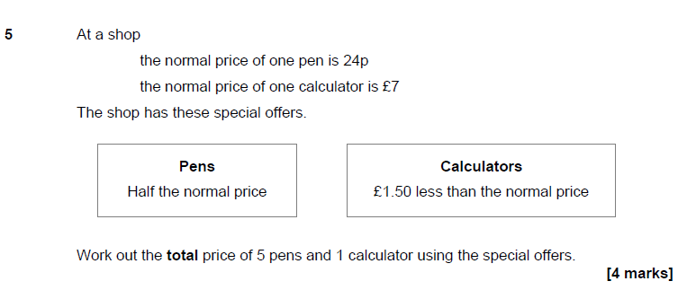
First mark for the first step
Paper 1F
Notes:
As we’ve already seen, this was the first question in context on 1F, and it performed really well, at least partly because of the way the mark scheme was set up

Slide 40
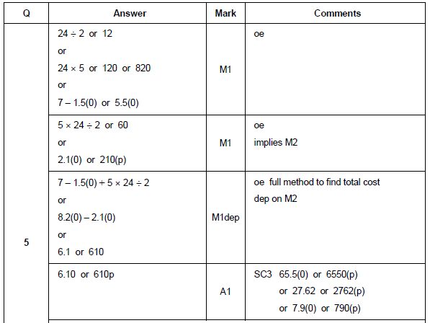
First mark for the first step
Paper 1F
Notes:
The first mark is awarded for any one of a number of possible first steps
Halving the pen price
Reducing the calculator price by £1.50
Working out the cost of 5 pens at the original price
For all these it is sight of the method or the correct answer that gets the mark

Slide 41
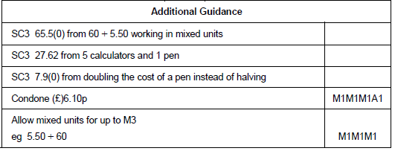
Using special cases to give credit
Paper 1F
Mark | % at mark
4 | 74.85%
3 | 10.18%
2 | 6.57%
1 | 5.58%
0 | 1.84%
Notes:
We go even further to be fair by identifying wrong answers that can only have come from creditworthy work, even if we are not shown that work.
So a misread of the cost of a pen as £12 rather than 12p only loses one mark, even if no working is shown and all we see is an answer of £65.50
A slip of working out the cost of 5 calcs and 1 pen to get £27.62 only loses 1 mark
The principle is that a single mistake should only cost a single mark and we try and apply this even when students do not show their working. This is not always possible so it remains vital that students do show their working always!!!!
Worth noting, we did not use SC to ‘save’ the performance of the question, nearly 75% got it fully correct anyway. We are doing it to be fair to all learners.

Slide 42
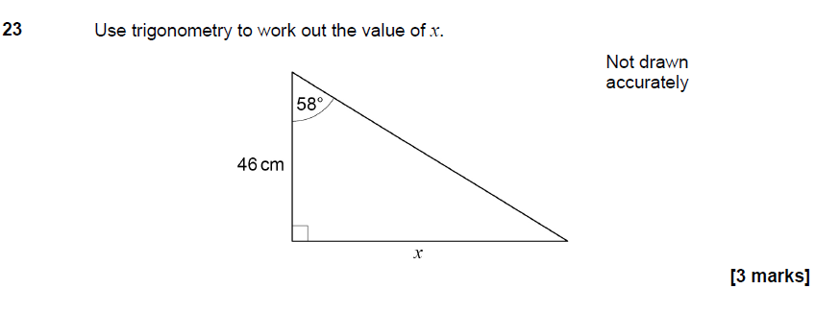
Easing award of the first mark
Paper 3F
Notes:
Straightforward trig question at end of tier F

Slide 43


Easing award of the first mark
Paper 3F
Notes:
First mark is for identifying Tan as the ratio of choice, much the best way to approach the question
BUT
A student who chooses to use Sin or Cos to find the hypotenuse first will get credit but they have to do a lot more

Slide 44
Resources

Slide 45
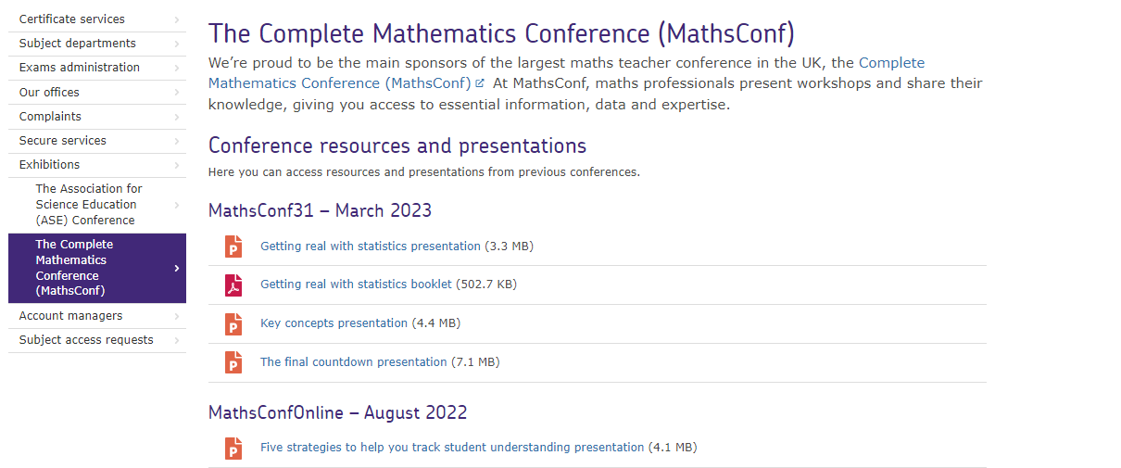
Resources
Go to the MathsConf area of the AQA website to find presentations from past events.

Slide 46

Resources
Find a huge range of resources in our All About Maths pages.

Slide 47

Get in touch
Our friendly team will be happy to support you between 8am and 5pm, Monday to Friday.
Tel: 0161 957 3852
Email: maths@aqa.org.uk
Twitter: @AQAMaths
aqa.org.uk

