Slide 1
GCSE Maths: Fundamental and Basic skills Leeds 2023 – Session 3
Julia Smith
MathsConf 33

Slide 2
Welcome

Slide 3
Biography:
@tessmaths
Maths Teacher Trainer
Maths Author – BBC Bitesize, Cambridge and Oxford University Press, Collins
AQA Expert Panel Member
5Rs Developer and Project Lead with the EEF Research Project
Shine Award Winner 2021 for the 5Rs Curriculum

Slide 4
Objectives

Slide 5
Fundamental and Basic Maths Skills
To consider the cornerstones of maths
To build a firm maths base for GCSE
To explore a number of assumed knowledge facts
To identify the nine mathematical basics with a range of alternative methods
To build skills which will impact and improve reasoning and problem solving
To review AQA resources and support

Slide 6
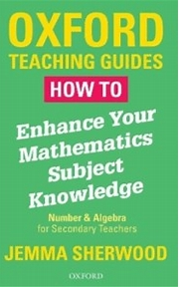
The Cornerstones of Maths
What does it mean to be fluent in anything? In maths?
Jemma Sherwood ‘Fluency in the four operations is the cornerstone of developing mathematical understanding’
Maths is like running, walking 10,000 steps a day, going to the dentist, eating 5 fruit and veg a day – it’s really good for you. It also requires practice, practice, practice…just like knitting, painting, cooking or football.
How To Enhance Your Mathematics Subject Knowledge: Number and Algebra for Secondary Teachers by Jemma Sherwood, OUP, 2018. Reproduced with permission of the Licensor through PLSclear.
Notes:
It requires conscious effort…habits need to form

Slide 7
To build a firm base for GCSE
By the time a learner gets to Year 11, or is in a re-sit year, they have seen all of the maths before – certainly enough to gain Grade 4 if not Grade 5…
Find out where the gaps are…quickly.
Strengthen what they already know to make it even stronger.
Sort out what they sort of know – misconceptions and mistakes.
The hierarchical nature of maths tell us to strengthen the basics.
Practice until you cannot get it wrong, not just until you get it right.
New AQA Fundamental Skill questions sets coming
AQA Basic Skill question sets
Notes:
Mathsbot.com Basic Skill tests online too
Mistakes and misconceptions form part of the 8 Effective principles from Malcolm Swan

Slide 8
Assumed Mathematical Knowledge
What maths knowledge do we think that students should have, but often don’t!
Things like:
How many mms in a cm…
How many days in January…
What is the first prime number….
How many hours in a day…
How many degrees in a full turn…
What’s a five sided shape called…?
Telling the time…
Days in a week… in a year
Estimating height, weight…
Vocabulary…median
The four types of triangle are…
Notes:
Covid legacy

Slide 9
Dealing with Assumed Knowledge difficulties
Pre-requisite skills – in lesson planning:
‘What comes before? What comes after?
Entry tickets
AO1 Students should be able to:
• accurately recall facts, terminology and definitions
• use and interpret notation correctly
• accurately carry out routine procedures or set tasks requiring multi-step solutions.
New AQA Fundamental Skill Questions coming…
Look out for the AQA Fundamental Skills and Basic Skills Blog
AQA Topic Audits will help in this process
Notes:
Accessmaths Pentagon Problems

Slide 10
Nine Mathematical Basics
Addition
Subtraction
Multiplication
Division
Fractions
Decimals
Percentages
Scale
Ratio
Use the AQA Basic Skills questions sets
AQA All About Maths - Basic skills questions
Use the Teacher Guidance and Rationale
Notes:
Have some copies available?

Slide 11
Alternative Methods
It isn’t for you to like or dislike a method, it might just be the method they need
How do you calculate it? How do you teach it?
413 – 267 =
34 x 23 =
-5 x -2 = (sequences approach)
$\frac{1}{5}÷\frac{2}{3}=$ $\frac{1}{4}+\frac{2}{3}=$
Marking protocol ‘any valid mathematical method gains the marks’
Influenced by publications Jo Morgan, A Compendium of Mathematical Methods & Ed Southall, Yes, but why?
Notes:
Ed Southall sequences

Slide 12
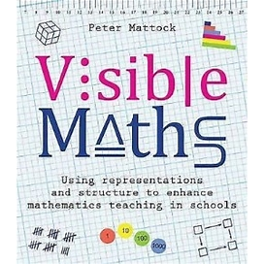
CPA Approaches
Bar modelling
Algebra Tiles
Ratio Table
Double Sided Counters
Double Number Line
Organises the maths
Offers a way into a wordy problem
Leads to alternative methods
Influenced by Pete Mattock, Visible Maths
Peter Mattock - YouTube
Visible Maths: Using representations and structure to enhance mathematics teaching in schools by Peter Mattock, Crown House Publishing, 2019.
Notes:
Check permissions for the links here

Slide 13
Inchworms and Grasshoppers Maths thinking styles: The wisdom of Professor Steve Chinn
Notes:
Mathsbot.com fluent calculations
Inclusive and Accessible teaching
Lead with an example – ask the audience – how do you calculate 27 x 34?

Slide 14
Inchworms
Characteristics of the Inchworm:
Sequential learner
Analyzes problems literally
Follows algorithms to solve (‘recipe’ learner)
Focused on details (sees the trees and not the forest as a whole)
Enjoys showing work
Typically uses exact numbers given to solve the problem
Solves maths problems mechanically
Answers the ‘how’ to the problem
Can have an underdeveloped conceptual understanding

Slide 15
Grasshoppers
Characteristics of the Grasshopper:
Intuitive learner
Reasons through problems to find answers
Forms connections and recognizes patterns with learning
Rarely enjoys showing work
Does not like practice exercises
Has difficulty explaining how they arrived at the answer
Focuses on the whole
Thinks of numbers flexibly (decomposes and composes them to get answers)
Uses variety of strategies to solve Explores reasons
Answers the ‘why’ to the problem
Excellent conceptual understanding.

Slide 16
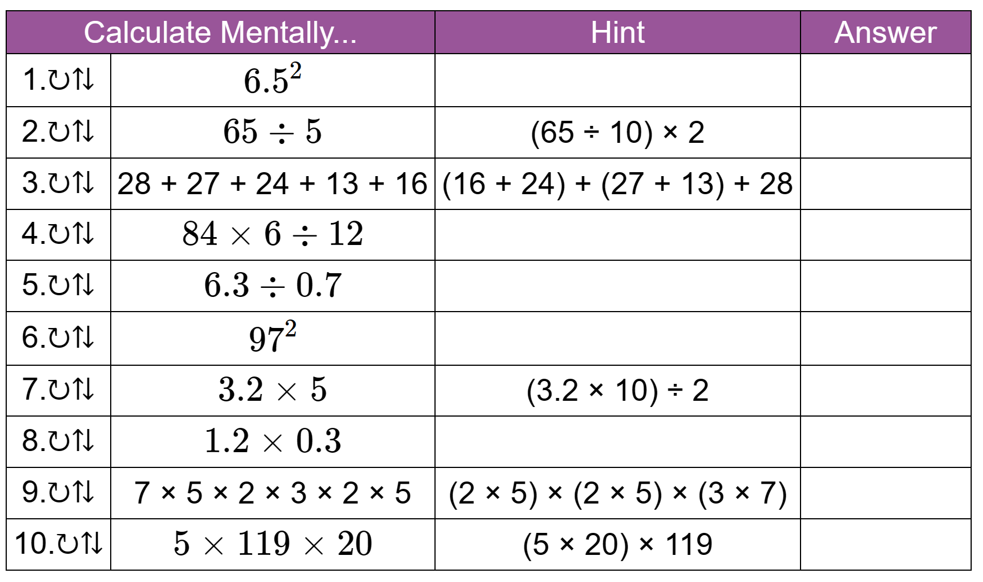
Inchworm or Grasshopper?
Do you know your primary students’ maths learning style? (mathsnoproblem.com)
12 x 13 =
Inchworm approach – common algorithm
Grasshopper approach (12 x 10) + (12 x 3) or (12 x 12) + (1 x 12)
Influenced by “Mathematics for Dyslexics and Dyscalculics”
By Steve Chin and Richard Ashcroft

Slide 17
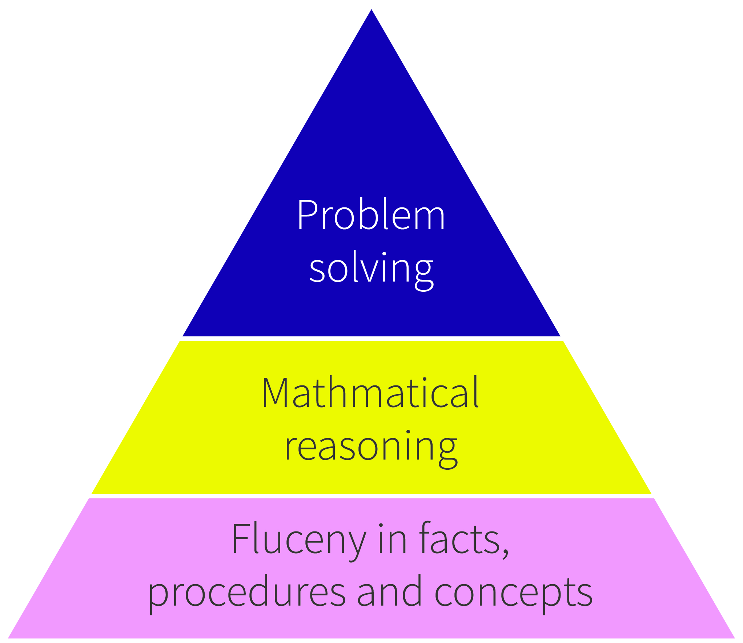
Building the Skills leads to Problem Solving progression
The fundamental problem with teaching problem solving (lboro.ac.uk)
Notes:
Link to the article from Colin Foster, President of the Mathematical Association
Identifies that Problem Solving depends entirely upon Fluency and Reasoning ability…by strengthening those then the consequences will be better problem solving ability

Slide 18
#DailyMaths
The only way to get good at maths is to do maths – lots of maths.
Like five portions of fruit and veg a day, Vitamin D, getting 10,000 steps, running, a trip to the dentist, cold showers, it’s good for you.
National Numeracy: Value, Belief and Effort
Maths is not a passive activity; you cannot read about it, watch it, or just see it to get good at it. You have to do it.
Notes:
Will start this with a question…how can we encourage students to do Daily Maths?

Slide 19
AQA Resources to support Impactful Teaching
New AQA blogs coming – Fundamental and Basic skills
New resources at All About Maths
Examiners reports – build pieces of these into your sessions – show students what people like them do well and what they don’t do so well
AQA Assessment Objective Guidance – go through sections of these with students
Notes:
Areas of AQA resource that will support Impactful teaching

Slide 20
Key strategies
Starting points – baseline gap fill and basic skill tests
Chief examiners – learning from the November reports
Tools and building a toolbox – filling your toolbox with mathematical methods
Any valid mathematical method
Self-assessment, daily maths and effort
#DailyMaths – good habits and practise, practise, practise
Practise until you can’t get it wrong!
Culture – Dylan Wiliam: making students the architect of their own learning
Notes:
A reinforcement of the key strategies…diagnostic tests, student ownership of the qualification and putting the effort in, Chief Examiners reports, tools and building a toolbox of methods, cultural change

Slide 21
AQA support resources
Look out for our update to the post-16 resource area – due this autumn.
Notes:
A reminder of some key AQA publications which we can include in the downloads

Slide 22
What’s your top tip?
What do you do that you’d be willing to share?
I will collate and tweet ideas
Contact me to get involved in the 5Rs
tessmaths1@gmail.com

Slide 23
Any questions?

Slide 24
Resources
Take advantage of our extra resources in the ‘Planning’, ‘Teaching’ and ‘Assessment’ tabs on the subject page.
The content of this training course contains no reference to future exam content as far as we know at the time of production (autumn 2023).
Notes:
Direct delegates to the specific subject page on the main AQA website, eg https://www.aqa.org.uk/subjects/mathematics/gcse/mathematics-8300

Slide 25
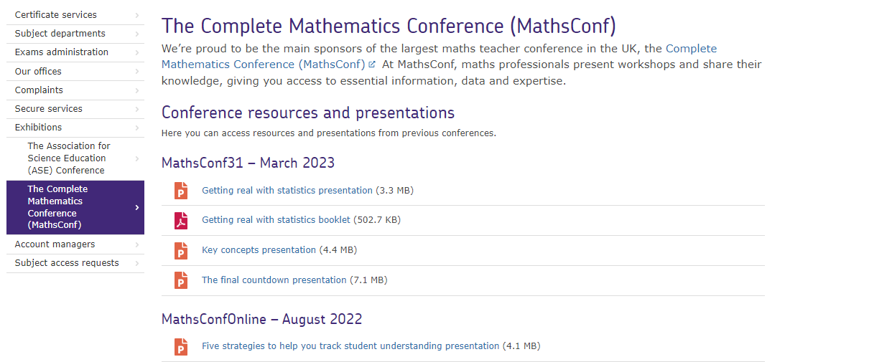
Resources
Go to the MathsConf area of the AQA website to find presentations from past events.

Slide 26
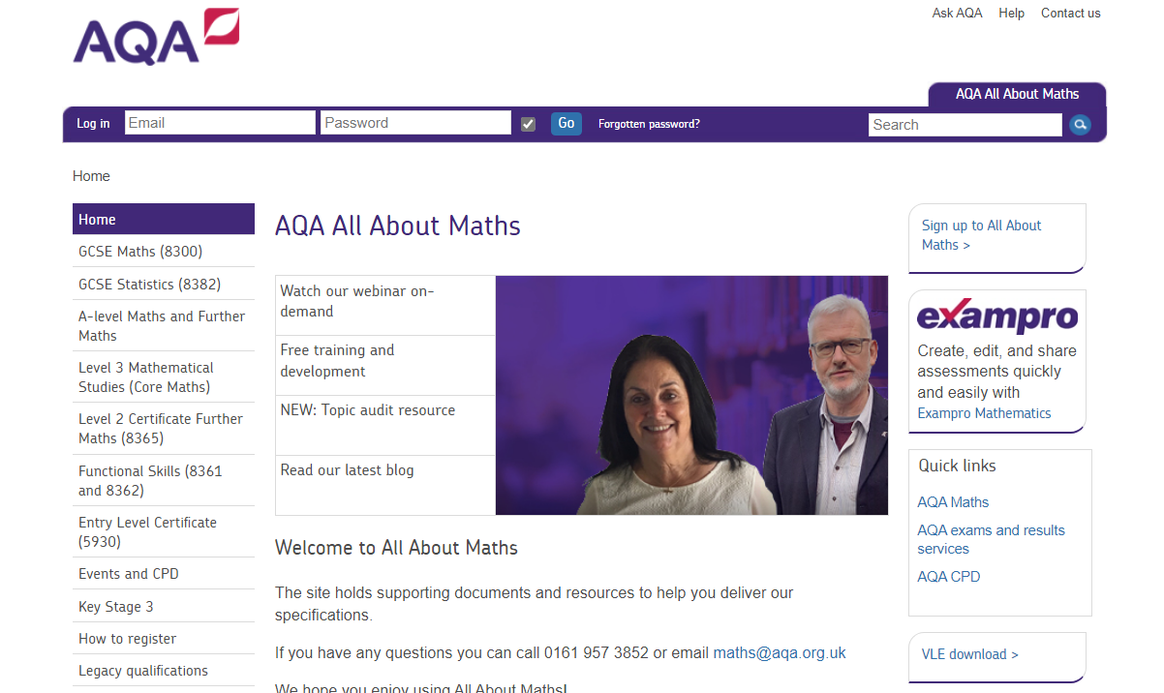
Resources
Find a huge range of resources in our All About Maths pages.

Slide 27
Get in touch
Our friendly team will be happy to support you between 8am and 5pm, Monday to Friday.
Tel: 0161 957 3852
Email: maths@aqa.org.uk
Twitter: @AQAMaths
aqa.org.uk

