Slide 1
Key concepts in GCSE Mathematics
David McEwan
MathsConf32

Slide 2
Welcome

Slide 3
There are 10 types of people in the world
    Those who understand binary
    Those who don’t
    Those who thought this joke was in base 2
    Those who now think it’s in base 4

Slide 4
Why do we need key concepts?
Conceptions vs misconceptions
Conceptual understanding vs performing methods
Selecting and using vs one correct way
Accessing GCSE questions vs not getting started

Slide 5
What are the key bits of maths needed for GCSE?
How to define them?
They have the greatest impact on future success.
They underpin other concepts and ideas.
Ideally, you would know them by the end of KS3.

Slide 6
Discussion 1: What are key things to know in KS3 maths?
They have the greatest impact on future success.
They underpin other concepts and ideas.

Slide 7
Discussion 2
What do you think of my list?

Slide 8
When does the DfE think students will know…
Find the area or volume of a compound shape by decomposing into constituent shapes. Find the perimeter of regular and irregular polygons.
Year 3
Manipulate multiplication and division equations, and understand and apply the commutative property of multiplication.
Year 4
Understand that two numbers can be related additively or multiplicatively, and quantify additive and multiplicative relationships.
Year 6
Solve a linear equation requiring a single additive step.
Solve a linear equation requiring a single multiplicative step.
Year 8

Slide 9
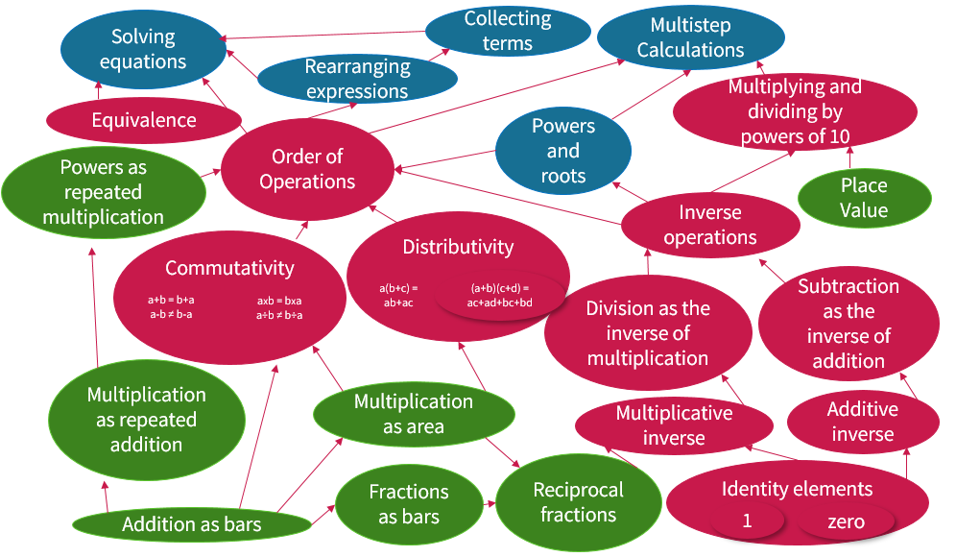
A way to bring it together?

Slide 10
Discussion 3
What do you think of this concept map?
What are the implications for teaching and learning?
How do you go about teaching these concepts together over KS3?

Slide 11

Collect terms and simplify
$$2g+2f−5g+4f$$

Slide 12
Discussion 4: How can we think about this?
Given what we have been discussing, what changes could we make to the way students experience their mathematics?

Slide 13
A conclusion?
There’s a series of threads that run through maths.
If these are the key things then we should focus on them.
Knowing the key conceptions allows us to focus on the key misconceptions.
Joining this up in a structured way that reveals the threads seems to make sense.

Slide 14
Any questions?

Slide 15

Resources
Take advantage of our extra resources in the ‘Planning’, ‘Teaching’ and ‘Assessment’ tabs on the subject page.
The content of this training course contains no reference to future exam content as far as we know at the time of production (summer 2023).

Slide 16
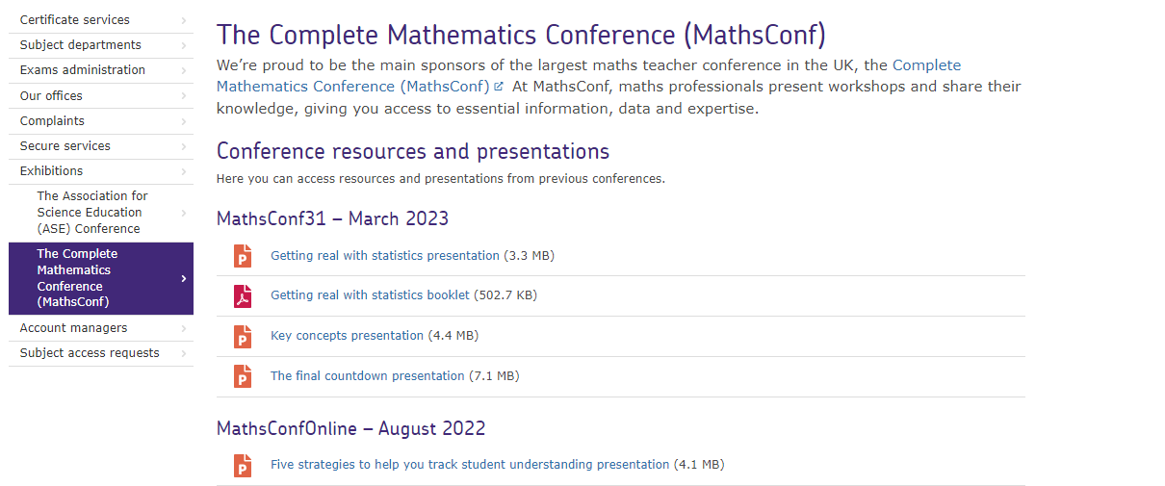
Resources
Go to the MathsConf area of the AQA website to find presentations from past events.

Slide 17
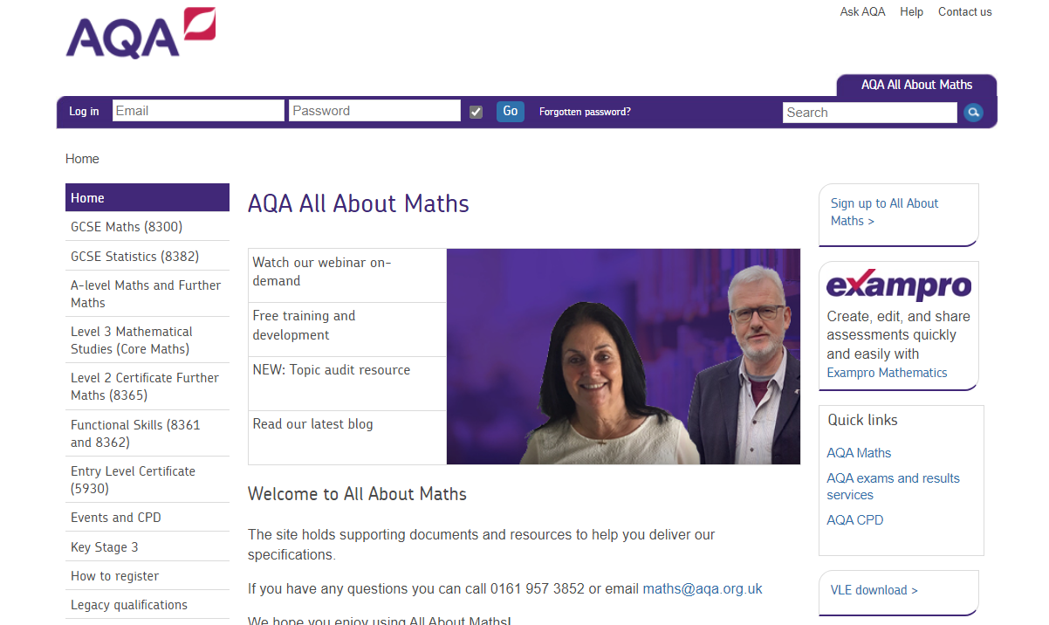
Resources
Find a huge range of resources in our All About Maths pages.

Slide 18

Get in touch
Our friendly team will be happy to support you between 8am and 5pm, Monday to Friday.
Tel: 0161 957 3852
Email: maths@aqa.org.uk
Twitter: @AQAMaths
aqa.org.uk

