Slide 1
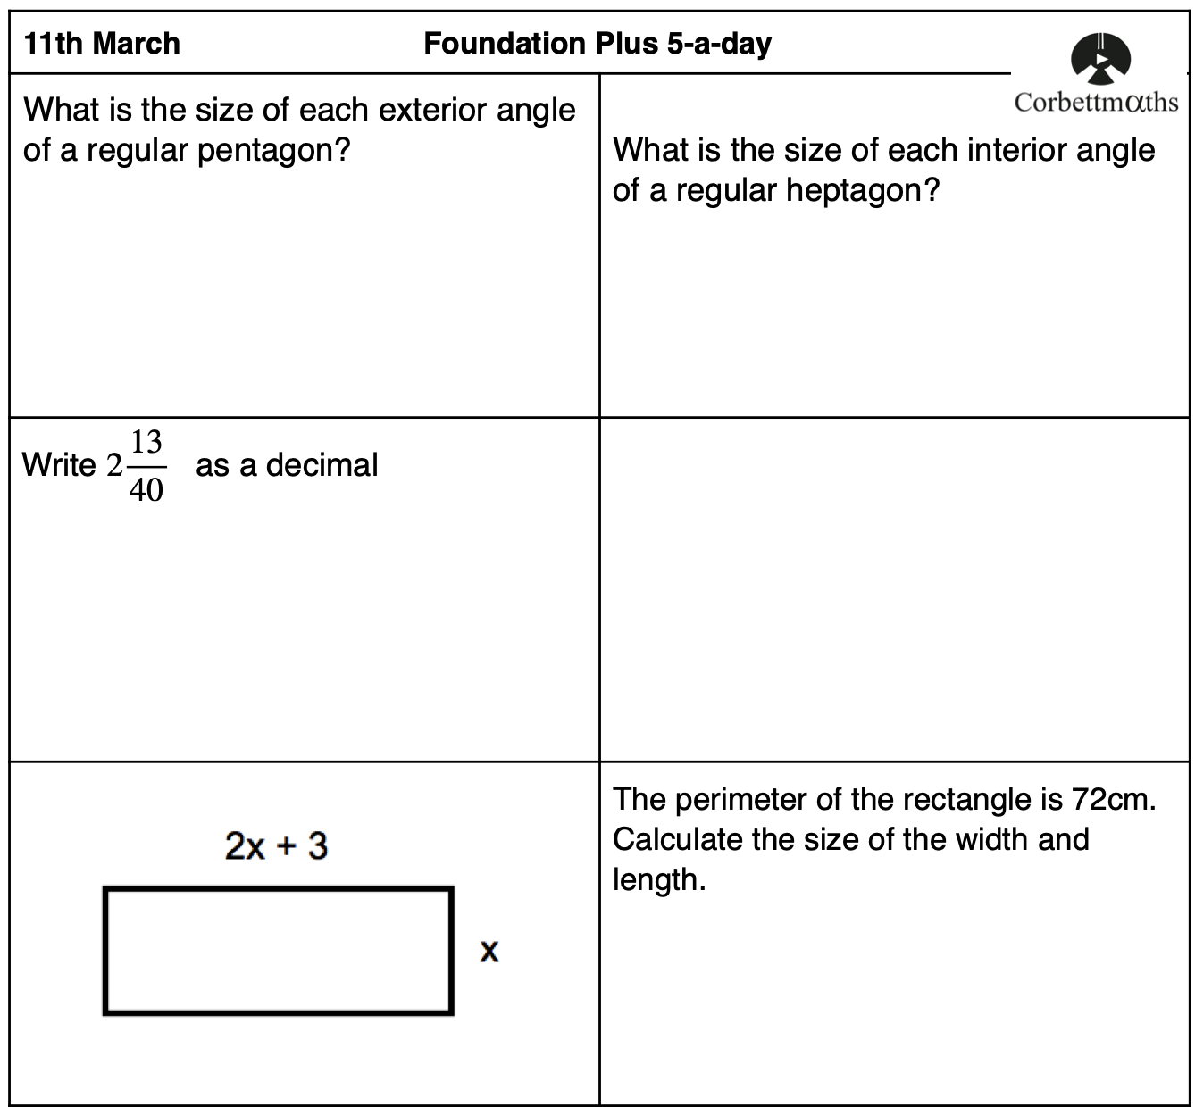
Starter
Credit: Corbett Maths

Slide 2
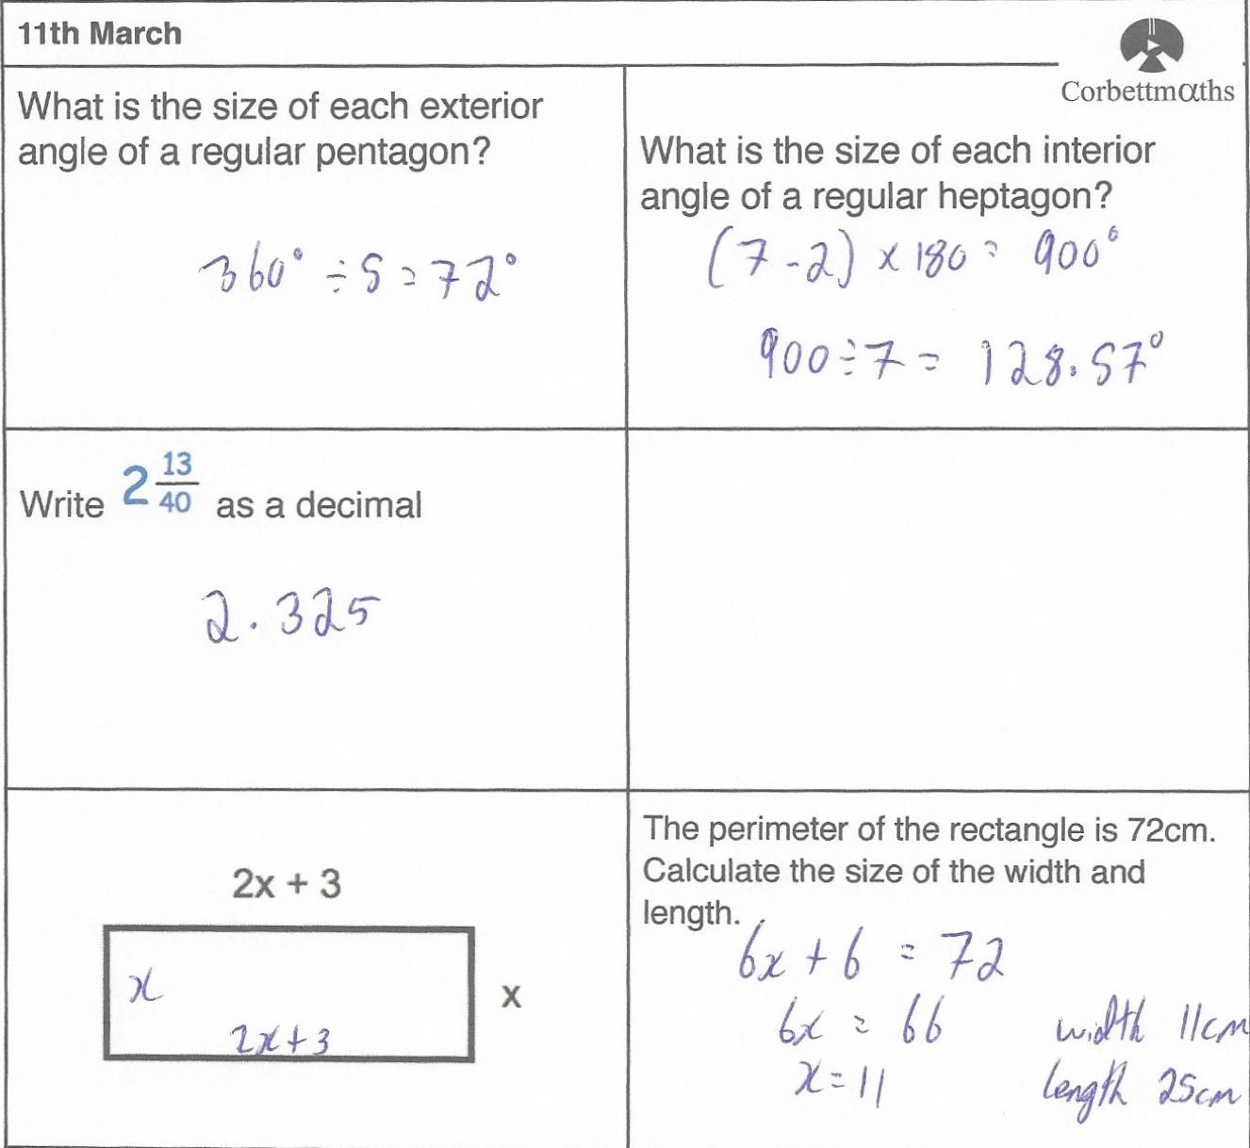
Starter
Credit: Corbett Maths

Slide 3

GCSE Maths The final countdown: Preparing for summer exams
Ian Andrews
Spring 2023

Slide 4
Welcome

Slide 5
Session structure
This training session will help you prepare your students for their exams.
We will be focusing on the following:
Revision cycle
Topic 1: Making the most of mocks
Topic 2: Great resources to use
Topic 3: 2022 review – key weaknesses nationally (AQA exams)
Topic 4: Final push – new sample papers plus differences to exams
Any questions
The content of this training course contains no reference to future exam content as far as we know at the time of production. (Spring 2023)

Slide 6
Revision cycle
Notes:
Provide information about why it is important and how concentrating on this will helps students to be successful

Slide 7
Suggested revision cycle
Student data analysis
Student plan
Teacher plan
Re-assess
Notes:
Refer to revising for maths – Not reciting information but applying to problems
Key part is to split student and teacher elements

Slide 8
Suggested revision cycle
Student data analysis
Topic level gaps (homework, classwork)
Mock exam analysers
Student plan
Individual topics
Accessible resources
Checklist of success
Teacher plan
Class topics
Resources
Class progress vs target
Re-assess
Past papers/online work
Shadow papers
Key topic tests
Low stakes quizzes
Notes:
Refer to revising for maths – Not reciting information but applying to problems
Key part is to split student and teacher elements

Slide 9
Topic 1: Making the most of mocks

Slide 10
Mock exams – a source of assessment for learning
Mock exams are one of the best ways to understand students’ strengths and weaknesses.
There is a wealth of information we collect during mock exams.
It can be used for heads of department to see gaps in student knowledge, for classroom teachers to focus their lessons and for students to find personalised gaps.
There’s so much data, how can we use it effectively?
Notes:
Can take hours to mark papers so really important that time is used really effectively
Use it to inform planning plus set work for students.

Slide 11
Mock exam analysers – a great way to collect data
  Student level
  Individualised so students have a personalised list
  They can fill this in themselves!
  Class/cohort analyser
  Allows teachers/key stage coordinators/heads of department to help spot general trends, strengths and weaknesses.
  Paste in the students’ individualised ones!
Notes:
I’m going to go through the AQA ones but there are others available. Refer to resource booklet

Slide 12
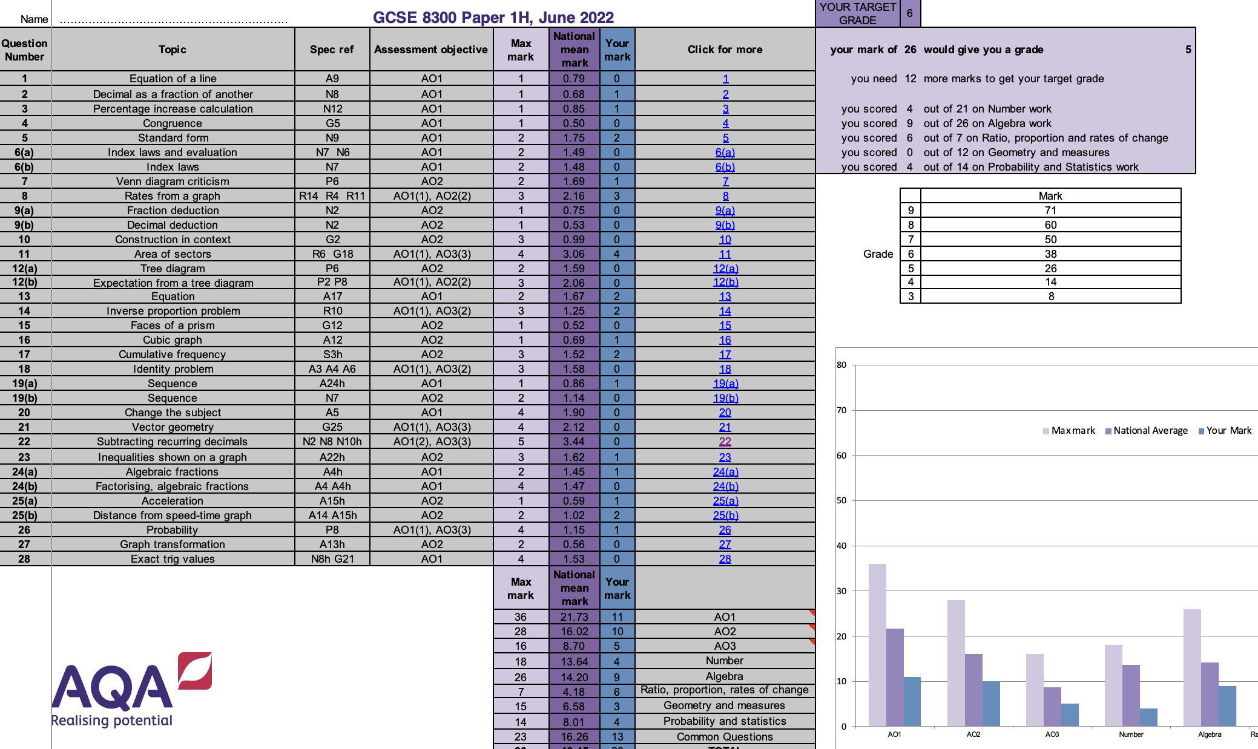
AQA student analyser
Notes:
I can show this onscreen at the conference

Slide 13
Other analysers are available
Hegartymaths, Sparx, Mathswatch, methodmaths……
Any more?
Notes:
Talk about on the next slide

Slide 14
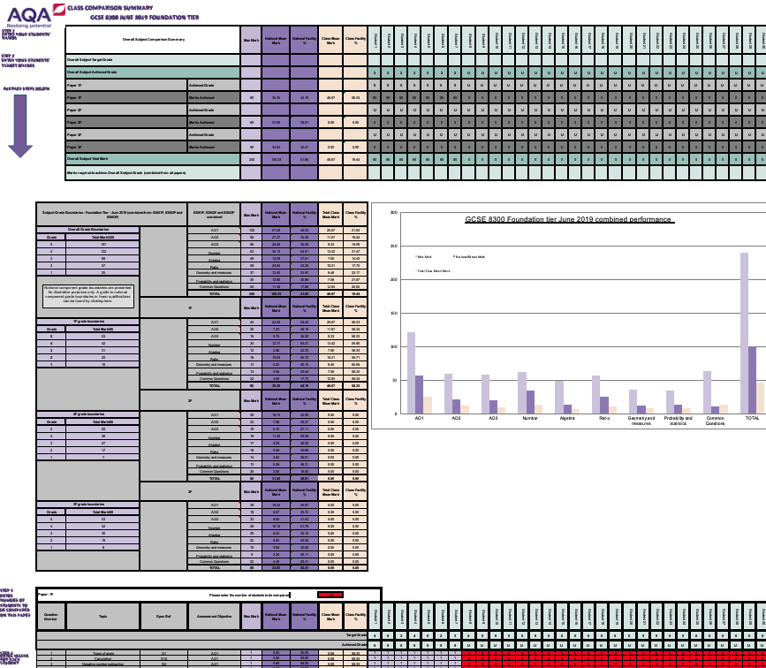
Cohort level
  Covers a whole series
(ie papers 1, 2 and 3 from June 2019 etc)
Enter/copy over every student’s data in question by question
Analyses each paper plus overall performance
Comparisons against target plus national average
Charts give visual comparisons automatically
Notes:
This is for class teachers or KS4 coords or head of dept. Again, will show live

Slide 15
Topic 2: Great resources to use
Notes:
Provide information about why it is important and how concentrating on this will helps students to be successful

Slide 16
All this data from mocks, so now what?
You know how students did, so it’s now time to use that data.
At a class level – teachers need to know which topics need attention as well as practicing key skills.
Students need a way to tick off those topics to cover and have the ability to easily find them.
As a key stage coordinator or head of department, are there certain areas you need to focus on in the future? Do topics need to be met earlier in the year groups?

Slide 17
Three main types of revision resource
Mixed topic tasks
Mini quizzes, five quick questions, revision mats etc
Topic specific resources
Mini quizzes, five quick questions, revision mats etc
Knowledge tests
Flash cards, quick recall tests

Slide 18
Mixed topic tasks – for use in class or for revision
Designed to test a mixture of skills – highlight any specific topics quickly
Tasks such as:
      Revision mats – lots available
      Access Maths have lots also
      Five a day questions
      Mathsbox have lots for a small subscription fee
Notes:
Highlight the need to zone in on specific topics and really practice
Don’t practice till you get it right, practice till you can’t get it wrong

Slide 19
Five-a-day
Credit: Corbett Maths

Slide 20
Revision mat – Miss B Resources

Slide 21
Topic specific resources – for teachers and students
There are lots of resources available to check specific topics.
Whilst we’re talking about revision and exam preparation today, many of these are great resources for teaching and learning in general.
Health warning!
Lots of the following sites talk about which ‘grade’ a topic is.
Typically, the way a question is asked determines the difficulty, rather than what topic it is.
For example, solving a quadratic could be anywhere between a grade 4 or a grade 9.
Notes:
Highlight the need to zone in on specific topics and really practice
Don’t practice till you get it right, practice till you can’t get it wrong

Slide 22
Teaching resources for specific topics
      These teaching resources are available to students too and have the following:
      PixiMaths – powerpoints, questions plus a revision zone
      Maths Genie – videos, “exam questions” and solutions
      Mr Barton Maths – a wealth of resources for all topics
      Corbettmaths – videos, exam style questions and textbook questions
      PiXL – If you’re a member of PiXL there are lots of resources and assessments available there
      Dr Austin Maths – Great selection of worksheets
      Remember, highlighted grades on these websites need to be treated cautiously.
Notes:
Highlight the importance of choosing one or two of these, not using all 4/5.
Say accessible to students also
Mention that all the links are in the resource booklet

Slide 23
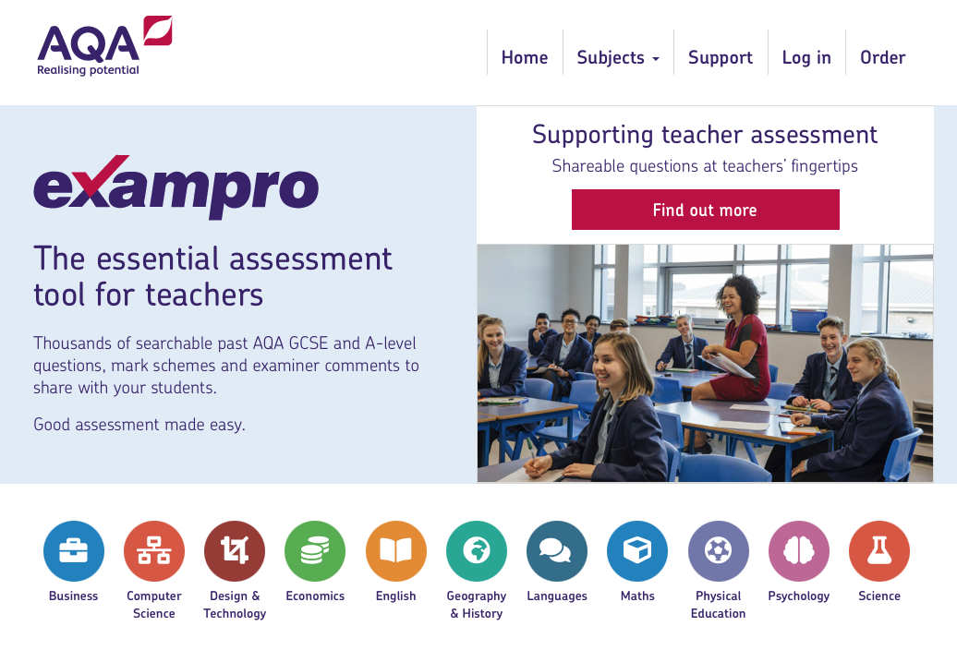
Specific exam question practice – Exampro
Exampro enables you to build your own selection of exam questions on a certain topic or skill, (£90 for GCSE).
Really useful source of real exam questions and mark schemes.

Slide 24
Knowledge tests
      Students will have formula sheets in Summer 2023 but there are still lots of formulae to remember
      Quick knowledge tests or knowledge organisers are important
        Flash cards – Make their own or there are ones to buy
        Knowledge organisers – Make their own or Resourceaholic has a great collection
        Online quizzes at www.quizizz.com, www.kahoot.com, www.blooket.com or www.quizlet.com are great also
Notes:
Maybe mention other ones that require subscription Mathsbox skills check (https://www.mathsbox.org.uk/l/logresources/skills.php) (£60 per year)
Mr Carter Maths (https://www.mrcartermaths.com/#) (£120 per year)

Slide 25
Lets do this!
Quizizz | Where motivation meets mastery

Slide 26
Your feedback – other great resources to use?
Notes:
Mention that we use Hegartymaths ones and Mathswatch ones plus Onmaths

Slide 27
Topic 3: 2022 review – key weaknesses nationally (AQA exams)
Notes:
Provide information about why it is important and how concentrating on this will helps students to be successful

Slide 28
Foundation tier – AQA key findings
Loci, bearings and vectors are regularly answered poorly – topics that may be seen as more peripheral or don’t link so well to other topics?
  Non attempts are a bigger problem on foundation tier than on higher
    Around 10 questions per paper had over 10% of candidates not attempting – worth around 25 marks per paper
    Issues with problem solving questions or spotting what maths to use may feed into this.
Fluency and the ability to use methods in unfamiliar situations appears to be a problem - especially with fractions, linear graphs, manipulating algebra and probability trees.
Strengthening these areas could improve student performance in the future.

Slide 29
Higher tier – AQA key findings
Non-attempts much less of an issue than previously – evidence of advanced information helping?
Loci, bearings and vectors!
Key weaknesses of higher pupils were:
  Quadratics – fluency across the methods
  Conditional Probability – using in unfamiliar situations
  Linear graphs – fluency across the methods
  Algebraic proficiency
  Unfamiliar questions
Getting students ready to apply their knowledge in different ways will really help students to gain the higher grades.

Slide 30
Topic 4: Final push – new sample papers plus differences to exams
Notes:
Provide information about why it is important and how concentrating on this will helps students to be successful

Slide 31
Specific topic and past paper practice are needed
PAST PAPER
MARK TO FIND GAPS
CLOSE THE GAPS

Slide 32
Specific topic and past paper practice are needed
PAST PAPER
MARK TO FIND GAPS
Hegarty
Mymaths
Mywatch
Corbett
Pixi
Miss B
Revision guide
Etc!
CLOSE THE GAPS

Slide 33

AQA have improved their papers for 2023
No multiple choice questions at the start
of the paper
Improved ramping of demand in the papers
Improved question wording
Fainter lines or more white space around
diagrams for working
Continue to reward students in the mark
scheme for good attempts
Check the sample papers on All About Maths
Notes and Guidance: Foundation and Higher
tier paper improvements (Summer 2023)

Slide 34
Summary

Slide 35
Summary
Think of the revision cycle in your planning
Maximise your use of mock exams and information
Really focus students and lessons on those areas that will make the most difference
Use the great resources out there
Prepare students for the changes
to AQA exams in 2023
Student data analysis
Student plan
Teacher plan
Re-assess

Slide 36

Any questions?

Slide 37
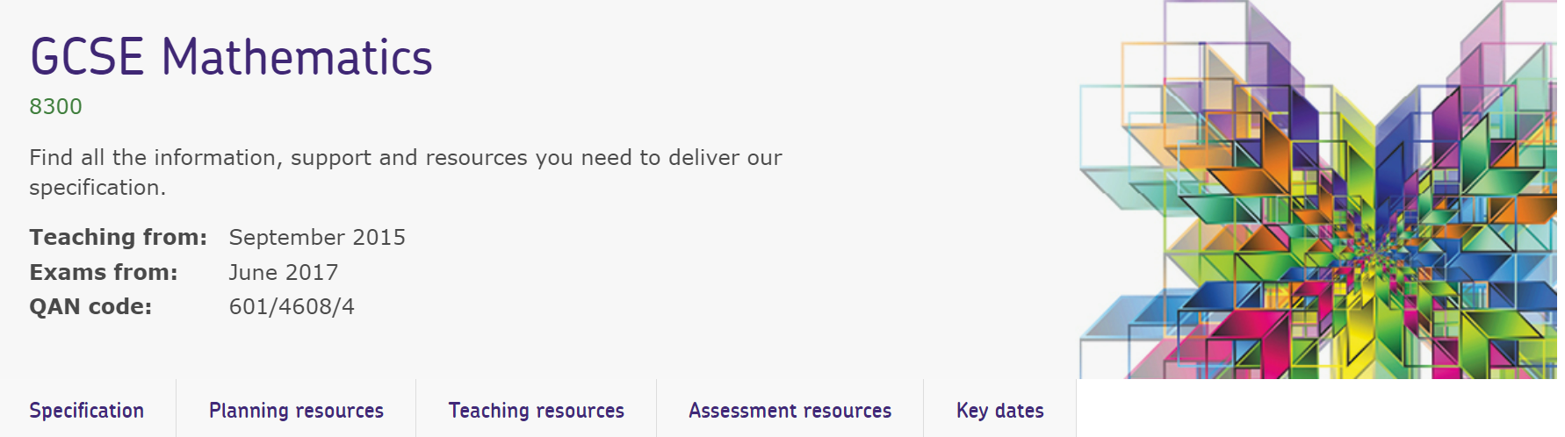
Resources
Take advantage of our extra resources on our website.
Notes:
Direct delegates to the specific subject page on the main AQA website, eg https://www.aqa.org.uk/subjects/mathematics/gcse/mathematics-8300

Slide 38
Get in touch
Our friendly team will be happy to support you between 8am and 5pm, Monday to Friday.
Tel: 0161 957 3852
Email: maths@aqa.org.uk
Twitter: @AQA
aqa.org.uk
Notes:
Our relevant Twitter accounts are:
@AQAEnglish (English subjects)
@AQAMaths (Maths subjects)
@AQA (Any other subjects).

Slide 39
Thank you

