Slide 1
Activity
On your table you will find some questions based on data from the LDS.
Please read the questions and discuss your answers.
Notes:
Arrival (5 mins)

Slide 2
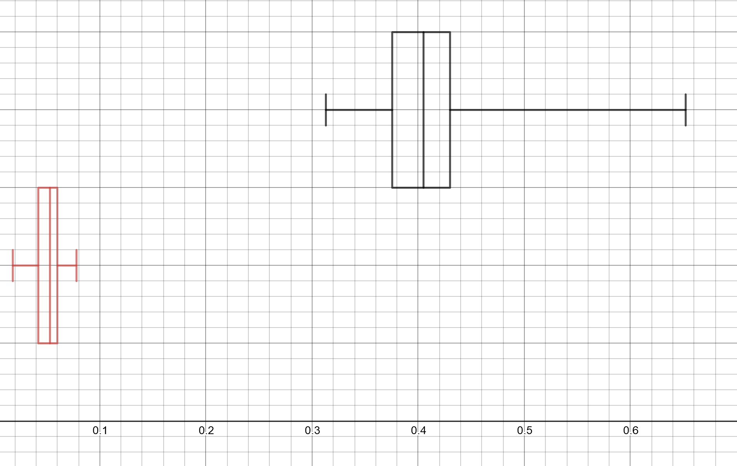
NOX emissions for diesel cars registered in NW in 2002 (above) and in 2016 (below)
Using information from the boxplots find an appropriate value for the percentage reduction in NOX emissions between 2002 and 2016.
Rose claims that these graphs show there was a very large reduction in the NOX emissions of cars in the UK.
What assumptions would Rose have to make to support her claim, based on these graphs?
An outlier is defined as a value more than 1.5 times the IQR below Q₁ or above Q₃
Determine whether either of the samples represented in these boxplots contains any outliers.
Notes:
Introductory activity – copies of this slide given to delegates to work on
There were only 83 cars in 2002.
Sample of 100 used for 2016.

Slide 3
NOX emissions for cars registered in NW in 2016 – diesel (above) and petrol (below)
Compare the distributions of NOX emissions for diesel and petrol cars.
Julian claims that, based on this evidence, petrol engines are much better for the environment than diesel engines. He says that the proposed ban on diesel engines is justified.
What assumptions must Julian make, based on this evidence, to support his claim?
Notes:
Approaches and sharing of ideas between delegates
Introductory activity – copies of this slide given to delegates to work on
Diesel above, petrol below. Samples of 100 cars in each case. Neither sample contained 100 values. Why not? Because there is no NOX emissions data recorded for some cars in the LDS.
NOX emissions for diesel cars are, on average, much higher than those for petrol cars, because the median is 0.05 compared with 0.02
The lower quartile for diesel cars is approximately equal to the upper quartile for petrol cars so it would be fair to day that diesel cars have significantly higher NOX emissions than petrol cars.
There is slightly more variation in the NOX emissions for diesel cars because the IQR is greater – about 0.03, compared with 0.02

Slide 4
This meeting will be recorded
Exam boards have an Ofqual requirement to record event audio.
Recordings are kept for the lifetime of the specification and not shared as an accompaniment to session resources.
The recording will begin now.
Notes:
1 min (6 mins)
… because I work for AQA.

Slide 5
A-level Maths: Getting real with statistics
Dan Rogan
MathsConf 31
March 2023

Slide 6
Welcome
Notes:
1 min (7 mins)
Quick intro to me; assuming some knowledge of Excel and the LDS.
Chair of Examiners AS and A-level Further Maths; teacher of Maths, mostly A-level Ma and Fm.
I want the LDS to be a tool for effective teaching.

Slide 7
What will we do today?
Use the enhanced LDS with built in sampling and graphing tools.
See how easy it is to pick up data and paste it into Desmos to draw graphs you can use in the classroom.
Share ideas about how to use the LDS to help teach statistics.
Consider exam questions and the material advantage.
Notes:
1 min (8 mins)

Slide 8
Where did the LDS come from?
Whilst looking for a replacement for the Family Food LDS, I wondered whether I could get vehicle emissions data from the DfT.
They offered me their stock vehicle database, which contains over 30 million vehicles.
I chose some restrictions and got down to 1.5 million vehicles.
I then introduced further restrictions to reduce it to a manageable size.
You don’t want a really large data set!
Notes:
1 min (9 mins)

Slide 9
Getting to know the LDS
Use a straightforward worksheet to explore the data in the LDS.
The worksheet (in your booklet) takes about an hour to work through and makes a good intro to the LDS.
The LDS tool and LDS worksheets are on AQA All About Maths.
Notes:
4 mins (13 mins)
Link to LDS and exploring worksheet.
The LDS tool runs macros. It is compatible with Excel 2016 as well as Office 365. If you have problems running it in older versions of Excel, I’m afraid we can’t help. Problems can arise with older versions of Excel 2016 – ask your network manager to update.
This worksheet (in your booklet) takes about an hour to work through and makes a good intro to the LDS.
I would expect students to use filters to explore the LDS and read the mean in the status bar

Slide 10
Sampling from the LDS
You can select simple random samples by choosing criteria from the fields in the large data set.
This allows you to compare data from two different groups.
The LDS tool is designed to be easy to use so you can present real data in the classroom.
Notes:
5 mins (18 mins)
A tour of the key features: changing the parameters of the sample; changing the sample size; studying sample statistics; looking at boxplots; looking at histogram
Excel boxplot draws outliers automatically and it’s vertical.
Excel histogram doesn’t use a proper scale, but it does let you see the shape of a distribution.

Slide 11
How can you use this in the classroom?
Select a small sample, say of size 10, and ask students to use their calculators to find the mean and standard deviation.
Ask students to identify the positions of outliers using a sample you have selected.
Compare two distributions using median and quartiles.
Notes:
2 mins (20 mins)
These aren’t complicated ideas – you can simply use real data from the LDS when teaching any of these topics: skewness, outliers, standard deviation

Slide 12
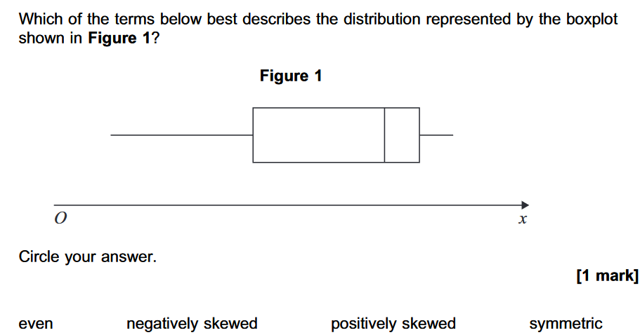
Q11 P2 AS Maths 2022
Notes:
2 mins (20 mins)
These aren’t complicated ideas – you can simply use real data from the LDS when teaching any of these topics: skewness, outliers, standard deviation

Slide 13
Graphs in Desmos
It’s very easy to pick up a sample from the LDS and drop it into Desmos.
Then you can easily draw a boxplot or simple histogram.
Notes:
5 mins (26 mins)

Slide 14
Formulating hypotheses
Company cars are too big
into a hypothesis that we could actually investigate in the LDS.
They would come up with something like:
The mean engine size of company cars is greater than the mean engine size of other cars.
A successful lesson began with me asking students how you could turn this statement:
Notes:
2 mins (28 mins)
I deliberately went for a statement that wasn’t about emissions, that makes them think about the Keeper Title Id field

Slide 15
Formulating hypotheses – try it
Can you improve these?
Cars are less polluting than they used to be.
Diesels have higher emissions than petrol cars.
Toyotas have more variable emissions than BMWs.
Notes:
Can you improve these?
2 mins (30 mins)
Time this for 1 minute and then share ideas

Slide 16
Q13 O2 AS Maths 2022
Notes:
1 min (31 mins)
AS Maths 7356/2 2022 Q13

Slide 17
Bivariate data with the LDS tool
Select | Select a sample and two sets of data to compare
Calculate | Calculate basic statistics for each sample
Construct | Construct a scatter diagram
Interpret | Interpret the product moment correlation coefficient
Interpret | Interpret the regression line of y on x
Notes:
5 mins (36 mins)
A tour of the LDS tools for this.

Slide 18
Using a scatter diagram
Try comparing a scatter diagram with a small sample size with one for a much larger sample to show how hard it is to judge correlation by eye.
Write down comments interpreting the scatter diagram.
We can use Desmos again.
Notes:
5 mins (41 mins)
Discuss whether they imply causation rather than correlation.

Slide 19
Causation or correlation
Cars with higher CO2 emissions have greater masses.
The bigger your mass, the greater your CO2 emissions will be.
In the sample of 100 cars, the cars with larger masses had higher CO2 emissions.
Some cars have higher CO2 emissions because they have bigger masses.
You should not load your car up, because the more mass it has the higher the CO2 emissions.
Notes:
Approaches and sharing of ideas between delegates
2 mins (43 mins)

Slide 20
Hypothesis testing for PMCC
This is a slightly strange topic in the new spec.
Students never calculate PMCC and they don’t have tables to look up critical values.
We can use this page of the LDS to find r and the critical value.
You can then focus on formulating hypotheses and interpreting the results.
Notes:
4 mins (47 mins)

Slide 21
More ideas
Can you fit a normal distribution to some data from the LDS?
I tried this in Desmos.
Notes:
2 mins (49 mins)
Easy to change mean and s.d. to see if you can fit a model.
Histogram is set to use frequency density.

Slide 22
More ideas
Can you estimate population parameters using sample statistics?
There is a sample worksheet based on this idea in your Resource booklet.
Notes:
2 mins (51 mins)
Talk through some examples

Slide 23
Any questions?
Notes:
2 mins (53 mins)
Questions

Slide 24
Resources
Take advantage of the extra resources on our website.
Find further resources on AQA All About Maths.
Notes:
Direct delegates to the specific subject page on the main AQA website, eg https://www.aqa.org.uk/subjects/mathematics/gcse/mathematics-8300

Slide 25
Event materials
The content of this training course contains no reference to future exam content as far as we know at the time of production (Spring 2023).
The electronic materials from this event will be available to download.

Slide 26
Get in touch
Our friendly team will be happy to support you between 8am and 5pm, Monday to Friday.
Tel: 0161 957 3852
Email: maths@aqa.org.uk
Twitter: @AQAMaths
aqa.org.uk
Notes:
1 min (54 mins)

Slide 27
Thank you

