Slide 1
GCSE Maths: #MathsConfOnline Five strategies to help you track student understanding
Ceri Ward Jones
Summer 2022

Slide 2
Welcome

Slide 3
Exampro
AQA’s Exampro question banks prepare students for their first public exams. Explore thousands of past questions with their associated mark schemes and examiner comments to create compilations suiting your students’ needs.
Embed questions in:
homework, to familiarise students with exam materials
class teaching, for greater understanding of what’s being asked
differentiated, targeted assessments, to check learning of content and skills
revision resources, for the best preparation.
AQA’s MERiT offers high-quality feedback from mock exams. See the strengths and weaknesses of your class to identify teaching focus; share performance data with SLT; and view student reports to support individual progress.
Notes:
For further information please refer delegates to pre-event materials book.

Slide 4
5 Ways to check for understanding
Today’s Session:
A reminder of what the evidence suggests is good practice:
5 ways to check for understanding.
summarise what has happened so far
think aloud
agree or disagree?
using multiple choice questions for Pose, Pause, Pounce Bounce
repeat the instructions
2. An opportunity for colleagues to share resources

Slide 5
The black box
Teaching and learning are interactive
Teachers need to know about:
Pupils’ progress
Pupils’ difficulties with learning
individual
varied
sometimes unpredictable
We get this information from:
Observation
Discussion
Written work
We use this feedback to adapt our teaching to meet the pupils’ needs.
“Opportunities for pupils to express their understanding should be designed into any piece of teaching, for this will initiate the interaction whereby formative assessment aids learning.” Black P, Wiliam D. Inside the Black Box: Raising Standards through Classroom Assessment. Phi Delta Kappan. 2010;92(1):81-90. doi:10.1177/003172171009200119
Notes:
Back to my 1st yr TF mentor’s recommendation 2003… Black and William’s 1998
Engineering/aviation: The classroom is the black box. Inputs from pupils, SLT, Dept, pupils, parents, assessments. Outputs follow: good results, confident pupils, happy staff/exhausted staff?. BUT WHAT HAPPENS between? It’s up to us to make it work.
Our classrooms are the black box.
Summary of what goes on inside the black box.
Quote
In this session, we will look at some ways in which we can provide these opportunities.

Slide 6
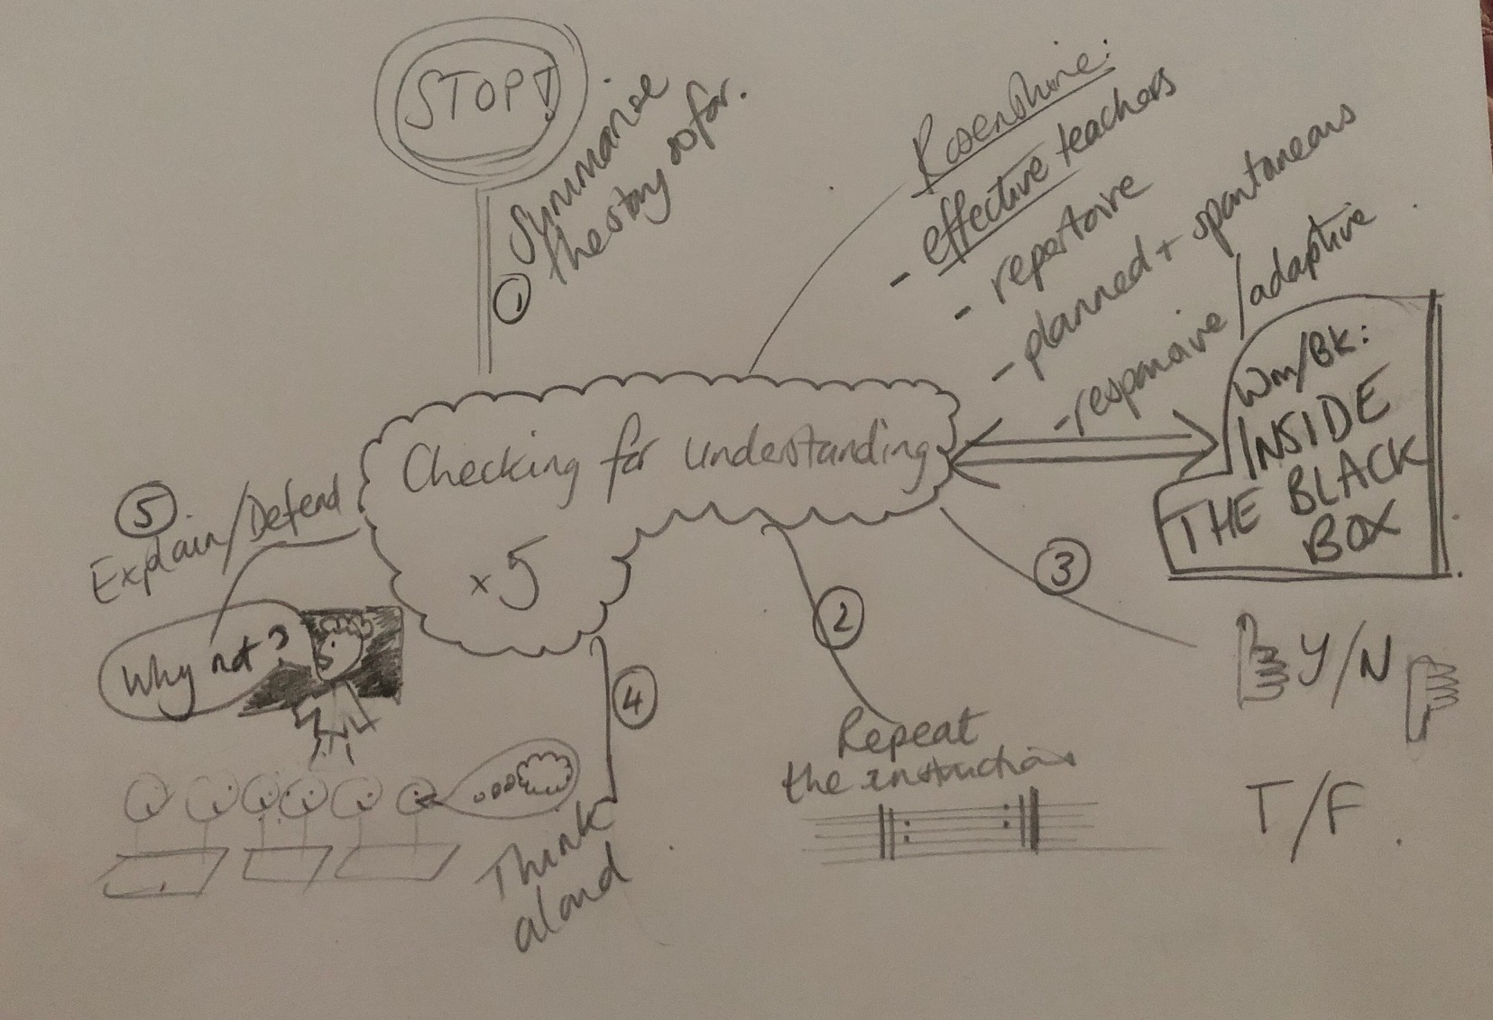
5 Ways to check for understanding: Maths

Slide 7
Reminder of the purpose of checking for understanding
Rosenshine 6
Credit: © iStocK.com/ graphic-bee
Notes:
Is everyone on the bus?!
Rosenshine, B. (2010). Principles of instruction; Educational practices series; Vol.:21; 2010.
“This checking has two purposes: (a) answering the questions might cause the students to elaborate on the material they have learned and augment connections to other learning in their long-term memory, and (b) alerting the teacher to when parts of the material need to be retaught.

Slide 8
Non examples
Does that make sense?
Any questions?
Do you understand?
Everyone got that?
Ok?
Credit: © iStock.com/SolStock
Notes:
https://media.istockphoto.com/photos/teaching-mathematics-picture-id911026294?k=20&m=911026294&s=612x612&w=0&h=FfqiAVfjHsveBjl0KM7nL-5YBmQBJXkzYj9UAmFIGkA=
Discuss why these are bad examples of checking understanding

Slide 9
“Summarise what has happened so far”

Slide 10
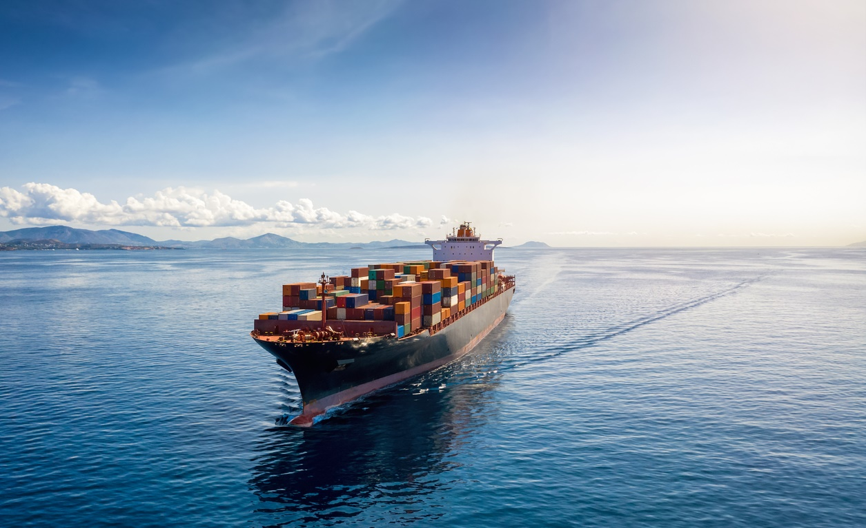
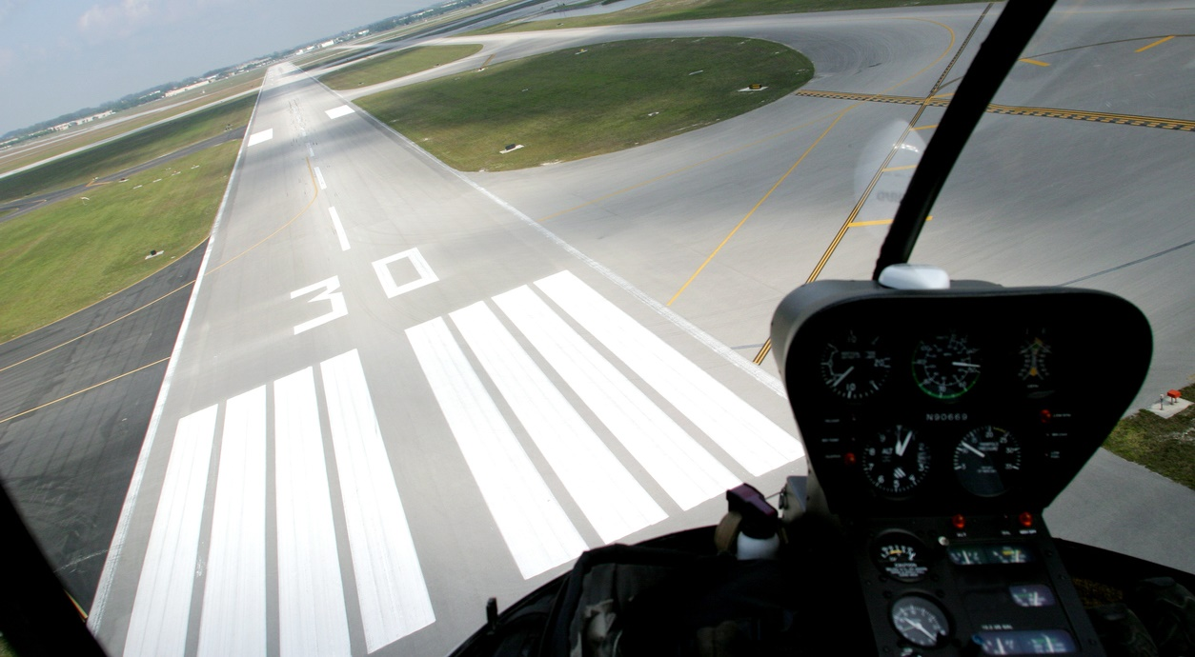
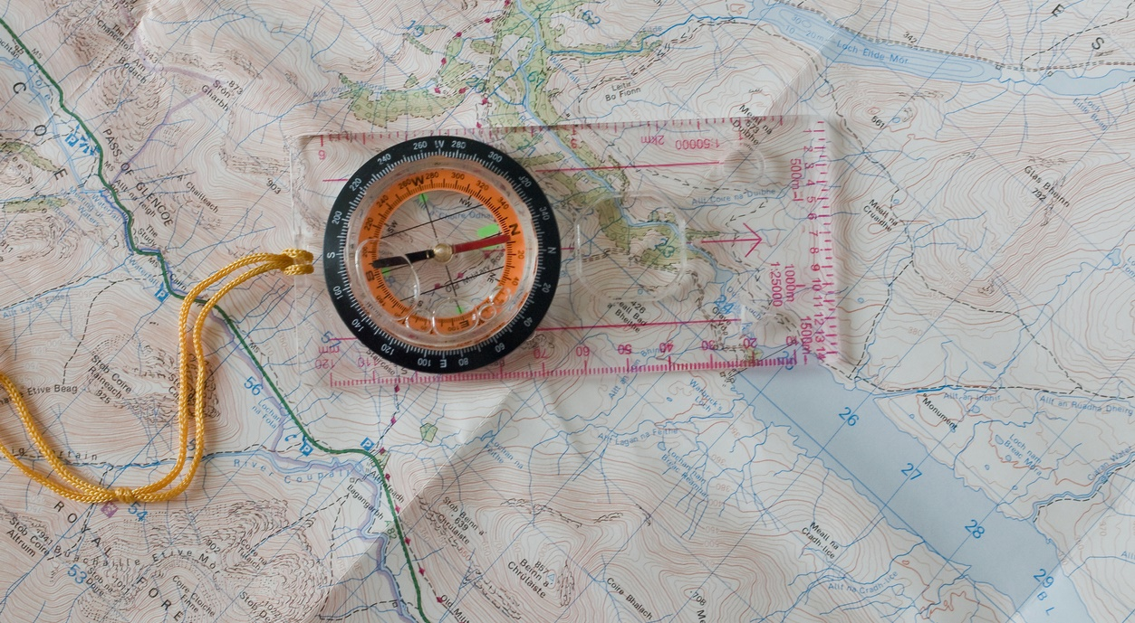
‘Summarise what has happened so far’
Students should be able to:
Mark points on a diagram given the bearing from another point
Draw a bearing between points on a map or scale drawing
© iStock.com/Shansche
© iStock.com/cristianl
© iStock.com/wzfs1s
Notes:
You’ve already introduced the topic, sharing who uses bearings etc. Maybe even done a lesson on compass directions.
https://media.istockphoto.com/photos/aerial-view-of-a-heavy-loaded-container-cargo-vessel-picture-id1279313029?k=20&m=1279313029&s=612x612&w=0&h=27Us9jy9yUX3z9u6tlBbTBtSHtCLPR3y0njmblcXj8U=
https://media.istockphoto.com/photos/helicopter-in-runway-picture-id114425633?k=20&m=114425633&s=612x612&w=0&h=sEPbQQ2taS8DTWNtxr30Y5AwSudZI4Qr8kxfdN_dyjY=
https://media.istockphoto.com/photos/compass-and-map-picture-id186243873?k=20&m=186243873&s=612x612&w=0&h=xrQi0qp1M1-D0tZYw-dUq6l2-bhppFL2utpjkWCcz54=
https://media.istockphoto.com/photos/classic-round-compass-on-green-wooden-vintage-background-picture-id1271540317?k=20&m=1271540317&s=612x612&w=0&h=f6iYZOaDQiB7-PT9rzls4LsuCCyNJ3aR9UiRxF0tawE=

Slide 11
‘Summarise what has happened so far’
Q) The bearing of C from A is 130º. The actual distance from A to C is 359 metres. Mark the point C on the diagram.
© corbettmaths.com
Notes:
https://corbettmaths.com/2021/03/07/bearings-video-collection/
This lesson follows “I do” “we do” “ you do”
“We are just going to pause there for a moment before you have a go at drawing one yourself. I’m going to ask a few of you to summarise what has happened so far. I’ll give you a little bit of time to think, and then I’ll choose someone to start us off. What has happened so far?”…wait… “What has happened so far, student A?”
Wouldn’t just ask one student. Encourages active listening.
“Student B, can you also summarise what has happened so far”

Slide 12
‘Summarise what has happened so far’
Solving equations with a variable on both sides.
3b + 1 = 2b + 7
Notes:
https://contrib.pbslearningmedia.org/WGBH/conv20/mgbh-int-balance/index.html
Again…“I’m going to ask a few of you to summarise what has happened so far. I’ll give you a little bit of time to think, and then I’ll choose someone to start us off. What has happened so far?”…wait… “What has happened so far, student A?”
Wouldn’t just ask one student. Encourages active listening.
“Student B, can you also summarise what has happened so far”.

Slide 13
Think aloud

Slide 14
Think aloud
Topic: Functions
Example | Student’s attempt
Given ƒ(x) =2x g(x) = x + 1 Find ƒg(2) | Given ƒ(x) =2x g(x) = x + 1 find fg gf
Based on an activity from Variation Theory
Notes:
https://variationtheory.com/2018/12/22/functions-collection/
Now it’s their turn in the lesson to have a go. Guided, so part of the I do-We do- You do.
Encourage students to say what they are thinking. Support with
Whats the same? What’s different? What do you notice?

Slide 15
Think aloud
Other sentence starters to facilitate thinking aloud:
How did you begin to solve this problem?
Can you break it down? What would the first part be?
What do you need to do next?
Can you share your method for solving…
Can you reword the question into simpler terms?
Try to explain what you are doing in your own words.
Do you see a pattern?
Have you tried…?
Did you have a system? Explain it.
What is the same? What is different?
How could you help someone without telling them the answer?
How would you explain today’s task to someone who wasn’t here today?
If passing the baton…
Would anyone like to add to this?
Notes:
https://www.gettingsmart.com/2016/01/08/talking-math-100-questions-that-help-promote-mathematical-discourse/

Slide 16
Teach - meet sharing opportunity: Solving equations with a variable on both sides
$$23=5y−47$$ | $$6\left(y+1\right)=48$$ | $$3\left(y−2\right)+5\left(y+1\right)=47$$ | $$8y−1=47$$
$$y=6$$ | $$y=7$$ | $$8y=48$$ | $$70=5y$$
$$6y+6=48$$ | $$6y=42$$ | $$14=y$$ | $$3y−6+5y+5=47$$
1
1
1
?
?
?
?
?
?
?
?
?
Place the cells in a correct logical order to form a solution to each of the following equations:
$23=5y−47$
$6\left(y+1\right)=48$
$3\left(y−2\right)+5\left(y+1\right)=47$
Based on an activity from Kangaroo Maths
Notes:
https://contrib.pbslearningmedia.org/WGBH/conv20/mgbh-int-balance/index.html
https://old.kangaroomaths.co.uk/samples/activities/booster13v2.htm
https://www.mathspad.co.uk/teach/linkedDocuments/equations/MysteryNumbers.pdf Could give everyone chance to try this.

Slide 17
Teach - meet sharing opportunity: Solving equations with a variable on both sides
Finding the missing number
Rules:
Both sides of the equals sign must be made the same.
The same number in each box within a question must be used, eg:
+ 5 + 5 + 10 = 5 + 20
+ + + 2 = + 8
+ + 3 = + + + 2
6 + + 12 = + + 14
+ + 19 = + 29
Based on an activity from Mathspad
Notes:
https://contrib.pbslearningmedia.org/WGBH/conv20/mgbh-int-balance/index.html
https://old.kangaroomaths.co.uk/samples/activities/booster13v2.htm
https://www.mathspad.co.uk/teach/linkedDocuments/equations/MysteryNumbers.pdf Could give everyone chance to try this.

Slide 18
Agree or disagree?

Slide 19
Agree or disagree?
For the function
Evaluate
Notes:
Word of warning: It needs to be crystal clear to the class that some of the Qs are WRONG. And the correct one shown too.

Slide 20
Agree or disagree?
Bossmaths.com
Notes:
https://www.bossmaths.com/a7a/
Perhaps this is a better option for this for us. Remembering that the purpose is checking understanding

Slide 21
Multiple choice Qs with pose, pause, pounce, bounce

Slide 22
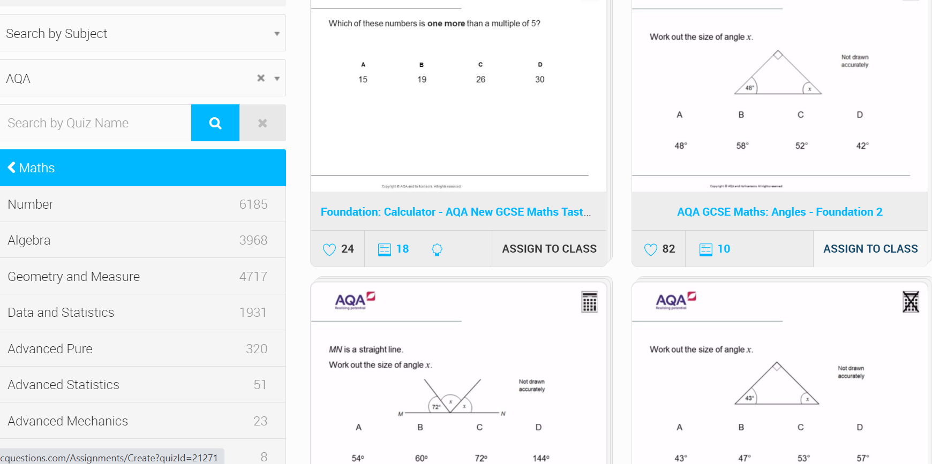
Multiple choice Qs with pose, pause, pounce, bounce
diagnosticquestions.com
Notes:
https://diagnosticquestions.com/Quizzes?Subject=3&Author=AQA&OrderBy=SubjectRelevance&IsLiked=False&IsColleagues=False

Slide 23
Multiple choice Qs with pose, pause, pounce, bounce
diagnosticquestions.com
Notes:
https://diagnosticquestions.com/Quizzes?Subject=3&Author=AQA&OrderBy=SubjectRelevance&IsLiked=False&IsColleagues=False

Slide 24
Repeat the instructions

Slide 25
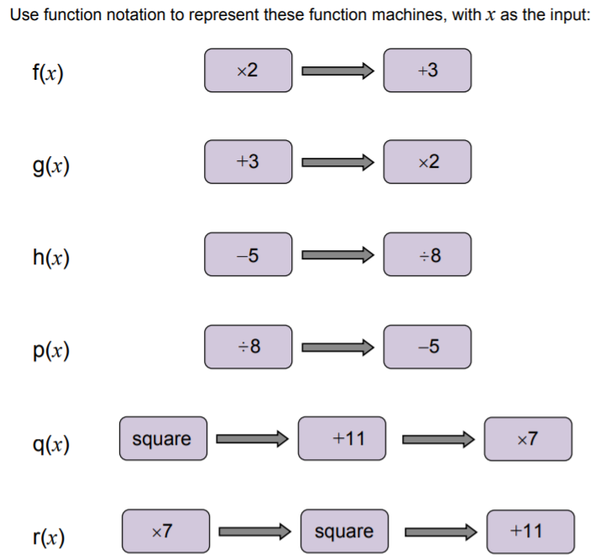
Repeat the instructions
To be able to interpret algebraic expressions as functions with inputs and outputs.
I can…
…apply order of operations (B I DM AS)
…use f(x) notation
Example 1
x 5
- 1
Example 2
+7
4

Slide 26
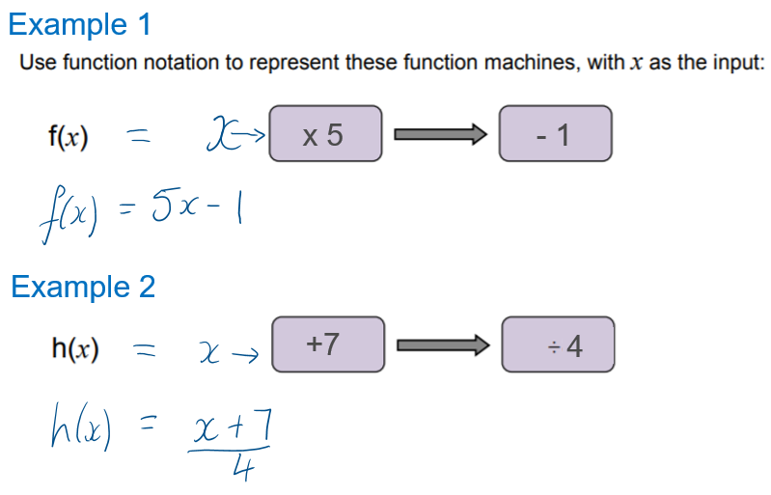
Repeat the instructions
Notes:
From AQA Bridging Units Pocket 2
https://allaboutmaths.aqa.org.uk/attachments/5097.pdf

Slide 27
Resources
Take advantage of our extra resources in our handy maths resource guide:
GCSE Maths - Handy links resource guide >>
Notes:
Direct delegates to the specific subject page on the main AQA website, eg https://www.aqa.org.uk/subjects/mathematics/gcse/mathematics-8300

Slide 28
Event materials
The electronic materials from this event will be available to download shortly. If you aren’t able to download them at this time, they will be made available to you in the customer portal of our online booking system.
Once we receive notification that you have attended the course, we will send you a certificate of attendance email. When you receive the email, please log in to your account and the materials will be available on the ‘my resources’ tab on the welcome screen.
Notes:
Please explain to the delegates that it may take a few days for the materials to be made available as we need to receive confirmation that they have attended (ie when we receive the attendance list). Once we have this confirmation, we can send a certificate of attendance email and the materials will be available in the portal. It is important that, if a delegate has attended in place of another colleague (ie they are not the named person on the attendance list) then they must let us know their name, school and email address so that we can send them a copy of the certificate email and provide access to the materials. Please send in the attendance list as soon as you can.

Slide 29
Get in touch
Our friendly team will be happy to support you between 8am and 5pm, Monday to Friday.
Tel: 0161 957 3852
Email: maths@aqa.org.uk
Twitter: @AQAMaths
aqa.org.uk
Notes:
Our relevant Twitter accounts are:
@AQAEnglish (English subjects)
@AQAMaths (Maths subjects)
@AQA (Any other subjects).

Slide 30
Thank you

