Slide 1

GCSE Maths: #MathsConfOnline – Engaging explanations
Colleen Young
Summer 2022

Slide 2
Welcome

Slide 3
Exampro
AQA’s Exampro question banks prepare students for their first public exams. Explore thousands of past questions with their associated mark schemes and examiner comments to create compilations suiting your students’ needs.
Embed questions in:
homework, to familiarise students with exam materials
class teaching, for greater understanding of what’s being asked
differentiated, targeted assessments, to check learning of content and skills
revision resources, for the best preparation.
AQA’s MERiT offers high-quality feedback from mock exams. See the strengths and weaknesses of your class to identify teaching focus; share performance data with SLT; and view student reports to support individual progress.
Notes:
For further information please refer delegates to pre-event materials book.

Slide 4
Agenda
GCSE: KS3 – KS4
Bridging the gap
Composite functions
Use of colour
Functions – building blocks
Spot the mistake – Andy Lutwyche
AQA Key Stage 3 tests for Years 7, 8 and 9
GCSE – KS4
AQA GCSE: 90 maths problem-solving questions
GCSE: Completion tasks
Here’s the diagram, what’s the question?
The answer is, what was the question?
GCSE: Foundation
GCSE: Use of technology – PhET Sims
GCSE Foundation – Venn diagrams
GCSE Higher – inequalities
GCSE methods in mathematics

Slide 5
Engaging explanations
‘When presenting content and ideas to students we need ‘engaging explanations that are just right for the students: neither too short nor too long; neither too complex nor too simple.’
Coe, R., Rauch, C.J., Kime, S., & Singleton, D. (2020). Great Teaching Toolkit: Evidence Review. Evidence Based Education. https://www.greatteaching.com/

Slide 6
GCSE: KS3 – KS4

Slide 7
GCSE: KS3 – KS4
AQA: Key Stage 3 – 4 – Bridging the gap.
AQA: Key Stage 3 tests for Years 7, 8 and 9.

Slide 8
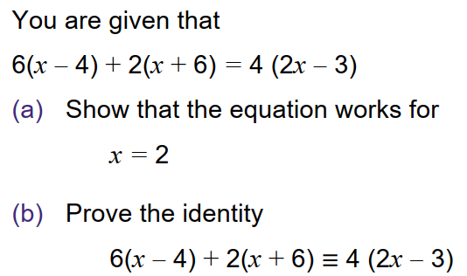
Bridging the gap – teacher guide

Slide 9
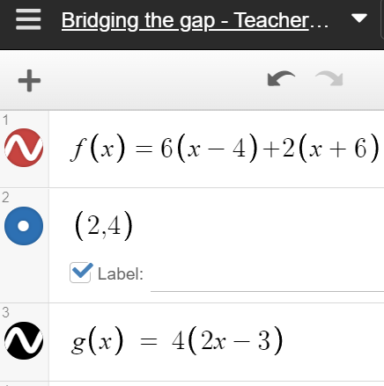
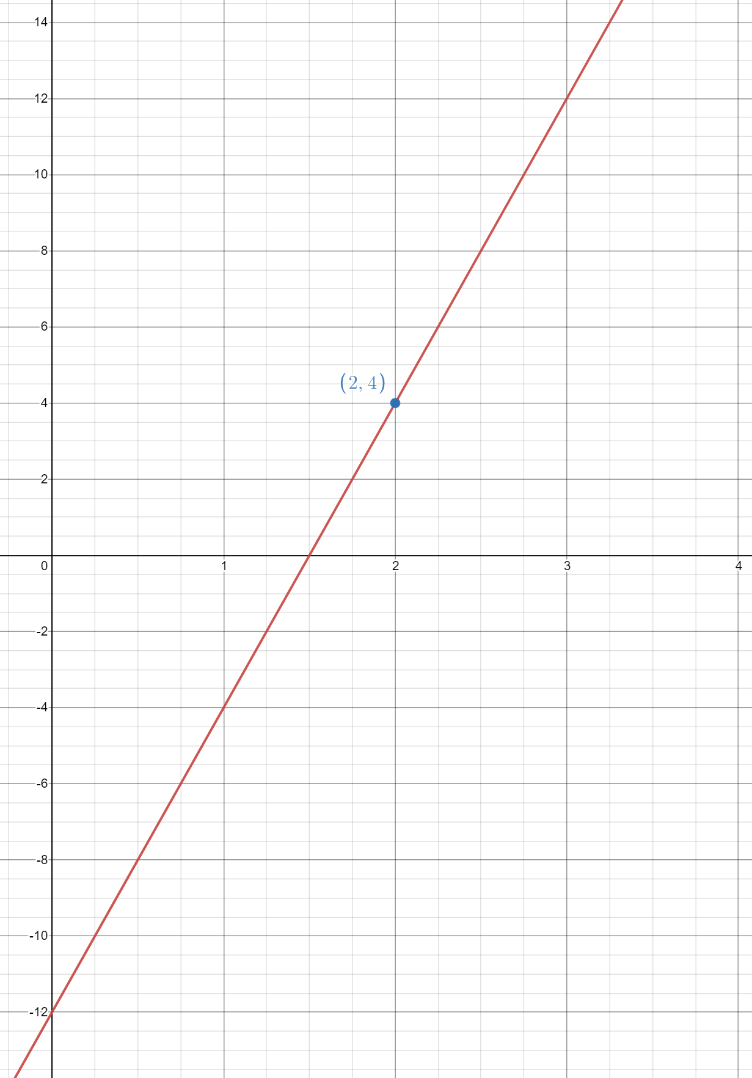
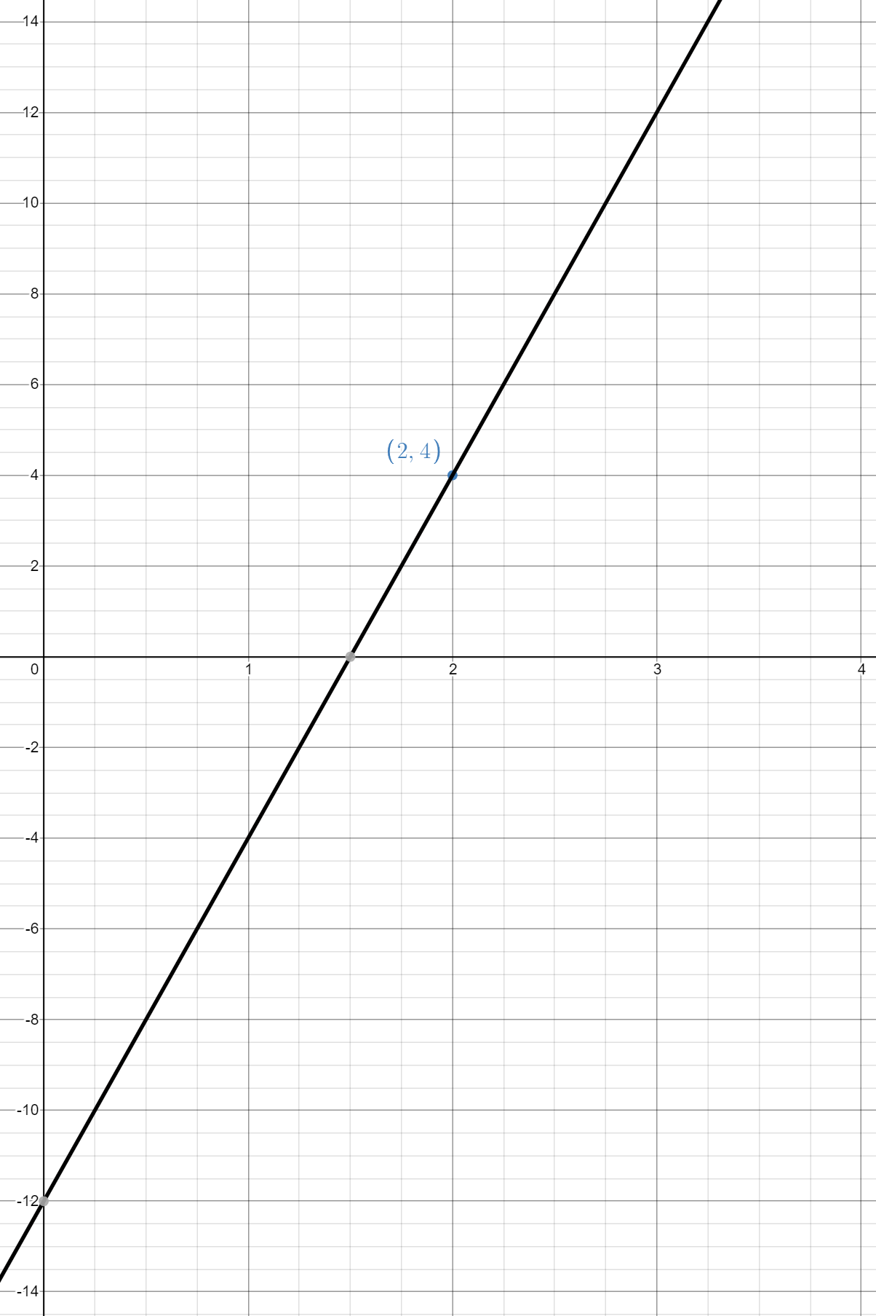
Bridging the gap – teacher guide

Slide 10
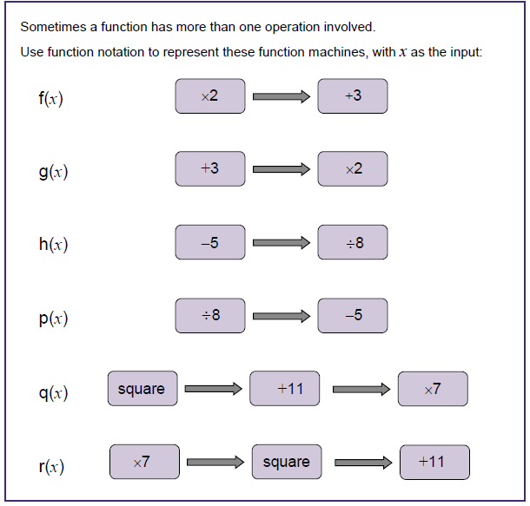
Bridging the gap – function notation
Does the order of operations matter?
How do we write the algebraic notation differently in the first two functions machines? In the next two machines?
How do we usually show division when using algebra? (ie, display vertically rather than
using the ÷ symbol.)

Slide 11
Bridging the gap – function notation
Stress the difference between functions h and p, and how important it is to draw the division line
between the correct terms.
For function q, try to discourage answers being left in the form
(x² + 11) × 7
For function r, discuss how this could be simplified to 49x² + 11

Slide 12
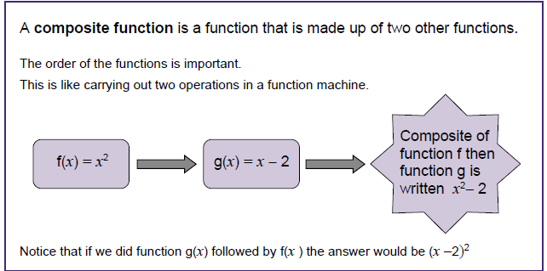
Composite functions

Slide 13
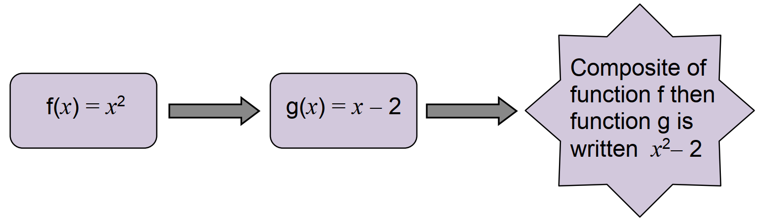
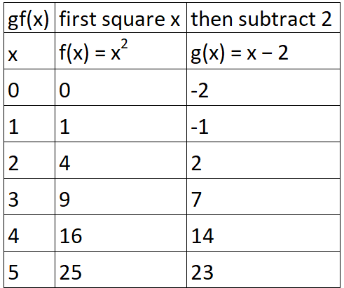
Composite functions
Example
f(x) = x²
f(3) = 3² = 9
g(x) = x − 2
g(9) = 9 − 2 = 7
gf(3) = g(f(3)) = g(3²) = 9
g(9) = 9 − 2 = 7
gf(3) = 7

Slide 14
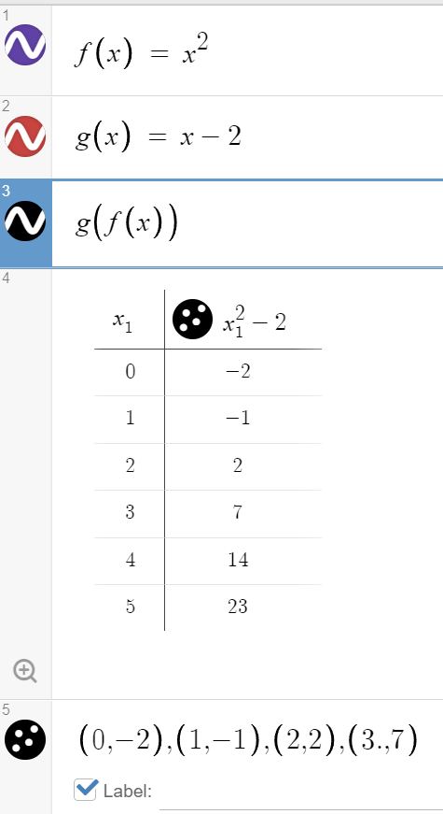
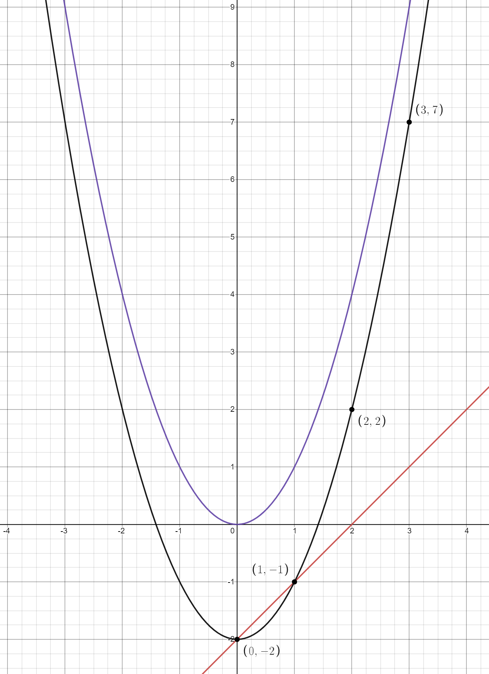
Composite functions

Slide 15
Use of colour
Like terms Factorisation
6a + 4b + 2a - 5b 5x²y + 15xy²
8a - b 5xxy + 5×3xyy
5xy(x + 3y)
Order of operations
4 + 2 × 3
4 + 6
10

Slide 16
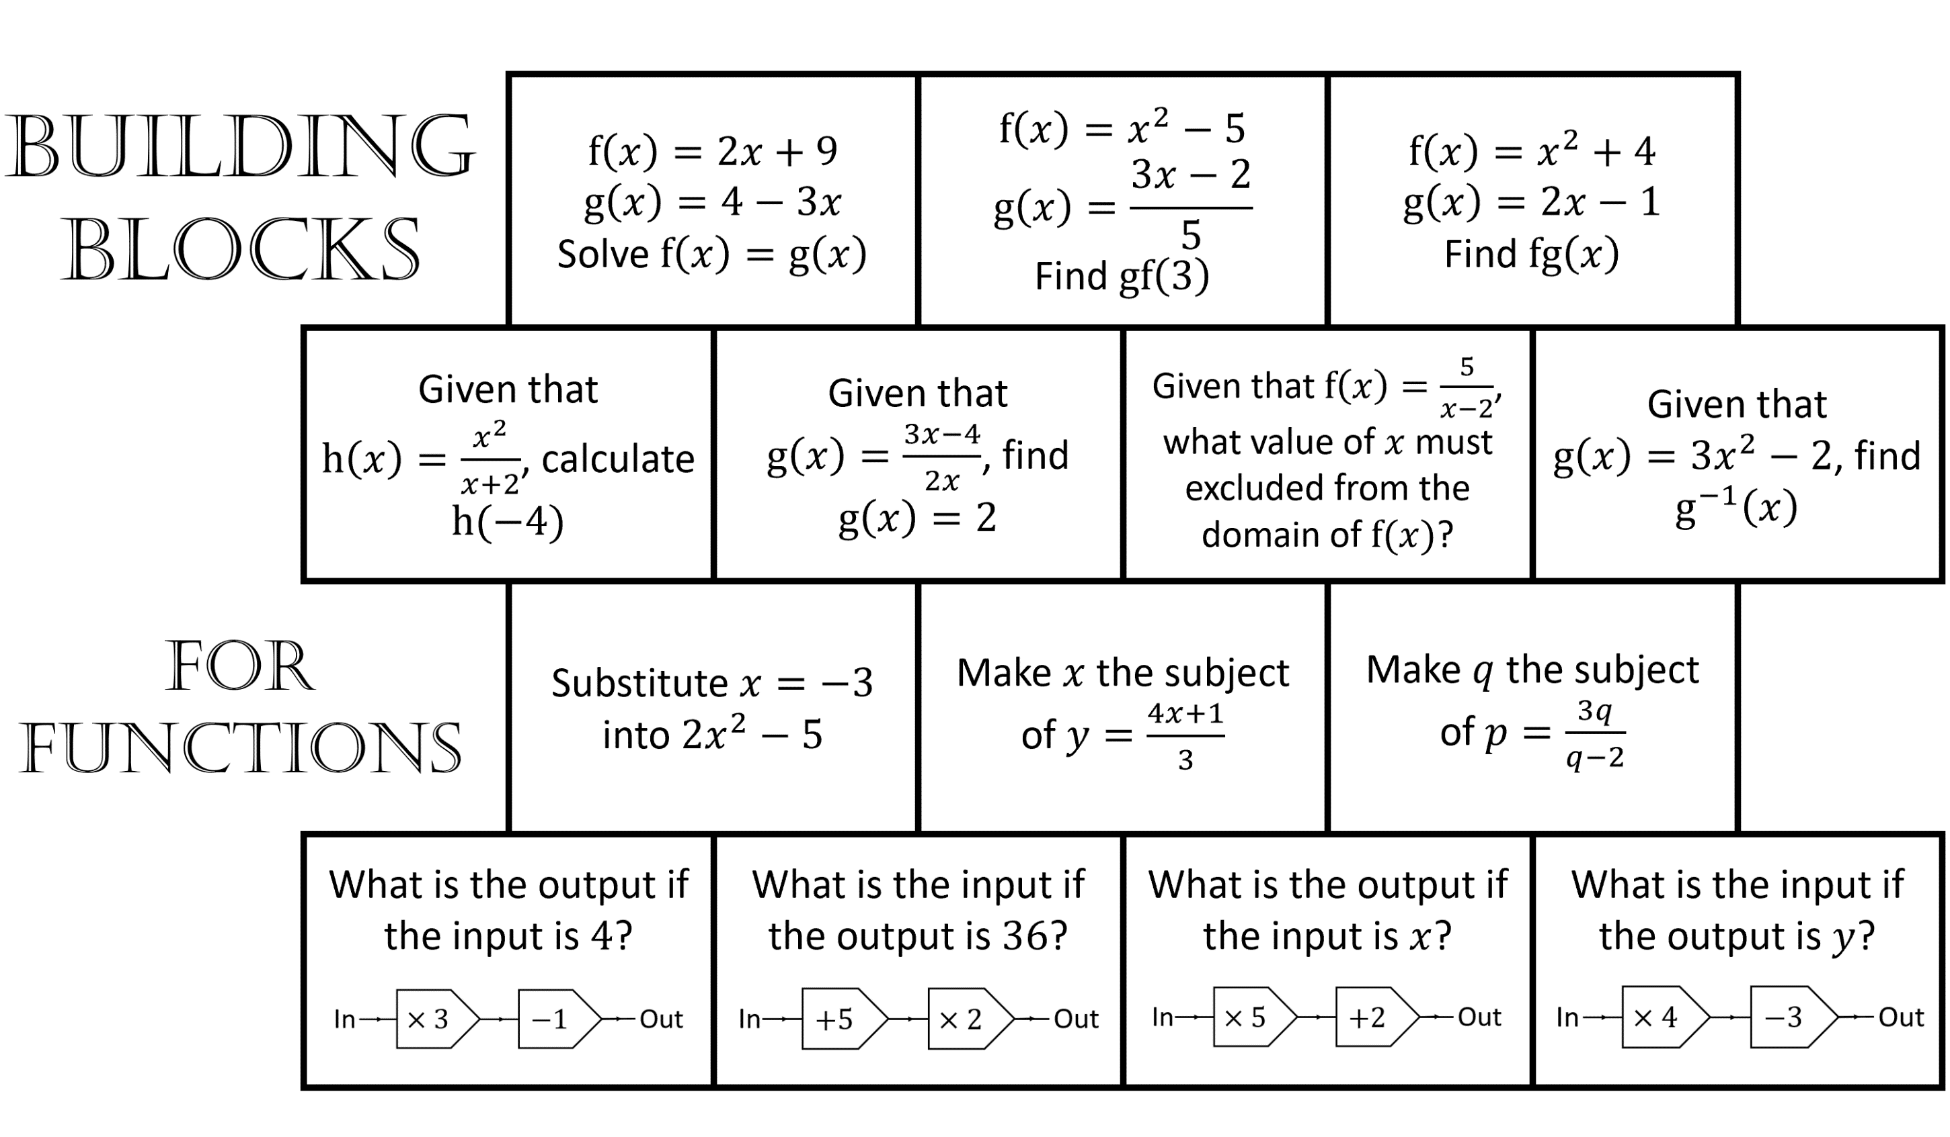
Functions – building blocks
Credit:: Andy Lutwych/TES CC-BY-SA https://creativecommons.org/licenses/by-sa/4.0/

Slide 17
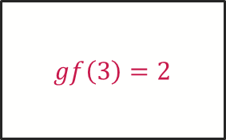
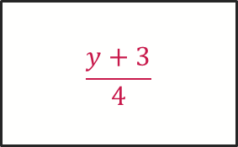
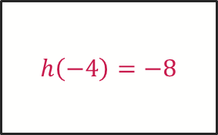
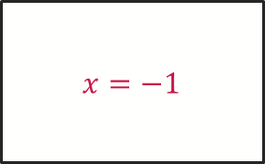
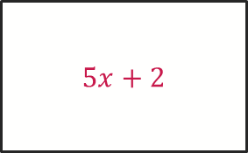
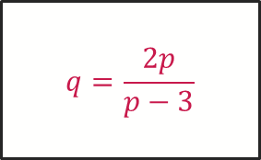
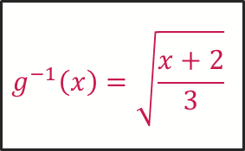

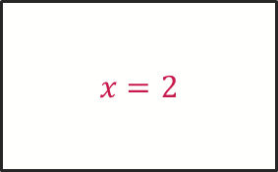
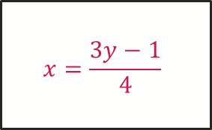

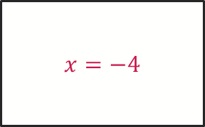
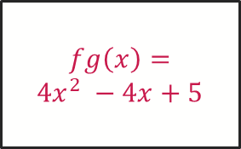

Functions – building blocks
$$x=−1$$
$$gf\left(3\right)=2$$
$$fg\left(x\right)=$$
$$4x^{2} −4x+5$$
Building blocks
answers
$$h\left(−4\right)=−8$$
$$x=−4$$
$$x=2$$
$$g^{−1}\left(x\right)=\sqrt{\frac{x+2}{3}}$$
$$13$$
$$x=\frac{3y−1}{4}$$
$$q=\frac{2p}{p−3}$$
For functions
$$11$$
$$13$$
$$5x+2$$
$$\frac{y+3}{4}$$

Slide 18
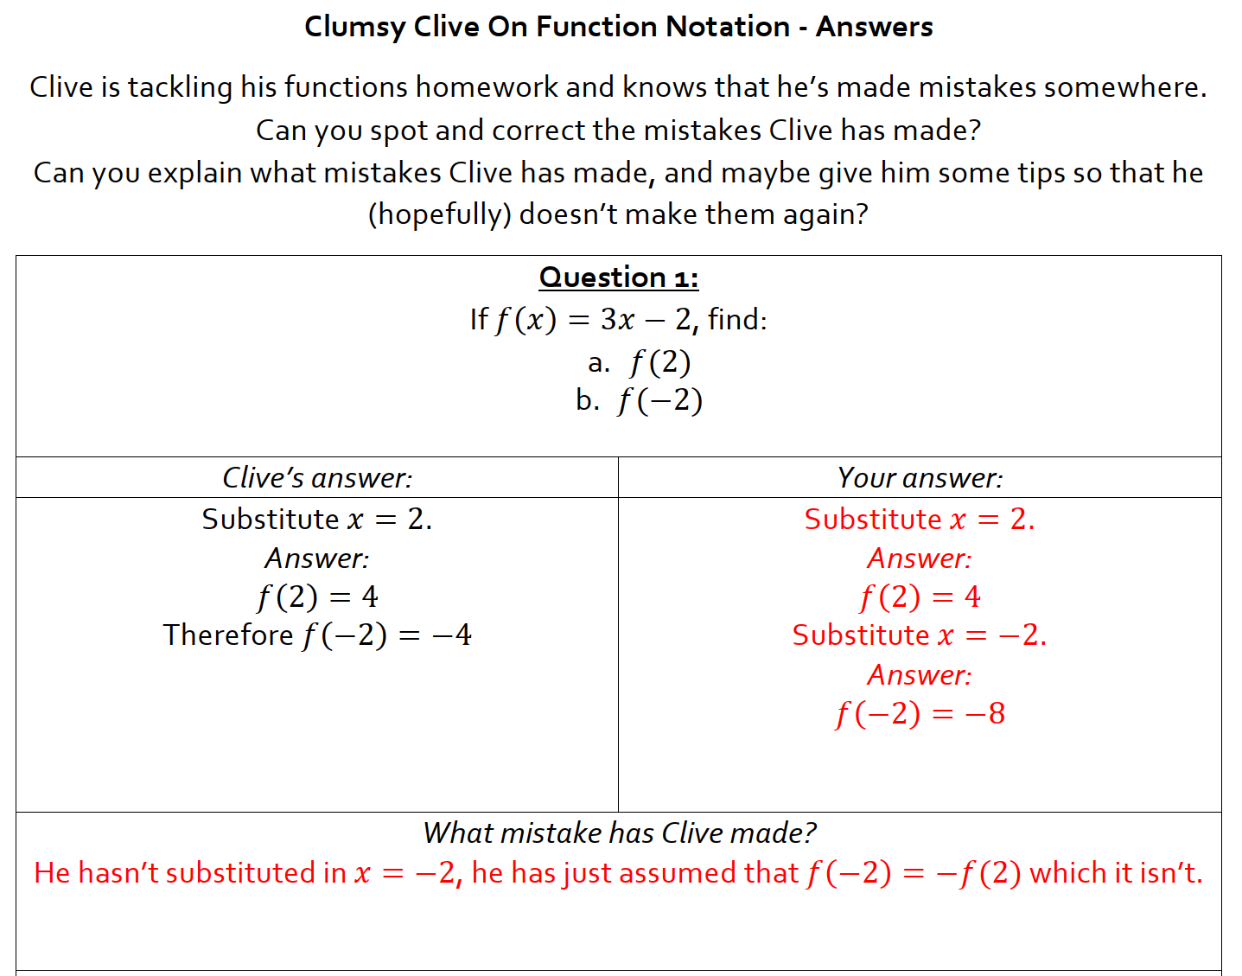
Spot the mistake – Andy Lutwyche
Credit: Andy Lutwych/TES CC-BY-SA https://creativecommons.org/licenses/by-sa/4.0/

Slide 19
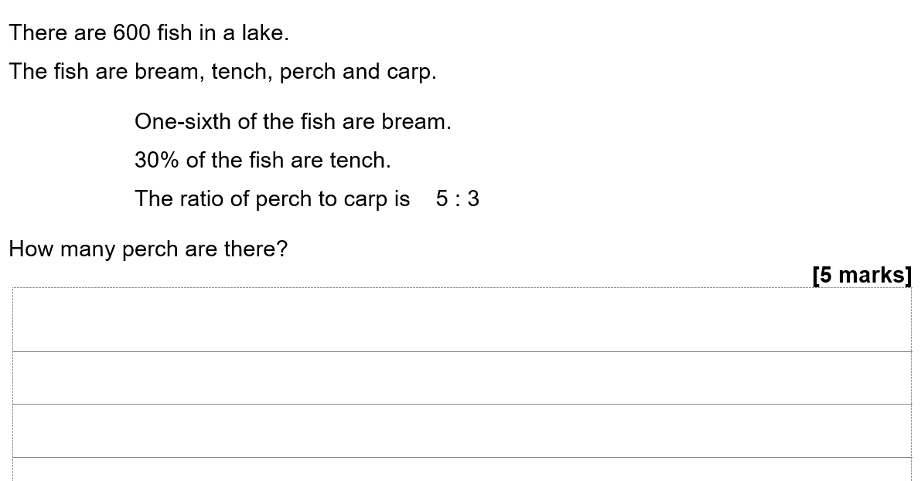
AQA Key Stage 3 tests for Years 7, 8 and 9

Slide 20
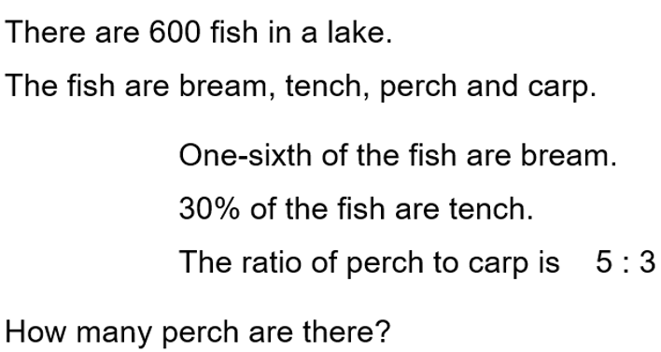
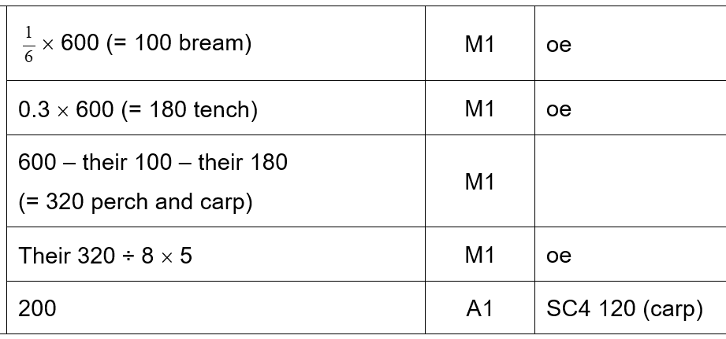
AQA Key Stage 3 tests for Years 7, 8 and 9

Slide 21
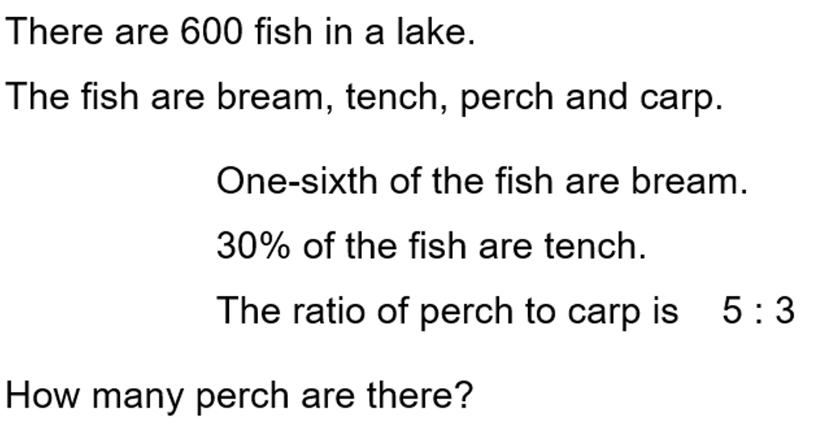
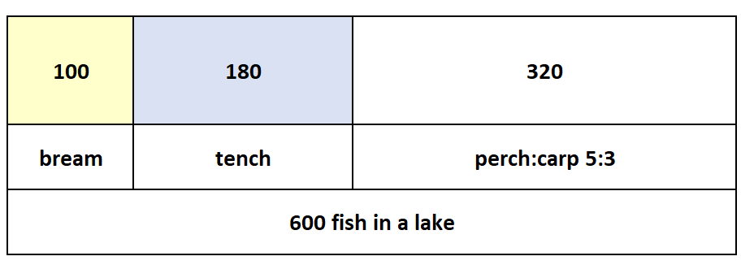
AQA Key Stage 3 tests for Years 7, 8 and 9
Please see page 5 of the booklet for an answer worth full marks.

Slide 22
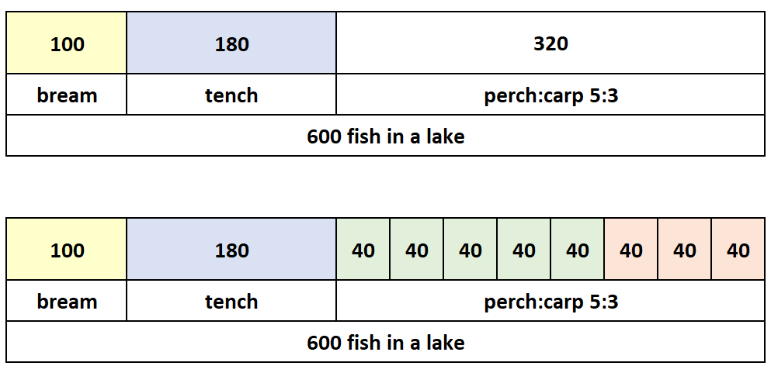
AQA Key Stage 3 tests for Years 7, 8 and 9

Slide 23
GCSE – KS4

Slide 24
GCSE – KS4
90 maths problem-solving questions
GCSE exam questions
Additional resources

Slide 25
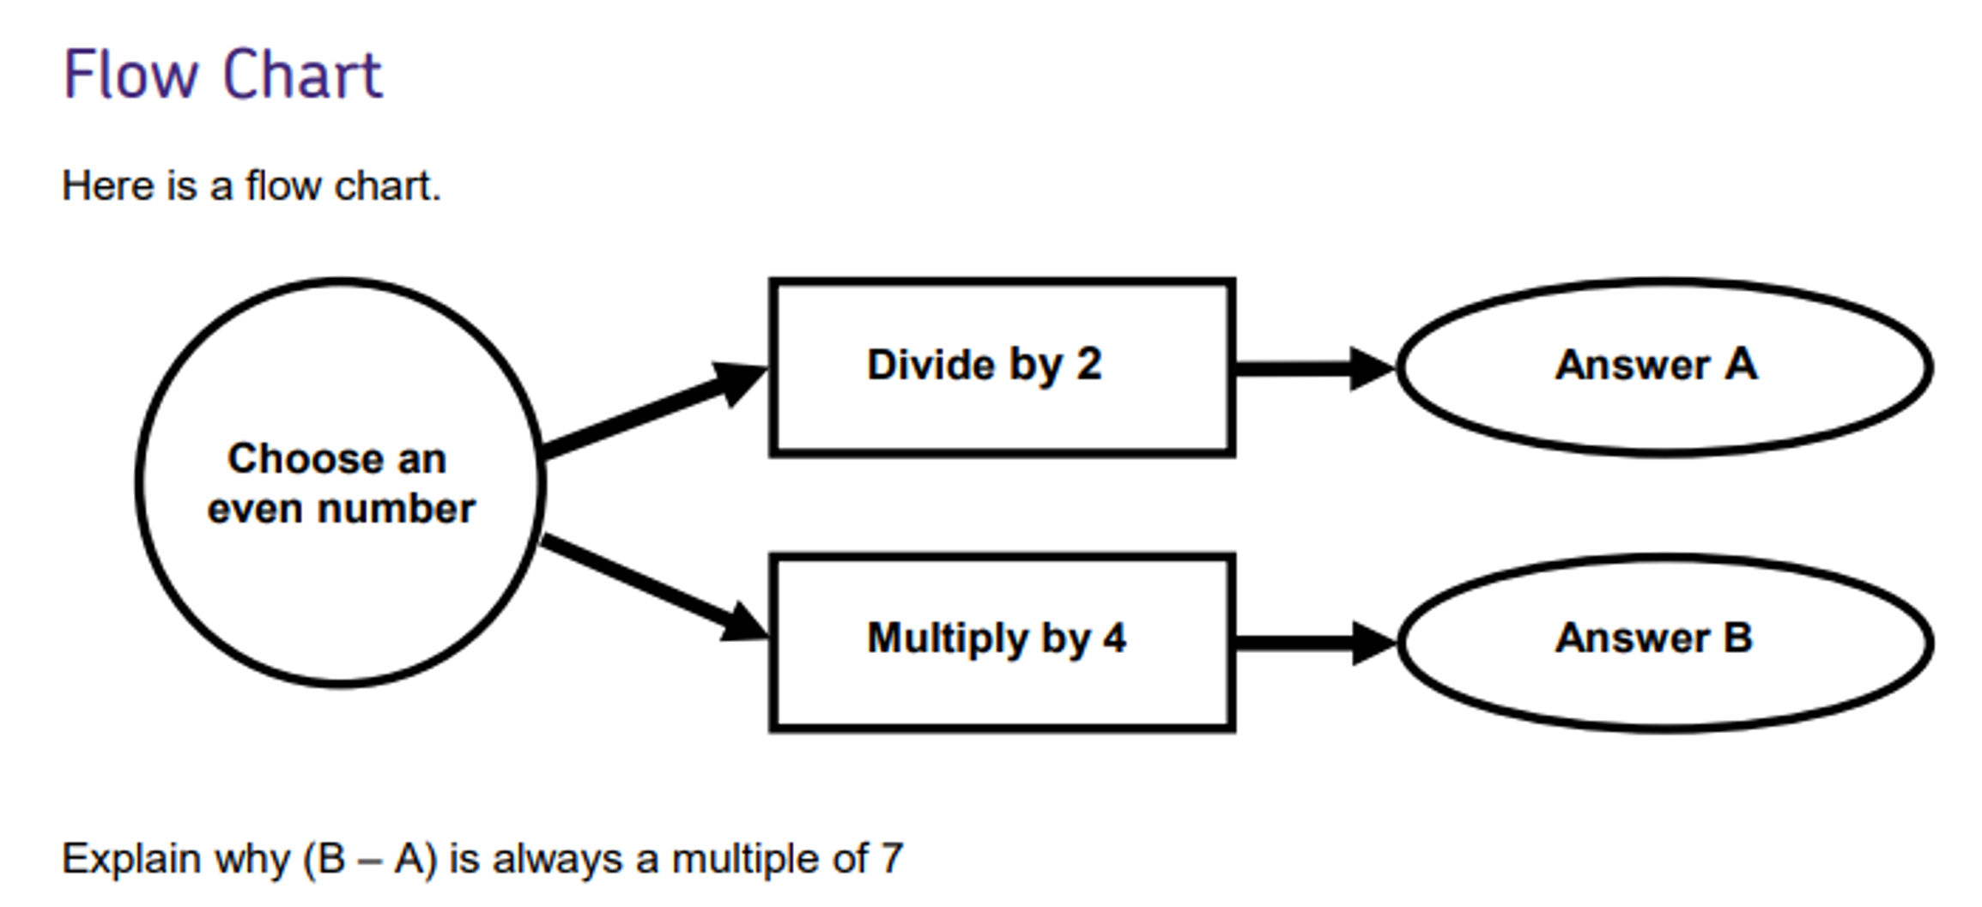
AQA GCSE: 90 maths problem-solving questions

Slide 26
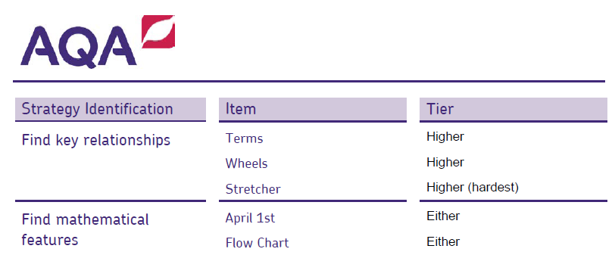
AQA GCSE: 90 maths problem-solving questions
The five strategies of the resource
1 Set out cases
2 Work back familiar; work back unfamiliar
3 Find an example to fit
4 Find key relationships
5 Find mathematical features

Slide 27
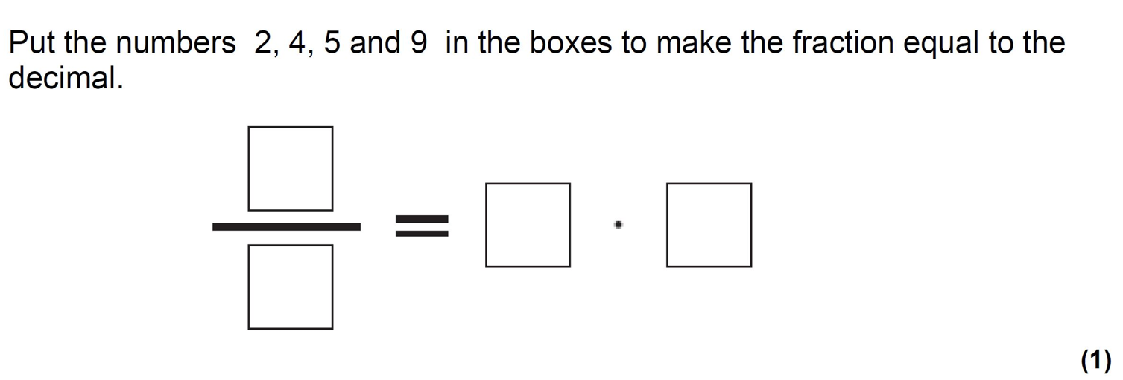
GCSE: Completion tasks

Slide 28
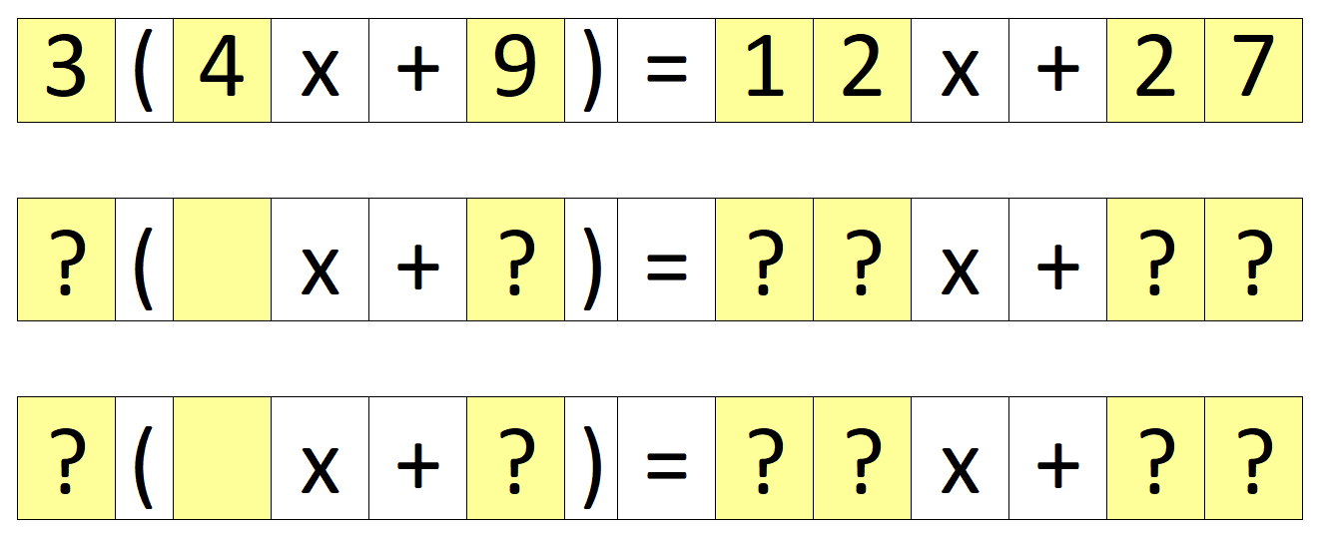
GCSE: Completion tasks

Slide 29
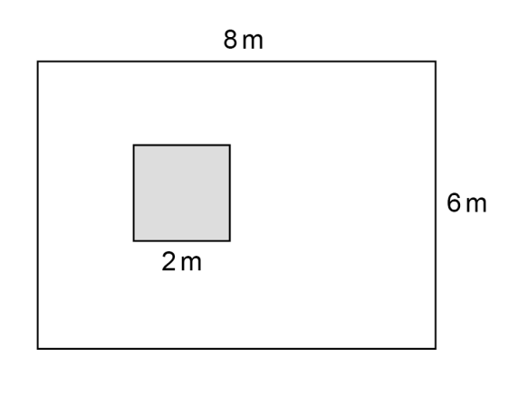
Here’s the diagram, what’s the question?

Slide 30
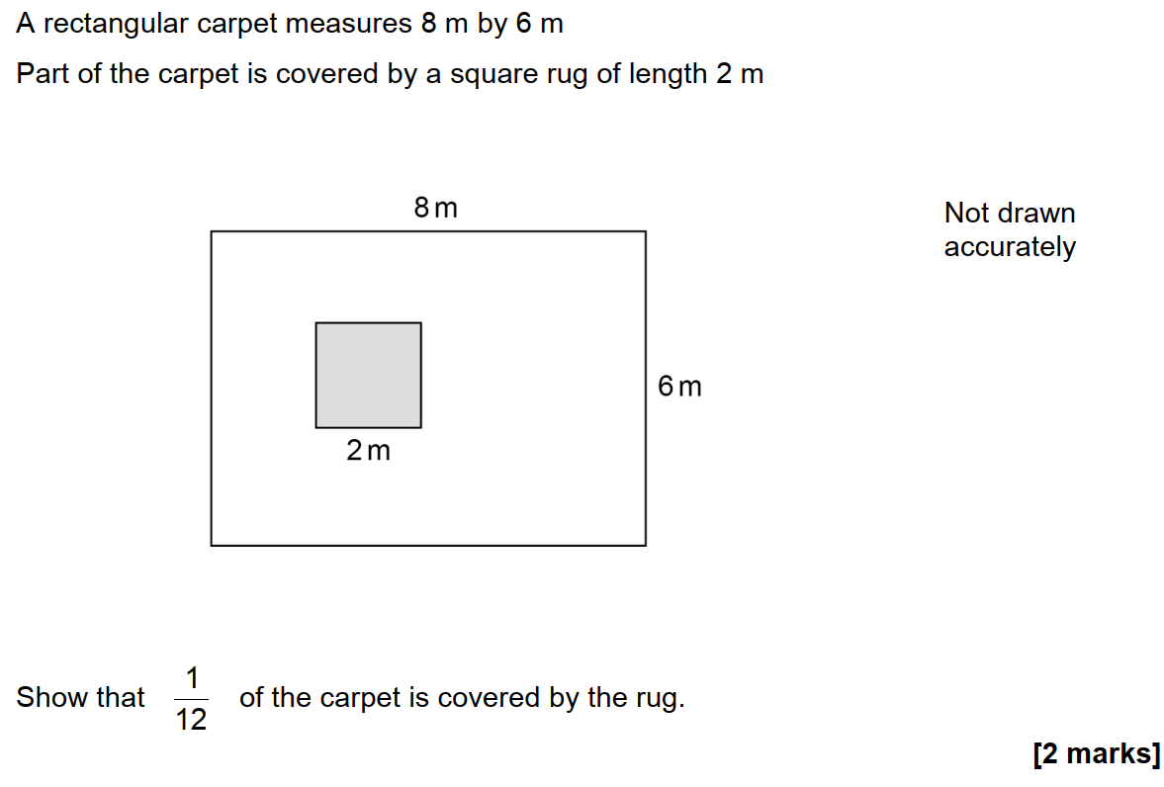
Here’s the diagram, what’s the question?

Slide 31
The answer is, what was the question?
Credit:: Andy Lutwych/TES CC-BY-SA https://creativecommons.org/licenses/by-sa/4.0/

Slide 32
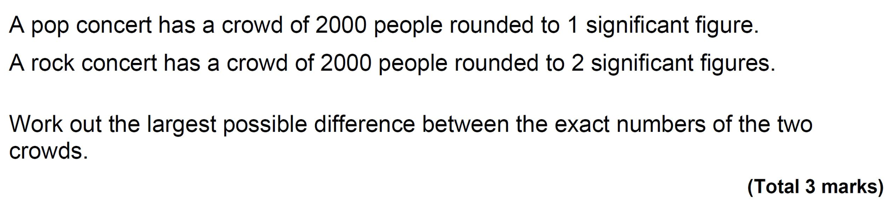
GCSE: Foundation

Slide 33
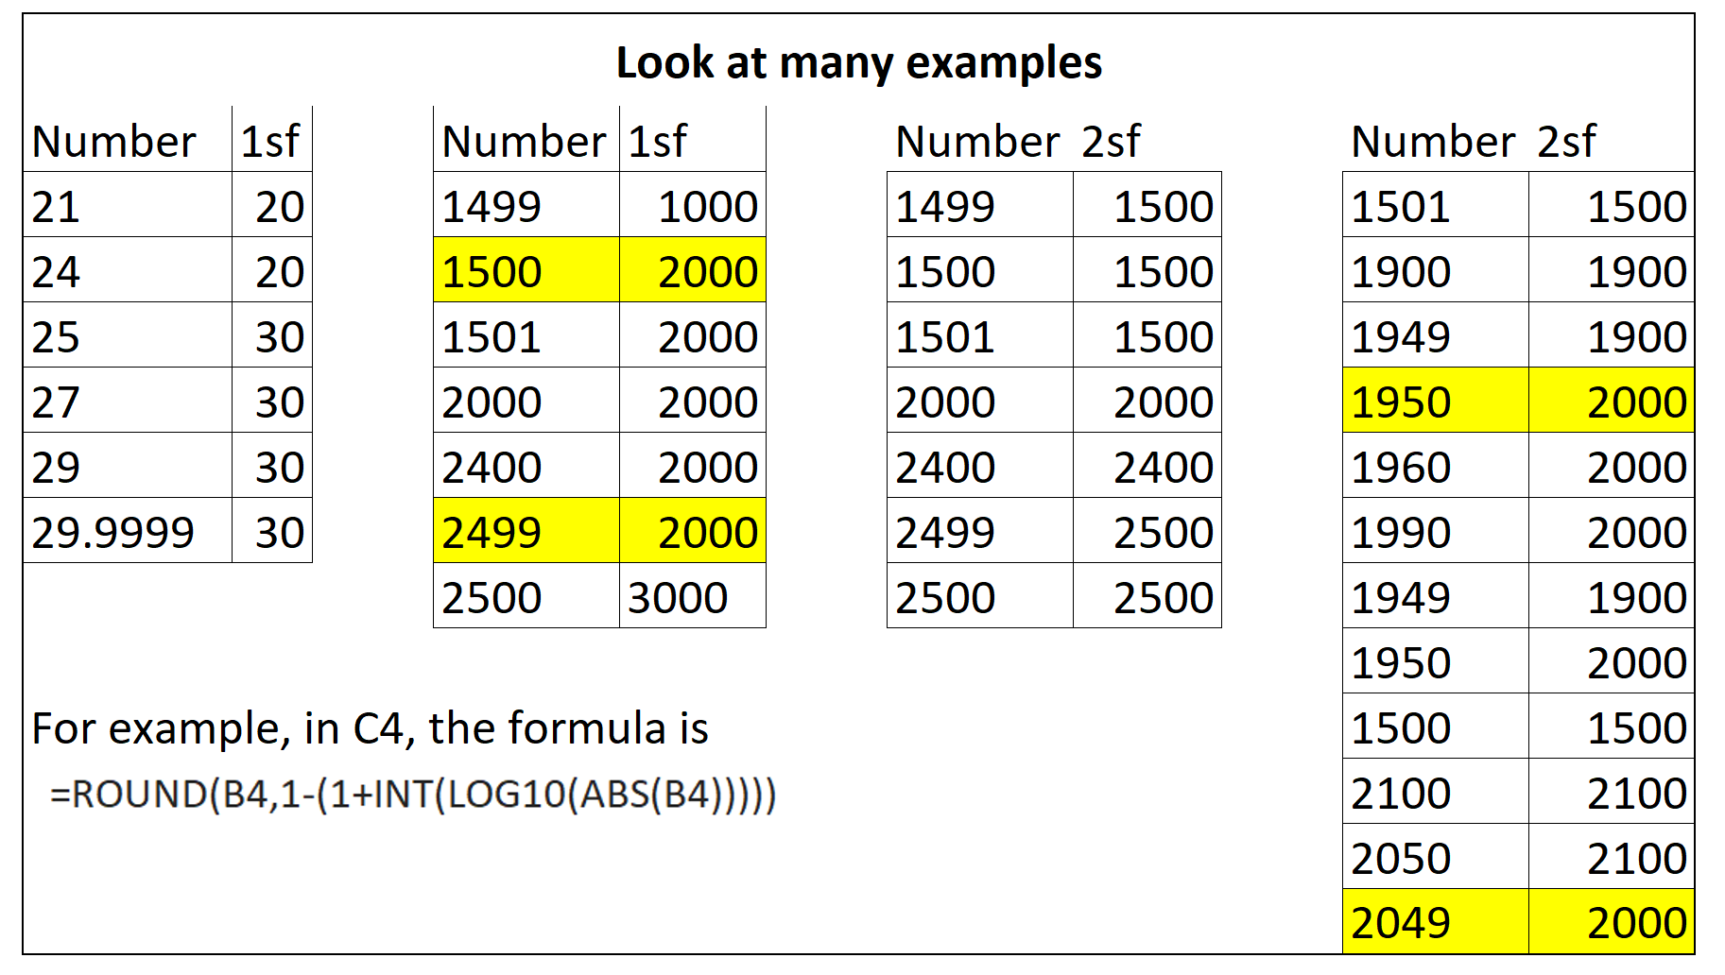
GCSE: Foundation

Slide 34
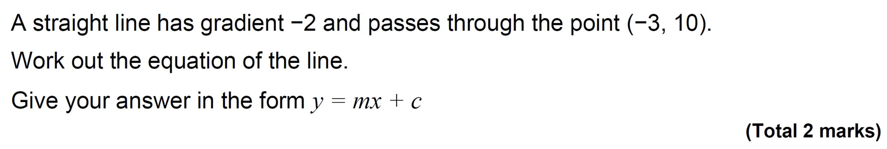
GCSE: Foundation

Slide 35
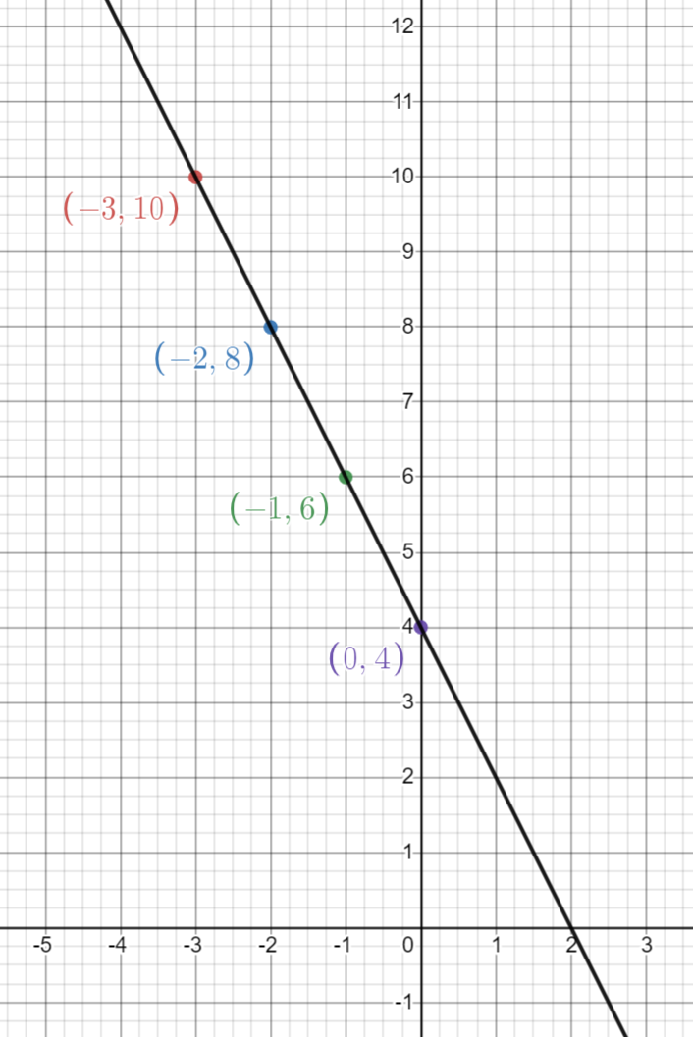
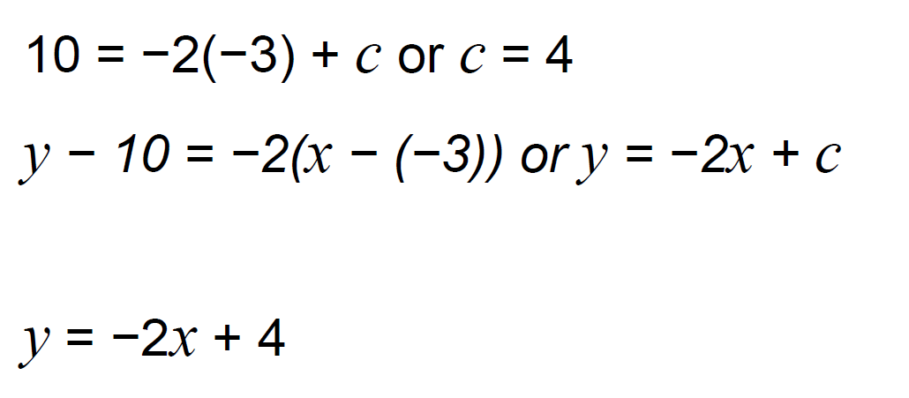
GCSE: Foundation

Slide 36
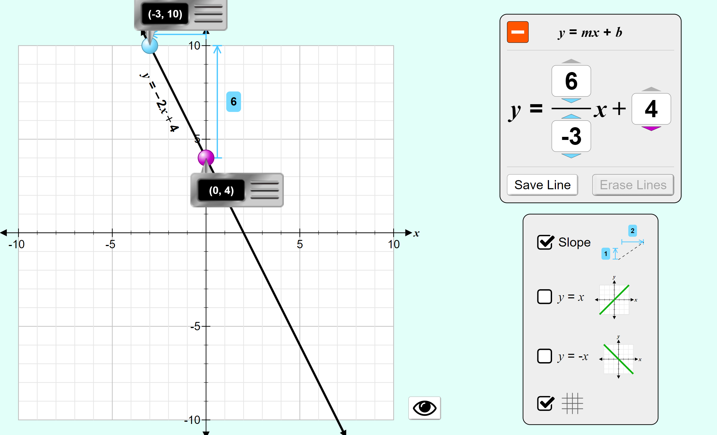
GCSE: Use of technology – PhET Sims
Credit:: PhET Interactive Simulations University of Colorado Boulder https://phet.colorado.edu Creative Commons Licence CC-BY v4.0

Slide 37
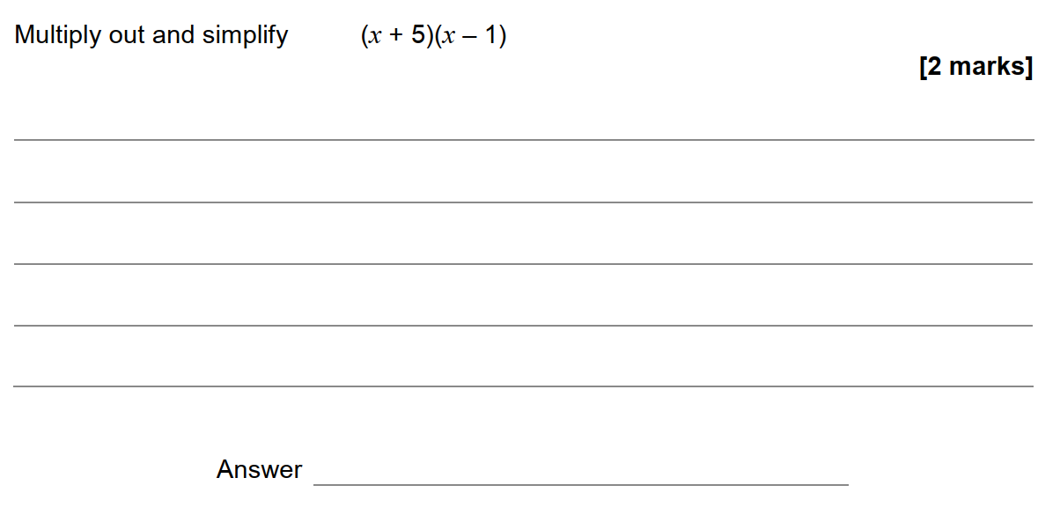
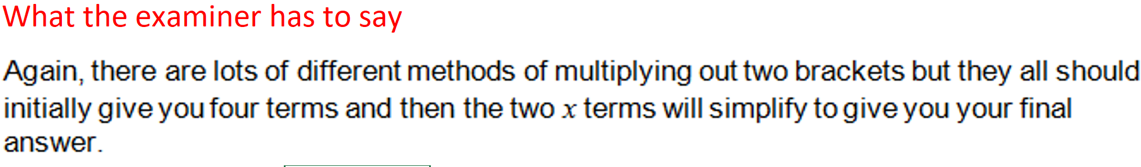
GCSE Foundation

Slide 38
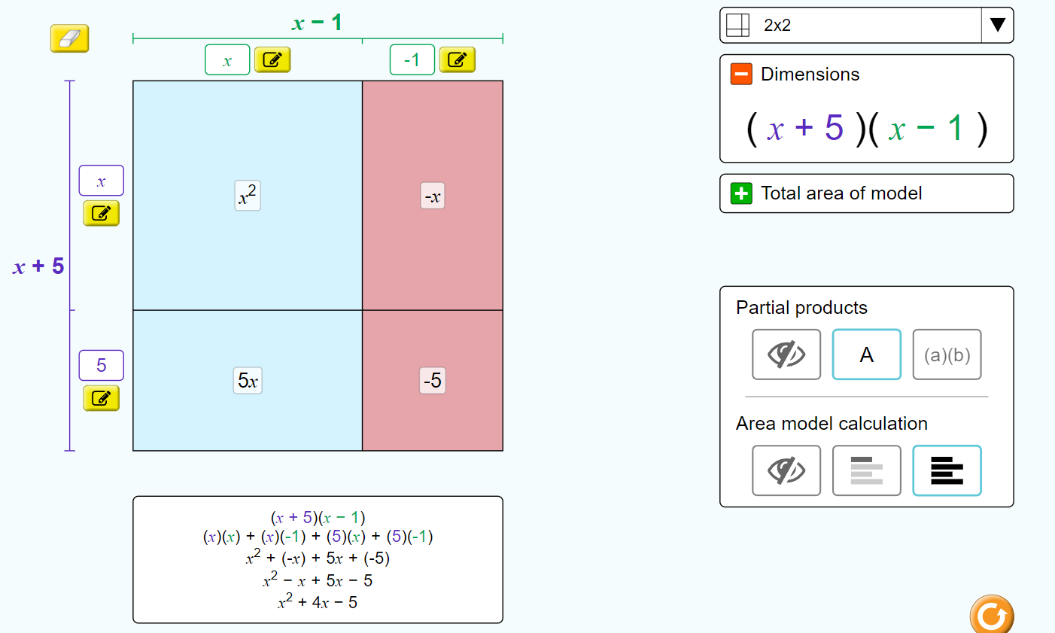
GCSE: Use of technology – PhET Sims
Credit:: PhET Interactive Simulations University of Colorado Boulder https://phet.colorado.edu Creative Commons Licence CC-BY v4.0

Slide 39
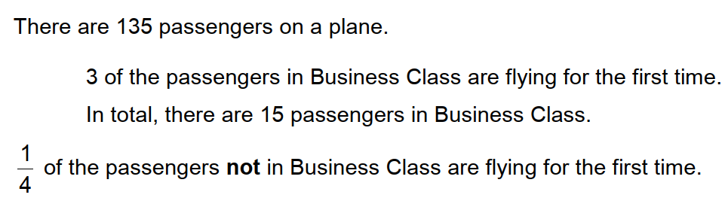
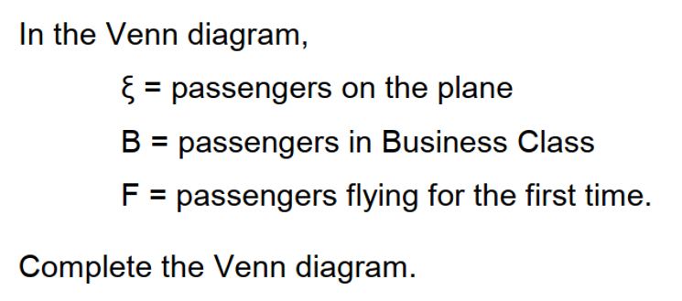
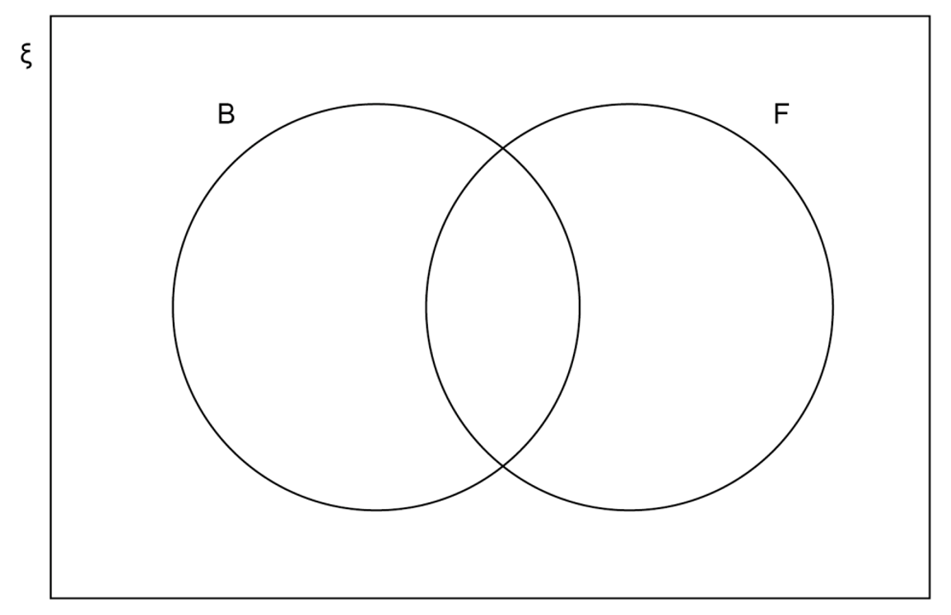
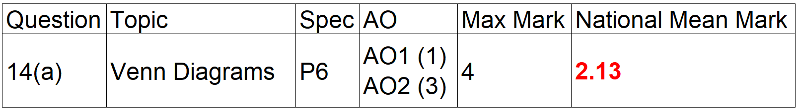
GCSE Foundation – Venn diagrams

Slide 40
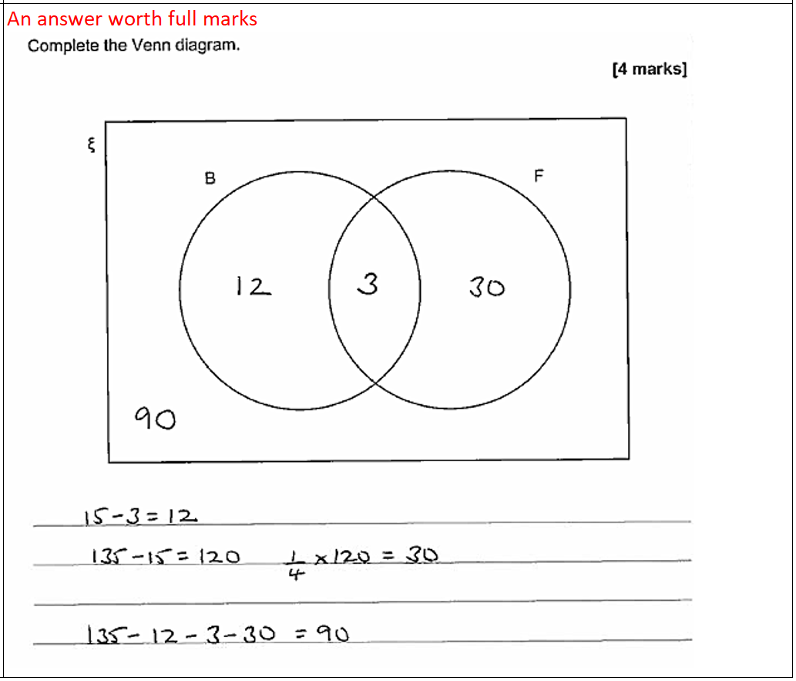
GCSE Foundation – Venn diagrams
What the examiner has to say
The overlap of the circles is for people in Business class who are flying for the first time so the 3 passengers go there. The total in B is 15 but you already have 3 in the overlap, so work out how many go in the other part of the B circle. You need to work out ¼ of the 120 passengers who are not in Business class and put that value in the right-hand part of F. All four values in the diagram must add up to 135, so you can work out the remaining number to put outside the circles but inside the rectangle.

Slide 41
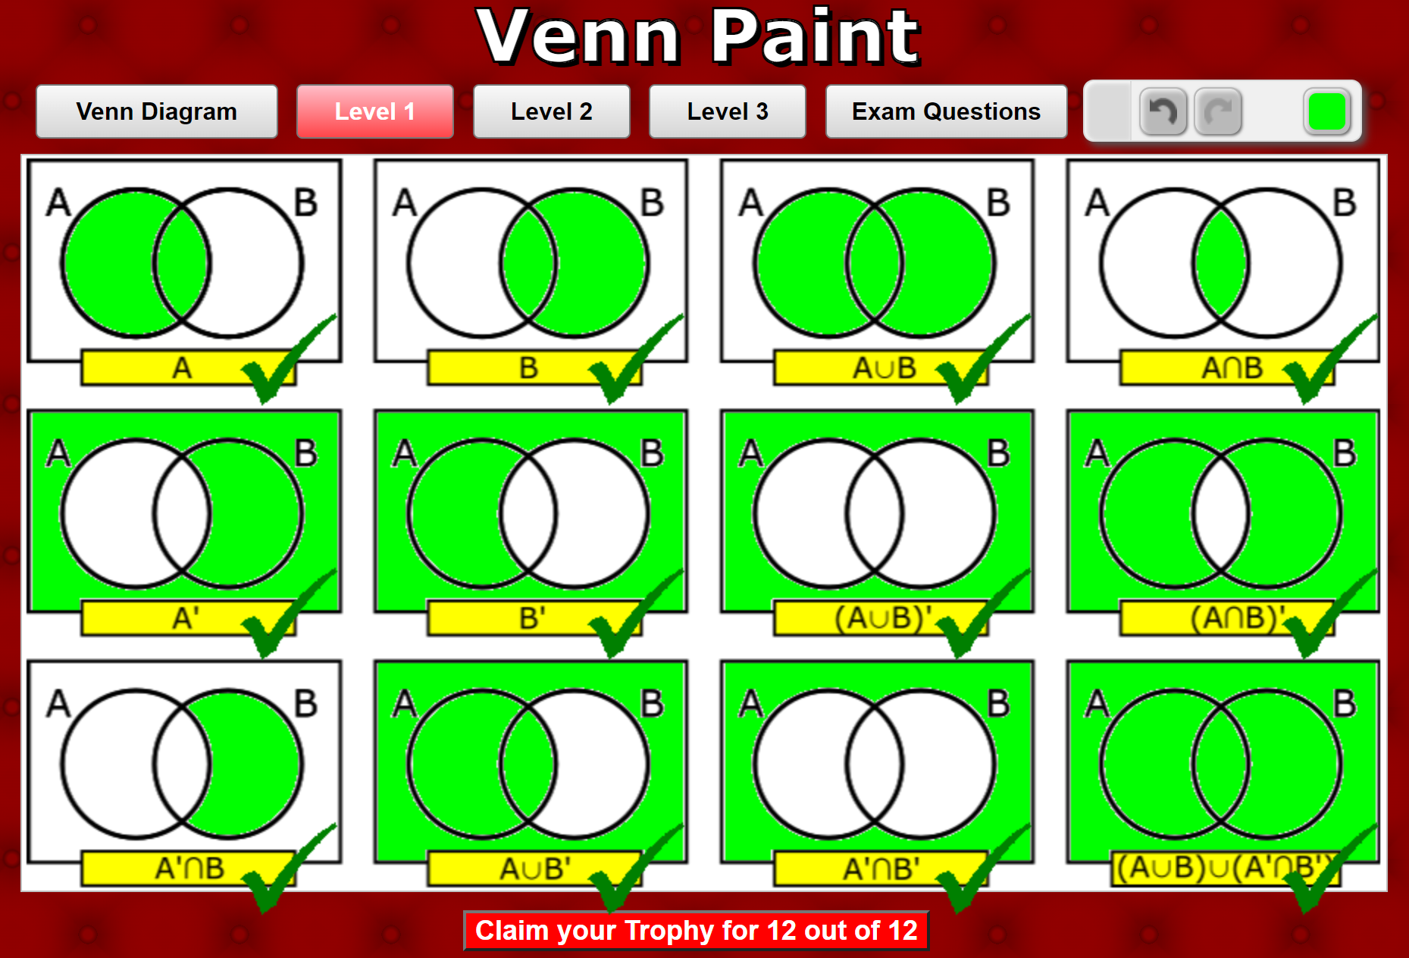
Transum mathematics – Venn diagrams
Transum Mathematics
Credit: www.transum.org

Slide 42



GCSE Higher – inequalities

Slide 43

GCSE Higher – inequalities
© Autograph

Slide 44


GCSE Higher – inequalities
Powered by Desmos

Slide 45

GCSE – inequalities
Credit:: Andy Lutwych/TES CC-BY-SA https://creativecommons.org/licenses/by-sa/4.0/

Slide 46

GCSE methods in Mathematics (legacy, linked pair)

Slide 47

GCSE methods in Mathematics (legacy, linked pair)

Slide 48

GCSE methods in Mathematics (legacy, linked pair)

Slide 49


Change the numbers…

Slide 50

Any questions?
What are your takeaways from today?

Slide 51

Resources
Take advantage of our extra resources in our handy maths resource guide:
filestore.aqa.org.uk/subjects/AQA-GCSE-MATHS-HANDY-RESOURCES.PDF

Slide 52
Get in touch
Our friendly team will be happy to support you between 8am and 5pm, Monday to Friday.
Tel: 0161 957 3852
Email: maths@aqa.org.uk
Twitter: @AQAMaths
aqa.org.uk

Slide 53
Thank you

