Slide 1
#MathsConf29: Progress your highest attainers towards A-level success with L2FM
Ian Andrews
Summer 2022
Notes:
Please feel free to try some of the questions in the resources booklet before we begin.

Slide 2
Welcome

Slide 3
Agenda
Introduction
Overview of Level 2 Further Mathematics
Spot the specification
How I have taught Level 2 Further Maths alongside the Mathematics GCSE
Overview of content alongside the GCSE
Resources to use
Taking a look through the papers
Summary and Q&A

Slide 4
Introduction: Ian Andrews
Maths and Statistics graduate
Maths teacher since 2007
Full time Head of department since 2015 in an 11–18 comprehensive in West Sussex
AQA Chair of examiners for GCSE Maths, GCSE Statistics and Level 2 Further maths since 2019 (part-time role)
Offered and taught Level 2 Further Maths for around 10 years

Slide 5
Overview of Level 2 Further Mathematics

Slide 6
Overview of Level 2 Further Mathematics
Level 2 qualification – GCSE standard level of difficulty
Two exams (calculator and non-calculator) – each is 1 hour 45 minutes
Awarded grades 5 to 9 (4 as a safety net)
Subject content
Number
Algebra
Coordinate geometry (2 dimensions only)
Calculus
Matrix transformations
Geometry
All the topics are included in, or extensions of, the GCSE Mathematics content, with the exceptions of calculus and matrices.

Slide 7
Why choose our Level 2 Certificate in Further Mathematics?
This qualification fills the gap for high-achieving students by assessing their higher order mathematical skills – particularly in algebraic reasoning – in greater depth.
It offers the opportunity for stretch and challenge that builds on the Key Stage 4 curriculum, and is intended as an additional qualification to the GCSE Mathematics.
This qualification places an emphasis on higher order technical proficiency, rigorous argument and problem solving skills.
The AQA Level 2 Certificate in Further Mathematics is an untiered Level 2 linear qualification for learners who:
either already have, or are expected to achieve, grades 7, 8 and 9 in GCSE Mathematics
are likely to progress to A-level study in Mathematics and possibly Further Mathematics.

Slide 8
Why I have offered Level 2 Further Maths in my school?
The qualification offers a good level of challenge and an additional qualification for high attaining KS4 students.
I believe it helps consolidate and improve their maths GCSE performance, even if they don’t sit the exam.
The content really helps students to span the gap from GCSE to A-level. Some of the questions are certainly AS level quality.
Allows students to see differentiation in year 11 and even some further maths in matrices.
It’s very easy to teach alongside the main GCSE as the topics are complimentary – the question style is very similar to the AQA GCSE Maths but also fine for other boards.
It’s a good opportunity to extend staff’s subject knowledge.

Slide 9
Key benefits to future A-level students
Improved algebraic proficiency.
Focus on pure maths and problem solving.
Early opportunity to do differentiation.
Harder questions and content improves their pure knowledge for the GCSE and consolidates or boosts their grade.
Gives students an early taste of A-level style questions – good early way to promote A-level Maths and boost uptake.

Slide 10
Spot the specification

Slide 11
Is the question from GCSE, Level 2 Further Mathematics or AS level?
The following slides show questions either from GCSE Maths, Level 2 Further Mathematics or AS level Mathematics exam papers.
You need to vote on whether the question is from:
GCSE Maths
Level 2 Further Maths
AS level maths

Slide 12
Topic 1: Surds

Slide 13
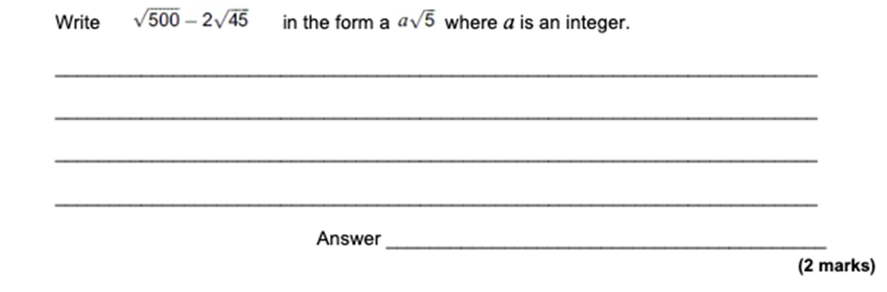
Question 1
A: GCSE B: L2 C: AS

Slide 14
Question 1: Q11, Paper 1, Jan 2013
A: GCSE B: L2 C: AS
Notes:
Q13W.1.11
2013 January Paper 1 Q11

Slide 15
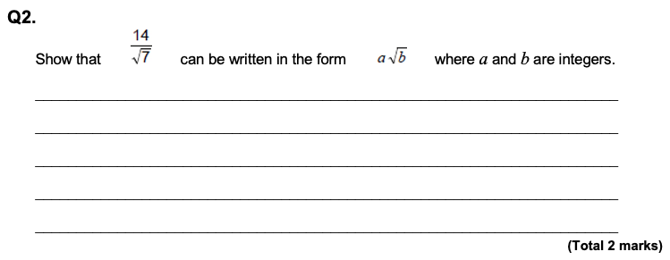
Question 2
A: GCSE B: L2 C: AS

Slide 16
Question 2: Q26a, Paper 1H, Nov 2020
A: GCSE B: L2 C: AS
Notes:
Q20.1H.26.A
2020 Paper 1H Q26a

Slide 17
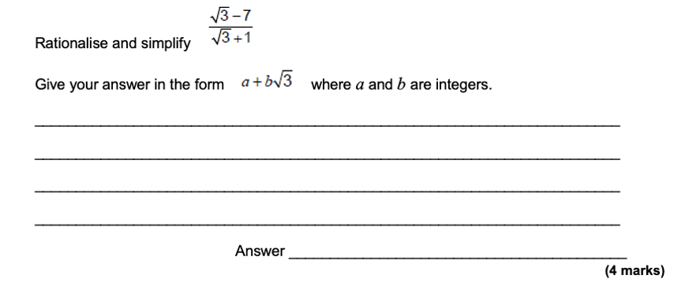
Question 3
A: GCSE B: L2 C: AS

Slide 18
Question 3: Q14, Paper 1, Specimen Papers
A: GCSE B: L2 C: AS
Notes:
QSP.1.14
Specimen Papers Paper 1 Q14

Slide 19
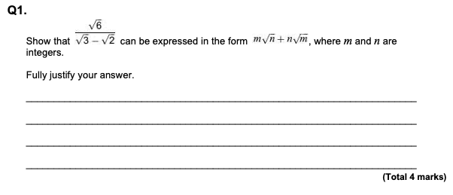
Question 4
A: GCSE B: L2 C: AS

Slide 20
Question 4: Q4, Paper 1, June 2019
A: GCSE B: L2 C: AS
Notes:
Q19.S1.04
2019 paper 1 Q4

Slide 21
Topic 2: Indices

Slide 22
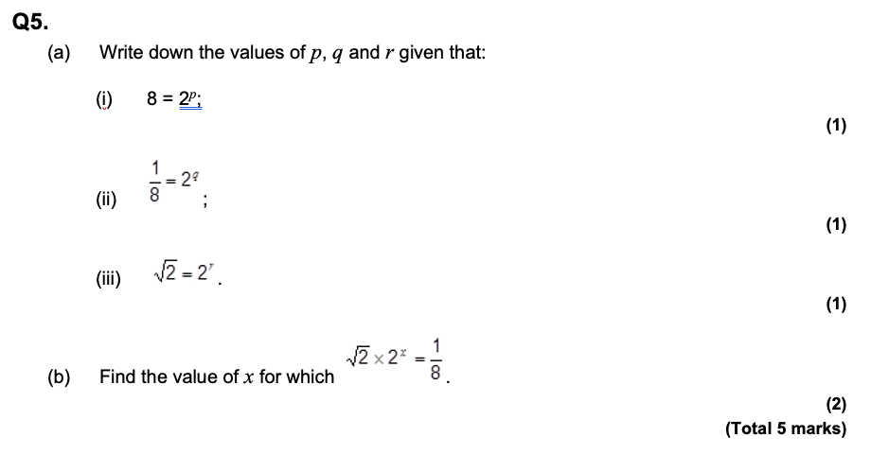
Question 1
A: GCSE B: L2 C: AS

Slide 23
Question 1: Q2, Pure Core 2 (MPC2), Jan 2011
A: GCSE B: L2 C: AS
Notes:
QCO11W.C2.02
Pure Core 2 (MPC2) 2011 January Q2

Slide 24
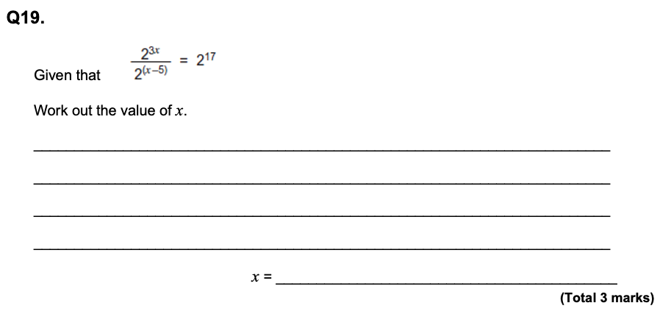
Question 2
A: GCSE B: L2 C: AS

Slide 25
Question 2: Q9, Linked pair methods (9356) Paper 1HA, Jan 2013
A: GCSE B: L2 C: AS
Notes:
Q13W.L1HA.09
Linked pair methods (9356) 2013 January Paper 1HA Q9

Slide 26
Question 3
A: GCSE B: L2 C: AS

Slide 27
Question 3: Q5, Paper 1, June 2012
A: GCSE B: L2 C: AS
Notes:
Q12.1.05
2012 paper 1 Q5

Slide 28
Question 4
A: GCSE B: L2 C: AS

Slide 29
Question 4: Q1a , Specimen Paper 1
A: GCSE B: L2 C: AS
Notes:
QSP.1.01A
Specimen Paper 1 Q1a

Slide 30
Topic 3: Circle geometry

Slide 31
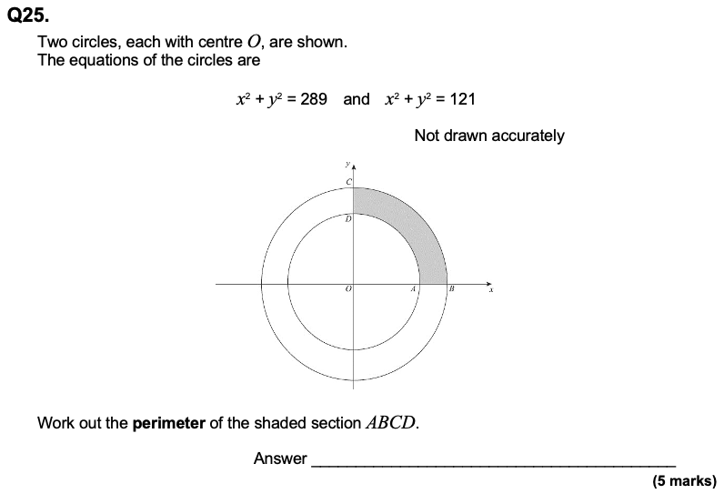
Question 1
A: GCSE B: L2 C: AS

Slide 32
Question 1: Q6, Paper 2, June 2014
A: GCSE B: L2 C: AS
Notes:
Q14.2.06
2014 Paper 2 Q6

Slide 33
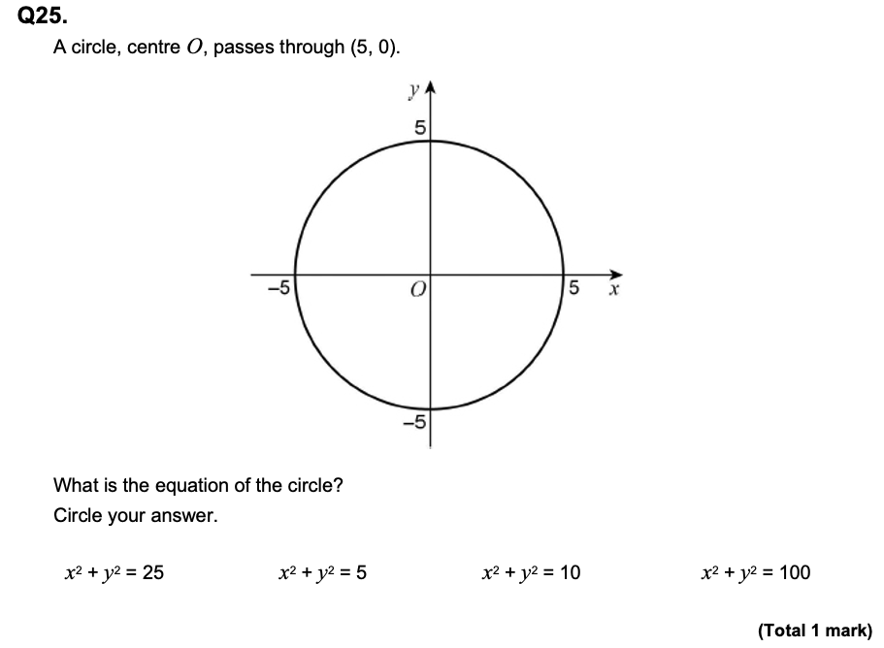
Question 2
A: GCSE B: L2 C: AS

Slide 34
Question 2: Q22, Paper 2H, June 2018
A: GCSE B: L2 C: AS
Notes:
Q18J.2H.22
2018 June Paper 2H Q22

Slide 35
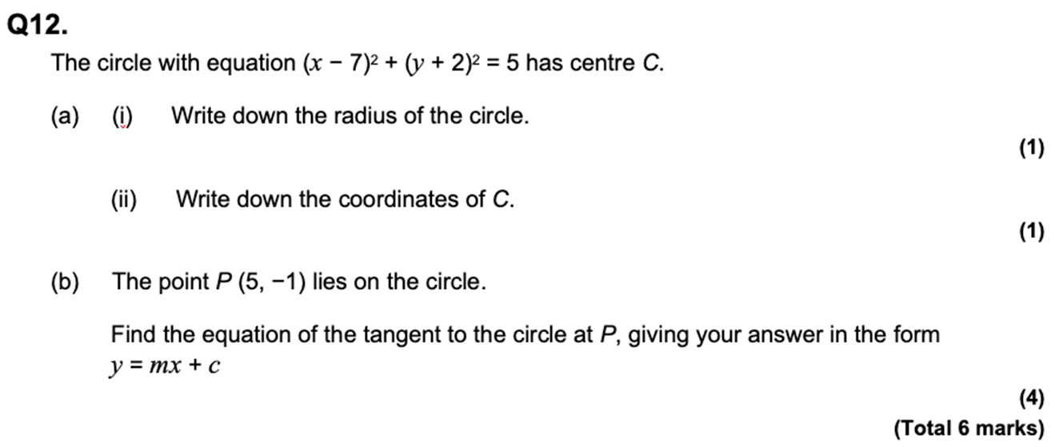
Question 3
A: GCSE B: L2 C: AS

Slide 36
Question 3: Q11, Paper 2, Specimen
A: GCSE B: L2 C: AS
Notes:
QSP7356.2.11
Specimen Paper 2 Q11

Slide 37
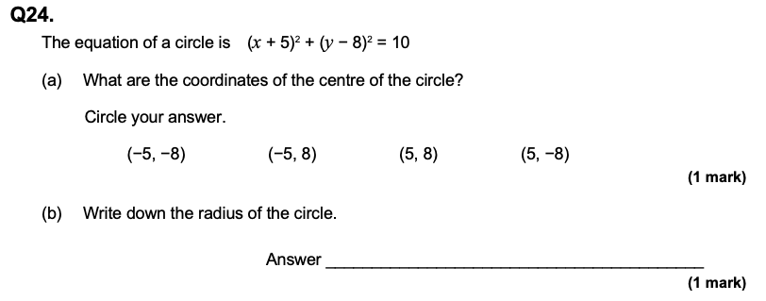
Question 4
A: GCSE B: L2 C: AS

Slide 38
Question 4: Q4, Paper 1, June 2016
A: GCSE B: L2 C: AS
Notes:
Q16.1.04
2016 Paper 1 Q4

Slide 39
How did you do?
Questions can overlap GCSE and AS level type questions.
Similar styles across all specifications helps students.
They are Level 2 standard, so they’re very accessible.
Minimum grade 5 (with 4 as a safety net) – students gaining grade 7 or above on the GCSE Maths should grade comfortably on the Level 2 Further Maths.

Slide 40
How I have taught Level 2 Further Maths?

Slide 41
Taught alongside the GCSE with exams optional
Level 2 Further Maths can be used primarily as extension material for the top sets.
It’s always taught alongside the main GCSE. It’s good to have a separate exercise book for the specific L2 Further Maths content.
All top set students cover the majority of the course. The final exams are optional.
Students sit a mock in December in Year 11 – most are surprised at how well they do.
We have around three quarters of the top sets opting to take the exam.
Revising for GCSE Maths alone prepares them for over half the Further Maths exam.

Slide 42
Overview of content

Slide 43
GCSE Maths and Level 2 Further Maths content
The following slides show a top level overview of topics and where I have them in the scheme of work.
The highlighted sections are where the content goes slightly beyond the GCSE content.
The final topics of calculus and matrices are taught late in Year 11, potentially in after school sessions depending on time.

Slide 44
GCSE Maths and Level 2 Further Maths content
GCSE Topic | Additional FM
Expanding double/triple brackets | Expand using Pascal’s triangle
Solving/factorising quadratics | Factor theorem
Indices | More complicated indices and solving
Surds | More challenging rationalising the denominator
3D Pythagoras and trig | Find the angle between line and a plane or two planes
Ratio | Harder problems involving ratio
Coordinate Geometry | Harder questions. Good to use $y−y_{1}=m(x−x_{1})$ from A-level
Circle Theorems | Harder proof questions
Completing the square | Include coefficients of x² greater than 1
Simultaneous equations | Solve equations with three unknowns
Inequalities | Harder inequality questions
Growth and decay | Include $y=ab^{x}$ and $y=ab^{−x}$
Sequences | Harder sequence questions

Slide 45
GCSE Maths and Level 2 Further Maths content
GCSE Topic | Additional FM
Expanding double/triple brackets | Expand using Pascal’s triangle
Solving/ factorising quadratics | Factor theorem
Indices | More complicated indices and solving
Surds | More challenging rationalising the denominator
3D Pythagoras and trig | Find the angle between line and a plane or 2 planes
Ratio | Harder problems involving ratio
Coordinate Geometry | Harder questions. Good to use $y−y_{1}=m(x−x_{1})$ from A level
Circle theorems | Harder proof questions
Completing the square | Include coefficients of x² greater than 1
Simultaneous equations | Solve equations with 3 unknowns
Inequalities | Harder inequality questions
Growth and decay | Include $y=ab^{x}$ and $y=ab^{−x}$
Sequences | Harder sequence questions

Slide 46
GCSE Maths and Level 2 Further Maths content
GCSE Topic | Additional FM
Equation of a circle | Include where centre is not (0,0)
Proof and Functions | Understanding domain and range and harder functions
Trigonometry | Using trig identities such as $tanθ≡\frac{sinθ}{cosθ}$ and $\sin^{2}θ+\cos^{2}θ≡1$ and solving trigonometric equations
Algebraic fractions | Simplifying and manipulating harder algebraic fractions
Rates of change – Gradients and areas under curves | Differentiation of polynomials and finding turning points and second derivatives
Vectors | 2x2 Matrices and transformations

Slide 47
GCSE Maths and Level 2 Further Maths content
GCSE Topic | Additional FM
Equation of a circle | Include where centre is not (0,0)
Proof and Functions | Understanding domain and range and harder functions
Trigonometry | Using trig identities such as $tanθ≡\frac{sinθ}{cosθ}$ and $\sin^{2}θ+\cos^{2}θ≡1$ and solving trigonometric equations
Algebraic fractions | Simplifying and manipulating harder algebraic fractions
Rates of change – Gradients and areas under curves | Differentiation of polynomials and finding turning points and second derivatives
Vectors | 2x2 Matrices and transformations

Slide 48
Resourcing

Slide 49
AQA resources for L2 Further Maths
Our website and All About Maths has a variety of useful resources.
Specification and Teaching guidance document – this is useful for checking topic specifics.
Route maps – two route maps for teaching alone or alongside the GCSE.
Level 2 Further Maths worksheets – a worksheet for virtually every topic. Great for using alongside teaching, extension questions, plus revision.
Past papers, practice papers, specimen papers and mark schemes – Both for this specification and the previous one. Mock analysers coming 2022
Exampro – Free access to Exampro for the L2 Further Maths for at least a year if you subscribe before the end of August 2022. It’s easy to filter questions and topics.
Notes:
We will be producing Mock Exam Analysers from summer 2022 onwards. The Summer 2022 analysers should be available by September.

Slide 50
Other resources
Other useful resources include:
Corbett Maths – a selection of videos and worksheets.
Increasingly Difficult Questions – covers the GCSE and L2 Further Maths.
Mr Barton Maths – another good selection of worksheets and presentations.

Slide 51
Time to look at an exam paper
Notes:
Question paper: Paper 1 Non-calculator – Sample set 1
Mark scheme: Paper 1 Non-calculator – Sample set 1
Question paper: Paper 2 Calculator – Sample set 1
Mark scheme: Paper 2 Calculator – Sample set 1

Slide 52
Summary
The Level 2 Further Maths qualification is a great source of extension questions and topics for able students.
It’s an excellent bridge to A-level Maths.
It’s easy to teach alongside the GCSE content.
The questions are very similar in style to the AQA GCSE, so will be familiar to students.

Slide 53
Resources
Take advantage of our extra resources in the ‘Plan’, ‘Teach’ and ‘Assess’ sections of our website.
Notes:
Direct delegates to the specific subject page on the main AQA website, eg https://www.aqa.org.uk/subjects/mathematics/gcse/mathematics-8300

Slide 54
Get in touch
Our friendly team will be happy to support you between 8am and 5pm, Monday to Friday.
Tel: 0161 957 3852
Email: maths@aqa.org.uk
Twitter: @AQAMaths
aqa.org.uk
Notes:
Our relevant Twitter accounts are:
@AQAEnglish (English subjects)
@AQAMaths (Maths subjects)
@AQA (Any other subjects).

Slide 55
Any questions?

Slide 56
Thank you

