Slide 1
#MathsConf29: How we make exams better and how that may help your teaching
Andrew Taylor
Summer 2022

Slide 2
Welcome

Slide 3
What makes a good question?

Slide 4
Try this…
$${67}^{2}− {33}^{2}=$$
Would it make a good exam question?

Slide 5
Principles for assessment items
Fair
Unambiguous
Clear
Appropriate
Reliable

Slide 6
What can we learn from writing questions?

Slide 7
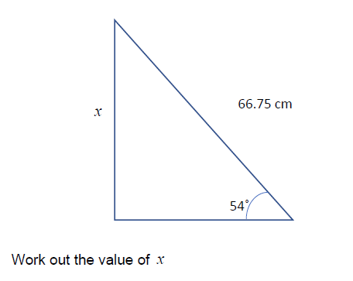
What is wrong with these questions?
1
2
3
4

Slide 8
What are we testing and how do we break it down?

Slide 9
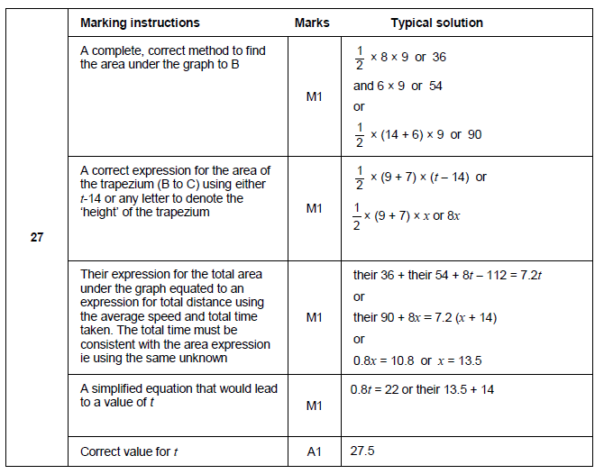
A possible mark scheme

Slide 10
Writing a better question

Slide 11
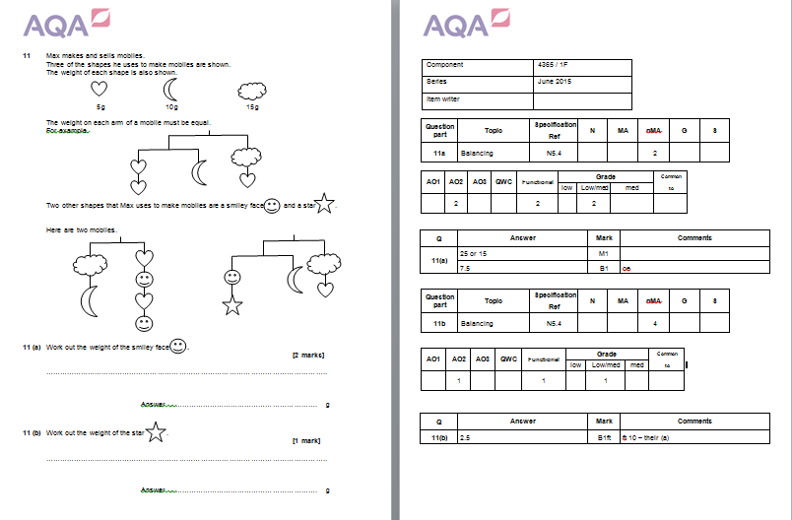
Reviewing the first draft of a question

Slide 12
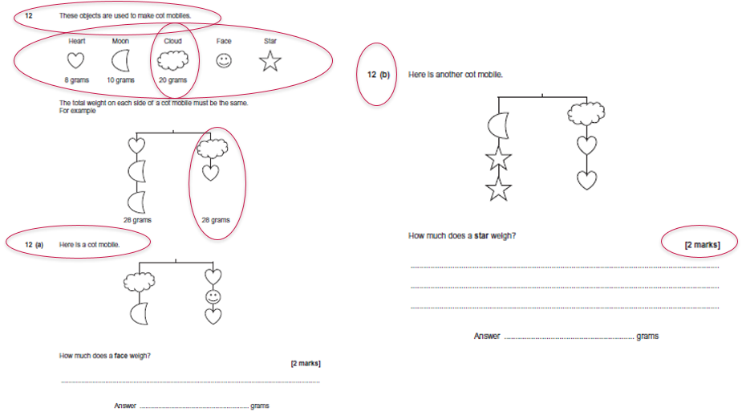
The final version

Slide 13
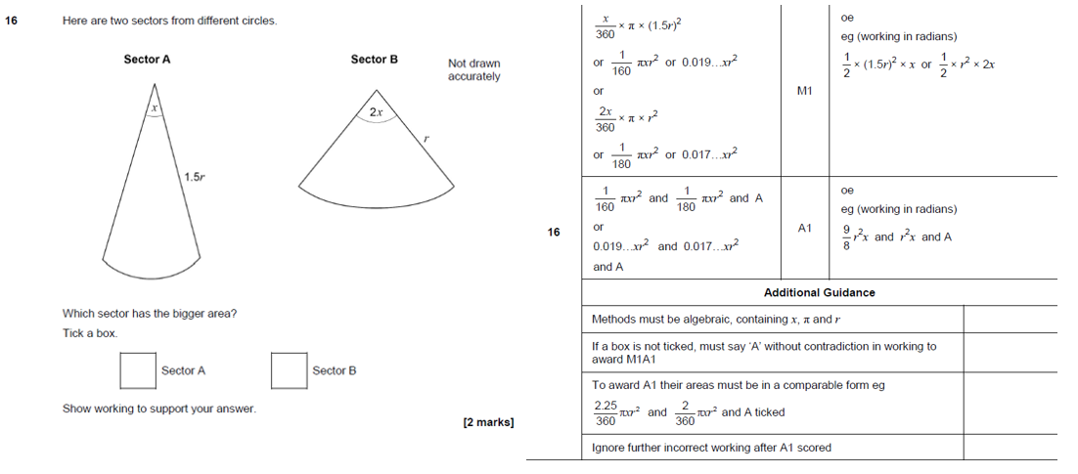
Revisiting unsuccessful questions

Slide 14
Question data
GCSE Maths, Q16, Paper 3H, June 2019
2 marks testing G18 and N8
2 marks at AO3 (AO3.1b and AO3.3)
Medium/high expected demand (Grade 6/7)

Slide 15
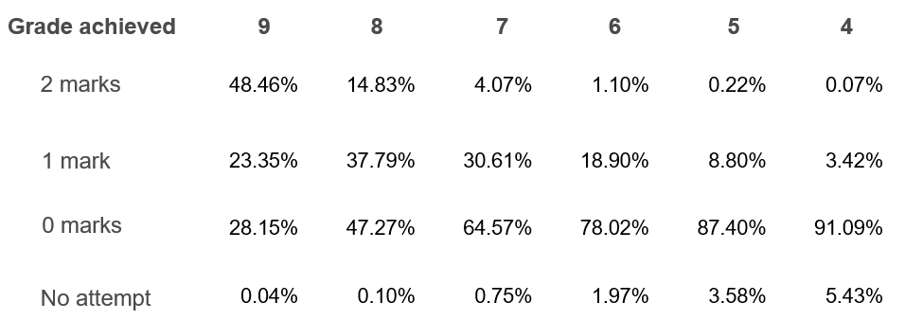
Actual performance

Slide 16
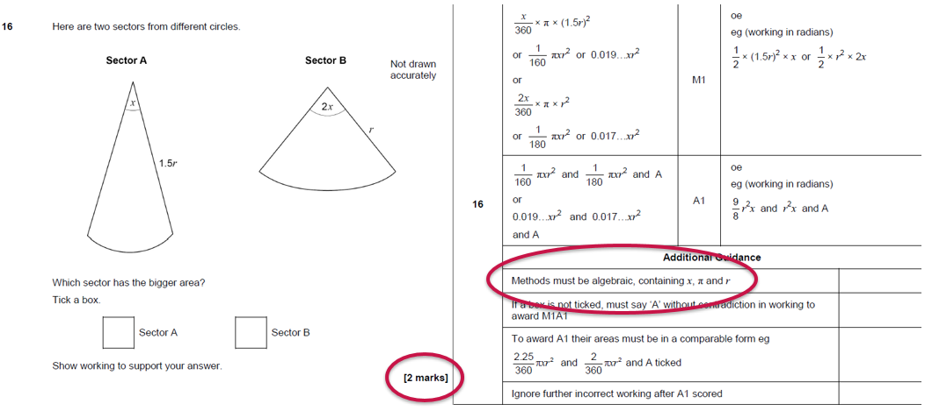
Revisiting unsuccessful questions

Slide 17
What can we learn from marking?

Slide 18
A fair and consistent mark scheme
Page 8 of your booklet.
Review the questions and the examples of student responses.
Use the template to write a mark scheme that can be applied fairly and consistently.
Mark the examples using your scheme.

Slide 19
The ‘right’ answers
Question | 1 | 2 | 3 | 4 | 5
9 (area)/4 | 2 | 3 | 1 | 2 | 3
11 (mean)/4 | 1 | 4 | 2 | 1 | 2

Slide 20
Get in touch
Our friendly team will be happy to support you between 8am and 5pm, Monday to Friday.
Tel: 0161 957 3852
Email: maths@aqa.org.uk
Twitter: @AQAMaths
aqa.org.uk
Notes:
Our relevant Twitter accounts are:
@AQAEnglish (English subjects)
@AQAMaths (Maths subjects)
@AQA (Any other subjects).

Slide 21
Any questions?

Slide 22
Thank you

