Slide 1
Supporting ITT – Understanding GCSE Science assessment
Damian Gent, Curriculum Support Manager AQA Sciences
ASE January 2024

Slide 2
Welcome
Notes:
The content of this training course contains no reference to future exam content as far as we know at the time of production. (Summer 2023)

Slide 3
Session overview
The specification
Assessment Objectives
Structure of the papers
Applying a mark scheme
Implications for teaching
Resources

Slide 4
The specification

Slide 5
The specification
Specification layout
Assessed content and skills

Slide 6
Trilogy specification
AQA Science specification
Notes:
Each of our qualifications has its own landing page and for GCSE you will see two combined and three separate sciences.
This session is specifically discussing the combined Trilogy spec 8464 which is the most common GCSE taken, but the layout and principles are the same for all of our GCSE qualifications.
Starting with the landing page, this is a really useful place to come if you are looking for supporting documents. It is divided into a number of Tabs: sec , planning, teaching and assessment. Towards the end of this part we’ll look at resources in a bit more detail.
For now we are focusing on the specification itself and how you should be using it in your teaching

Slide 7
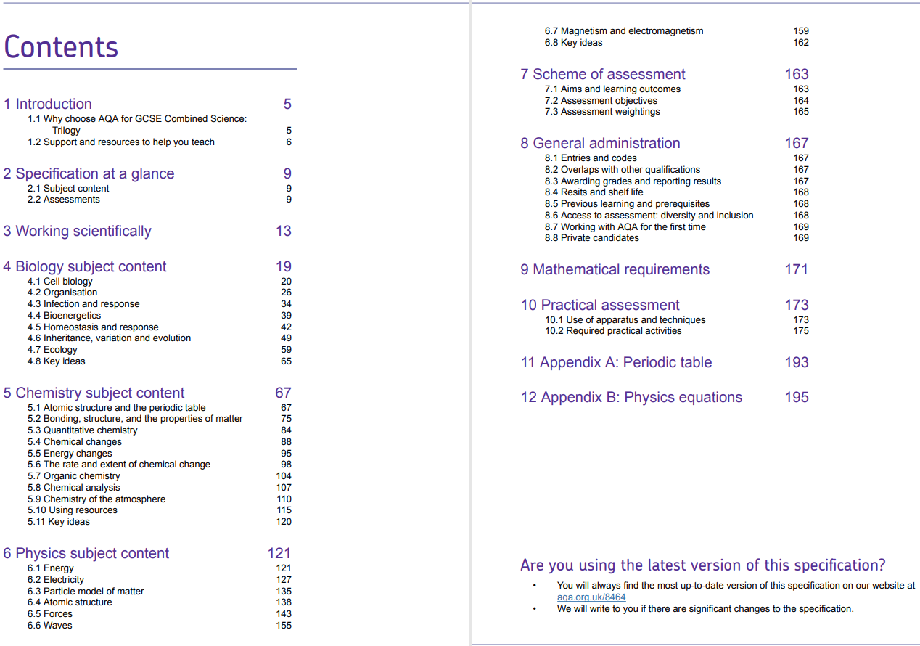
Notes:
A question for you - What do you, as a classroom teacher, use a specification for?
The specification lists the content that can be assessed, the skills that students need in assessment and, importantly, HOW the content and skills are assessed.
Depending on the school or trust that you work for you may be given a scheme of work to follow, possibly sets of PowerPoints to teach from and worksheets for the students to do. All of these resources would have been developed using the specification so if ever you want to drill down to the core content, you can align the scheme of work with the spec to see where it is listed. Many SOWs list the spec point adjacent to the learning objective for easy cross referencing.
The point of showing the contents page is to highlight what you already know – the content makes up the bulk of the document, and this is, of course, the main focus “what do they need to know?”
But the other aspects of the specification are just as important namely the skills students need to proficient in and HOW students are assessed.
I’m going to briefly treat each of the skills separately in the following slides.

Slide 8
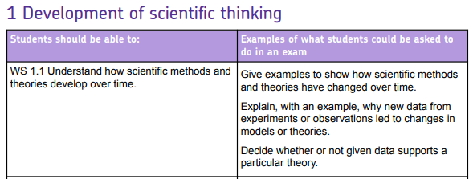
Working scientifically
Notes:
Working scientifically is the sum of all the activities that scientists do. We feel it is so important that we have woven it throughout our specification and written papers.
We have identified 4 main WS skill areas that naturally come out of teaching science, and in this section of the spec we set them out and give examples of what students may be asked to do in an exam.
If you have a SOW, it may be worthwhile looking at the activities in it and mapping them onto it so that you can see where in the course students are getting opportunities to develop these skills

Slide 9
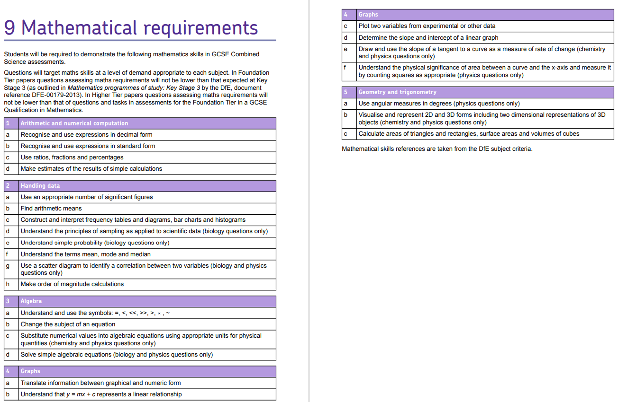
Maths
Notes:
Maths skills are of course key in science with physics having the highest maths requirement, then chemistry followed by biology.
On a Foundation tier paper, maths skills will not be lower than KS3 expectations and, on a higher tier paper, will not be lower than Foundation tier maths.
If you look at our papers, you will see certain skills that are assessed every year (e.g. graphing questions for 4 marks are not uncommon) so it is just as important to prepare your students in maths skills as subject knowledge

Slide 10
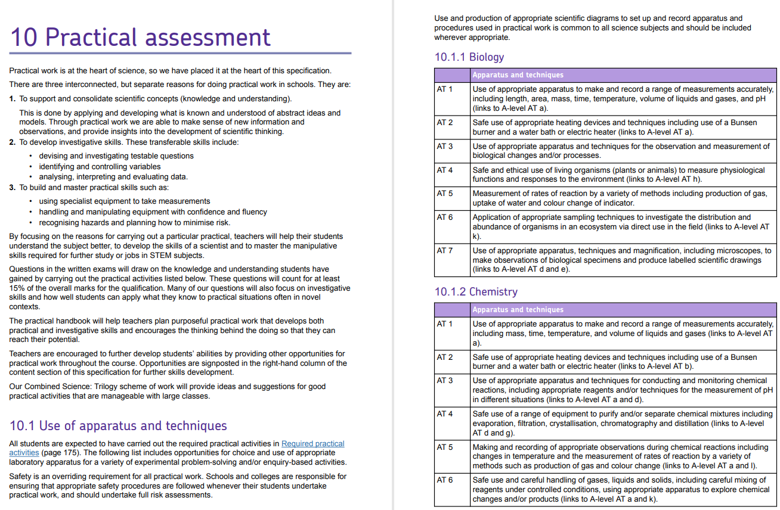
Practical assessment
Notes:
Questions on Practical skills count for 15% of the papers.
Students are required to carry out the 21 RPs (7 each BCP) over the course and, although the practicals are not assessed directly in the classroom, they are indirectly assessed in the exams. Your headteacher will sign a centre declaration form at the end of the course stating that all students were offered the opportunity to carry out the practicals.
If you look at our papers you will see that we assess the RPs - we are assessing is the student’s knowledge of the described apparatus and techniques. Sometimes the RP is set in a slightly different context to that carried out in the classroom so it is important to remember that you are teaching the skill NOT the specifics of the RP. For example, if a student is taught chemistry AT5 “measurement of rates of reaction by a variety of methods” they can apply the skill to a question on any practical involving rates, RP or not.
We also ask practical questions that are not based on the RP but on unfamiliar investigations so students should be equipped to recognise the Ats in exam questions and apply their knowledge of the skill to the new context.

Slide 11
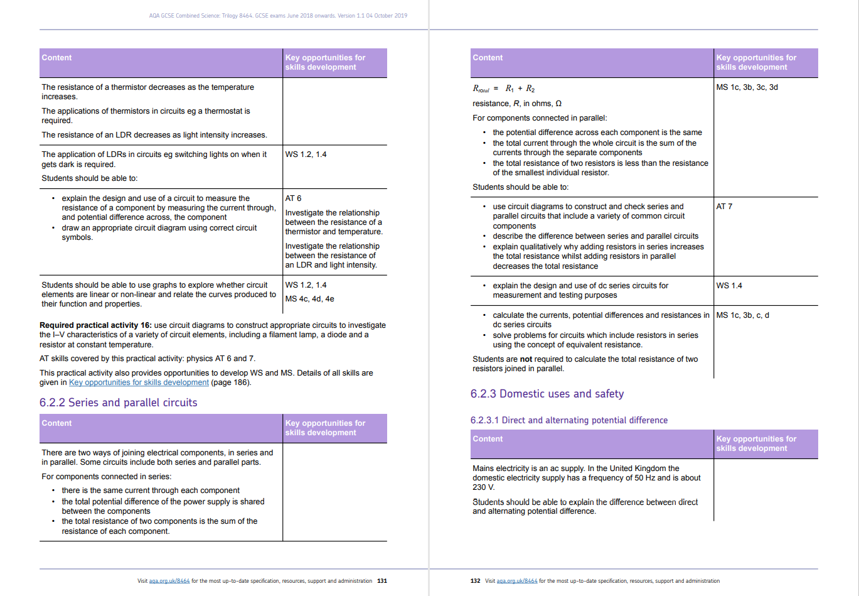
Specification – at a glance
Notes:
How does this all hang together in the specification.
You can turn to any page in the specification for examples of WS, AT, MS and RPs. The content is presented in two columns, the first is SK and the 2nd is key opportunities for skills development.
The content is organised into a series of sub-headings with specification point numbering. This is the numbering that was used in describing the AI and, for some teachers who do not consult the spec often, this proved problematic in interpretation. I mention this because if we ever have AI again, it is vital that you are referring to the spec points in this document, not a textbook, SOW or other knowledge provider (eg bitesize).
For paper 1 we listed 4.2.2 animal tissues, organs and organ systems which included 4.2.2.6 The effect of lifestyle on some non-communicable disease which some people didn’t realise because they weren’t suing the spec (check this).

Slide 12
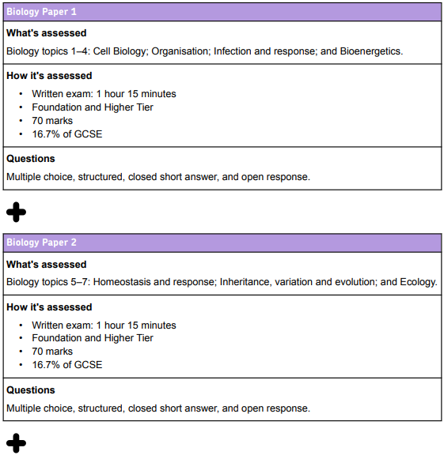
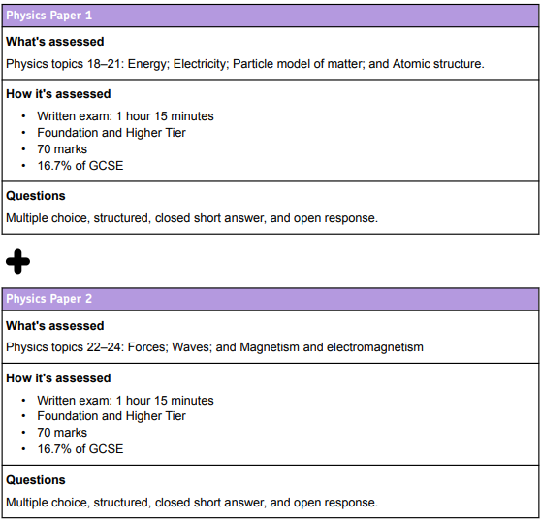
Exam papers
Notes:
There are 6 papers as described here.
Content can be taught in any order as exams are terminal. Most schools teach all of P1 in year 10 to be able to use the previous years papers as mocks but, if you have a preferred sequence, that is also fine. Mocks can be adapted or made with ExamPro to suit your teaching order.
We will look at structure of the levels of questions and tiering in more detail in later slides.

Slide 13
Assessment Objectives

Slide 14
Assessment Objectives
How many science GCSE Assessment Objectives (AOs) are there?
What does each AO cover?
What percentage of the award is assigned to each AO?
Why are AOs important to teachers?
Notes:
Do you know the answers to any of these questions?
I’ll explain the AOs briefly and you can try to identify them in a question.

Slide 15
GCSE Science Assessment Objectives (AOs)

Slide 16
Can you identify the AO?
Example 1, page 4​
3.1
3.2
3.3
3.4
3.5
AO2
AO3
AO1
AO1
AO2
Notes:
Look at example 1 in the booklet. There is a further example for you to look at later (Biology)

Slide 17
Structure of the papers

Slide 18
Structure of the papers
Approximately seven questions on Combined Science and 10 for separate sciences.
Questions are made up of several ‘items’.
Each question covers an area of science. The stem introduces it.
Papers are ramped and tiered.
Common questions make up 30% of marks.
Demand | Target grades | % marks | Tier
Low | 1–3 | 60% | Foundation
Standard | 4–5 | 40% | Foundation
Standard | 4–5 | 40% | Higher
High | 6–9 | 60% | Higher

Slide 19
Types of questions
Different question types
Multiple choice, link boxes: 1 or 2 marks
Short answer: 1–3 marks
Calculations: 1–4 marks (compensatory marks)
Extended response: 4–6 marks (levels of response mark scheme)
Multistep calculation: 4–6 marks
Graphs: 3 marks (plots, axis, scale, line of best fit)
Diagrams
Questions cover several AOs (eg Example 3, page 10)
Notes:
Example 3 on page 10 of booklet is a standard demand question, demonstrating the variety of question types.

Slide 20
Graphs
Students may be asked to:
plot the data from a table
ideally use a sharp pencil
crosses (x) or dots can be used (but crosses (x) easier to see)
label the axis – use the headings in the data table
draw the scale – use most of the graph paper given
draw a line of best fit – lines of best fit can be straight or curved – look at the pattern in the data first to decide
marked for accuracy (divisions of scales depend on demand).
Notes:
More information here on what we could ask students to do, and good practice in responding to graphing questions

Slide 21
Extended response
Assessment criterion to write an answer that’s ‘coherent, relevant, substantiated and logically structured’.
Marked using ‘levels of response’ mark schemes.
When a learner writes their answer, they can:
write in paragraphs
use short sentences in bullet points
use labelled diagrams
Use tables with headings for compare and evaluate questions.
Don't need to fill all the space.
Have a go! VITAL ADVICE
Notes:
What we’re looking for with Extended response questions – there are examples in the booklet

Slide 22
Applying a mark scheme

Slide 23
Applying a mark scheme
Marking questions in the booklet
Examples 4–9 (pp 14–21): How many marks would you give each of these examples?
Copyright © AQA and its licensors. All rights reserved.
Notes:
Look at a few examples – don’t need to do all.
Examples 4–9 are on pages 14–21

Slide 24
Marks awarded: On the scripts
Example 4 0 marks
Example 5 0 marks
Example 6 2 marks
Example 7 0 marks
Example 8 1 mark
Example 9 2 marks
Copyright © AQA and its licensors. All rights reserved.
Notes:
How did you do?
Discuss each one.
Comments and marks awarded are given at the end of the booklet

Slide 25
Applying a mark scheme: Graphs
How would you mark the example graph questions?
Examples 14–17 (pp 27–31)
Notes:
Look at these examples – go through one or two rather than get delegates to mark them.

Slide 26
Extended response
Extended response questions are marked on level of response mark schemes.
Level of response mark schemes are broken down into levels, each of which has a descriptor.
The descriptor for the level shows the average performance for the level.
There are two marks in each level.
Before you apply the mark scheme to a learner’s answer, read through the answer and, if necessary, annotate it (as instructed) to show the qualities that are being looked for. You can then apply the mark scheme.
Step 1: Determine a level
Step 2: Determine a mark
For a detailed description of these steps, see the Information for examiners at the beginning of any mark scheme.
Notes:
There are a number of examples of extended response questions with commentaries in the booklet
Might want to go through one or two – examples 18 to 21 (pp 33–38)

Slide 27
Implications for teaching

Slide 28
Areas of challenge
AO2: Unfamiliar contexts
Required practicals
Maths skills
Copyright © AQA and its licensors. All rights reserved.

Slide 29
Area of challenge: AO2 in unfamiliar contexts

Slide 30
Area of challenge: AO2 in unfamiliar contexts
Copyright © AQA and its licensors. All rights reserved.

Slide 31
Supporting assessment in class
Explain to learners that they need to expect these types of questions.
Use examples in your lessons:
Ideas for integrating AO2 into practicals in Activity 4 of AO2 focus on success.
Change names of chemicals used in practicals in homework questions.
Look at examples already used in assessment questions.
Model identifying the science behind the questions.

Slide 32
Area of challenge: Required practicals
Didn’t fully understand why they’d carried out each step in the practical
Lack understanding about the science underlying the practical
Identifying control variables and independent and dependent variables
Difference between a control and a control variable
Use of vague terms such as ‘same amount’, ‘fair test’ , ‘it’ and ‘they’
Types of errors
Subject-specific vocabulary
Notes:
Areas of working scientifically in the context of the RPs
repeatable or its significance
identify control variables and other variables term ‘fair’ is always inadequate unless suitably qualified types of errors how to improve accuracy - improves inaccuracy is insufficient for a type of experimental error, human error is insufficient

Slide 33
Supporting assessment in class
How can you support your students in accessing the assessment of practical skills?
Take more than one lesson to cover the practical.
Use a holistic approach covering:
why they’re doing each step
explaining science behind the practical
include working scientifically skills, eg variables, errors, improvements
construct graphs and interpreting them
setting the practical in a different context
discussion of errors and improvement using correct scientific language.

Slide 34
Area of challenge: Maths in science
Unit conversions: g to kg, dm³ to cm³
Use of prefixes and powers of ten for order of magnitude
Significant figures
Selecting numbers in the diagrams that are needed in the calculations
Percentages, eg percentage change is challenging
SA:volume ratio
Not using a calculator

Slide 35
Supporting assessment in class
Are you familiar with the maths skills assessed in science?
Which ones would you be confident in teaching learners if they don’t know how to use them in a calculation?
Where would you go for support?
Do you understand how calculations are marked?
What piece of advice would you give all your learners concerning calculation questions?
Focus on success – maths in science.

Slide 36
Resources

Slide 37
Website: Resources
Notes:
NB Old resources slide referring to Covid and 2022!

Slide 38
Website: Teaching resources
Notes:
The practical handbook is invaluable for any practical related queries
You might also look at the mandatory CPAC training for lead teachers if you are teaching A-level or want to know more about progression of practical skills from GCSE to A-level

Slide 39
Practical handbook
Notes:
It worth mentioning that this is an invaluable resource that supports with the practical and skills components of all of the RPs with links to the spec and the AT focus

Slide 40
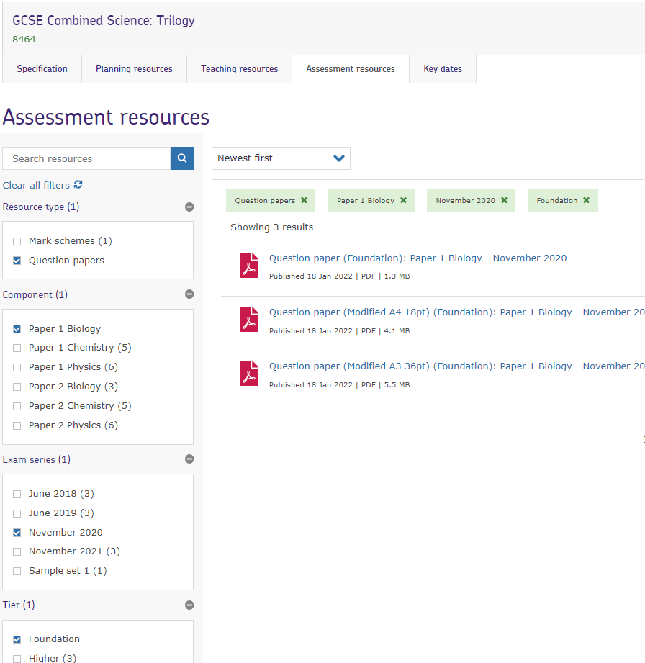
Website: Assessment resources
Notes:
Landing page as already mentioned. There are a wide variety of resources including teaching guides for maths and other skills.
The practical handbook is something that you should look at.

Slide 41
Centre services: Secure resources
Notes:
More resources here. Worth a look for training and support resources

Slide 42
GCSE science resources
Six self-guided modular training packs –
AQA | GCSE | Combined Science: Trilogy | Planning resources.
Helping teachers to better understand the assessment requirements.
Each pack includes notes, ideas for group discussion, an activities booklet and handouts. They cover:
Disciplinary language
Extended response questions
AO2
Practical questions
AO3
Maths in science
Notes:
PR NOTES: possibly remove the link from this presentation and add it into the booklet instead

Slide 43
Get in touch
Tel: 01483 477 756
Email: gcsescience@aqa.org.uk
Email: alevelscience@aqa.org.uk
X: @Science_AQA
aqa.org.uk

