Slide 1
Purposeful questioning in science
Jane Bryant, Curriculum Manager AQA Sciences
ASE January 2024

Slide 2
Welcome
Notes:
The content of this training course contains no reference to future exam content as far as we know at the time of production. (Summer 2023)

Slide 3
Session overview
AO2 in unfamiliar contexts
Recognising the science behind the question
Understanding key command words
Resources
Notes:
I’m going to concentrate on a couple of areas of the assessments where key areas of challenge appear to be:
Applying knowledge and understanding in unfamiliar contexts: especially in terms of content, practical skills, maths and working scientifically
Understanding key command words: many students miss out on marks because they don’t address the requirements of the command word, so giving them a better understanding will help them access questions

Slide 4
Here are some answers about questioning in lessons, but what are the questions?
135
0.97 seconds
84% of lessons
62% of questions
What’s the average number of questions posed by a teacher in an hour-long lesson?
How long does a teacher wait on average before giving the answer to a question or prompting the learner?
What % of lessons start with a general question and answer recall session?
What % of questions asked are closed or low order?
Notes:
Two-minute icebreaker.
Here are some answers, what do you think are the questions?

Slide 5
Purpose of the session
To explore the use of AQA science questions to stimulate engagement and curiosity, while supporting learners’ learning and outcomes
To give you some useful ideas and strategies that can be applied in the classroom

Slide 6
Using summative questions to aid learning
Exam questions are summative – they assess what a learner has learned and understood after a two-year course of study
Use summative questions in a diagnostic context by:
Identifying common misconceptions using comments in the examiner reports and experience from your own learners
Developing short questions to probe these misconceptions further and identify where intervention/focused revision is needed.
Use summative questions in a formative way to aid learning by:
Identifying the key ideas needed to answer a question
Developing short questions to support these ideas, build up understanding and give learners the confidence to tackle such exam questions.
Notes:
Teachers often use exam questions with students to assess their learning as they go through the course (and familiarise them with exam questions).
But you need to bear in mind that the questions in the exam papers are summative – they are designed to assess what a student knows after two years of study and even the simplest AO1 understanding requires them to bring together quite a few bits of knowledge and understanding of the spec. content to be able to answer it.
So it’s not really surprising that Y10 (or even in some cases Y9) students can’t answer such questions fully – they simply haven’t embedded enough of the course yet.
But teachers don’t have to use past exam questions just as they are – they can be used in many ways to support learning as you are teaching the course as well as assessing students at the end of the course. They have served their purpose as far we (AQA) are concerned, so we would encourage you to use and adapt them to use in your teaching as well as assessing student progress.
You can use past exam questions in a diagnostic way in homeworks or short classroom exercises, for example as revision with Y11 to understand what areas of content students are not grasping correctly or are misunderstanding, or are having trouble expressing what they know. You could also use them as end of topic questions in a diagnostic way so that you can support students who are not getting it all.
Then you can adapt the question, or devise similar questions at different levels of difficulty to help students understanding.
You can also use exam questions to support student learning in a formative way (assessment for learning rather than assessment of learning).
To do this you can identify the detailed content students really need to understand to be able to answer the question You could write a list of key ideas needed for this question and devise simpler questions to help probe the issues and build up student understanding. The statements in the mark schemes will help you with that.
It’s not just overarching statements in the specification – to make the exercise effective you really need to drill down into detail.
You could keep a bank of past questions and the formative questions you have devised from it for use in future.

Slide 7
AO2 in unfamiliar contexts
Notes:
So, first looking at application in unfamiliar contexts
Students often seem to have problems when they come across a question within a context they haven’t explicitly been taught.
They don’t seem to be able to see through the context to the underlying science so think they don’t know or can’t work out the answer. There are examples of these in every exam series.
I’ll look at how we assess it in terms of content, practical skills, Working scientifically and maths skills, with some examples for you to think about and maybe work on some ways of supporting students
Of course, these aspects are not stand-alone and are closely linked with knowledge of the subject content. So it’s not always a simple ‘this is WS, this is maths, this is practical, this is knowledge from the specification’. For example, WS and Maths may be assessed in a practical context or in the context of subject content

Slide 8
The challenges of unfamiliar contexts
Learners face a number of challenges with questions framed in unfamiliar contexts:
Recognising the science they need to apply to answer the question.
Recognising the practical when it’s slightly different from the one they’re familiar with from the classroom.
Recognising the maths or scientific knowledge they need to apply to the science context.
Having the confidence to tackle a question when the topic appears unfamiliar.
Notes:
If a question is set in an unfamiliar context many students don’t seem to be able to relate what they’re reading to what they know.
If an investigation in an unfamiliar context is presented to them many students panic, become unable to relate it to any of their knowledge and either answer wrongly or miss out the question completely. This happens especially if the method shown is completely out of the student’s experience (eg related to areas of content rather than to a required practical).
A question may assess particular WS skills or maths skills listed in the specification (eg understanding appropriate methods of presenting information) and they struggle to apply these skills to the given situation
This knocks their confidence and so they often don’t even attempt a question when it appears unfamiliar to them.
These are the areas I’d like to address (albeit briefly) in this presentation. But first, why do we set questions like this and what actually constitutes ‘unfamiliar contexts’?

Slide 9
Why unfamiliar contexts?
Ofqual requirements
Learners must apply knowledge and understanding to provide meaning or explain something.
Application must relate primarily to:
novel situations not clearly indicated in the specification (unfamiliar contexts)
developing an idea from the specification beyond the basic knowledge
making links between different areas of knowledge.
Two strands:
Scientific ideas assess subject content and includes some maths skills, working scientifically and models.
Scientific enquiry, techniques and procedures means practical skills and some more maths skills in practical contexts. ‘Encompasses but is broader than’ means contexts other than just those of the required practicals.
Notes:
About 40% of the marks are for this AO.
Page 4 of your booklet shows the regulations from Ofqual on AO2. These are the rules that all exam boards have to follow. I’m sure you will have seen this many times before!
This document is vital to understanding how we examine it, and why we do it the way we do.
The key aspect of AO2 is the requirement to apply knowledge and understanding. That means that students must use their knowledge of the subject content (including the Working scientifically, maths and practical skills) to explain something in order to give meaning to it.
Ofqual requires that application must primarily
relate to unfamiliar contexts (‘novel situations that are not clearly indicated in the specification’)
expect students to take an idea from the specification and develop or further it beyond the knowledge in the specification
expect students to make links between different areas of knowledge to answer a question (for example, there may be a question about the effect of air pollution on the health of animals and/or plants in a particular environment, where they would need to understand what air pollutants there are (from one part of the specification) and link that to the effect of these on (eg) photosynthesis, respiration, etc) to give a full account. The links should be made by the students in their answer – we don’t tell them in the question to make the specific links: that little extra phrase ‘which are not signalled in the specification’
expect students to look at data or information and make sense of connections and links within it, but not to the extent of drawing conclusions (as that moves on to AO3).
There are two strands for AO2. It is separated into ideas, and enquiry, techniques and procedures. Again, the right hand column gives more detail on what is meant here.
Ideas assess subject content, which remember includes Working scientifically, practical and maths skills. So it will include theories, models, methods and how they develop over time, as well as use of mathematical formulae and units
enquiry, techniques and procedures mostly means practical skills, but also includes some of the technical maths skills such as drawing lines of best fit. Note that it says here ‘is broader than’ knowledge of the core practical activities. This means that we will be assessing application of practical skills in contexts we will give students, other than just those in the RPAs – further pushing the relation of this AO to unfamiliar contexts. It will also cover the range of ideas featured in WS2 (Experimental skills and strategies)

Slide 10
What do we mean by ‘unfamiliar contexts’?
Unfamiliar contexts can be anything that isn’t clearly mentioned in the specification and can be very wide ranging.
Examples include:
beta decay in strontium-89
calculating percentage by mass of chlorine in a molecule of C₆H₁₀Cl₂
testing thermoconductivity of a swimmer’s wetsuit
comparing number of subatomic particles in atoms of boron and carbon
explaining inheritance in maple syrup urine disease
explaining natural selection in tawny owls
determining specific heat capacity of vegetable oil
identifying size and direction of force of water on a boat propeller
explaining the effect of human papillomavirus on human DNA
investigating concentrations of salts in samples of sea water.
Notes:
The thing to understand about unfamiliar contexts is that they can be almost anything – from something as relatively simple as an experiment on osmosis using sweet potatoes or eggs rather than what students are more likely to be familiar with (which is potatoes), or using an ‘appearing cross’ experiment rather than the usual disappearing cross or determining the specific heat capacity of a liquid rather than a solid block.
Also students’ experience will make a context familiar or unfamiliar – for example students in a very urban environment may have less opportunity to explore different habitats than those in a more rural community.
This list mentions some of the contexts that have been used in recent exams, and there are some actual examples in the booklet, pages 4-6.
Example 1 (biology, page 5) Learners are unlikely to have even heard of MSUD (maple syrup urine disease), so the context might throw them off. But if they look beyond the context, the question tests their knowledge of how digestive enzymes work to break down substances (4.2.2.1), and of diffusion (4.1.3.1) to work out why the substance will build up in the blood without that enzyme.
In Example 2 (chemistry, page 6) Students might not have come across this particular reaction but should know that in acid-base reactions the salt produced depends on the acid and the positive ions (4.4.2.2), so should be able to apply that knowledge to determine the reactants as zinc oxide and sulfuric acid
Similarly in physics (look at example 3, page 6): Students might never have heard of Scafell Pike, but the question is actually about understanding why atmospheric pressure decreases with an increase in height (4.5.5.2) and they need to look through the context to the science beneath.

Slide 11
Unfamiliar contexts in relation to practical skills
Practical questions are primarily set in the context of non-required practicals.
This could be something completely new or a variant on what students have done in a required practical.
Learners need to use the skills and understanding they have gained doing practical work to, for example:
identify control variables in an unfamiliar practical where the variables are given
identify dependent and independent variables in an unfamiliar practical
make a prediction or a hypothesis based on information in the specification
take readings from scales on apparatus
use diagrams to communicate experimental methods.
Notes:
Practical questions can be based on a required practical but are also very likely to be assessed in the context of a practical students haven’t seen before – it may be something totally new, or a variant on what they may have done in a required practical. They need to use the skills and understanding they should have gained by doing practical work to do the things that are listed here.

Slide 12
Context and maths skills
Most maths skills are assessed in a practical or unfamiliar context.
Examples include:
Use information to give probabilities
Manipulate numerical and other data (eg rearranging equations)
Perform calculations involving rearranging and/or substituting into an equation, whether given, selected or recalled
Use data from graphs and tables in calculations
Plot graphs and draw lines of best fit
Select appropriate axes and scales for plotting
Construct and translate graphical ways of presenting data (eg bar charts, pie charts, line graphs)
Suggest why data should be plotted in a particular way (eg why a line graph should be plotted instead of a bar chart)
Translate tables and statistical diagrams.
Notes:
Here are some examples of how we assess maths skills.
Maths questions are usually set in some sort of a context – not maths for the sake of doing maths, but applying it to the scientific context given, whether it’s a practical, investigation or in terms of sections of content – eg calculating relative formula masses or number of moles in a given substance; calculating the probability of a particular trait being inherited; using information on a graph to calculate the half life of a radioactive isotope.

Slide 13
Context and working scientifically
As with maths, working scientifically skills are assessed in a practical or unfamiliar context.
Examples include:
Describe patterns, trends and simple relationships
Use graphs to explain behaviour
Translate information from one form to another (eg tabular to graphical)
Use specialist diagrams, such as wave diagrams to explain refraction, Punnett squares to explain inheritance, dot-and-cross diagrams to show atomic structure and bonding
Apply knowledge and understanding in both familiar and unfamiliar contexts
Make connections and linkages between ideas
Understand how decisions about science and technology are made in different situations.
Notes:
Aspects of working scientifically that relate to AO2 are included in:
WS1.2 (Use a variety of models such as representational, spatial, descriptive, computational and mathematical to solve problems, make predictions and to develop scientific explanations and understanding of familiar and unfamiliar contexts); 2.1 (Use scientific theories and explanations to develop hypotheses)
2.2 (Plan experiments or devise procedures to make observations, produce or characterise a substance, test hypotheses, check data or explore phenomena)
2.3 (Apply a knowledge of a range of techniques, instruments, apparatus and materials to select those appropriate to the experiment) and
much of WS3 (analysis and evolution) when applied to unfamiliar data
Again, much of this will be in unfamiliar contexts, especially if the question is based on practical or experimental work.
Example 4 in the booklet (page 7 – 9) covers a number of the aspects talked about on the last few slides, in the context of a variant on Chemistry RPA 5 (Trilogy RPA11), where investigation is of effect of temperature on rate of reaction, not concentration.

Slide 14
Key areas of challenge in practical questions
Understanding why key steps are being carried out
Correct use of equipment
Understanding risks and hazards
Identifying variables and their meanings
Suggesting possible improvement to methods
Recognising errors
Drawing conclusions
Applying the science behind the practical
Understanding key working scientifically terms
Plotting line graphs and bar charts
Drawing lines of best fit
Using and interpreting information in graphs
Notes:
Key areas of weakness shown in exams we see in every series
You can see that some of these problems relate to the maths and WS criteria – as I said at the beginning, these criteria are strongly linked

Slide 15
How do we get learners thinking about their learning in unfamiliar contexts?
Start your lesson with a context-based question or scenario to solve by the end of the lesson.
Autosomal Recessive inheritance crosses
How can you explain the inheritance of maple syrup urine disease?
Titration
Which indigestion tablet is the most effective?
Think of a topic you are going to teach. What question could you lead your lesson with?
Notes:
So, how can we get students thinking about learning in unfamiliar contexts in our lessons?
You could start of a new topic by introducing a question in a context, then help students to understand that by the end of the lesson they’ll know how to solve this type of question because they’ll have learned about the topic.
Example 5 in the booklet (page 10) shows a question asking about inheritance of MSUD that you could use as a starter for this exercise. As I mentioned earlier, students are unlikely to have ever come across this particular disease, and the context could worry them, but by teaching understanding of the inheritance diagrams (which you might already have done, so could go over the interpretation of these quickly to instil confidence), you can go on to understanding of recessive and dominant alleles and the production of Punnet squares to determine the correct cross.

Slide 16
How do we get students thinking about their learning in unfamiliar contexts?
Start with a familiar context and then follow up with unfamiliar context questions.
Could learners design their own questions to make the concept more challenging?
Notes:
Start using questions in a familiar context and then move on to less familiar ones, for example if looking at calculating relative formula mass you could start with compounds given in the specification (such as sodium chloride or ammonia (NH3) or methane) then move on to more complex and less familiar ones – building up to something like the one here which uses an compound they might not have come up against.
In example 6 (page 11) students need to use their understanding of relative formula mass and how to calculate it from relative atomic masses, but they might not have come across carbonic acid, having maybe done calculations with more familiar chemicals. They just need to know that they have done this type of calculation before and that they do know how to do it.
Keep exposing them as much as possible to unfamiliar contexts – in class, in homeworks. Could even get students to research and design their own questions to ask each other to build up their confidence in less familiar material.

Slide 17
Recognising the science behind the question

Slide 18
Recognising the science behind the question
Modelling is reminding learners to apply what they know by looking through the questions and understanding that they do know the science behind it.
Examples 7, 8 and 9 are all set in contexts learners are unlikely to have encountered (pp 12–16 of the booklet).
How might you model identifying the science that’s being assessed behind the context?
Notes:
Examples 7- 9 (pages 12 – 16) are questions set in unfamiliar contexts: consider how you could use these to help students identify the science behind the context.
This is just to point you to some examples that you could work with colleagues. If time could look through one

Slide 19
Using practical questions to build confidence
Our GCSE exam questions cover aspects of practical skills, but not all of them in any one paper.
Take any method and use targeted questions to explore the science behind the method.
Use a framework of generic questions to draw from for any method.
Questions can be adapted for specific methods or to change the demand.
You could include tables of results for further analysis.
Start with a familiar context then progress to unfamiliar ones to build confidence.
Notes:
So how can you help students achieve confidence without exposing them to many different variants on practicals?
The exam questions have to assess many aspects of a student’s knowledge and understanding and only parts of any one question are going to cover the different aspects I’ve mentioned.
Exam papers do all contain questions based on familiar and unfamiliar contexts for investigations, and you could use source materials (eg the method/experimental set up) as the basis for class- or homework.
You could use these examples to help enhance student understanding: first demonstrating what they know in a very familiar context (Example 10, page 17), then in the much less familiar contexts (Examples 11-13; pages 18-20).
To do this, as a science department you could build a bank or framework of generic questions that you can use to explore different aspects of the WS criteria and give students the skills to look deeper into the practical. You could even build sub-sets of types of questions addressing different levels of demand.
The usefulness of such a bank is that it is subject agnostic so your whole science department could use it for all three sciences, reinforcing the thinking across the cohort.
You could use the same example several times, posing different questions from the bank to explore and develop confidence in different aspects, as short exercises or homeworks.
The questions you would ask in this context fall into a number of different categories, such as developing or testing hypotheses, variables, sampling/controls, making predictions, types of measurements, errors, evaluating a method.
Within each of these categories there are many different questions you could ask to draw out different aspects of the method and enhance understanding. So you are starting to build up a bank of generic questions – at the moment not in any particular order, and not aimed at any particular level of demand.
These could be used for both familiar and unfamiliar methods.
There’s some suggestions in the booklet page 21-22.

Slide 20
Interrogate practicals using exam questions
Variables | Is the learner changing any variables in this investigation? What variables are they changing? Why are they changing that variable? What is the independent variable? What is the dependent variable? What variables to they need to keep the same?
Notes:
Here is an example of a method from a past paper along with a set of questions you might want to get them to think about regarding variables – but could equally use any of the other types in the table on page 23.
This is related to the Chemistry RPA on how changing concentration affects the rate of reaction. But it is looking at how a change in a different variable (size of marble chips – surface area) affects rate of reaction. They might not have done this. You could use this and the questions to help students think more about variable.
This is Example 11 in the booklet (page 18) – a chemistry example. Example 12 is biology and Example 13 Physics.

Slide 21
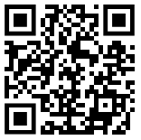
Practicals with a twist
Using indigestion tablets to neutralise acid
Appearing cross
Burning magnesium
Notes:
KM thinking of using the question(s) as a start point for a lesson.
Unfamiliar practicals with katie webb

Slide 22
Understanding some key command words
Notes:
Some command words seem to cause students some problems, and they don’t always achieve as well as they could perhaps because they don’t understand what is required of them.
Students need to be able to show that they do have understanding of the content and practical skills. They often have learnt the material but can’t effectively show it, as they don’t understand what the question is asking, so if you are trying to see if they have the level of understanding needed, you first need to try and get them to understand what these command words mean.

Slide 23
Key command words
Learners need to show understanding of the content and practical skills, but they don’t always understand what the question is asking.
The following command words seem to cause particular difficulty:
Describe
Explain
Compare
Evaluate
Notes:
Many of the command words are fairly straightforward and don’t cause students problems, but these ones often do. Booklet page 21 which has the command words and their basic definitions in
The mark scheme makes the specific requirements for each individual question clear. Command words also listed in the support document
There is a continuum of requirements through these four commands, which you can see in the descriptions below.
You might want to consider things you can do to help students understand what they need to do to for each type of questions.
There are examples of each of this type of question in the booklet

Slide 24
Describe
AQA definition for GCSE Science
Learners may be asked to recall some facts, events or processes in an accurate way.
Examples of what students may be asked to do:
Give an account of a practical procedure, such as an experiment they have done.
Describe what they might expect to observe with a given procedure.
Describe what something looked like or what happened in a practical.
Describe a trend in data on a table or graph.
Describe a relationship shown by the data in a table or a graph.
Use their knowledge to describe facts or features from the subject content.
Questions may be worth any number of marks (from 1 to 6).
Notes:
These slides expand a little on the basic wording that’s in the command words document on the website.
Account of practical procedure, eg how to use a microscope; how to set up a circuit; the test for oxygen)
Describe what they might expect to see with a given procedure (eg what they would expect to see at the positive electrode when a particular solution is electrolysed)
Describe what something looked like or what happened (eg gas given off; resistance decreased)
Use knowledge to describe facts or features (eg how plant and animal cells differ; how the body defends itself against pathogens; the bonding in graphite; how particle motion changes with temperature).
There are some examples of describe question in the booklet page 26

Slide 25
Explain
AQA definition for GCSE Science Learners should make something clear, or state the reasons for something happening.
What we are looking for in assessments:
The answer should not just be a simple list of reasons or points. Points in the answer must be linked coherently and logically.
Explain questions are always worth more than 1 mark, which should give a clue that more than a simple statement is required.
Suitable linking words include ‘so’, ‘therefore’, ‘because’, ‘due to’, ‘since’ and ‘explain’.
Examples of what learners may be asked to do include:
Explain why sets of experimental data are different.
Explain why a trend shown in a table of data or in a graph is happening.
Use knowledge and understanding to give logically linked reasons for what they are seeing in a diagram or in a piece of information.
‘Explain’ questions are always worth more than 1 mark.
Notes:
Students need to go further than in describe.
‘Explain’ questions are always worth more than 1 mark, which should give students a clue that something more than a simple statement is required.
There is likely to be a mark for stating something and mark(s) for the reasons for this.
What we unfortunately commonly see is students write a series of (possibly correct) statements, but not linking them to give an explanation. We want to see something like ‘the rate of reaction goes up because …’ or ‘the rate at 10 degrees is lower than at 20 degrees because …’ or ‘when the temperature went up so did the rate of reaction. This means that …’
Other linking words could be ‘this means’ or ‘meaning that’.
Explain examples on page 26

Slide 26
Compare
AQA definition for GCSE Science
This requires the learner to describe the similarities or differences between things, not just write about one.
What we are looking for in assessments:
If learners are asked to ‘compare X with Y’ they need to write down something about X and something about Y, using comparative words and phrases such as ‘better’, ‘more than’, ‘less than’, ‘quicker’, ‘more expensive’ or ‘on the other hand’.
Answers need to be clearly comparative.
Questions often require students to compare aspects of knowledge that may have been taught separately (eg bonding in different types of molecule; different adaptations to the environment).
Questions are likely to be higher tariff (4–6 marks), although some may require a simple comparison and be worth 2 or 3 marks.
Notes:
JB
Often what we see is a description of or a list of statements about X, followed by a description of or a list of statements about Y, without any comparative language in the answer. Such lack of clarity puts the onus on an examiner to decide whether the student is making a comparison or not. It also runs the risk of a student who clearly knows quite a lot about the subject not gaining marks because they have not made a comparison.
‘Compare’ questions are likely to be mostly AO2 and AO3, although there will often be some element of AO1.
Examples on page 27 and 28

Slide 27
Evaluate
AQA definition for GCSE Science
Learners should use the information supplied, as well as their knowledge and understanding, to consider evidence for and against when making a judgement.
What we’re looking for in assessments:
An evaluation goes further than ‘compare’. For example, learners may be given a passage to read and told to ‘evaluate the benefits of using system X and system Y’. This means they will need to write down some of the points for and against both systems to develop an argument. They should then provide a judgement or conclusion based on the evidence they have given.
Answers should use linking words such as ‘however’, ‘whereas’ and ‘but’.
No credit is given for simply stating information given in the question – learners need to do something with this information.
‘Evaluate’ questions are always higher tariff (4 marks or more).
Notes:
These questions are almost always going to be AO3, with some AO2, but are unlikely to involve much AO1. They are always going to be higher tariff questions (4 marks or more).
What is often lacking in student responses is a judgement of any kind, which means what we’re getting is really a comparison not an evaluation.
Examples on page 28

Slide 28
Strategies to support learners
Identifying command term from the mark scheme
Learners as examiners
Learners designing mark schemes
Stick copy of definitions in book to refer in lessons
Notes:
Help them to understand these command words by, for example, using a command words card sort.
Give students a mark scheme and get them to decide what command word was used in the question.
Give students a question and ask them to design the mark scheme that would match the command word.
Use the generic levels descriptors for extended response questions, along with the description of the command word.
Although these are written for extended response questions, familiarity with the levels descriptors helps understanding of how to answer this type of question.
Might want to consider using the Generic levels descriptors for the Extended Response questions – booklet page 26. The top level descriptor for each of these gives a really clear indication of what we would want to see for all of these command words – sharing with students would support their understanding.

Slide 29
Resources

Slide 30
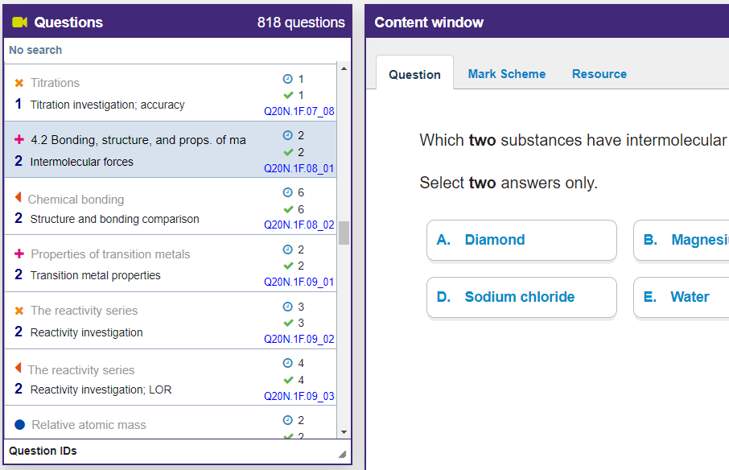
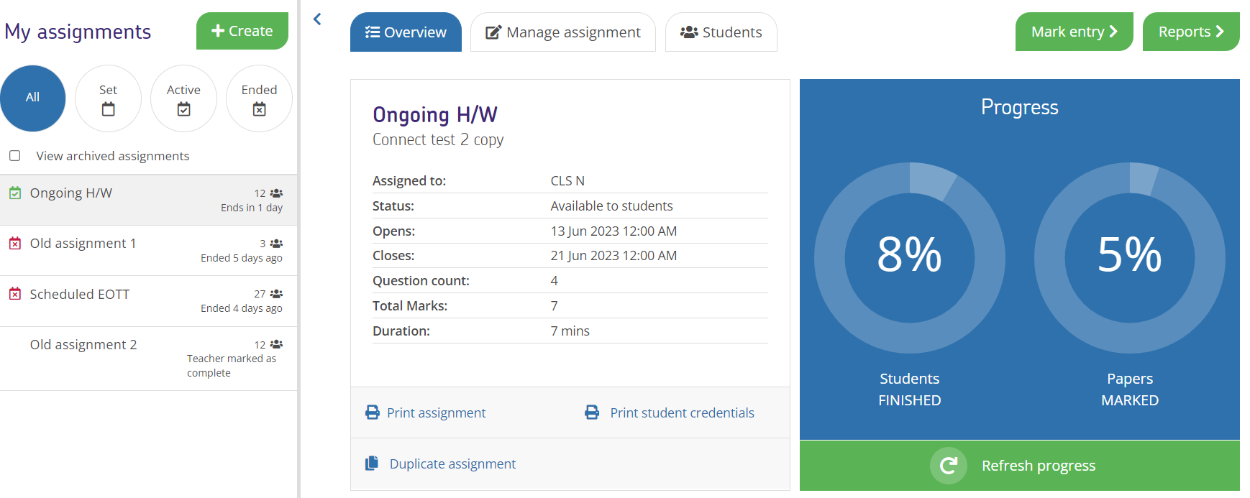
Exampro onscreen secondary science
Find out more at the AQA stand or contact Sam Scott: sam@exampro.co.uk

Slide 31
Resources
Take advantage of our extra resources in the ‘Plan’, ‘Teach’ and ‘Assess’ sections of our website.

Slide 32
Get in touch
Tel: 01483 477 756
Email: gcsescience@aqa.org.uk
Email: alevelscience@aqa.org.uk
X: @Science_AQA
aqa.org.uk

