Slide 1
ASE 2023: Sustainability and the environment
Natalie Vlachakis and Elise Reece
Spring 2023

Slide 2
Sustainability and the environment
Dive into AQA science specifications to discuss how current specification can support students learning on sustainability and the environment.
What more could be done to enhance these important topics across the sciences by a more integrated approach.
Could our current A-level Environmental Science be an option?
Notes:
This is the blurb for the talk

Slide 3
Focus of session
The environment in AQA GCSE specifications
Bringing it together
Assessment
Resources
A-level Environmental Science
Notes:
This is what we will cover today

Slide 4
Do you teach a GCSE 'Environment' module?
Yes – it's built into our scheme of work.
No – we teach it in the subject content.
Sort of – it's not in the SOW but I try to bring it together in my teaching.
Notes:
You're here because you are interested in teaching the environmental science component of the specification.
Can I get an idea of how many of you who teach AQA GCSE science teach the environmental components as a separate topic or module.
Is there an opportunity for a brief discussion here?
Perhaps use Menti. Or show of hands
Questions:
https://www.menti.com/alx34eb2fqxc
https://www.menti.com/alzgg3r32cj7

Slide 5
Climate science in schools
Covered in science but not in other subjects​
The national curriculum barely mentions the climate crisis. Children deserve better | Fiona Harvey | The Guardian​
'Teach the future’ – students are asking to be better prepared​
Climate change: Schools failing us, say pupils - BBC News
Notes:
There is a charge that the climate crisis and the environment aren't sufficiently covered at school. These types of protests often happen around COP summits but climate activism is now common and high impact. Schools are being asked to take more of a role in setting out the problem, what can be done to mitigate it and solutions that are being implemented.
Many of the jobs of the future will be on the field of clean energy, transport, food production to name a few, and young people need to be made aware of the role they can play in the industries of the future.
As the above mentions, climate science isn't widely covered at school but it does feature in the science curriculum.
The national curriculum barely mentions the climate crisis. Children deserve better | Fiona Harvey | The Guardian
Climate change: Schools failing us, say pupils - BBC News

Slide 6
KS4 National Curriculum (POS)
Credit: Science Programmes of Study Key Stage 4.
Department for Education (publishing.service.gov.uk)
Used under the Open Government Licence V3.0
Notes:
If we have a look at the DfE POS to see what needs to be taught regarding the climate and the environment, we can pick sections from each subject area that have relevant content.
In the next few slides we'll look at how we have used this content in the specification.
Department for Education (publishing.service.gov.uk)

Slide 7
AQA GCSE Trilogy combined science
Notes:
The starting point is to look at the WS skills, also found in the DfE POS.
The first WS category is "The development of scientific thinking " which includes the following. In our specifications we have given examples of how you might get students to learn and demonstrate this skill and here we directly reference thinking about environmental problems.

Slide 8
GCSE Trilogy Biology
Notes:
Looking at the biology content, the preamble for the Ecology section clearly sets out the problems of human impact on the environment (read it out...)

Slide 9
Biology
4.7.1 Adaptations, interdependence and competition
4.7.2 Organisation of an ecosystem
4.7.3 Biodiversity and the effect of human interaction on ecosystems
Biodiversity
Waste management
Land use
Deforestation
Global warming
Maintaining biodiversity
4.4.1 Photosynthesis
4.6.2 Variation and evolution
Notes:
If we drill down into the specification and look at the content that is covered, we can see some big themes. Many of these overlap with geography teaching so if you are thinking about teaching a comprehensive environmental module, it's worth involving them. Can you time your teaching so that you support one another content wise? Is there overlapping content? How can this be used to support student learning (e.g. can you reference 'tell me about what you have learnt about deforestation in geography this week'.
Click: An option, and something that I would do is either include photosynthesis teaching as it plays directly into so many of these topics, or, if taught in year 10, use it as an opportunity to embed it. There are also strong links of 4.6.2 to biodiversity so teaching these topics attached to the environment is also an option.
Carbon cycle etc

Slide 10
GCSE Trilogy Chemistry
Notes:
Same for chemistry

Slide 11
Chemistry
5.9.2 Carbon dioxide and methane as greenhouse gases
Greenhouse gases
Human activities which contribute to an increase in greenhouse gases in the atmosphere
Global climate change
The carbon footprint and its reduction
5.9.3 Common atmospheric pollutants and their sources
Atmospheric pollutants from fuels
Properties and effects of atmospheric pollutants

Slide 12
Chemistry: 5.10 Using resources
5.10.1 Using the Earth's resources and obtaining potable water
Using the Earth's resources and sustainable development
Potable water
Waste water treatment
Alternative methods of extracting metals
5.10.2 Life cycle assessment and recycling
Life cycle assessment
Ways of reducing the use of resources
Notes:
Worth flagging from spec: sustainable development, which is development that meets the needs of current generations without compromising the ability of future generations to meet their own needs. Ie. Use teaching these topics to address the implications of the science

Slide 13
GCSE Trilogy Physics
Notes:
And physics

Slide 14
Physics: 6.1.3 National and global energy resources
Notes:
Another interesting piece from the spec "show that science has the ability to identify environmental issues arising from the use of energy resources but not always the power to deal with the issues because of political, social, ethical or economic considerations."
By this stage, students will have been taught the energy resources before so this is a great opportunity to revisit/revise them and dig deeper into the wider implications of generating power in a sustainable way.
So how can we bring this all together to teach the climate/ environmental components in a comprehensive, joined up way.

Slide 15
Bringing it together
transport
Renewable energy
Earth’s resources
Ways of reducing use of resources
Electricity generation
Nuclear fuel
Metal extraction alternatives
Human activities and greenhouse gas emissions
How materials are cycled​
heating
hydroelectricity
Waste water treatment
Pollutants from fuel
Fossil fuels
Land use​
Effects of pollutants
Wind power
geothermal
Global climate change
Deforestation
Carbon footprint​
Political considerations
Potable water
Tidal power
CH₄​
recycling
Environmental impact
Life cycle assessment
Ethical considerations
Wave power
CO₂
Solar power
Waste management
Sustainable development
Maintaining biodiversity​
Global warming​
Social considerations
Bio-fuel
Evolution
Respiration
Photosynthesis
Economic considerations
Notes:
Here I have pulled what I consider key words and phrases from the spec points that I have just mentioned. They come from all three sciences but I've chosen not to indicate where they are from.
Imagine I had given you these as cards and asked you to organise them on your table to show the links between them. You could organise them as a mind map. Once you have grouped or linked, can you describe a teaching order for them? Where would you start? How could you show links between different areas to create a story about the human impact on the environment and what we are doing about it?
It may be a way of making the content more engaging by presenting it as a story eg. 5.10 Using resources can be taught from the perspective of sustainable development to make it more relevant and engaging. Can you use it to show the links between biodiversity, recycling, greenhouse gas emissions, deforestation, drinking water and energy resources? Does it give the opportunity to bring discussion into the classroom and get students to share what they know from watching TV and documentaries.
Can you spend 5 minutes talking and working with the person/people next to you to talk about how you might use these headings to produce a SOW that covers all of the spec points (for success in exams) but also makes for an engaging, interactive, creative learning experience.

Slide 16
Bringing it together
Global climate change
Environmental impact
Earth’s resources
Pollutants from fuel
Effects of pollutants
Ways of reducing use of resources
Metal extraction alternatives
Human activities and greenhouse gas emissions
Fossil fuels
Carbon footprint​
Life cycle assessment
Economic considerations
CO₂
Global warming​
Carbon cycle​
recycling
Water cycle​
Waste water treatment
Photosynthesis
CH₄​
Social considerations
Potable water
Waste management
Deforestation
Maintaining biodiversity​
Land use​
Sustainable development
transport
Political considerations
heating
Evolution
Ethical considerations
Electricity generation
Notes:
Hopefully you found that a useful discussion.
This is how I might start thinking about it.
Click: I might use these as broad headings to divvy up the content
Click: For me, photosynthesis is key to the topic of climate change. You may have taught it previously and use it as an opportunity to reinforce it or it could be taught as part of the topic.
Click: Then the topic areas that relate directly to the atmosphere (we have PS, fuels, carbon cycle, carbon footprint and global warming ie an opportunity to show links that may be less obvious when taught as separate topics)
Click: now bring in the biological topics that link to PS and greenhouse gases making connections to sustainable development. Can we link land use to CH4? Can we link evolution to climate change through maintaining biodiversity?
Click: then topics that are mainly about resource use but of course, these all have links to the atmosphere topics that can be discussed.
Click: how does transport, heating and electricity generation play a role here
Click: and throughout all of it, can you interweave the ideas of the economic, social, ethical and political considerations
BCP all talk to your colleagues
This is all very well but what about the exams?
Most of these topics are assessed in paper 2. PS and E resources in Paper 1 so you may teach these as subject content in year 10 if you need to cover them for a paper 1 mock (if you have more flexibility around you mock exams then less of a consideration).
Might it be an option, at the end of year 10 or the beginning of year 11 to teach this content in a themed way around the environment? To teach it as a separate module?
Now that COP summit is so well covered, it may be an option that you time teaching the content to after half term (November) to include some of the coverage in your teaching.
This also presents excellent opportunities for students to do some presentations or research of their own and find out about aspects that they fin engaging.
For this to happen effectively you will need to get you BCP teachers together to discuss how best to organise it. Depending on your timetabling, it may be easier to do with Combined Science than separate but it is possible for both.

Slide 17
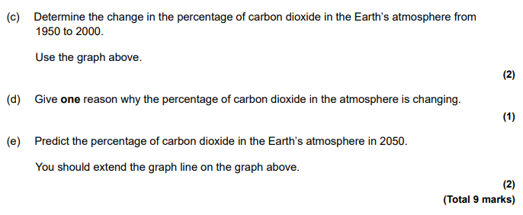
Assessment: Trilogy Chemistry 2F 2021
Notes:
Examples of questions only to show that it doesn’t matter how you are teaching it. You can still access the questions. See the following 3 examples.
Don’t need to teach it chopped up in subject areas to be able to access the questions
Teaching this way gives more opportunities to introduce unfamiliar contexts to support AO2 in assessment and give a more holistic understanding of the topics
There may be more opportunities for writing to help with teaching extended response skills

Slide 18
Assessment: Trilogy Biology 2F 2021
Notes:
Examples of questions only to show that it doesn’t matter how you are teaching it. You can still access the questions. See the following 3 examples.
Don’t need to teach it chopped up in subject areas to be able to access the questions
Teaching this way gives more opportunities to introduce unfamiliar contexts to support AO2 in assessment and give a more holistic understanding of the topics
There may be more opportunities for writing to help with teaching extended response skills

Slide 19
Assessment: Trilogy Biology 2H 2020

Slide 20
8465 Synergy
4.4 Explaining change
The Earth's atmosphere
Ecosystems and biodiversity
Inheritance
Variation and evolution
Notes:
Synergy links content. Direct teachers to it for ideas. Same content as Trilogy.

Slide 21
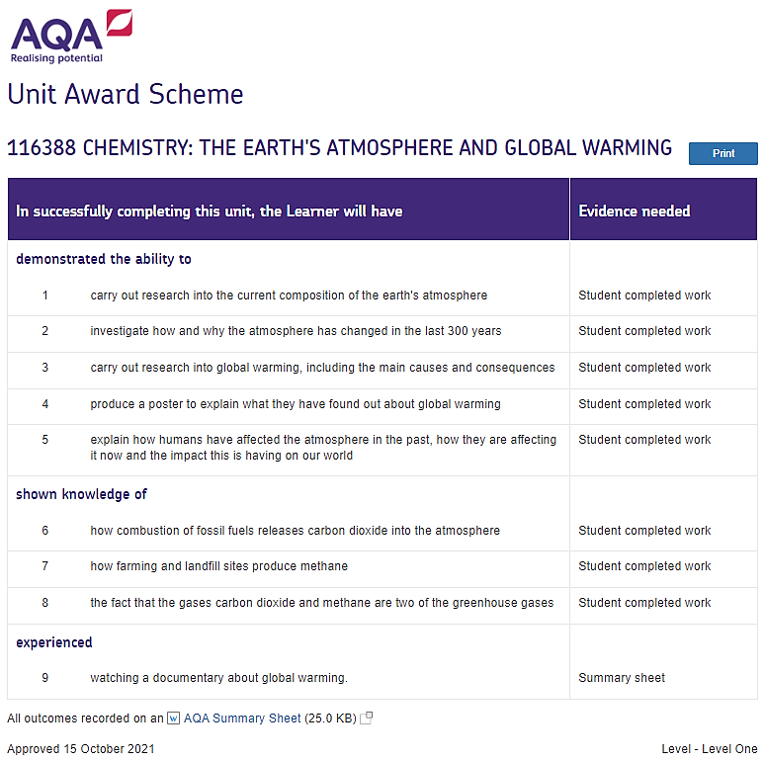
AQA UAS example
Notes:
Use of UAS in climate teaching

Slide 22
Resources and ideas
STEM – Climate Change Education Partnership
RSC – 14 ways to teach sustainability in Chemistry
IOP – Looking Glass: Climate Solutions
SAPS – Bog Core Analysis and Climate Change
Teachers Climate Guide
COP27: How school partnerships can help with climate learning
Notes:
External links that may be useful

Slide 23
A-level Environmental Science

Slide 24
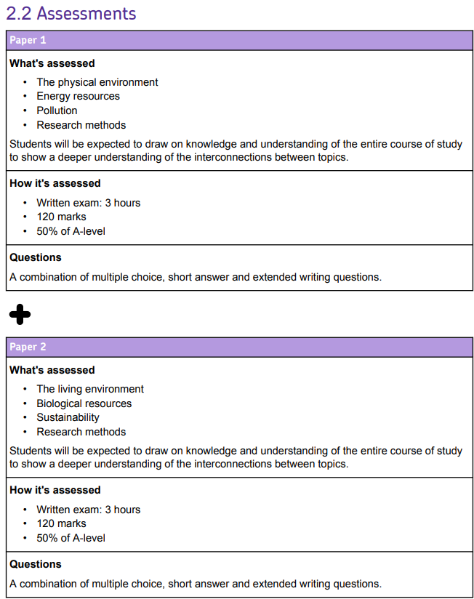
Environmental Science summary
3. Subject content
3.1 The living environment
3.2 The physical environment
3.3 Energy resources
3.4 Pollution
3.5 Biological resources
3.6 Sustainability
3.7 Research methods
Notes:
Key points about the qualification

Slide 25
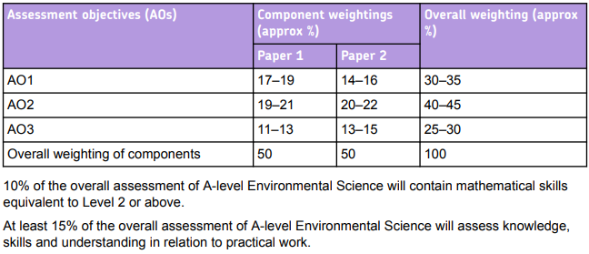
Environmental Science summary
Notes:
Key points about the qualification

Slide 26
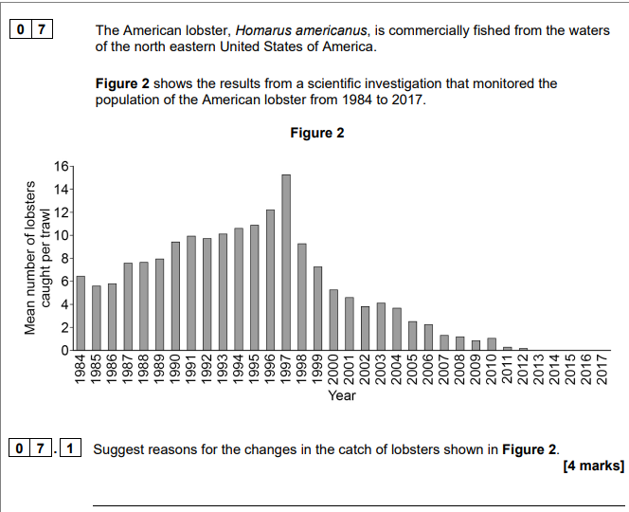
Exam question examples 2021
Long Island Sound Study and Connecticut Department of Energy and Environmental Protection
Notes:
To give you an example of the kinds of questions that you might find on the papers.
Here we see examples from paper 2 2021 that cover all three AOs.
Question paper: Paper 2 - November 2021 (aqa.org.uk)
6.1 AO1
6.2 AO2
7.1 AO3

Slide 27
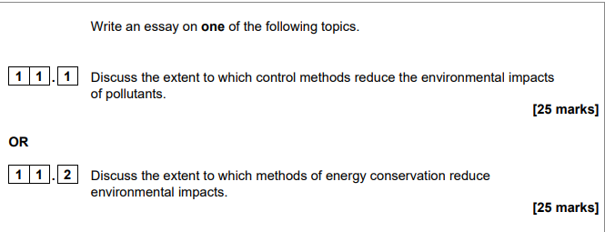
Assessment: Synoptic essay question Paper 1 and 2
Notes:
Example of essays from P1 and P2.
Show style of question and marks

Slide 28
Practical handbook
Page 26
Notes:
Practical handbook available at our table

Slide 29
Get in touch
Our friendly team will be happy to support you between 8am and 5pm, Monday to Friday.
Tel: 01483 477756
Email: gcsescience@aqa.org.uk alevelscience@aqa.org.uk
Twitter: @AQA
aqa.org.uk
Copyright © 2023 AQA and its licensors. All rights reserved.
Notes:
Our relevant Twitter accounts are:
@AQAEnglish (English subjects)
@AQAMaths (Maths subjects)
@AQA (Any other subjects).

Slide 30
Thank you

