Slide 1
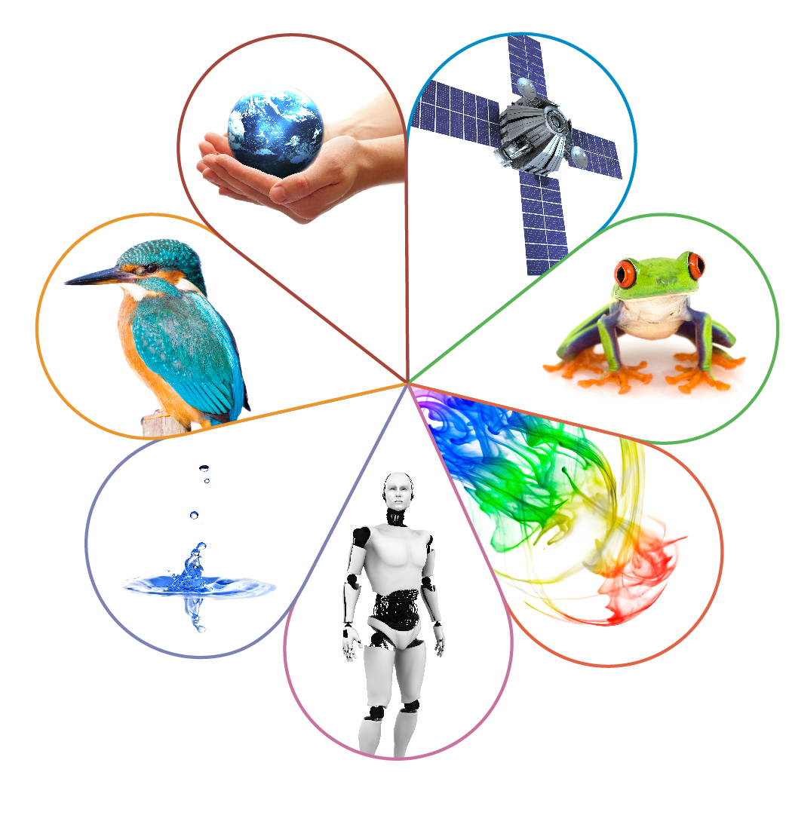
ASE 2023: Reinvigorating the learning experience during practical lessons
Jane Bryant
Spring 2023

Slide 2
Focus of today’s session
Why do we do practical work in schools?
Indirect assessment of practical skills in GCSE and A-level sciences
What we assess
How we assess it
Student performance on practical questions.
The cookbook problem of ‘the scientific method’
Introducing Project Calibrate
What’s Brandon’s Matrix?
Helping widen student experience in practical lessons
Notes:
This is how this presentation is structured:
Why do we do practical work in science? What is it we want students to gain?
What skills do we assess in our GCSEs and A-levels?
How do we do this?
I’m then going to focus on GCSE but what I’m discussing could be taken forward into A-level practical work also
I’ll look at particular issues GCSE students have with practical skills assessment – some examples of common problems from summer 2022 papers – but they’re not unique to this summer, if you look back at feedback and examiners’ reports from 2018, 2019 – and even back to previous specifications there has always been difficulty.
So we’ve identified a problem – what’s stopping students being able to apply their learning from practical sessions into written papers?
And what can we do about it?
I’m going to be talking about a project that you might not know about or not have had much time to look at, but which might give you some ideas and support about widening student experience in their practical lessons to help improve their understanding.

Slide 3
Why do we do practical work in schools?
To support and consolidate science knowledge and understanding.
To develop investigative skills.
To build mastery of practical skills for future study or work.
To encourage inquisitiveness.
Notes:
So, why do we go through all the trouble we do to ensure students have a thorough experience in practical work in school?
Here are some main headings – any other thoughts?
How does assessment help students achieve these goals? Does assessment help students achieve these goals?
The next couple of slides reiterate how we assess practical skills at both A-level land GCSE.
Starting with the A-levels, at A-level we assess skills both directly and indirectly. You will all be familiar with the direct assessment of skills at A-level through the CPACs and practical endorsement – but in this session I will be focussing on the indirect assessment – ie through written exams

Slide 4
Indirect assessment of practical skills
At least 15% of marks assess the skills and understanding gained through doing practical work.
Practical skills criteria (A-level)/Working scientifically criteria (GCSE).
Knowledge and understanding of the apparatus and techniques criteria.
All three assessment objectives (AOs).
Appropriate maths skills such as plotting and interpreting graphs.
Familiar and unfamiliar contexts.
Knowledge of subject content through a practical context.
Notes:
Indirect assessment for AS, A-level and GCSE is through the same medium – exam questions. At A-level we also have direct assessment of some practical skills (the CPACs) but in this session I am focusing only on the exam papers.
For all the sciences, at least 15% of the marks assess the skills and understanding gained through doing practical work.
What do we actually assess?
We assess the Practical Skills criteria and Working Scientifically criteria, as set out by the DfE in the subject content. The A-level criteria are very similar to the GCSE ones, but are intended to develop more independence (as expected at A-level). See each specification for more detail. we’ll have a quick look at those on the next few slides.
The AT criteria are set by the DfE, and listed in the sections on practical assessment in each specification. The AT criteria are subject-specific (although some of them are quite general and would be common to all practical work)
For either level, knowledge and understanding of the AT criteria is gained through carrying out Required Practicals. The RPAs are devised to ensure they cover the AT criteria.
For all levels (in a practical context):
AO1 – Demonstrate knowledge and understanding of scientific processes, techniques and procedures
Includes assessment of knowledge of practical techniques, such as measuring, use of correct apparatus, carrying out basic methods (such as dilutions, titrations, setting up electrical circuits). Will also assess knowledge of scientific content in a practical context.
AO2 – Apply knowledge and understanding of scientific processes, techniques and procedures
Slight variation between Ofqual requirements for the GCSEs and A-levels, but very similar guidance.
For the GCSEs Application of knowledge and understanding is assessed ‘principally in novel situations that are not clearly indicated in the specification’ and ‘Scientific enquiry, techniques and procedures encompasses, but is broader than, knowledge and understanding of the core practical activities’.
For the A-levels they state that AO2 should relate principally to ‘novel situations that are not clearly indicated in the specification’; ‘developing further material that is covered in the specification’.
This all means that students should expect to see questions based on methods or experiments they have not done. The point of these questions is to assess their ability to apply knowledge and skills.
AO3 – Analysis, interpretation and evaluation
Students will be given experimental data to analyse and evaluate. There is a requirement to address a range of material. Students should understand that this will not always be in the context of a practical they have done themselves but the skills they have gained through their learning will enable them to answer the questions. Where Learners’ conclusions relate to practical work, they would involve either refining practical design and procedures or developing/planning practical procedures to solve problems

Slide 5
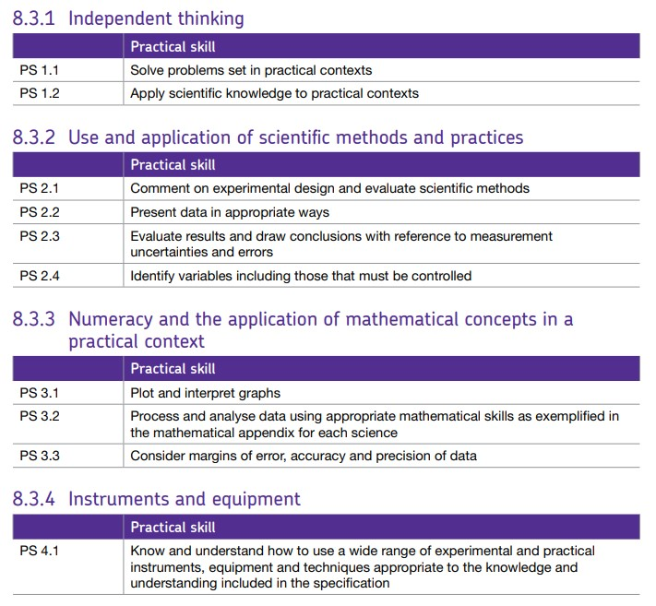
A-level practical skills criteria
Notes:
This is the practical skills list that you will find in all of the AS and A-level science specifications – this one is copied from the A-level Chemistry specification

Slide 6
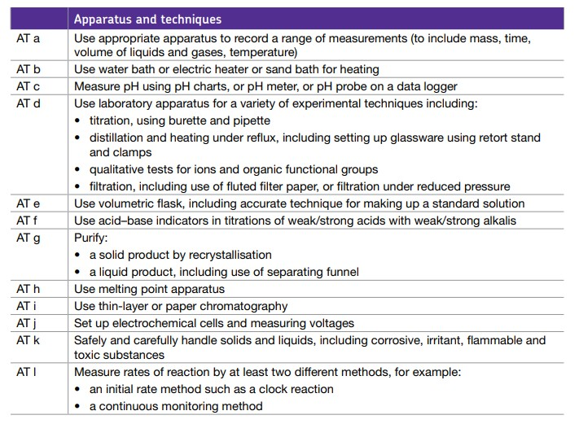
A-level apparatus and techniques criteria
Notes:
The AT criteria, which we assess in the written exams, are detailed in the specification. They are subject specific, although there is some commonality in ATa between the subjects, which is about using appropriate apparatus to make and record measurements. These are the A-level Chemistry criteria

Slide 7
GCSE working scientifically criteria
WS2: Experimental skills and strategies
WS2.4 Carrying out experiments appropriately, accurately and safely
WS2.6 Making and recording observations and measurements
WS3: Analysis and evaluation
WS3.1 Presenting observations and other data appropriately
WS3.2 Translating data from one form to another
WS3.3 Carrying out and representing mathematical and statistical analysis
WS3.8 Communicating the scientific rationale for investigations, methods used, findings and reasoned conclusions through paper-based and electronic reports and presentations
Notes:
At GCSE practical skills are assessed through the Working Scientifically criteria and the AT criteria.
This is a very brief resume of the more ‘hands-on’ GCSE Working scientifically criteria that relate to practical work and build up to the more independent working at A-level.
These are listed in detail in Section 3 of each of our GCSE science specifications.
You might like to look at all of them at some point and see where (if) you can see how the GCSE WS can be used to build to the CPACs and to the A-level practical skills

Slide 8
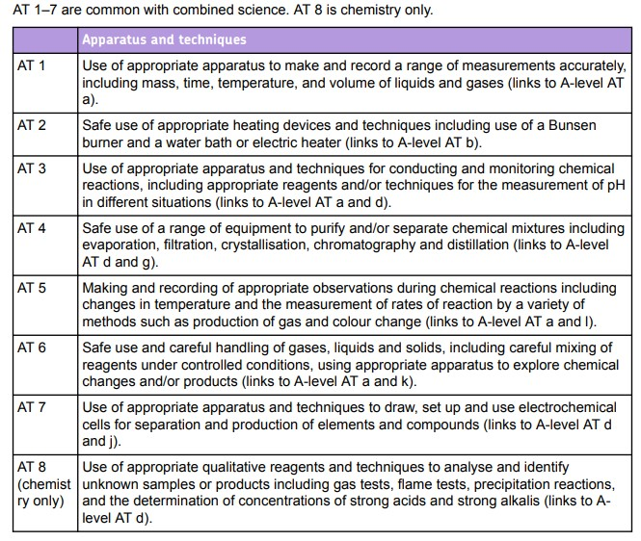
GCSE apparatus and techniques criteria
Notes:
This is the list of Ats for GCSE Chemistry – as with the A-level AT criteria they are subject specific, although there is a lot of commonality in AT1 across biology, chemistry and physics. You can see here that we have made it clear where the links from GCSE to A-level are.

Slide 9
Practical skills assessment and the AOs
AO1: demonstration of knowledge and understanding
knowledge of practical techniques, use of correct apparatus, safe working
carrying out basic methods such as dilutions, titrations, setting up electrical circuits
knowledge of scientific content in a practical context.
AO2: application of knowledge and understanding
questions based on methods or experiments students have not done
the point of these questions is to assess their ability to apply knowledge and skills.
AO3: analysis and evaluation
students will be given experimental data to analyse and evaluate
not always in the context of a practical they have done themselves but the skills they have gained through their learning will enable them to answer the questions
refining practical design and procedures or developing/planning practical procedures to solve problems.
Notes:
This shows how practical skills assessment ties in with the Assessment Objectives: as you can see, different questions will address different Aos.
There are examples of how different types of question address the different Aos in the support booklet, pages
All of these things (AOs, WS and ATs) tie in together, so to ensure students are well equipped, you need to be covering relevant WS, AO, AT and maths skills as well as relevant content when you are doing practical work. That’s a big ask.

Slide 10
Practical skills questions
Write/describe a method.
Identify risks and hazards and suggest ways of avoiding or mitigating them.
Understand and identify control, dependent and independent variables.
Identify and explain errors.
Suggest improvements to a method.
Read measurements.
Record experimental data appropriately.
Interpret data.
Draw conclusions from experimental information.
Comment on validity of procedures.
Suggest a hypothesis.
Make predictions about observations or results.
Notes:
These are the common types of tasks we will ask students to do in our exams
Practical skills assessment in relation to AO1 are more likely to be in the context of a practical they know.
It’s very varied, as you can see – but we will ask all students at all levels of demand to demonstrate these skills

Slide 11
Student performance on practical questions
Performance on practical questions this summer and in past exams shows that students can’t seem to apply what they have done in practical lessons to the context, particularly:
understanding why key steps were being carried out
correct use of equipment
identifying control, dependent and independent variables
recognising errors and reasons for errors
suggesting possible improvements to methods
understanding key working scientifically terms
drawing conclusions
drawing lines of best fit
using and interpreting information in graphs.
Notes:
So, this session is offering you a solution – but what’s the problem?
The problem is that students struggle to answer questions based in a practical context – particularly if it’s in a context they haven’t come across. These are all weaknesses shown in this summer’s exams – across all subjects.
So they can’t seem to apply what they have done in practical lessons to the context. They don’t have a deep enough understanding of why they’re doing what they’re doing to be able to apply it.
The example questions in the booklet on pages are all questions that students struggled to answer well this summer. There are also a number of different examples, including student responses in the support materials for one of the other sessions we’re presenting (Implications of the Summer Series)
I don’t think you’ll be surprised by any of these: they’re the kind of issues we’ve been talking about for a while. It’s possible that some of them are exacerbated this year as a result of not being able to get as much hands on practical experience over the last couple of years.
So, how can we help students to do what they need to do?

Slide 12
Introducing Project Calibrate
Joint project between Oxford University and AQA, funded by the Wellcome Trust, Gatsby Foundation and the Royal Society.
Aims of the project:
to broaden the scope of practical science at Key Stage 4
to give students a better understanding of the wide variety of methods scientists use while conducting investigations.
Approach:
‘hands-on’ and ‘minds-on’ practical science
challenges the simplistic, step-by-step process of ‘the scientific method’ as hypothesis testing through experiments (the ‘cookbook’ problem)
uses a tool called Brandon’s Matrix to give an account of diversity in scientific methods.
Free teaching and CPD resources for teachers on different approaches to practical work, including sample summative assessments.
Notes:
Have you heard of Project Calibrate? Yes/No
The project has developed a range of free teaching and CPD resources which you may like to take a look at. They include
videos talking through different approaches to practical work
sample assessments that target students understanding of the practical investigations as well as their understanding of Working scientifically.
This project was a research collaboration between AQA and the University of Oxford with the aim of fostering effective teaching and learning of practical science at GCSE.
The approach taken develops the ‘hands-on’/’minds-on’ approach to practical science teaching – which I will explain further in a couple of slides
Concerns were raised by science stakeholders (who funded the project) that (for many understandable reasons including lack of time in the curriculum) students are often exposed to only a fairly simplistic account of the science method, causing a ‘cookbook’ problem (explained more in the next slide).
The underlying framework of practical science the project uses is called Brandon’s Matrix, which challenges the traditional linear model of the scientific method in the science curriculum.
A range of teachers and students took part in this project, and some of their comments are presented on the next slide along with the key findings.
The approach taken introduces the ‘hands-on’/’minds-on’ approach to practical science, which I will explore more a little later.

Slide 13
The ‘cookbook problem’ of ‘the’ scientific method
The scientific method is commonly used to refer to any type of science teaching and learning activity involving manipulating and/or observing of objects and materials in order to understand how science works.
Reduces science to a series of steps:
1. Question: What do I want to learn? What question do I want to answer?
2. Do research: What questions do I need to answer before I get started? What can I learn from past experiments?
3. Make a hypothesis: What is my best guess of what will happen? Make a prediction: ‘If ___ then ____ will happen’.
4. Experiment: Test the hypothesis. Record data.
5. Analyse: What were the results of my experiment? What does the data tell me about my hypothesis?
6. Share: What did I learn? What are my next steps?
Has led to the ‘cookbook’ problem in practical science teaching in which students principally follow predefined steps or a ‘recipe’ that requires little skill or understanding on the part of the student.
Notes:
This is what I mean by the cookbook problem.
A fairly typical depiction in school of how science is done involves the so-called ‘scientific method’, which is described as a process through which scientists produce robust evidence by applying procedures such as experimentation and observation.
The numbered points come up on successive clicks to make the point.
According to this model, scientists begin with a question they want to answer. They then design an experiment and, by carefully tracing independent and dependent variables, they produce findings that help them answer the question.
However, such a stepwise and linear description of the scientific method is simplistic and hardly a realistic representation of how scientists actually do science. Rather, scientists engage in a wide array of methods some of which include hypothesis testing, and some other approaches including those where there is no manipulation of variables.
It has led to a problem of students following a method for a practical, but not being able to develop deeper understanding of why they are doing what they’re doing – which then leads to difficulty in answering questions that require them to apply what they have learned in a different context. This can also be described in terms of students being ‘hands-on’ and ‘minds-on’.

Slide 14
Differences between ‘hands-on’ and ‘minds-on’
A student who has had the opportunity for ‘hands-on’ can:
follow a method correctly
manipulate apparatus correctly and safely
make and record observations and results
present data in an appropriate format.
A student who has had the opportunity for ‘minds-on’ can also:
understand the reasons for using a particular method
understand what variables need to be manipulated, if any
understand why variables are being (or not being) manipulated
understand about sampling
understand about sources of error and how to minimise them
use their understanding to choose appropriate methods for different situations.
That is, they can think like a scientist as well as carry out procedures.
Notes:
So – what do I mean by ‘hands-on’ and ‘minds-on’? What is the benefit of one over the other? Some of you may have come across this and the next slide before, as I have used them in a previous Virtual Communities meeting.
First click Students who have had the opportunity to experience ‘hands-on’ will be able to carry out the physical aspects of investigations: manipulating apparatus, following a method and taking, recording and presenting readings.
Second click But there are many other aspects that this approach doesn’t necessarily cover. These are the ‘minds-on’ aspects. A student who has had the opportunity for ‘minds-on’ will also
understand the reasons for doing a particular method
understand why variables are being (or not being) manipulated
be able to adapt a specific method to a different set of circumstances (eg to answer a slightly different question/test a different hypothesis)
understand about sampling
understand about uncertainty, accuracy, precision, repeatability, reproducibility and potential causes of error
comment on the extent to which data are consistent with hypotheses
evaluate, adapt or improve a method.
Third click These are the ‘soft’ practical skills if you like. Developing them means you will be more able to apply any knowledge you have gained from one context to another. Note how many of them start with ‘understand’
Our Focus on Success Pack on Disciplinary Language includes a section about these skills.

Slide 15
Advantages of using a ‘minds-on’ approach
Develops the ability to apply practical skills to different situations.
Students understand more about the principles behind the investigation, rather than simply following or memorising a recipe, so:
are more able to cope with the unfamiliar situations in practical-based exam questions
develop transferrable skills for later study/work.
Embeds these principles in student thinking so they are more confident:
independently working at A-level to achieve CPAC criteria
doing independent practical research when progressing to higher education.
Encourages a more open approach to practical investigation.
Makes practical work more interesting/engaging/applicable.
Notes:
BP1 In our exam papers most of the practical based questions are set in a context students are unlikely to have come across, so being able to apply what they have learned in one context to a different context is really important in terms of how well they do.
BP2 It means that they can look behind the unfamiliar context to the science underneath and use their understanding of that science to answer the questions. And this skill of looking below the surface will be so useful for them in further study and in the world of work. That is, they are more equipped to answer the types of questions on slide 11 – the ones where students still seem to struggle.
BP3 At A-level independent thinking and understanding of why they are doing what they are doing is part of the CPAC criteria. And building these skills will give students a head start when they start independent study at university.

Slide 16
Project Calibrate teacher workshops
Teachers attended a workshop or webinar that introduced Brandon’s Matrix and used the pilot assessments in the classroom.
Activity:
in groups, put the GCSE required practicals on Brandon’s Matrix as you would normally teach them
discuss the output and any differences of opinion, especially any that come from teaching practice.
Pilot assessments: in groups, plan a lesson around one of the topics, asking
How could I convey Brandon’s Matrix to my students?
Which method(s) from Brandon’s Matrix will I focus on in the practical?
What content/theory do I need to teach in order to undertake the practical?
Notes:
So, how did this project work?
In workshops, teachers used Brandon’s Matrix to analyse how they would normally teach the GCSE required practicals and used the pilot assessments, which were devised based on the Brandon’s Matrix, to plan a lesson and see how it would change their attitude to practical teaching

Slide 17
Teacher and student responses to Brandon’s Matrix
‘I think it is a really good way of kind of like organising the practicals that we already have within our curriculum. It makes it really clear to see what we clearly do assess and what we focus on a lot, and where our areas of weakness are […] I thought it was a really good model, really clear model and quite easy to understand as well.’
‘They [students] felt like they had more ownership of it because they had more say in what they were actually doing. So they understood the logic behind it.’
‘I felt that it made the practical go better because it made the children think about what they were doing.’
‘It makes them think about variables. So that becomes an active process. It is in the foreground, not the background.’
Notes:
Teachers and students involved in the project were asked about what they thought about Brandon’s Matrix Their feedback was overwhelmingly positive.
They saw it as a useful framework to allow teachers and students think about the methods they use and will use in practical science, and were pleased with the broader, more nuanced approach, compared with the narrow view of “the scientific method” that many students are presented with.
Students also indicated that the Project Calibrate approach helped them understand scientific methods better. – the two comments ‘I liked the questions because’ and ‘Before I watched the videos …’

Slide 18
Teacher and student responses to Brandon’s Matrix
‘I think it's an opportunity for students to think more deeply about practical methods of investigation.’
‘I like it as a teaching tool. I like it as a way of making children think.’
‘I liked the questions because they helped me really think about the experiments I have done previously.’
‘Before I watched the videos I thought all scientific investigations require a hypothesis of some sort, which these videos disproved in an easy to understand way. Thank you for opening my eyes.’
Notes:
Teachers and students involved in the project were asked about what they thought about Brandon’s Matrix Their feedback was overwhelmingly positive.
They saw it as a useful framework to allow teachers and students think about the methods they use and will use in practical science, and were pleased with the broader, more nuanced approach, compared with the narrow view of “the scientific method” that many students are presented with.
Students also indicated that the Project Calibrate approach helped them understand scientific methods better. – the two comments ‘I liked the questions because’ and ‘Before I watched the videos …’

Slide 19
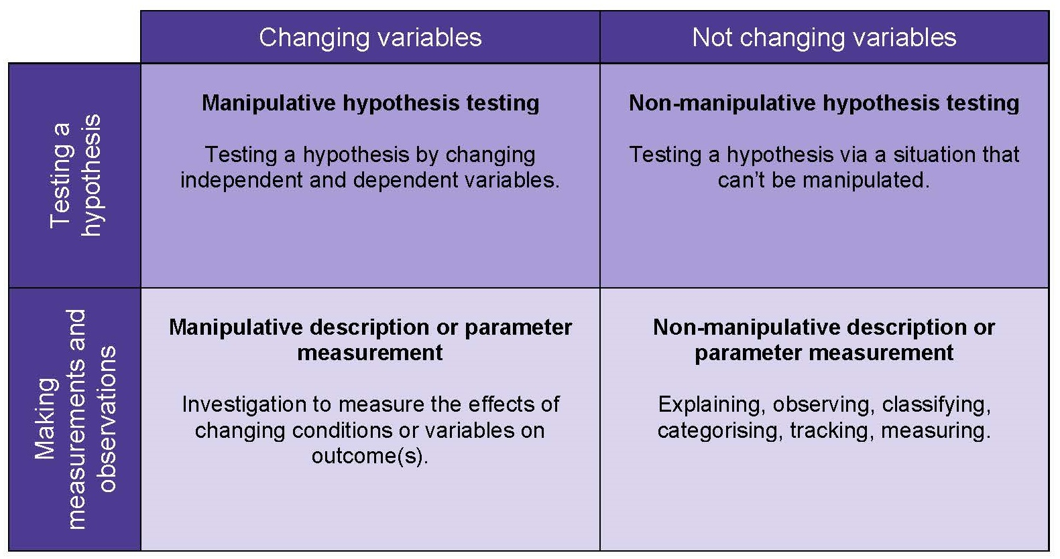
What is Brandon’s Matrix?
A simplified 2 × 2 matrix based on two questions:
Are we testing a hypothesis, or are we making observations and measuring parameters?
Are we changing (manipulating) variables, or not?
Notes:
So, what is this Brandon’s Matrix?
It is the tool used by Project Calibrate to challenge the traditional linear model of the scientific method in the science curriculum.
It’s a simplified 2 × 2 grid based on two questions:
Are we testing a hypothesis or are we making observations and measuring parameters?
Are we changing variables or not?
Illustrates that not all experiments rely on hypothesis testing and that not all descriptive work is non-manipulative.
This is an explanation of the four quadrants. For more information on the matrix and how you could use it in your teaching and learning go to the project page.
A contemporary example about Brandon’s matrix involved the Covid-19 pandemic. Scientists collect data on how the virus might be influencing a patient’s breathing over a period of time. Such observation is simply based on the recording of parameters where there is no manipulation of variables in the sense of an experimental design. Sometimes the data might be subjected to hypothesis testing about the correlation between incubation period and extent of lung disease, but without an experiment resulting in non-manipulative hypothesis testing. Scientists may conduct randomised control trials in which a drug could be treated as a variable in interventions that also include control groups to test the placebo effect.
The resources on the Project Calibrate page include some videos of how a particular practical could be handled in each of these four ways – you might find these very informative for ideas in your own teaching
I’ll come back to this matrix in a little while

Slide 20
Planning required practicals around Brandon’s Matrix
What’s the format of your practical lessons?
Do you mostly use the ‘hypothesis/test/analyse’ approach or do you use different approaches dependent on the practical?
What quadrant of Brandon’s Matrix would your practical sessions mostly fall into?
How do you think that affects students’ ability to answer practical questions in the exams?
Is there scope within your lesson plans to vary the practical work to cover different aspects, ie can we explore the science in another way?
Notes:
What sort of variety do you use with your students? What quadrant would most of your practicals fit into? Do you get a spread, or are they primarily based on that top left hand quadrant?
Looking at exam questions that students commonly struggle to answer, might there be scope to change some of what you do to open students’ thinking to other aspects of the scientific method?
Is it possible to plan practicals around the RPs that cover different aspects?
Videos on the PC website have ideas based around three of the RPs – but let’s have a look at how you could set something up
Also examples of assessments based on the quadrants of the matrix for each of these RPAs

Slide 21
Reframing a practical to move it around the matrix
Biology RPA 7: Plan and carry out an investigation on the effect of a factor on human reaction time
✓
✓
Notes:
Let’s have a look at one of the suggested methods from our practical handbook and see how it fits into the Matrix
This is Biology RPA 7 – investigating the effect of a factor on human reaction time. I’ve copied the method into the support document for the session – pages
In the Handbook method students are encouraged to make a simple hypothesis that they test using a given standard method. They are asked to suggest the condition they are gong to change, but it does not go into depth on independent or dependent variables – so you could argue for it to fit into two of the four quadrants (not top or bottom right).
How do you do this practical with your students?
What quadrant do you think your practical would sit in? Why?
Is there scope within this practical to put it into another quadrant? How?
What learning could students gain by varying the practical to fit into a different quadrant?
There is no right or wrong here. I’m just getting the discussion going to help you think outside the ‘cookbook’ approach. And see if there are other ways of presenting practical work that will widen student experience and deepen their understanding.

Slide 22
Reframing a practical to move it around the matrix
Chemistry RPA 3: Investigate what happens when aqueous solutions are electrolysed using inert electrodes
✓
Notes:
Here’s an example of one of the Chemistry RPAs: Electrolysis
Support booklet pages
Let’s have a look at one of the suggested methods from our practical handbook and see how it fits into the Matrix
IN this practical students are observing what happens when an aqueous solution of a salt (copper chloride and/or sodium chloride) is electrolysed.
What quadrant does this experiment fit into?
How do you do this practical with your students?
What quadrant do you think your practical would sit in? Why?
Is there scope within this practical to put it into another quadrant? How?
What learning could students gain by varying the practical to fit into a different quadrant?
Again, there is no right or wrong here. I’m just getting the discussion going to help you think outside the ‘cookbook’ approach. And see if there are other ways of presenting practical work that will widen student experience and deepen their understanding.

Slide 23
Reframing a practical to move it around the matrix
Physics RPA3: Investigating how the resistance of a wire depends on its length.
✓
Notes:
And here’s an example from the Physics RPA3 on investigating the factors that affect the resistance of an electrical circuit.
IN this practical students are measuring the potential difference and current across a circuit and how that changes when the length of the wire changes.
What quadrant does this experiment fit into?
How do you do this practical with your students?
What quadrant do you think your practical would sit in? Why?
Is there scope within this practical to put it into another quadrant? How?
What learning could students gain by varying the practical to fit into a different quadrant?
Again, there is no right or wrong here. I’m just getting the discussion going to help you think outside the ‘cookbook’ approach. And see if there are other ways of presenting practical work that will widen student experience and deepen their understanding.

Slide 24
Reframing a practical to move it around the matrix
Using a blank matrix, could you think of other practical activities you do in school to introduce the ideas of the different scientific methods to students?
Which quadrant might you start in?
How might you adapt the practical to move through different aspects?
Notes:
Here’s a blank matrix – could you think of other practical activities you do in school that move around the matrix to explore different aspects of scientific thinking.
Brief discussion here – where in the matrix might you want to start in a series of practicals? Perhaps you might just want students to observe something – eg:
In a set of field studies start by simply looking at and classifying the the different types of organisms in a quadrat
Then you might like to move on to noticing that there are more (I don’t know, dandelions) in a particular area than in another so you might want to measure the numbers
Then you might move on to hypothesising a reason for the higher number in this area in others and devise an experiment to test that hypotheses

Slide 25
Using Brandon’s Matrix to support a practical session
Introduce the different scientific methods to students:
scientists perform investigations in a variety of ways
sometimes they test a hypothesis by changing variables
sometimes they change variables to see the outcome of the investigation without developing a hypothesis
sometimes they only make observations without developing a hypothesis or manipulating any variables.
Introduce the practical, including any subject content, skills or working scientifically points you want to emphasise or use as the background.
Explain the quadrant of the matrix the practical fits into (not every practical session covers all quadrants).
Introduce questions during the session to explore student understanding.
Get students to think about how they could adapt or do other work around the RPA that would involve the other quadrants.
Notes:
Some ideas from the project on how you could use the matrix to support a practical session.
Introduce the matrix (could be in a pretty simple form) and the variety of methods scientist use
Introduce any learning objectives for the lesson – maybe you’re looking at a particular bit of subject content – eg in an electrolysis experiment revisit what electrolyisis is, what a salt is, etc
Introduce what this practical will be doing and what quadrant is falls into – eg in this practical we’ll be observing what happens when we electrolyse copper chloride solution.
Ask questions about student understanding – eg are we manipulating any variables here? If we are, what are we manipulating? What is the dependent/independent variable?
Why are we changing/not changing things?
Etc
Benefit of this is to get students really thinking about why they’re doing what they’re doing rather than simply following the method – helps to apply to other experiments.

Slide 26
Support materials from the project
Look at the teaching and learning resources videos on the Project Calibrate website for some ideas:
Introduction to scientific methods
Osmosis (Biology RPA3)
Chromatography (Chemistry RPA6)
Refraction (Physics RPA9)
Project Calibrate have produced a CPD pack
Summative assessment tasks that can be used to target students’ understanding of the practical investigations and of how science works
Notes:
The Project Calibrate website presents four videos produced as part of Project Calibrate to show possible ways of teaching about scientific methods. The introductory video discusses different methods that are applied by scientists in order to answer their questions. The rest of the videos present practical investigations performed by the Calibrate team, while they discuss the scientific methods that are applied in each of the investigations.
The PC videos look at three RPAs in GCSE – Chromatography (Chemistry RPA 6), Osmosis (Biology RPA 3), Refraction (Physics RPA 9)
They also have a CPD pack for teachers to use that explains the project, and how to use the principles to enhance your teaching.
There are summative assessments for a number of required praacticals at GCSE – you might like to use some of these in your teaching, or use the ideas within them to adapt some of our live assessment materials to help deepen student understanding.
The project hope that use of Brandon’s Matrix could become as ubiquitous in teaching of practical work as Bloom’s taxonomy is in teaching.

Slide 27
AQA resources to help student progress
AQA Focus on success packs:
Disciplinary language
Practical questions
AO2
AQA teaching guide on common misunderstandings
AQA Virtual communities meetings
Notes:
BP2 The latest Focus on success pack looks at some of the issues students have with:
The use of disciplinary language in GCSE science assessments
The language examiners use in questions.
It’s the final piece in understanding the GCSE assessment model, and much of it is based on research carried out by the Education Endowment Foundation.
The pre-reading touches on accessibility and reading age in our papers, which teachers may find useful in understanding our questions better it would also help you in designing your own assessments.
The pack also looks at the working scientifically vocabulary and the importance of understanding what is required to answer certain command words.
It is definitely not about strategies to teach literacy in science or misconceptions in science content. It is looking at this from an assessment angle.
BP3 Students demonstrate common mistakes and misunderstandings, which we see every exam series. This booklet gives clear guidance for both teachers and students on what we see, covering each question type – see purple list to the rhs of the slide. Explains common errors examiners see (including in exam techniques) and gives top tips for the teacher and student to avoid making them.
Would be a useful tool to use after first mocks to help diagnose and correct any issues.
BP4 In our Virtual Communities meetings we focus on a particular aspect of assessment and how our resources can be used in teaching and learning. Recent meetings have covered:
Supporting students in understanding subject content using AO1 questions
Supporting students in their application of practical skills in unfamiliar contexts
Supporting transition from KS3 to GCSE and from GCSE to A-level using a key transferrable maths skill in science
Understanding the requirements of some key command words in exam papers using student responses
Revisiting AO2 – what it is, how we assess it, suggestions for supporting students in applying their knowledge, particularly in unfamiliar contexts
Revisiting Extended response questions
The materials from these meetings are all free to download from our website.
BP5 The CREST team produce excellent resources to support practical science in the curriculum and this document shows how you can build open-ended practical work in your teaching, supporting Required practicals and building on the CPACs

Slide 28
Any questions?

Slide 29
Get in touch
Our friendly team will be happy to support you between 8am and 5pm, Monday to Friday.
Tel: 01483 477756
Email: gcsescience@aqa.org.uk alevelscience@aqa.org.uk
Twitter: @AQA
aqa.org.uk
Copyright © 2023 AQA and its licensors. All rights reserved.
Notes:
Our relevant Twitter accounts are:
@AQAEnglish (English subjects)
@AQAMaths (Maths subjects)
@AQA (Any other subjects).

Slide 30
Thank you

