Slide 1
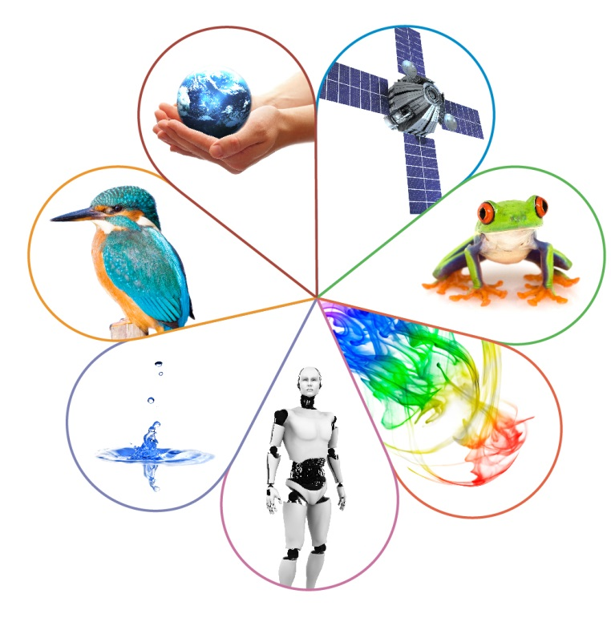
ASE 2023: Implications of the summer series
Elise Reece
Spring 2023

Slide 2
Welcome

Slide 3
Session structure
Key messages from the summer
Marking guidance
Focus on success teaching guides

Slide 4
Outcomes and grade boundaries
The policy of more generous grading was applied across all subjects and levels of qualification.
The government’s intention was and is to perform a stepped return to the grade standard of 2019 to ensure the value and integrity of examinations in the wider sphere.
National outcomes in 2022 are lower than in 2021 (TAGs) but higher than in 2019.
Grade boundaries were set to achieve outcomes that were a mid-point between 2021 and 2019 values.
Some boundaries are higher than 2019 because of the unique situation of 2022.
Advance information, the extended Physics equations sheet, the 9 marks awarded for the error on the GCSE Physics 1H paper and more generous grading have all had an effect on the grade boundaries for 2022.

Slide 5
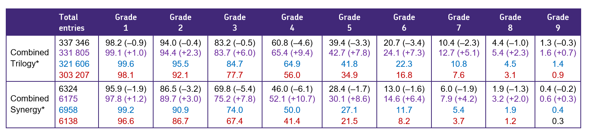
Outcomes: Combined Science
GCSE statistics 2022, with data from 2021 (TAGs), 2020(CAGs) and 2019 for comparison. Cumulative percentages at each grade.
Figures in brackets are the difference between 2022 and 2021 and 2021 and 2019.

Slide 6
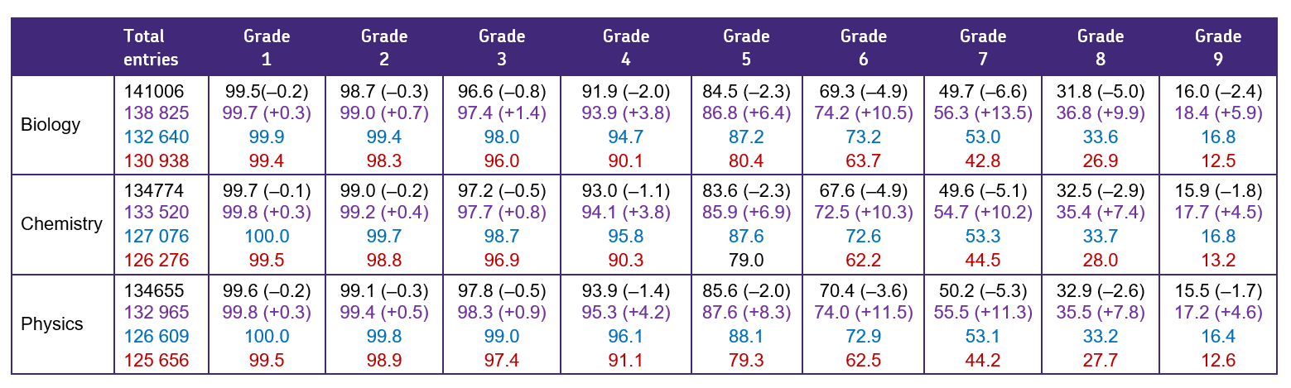
Outcomes: Separate sciences
GCSE statistics 2022, with data from 2021 (TAGs), 2020(CAGs) and 2019 for comparison. Cumulative percentages at each grade.
Figures in brackets are the difference between 2022 and 2021 and 2021 and 2019.

Slide 7
Ofqual announcement 29th September
‘We expect that overall results in 2023 will be much closer to pre-pandemic years than results since 2020. This decision means that results in 2023 will be lower than in 2022. At this point in the academic year, we can’t be precise about results in specific subjects and specifications. Entries have not yet been made and students have not taken any exams. But there is no pre-determined ‘quota’ of grades.’ - Grading Exams & Assessments Summer 2023 and Autumn 2022.’
Credit: Grading exams and assessments in summer 2023 and autumn 2022 - GOV.UK (www.gov.uk) Used under the Open Government Licence.
‘The Department for Education (DfE) has asked us to continue to require exam boards to provide formulae and revised equation sheets for GCSE mathematics, physics and combined science exams.’
Credit: Grading Exams & Assessments Summer 2023 and Autumn 2022. Grading exams and assessments in summer 2023 and autumn 2022 - GOV.UK (www.gov.uk) Used under the Open Government Licence.

Slide 8
Using grade boundaries in the future
The adjustments were not in play in 2019 so it is advisable not to draw comparisons between the two sets of grade boundaries.
These adjustments won't be available to support students except the extended Physics questions sheet which may be provided in summer 2023.
Grade boundaries are set to apply to that cohort of students sitting that particular paper on that day.
Using them under different circumstances needs to be done with caution and consideration.
If you are using the 2022 papers as mocks you may want to consider rank ordering your students and review the outcome profile you get when applying the 2022 grade boundaries to the historical profile of a ‘normal’ cohort in your school.
If you think this is not reflective of your cohort you may consider adjusting the grade boundaries.

Slide 9
Key messages from summer series
Tier of entry:
Due to more generous grading students have not fallen off Higher tier though students achieving grades 3 and 4 may have performed better on Foundation tier due to higher percentage of low-demand marks.
Tiering decision: Review performance in mocks on standard demand questions (common question plus 1 on higher tier).

Slide 10
Key areas of weakness in practical questions
Performance on practical questions showed weaknesses in a number of key areas (all examples are from Combined Science Trilogy):
understanding why key steps were being carried out (C1F Q5/1H Q1)
correct use of equipment (B2F Q2.1; P1F Q1.3; P1H Q5.1)
understanding risks and hazards (P2F Q2.1)
identifying variables and their meanings (C2F Q4.1; P1F Q3.6)
suggesting possible improvement to methods (B2F 2.7 P2H Q5.1)
recognising errors (C2F Q6.1/2H Q1.1)
drawing conclusions (B1H Q4.3; C2F Q6.2/2H Q1.2)
applying the science behind the practical (B1H Q3.3; C2H Q3.5)
understanding key working scientifically terms (P1F Q4.6)
plotting line graphs and bar charts (C2F Q1.1; C2H Q3.3; P1F Q4.2)
drawing lines of best fit ( C2H Q3.3 P1F Q4.2)
using and interpreting information in graphs (B1F Q5.4/1H 1.4) (B1H 3.6) (P1F Q5.1 and 5.2/1H Q1.1 and 1.2; P2F Q5.6; P2H Q6.2 and 6.3).

Slide 11
Key areas of weakness in content: Biology
The examples below are from Combined Science: Trilogy
role of bile in digestion (B1F Q1.5)
adaptation of palisade layer (B1F Q2.1)
why leaves go yellow (B1F Q3.2)
cancers (B1F Q4.4 and 4.7)
cell cycle (B1F Q6: Higher tier performed well)
determining a rate from a graph (B1H 3.6)
heart valves (B1H Q6.2 and 6.3)
why low blood sugar levels makes you feel weak (B2F 4.9: rest of question performed well )
recycling carbon (B2F Q5.5/2H Q1.6)
economic and environmental implications of nitrate fertilisers (B2H Q4.4)
identifying negative feedback and hormones (B2H Q5)
working out kingdom and domain (B2H Q6.1)
extracting information on polar bears’ hunting habits (B2H Q6.3).

Slide 12
Key areas of weakness in content: Chemistry
The examples below are from Combined Science: Trilogy
recognising an exothermic reaction (C1F Q2.5)
difference between an alloy and a pure metal (C1F Q3.9)
conduction of electricity in solids and molten solids (C1F Q4.6)
working out molecular formula from a picture (C1H Q4.3)
recognising fullerene from a picture (C1H Q5.1)
bonding and intermolecular forces in polymers (C1H Q5.4)
strong and weak acids (C1H Q6)
sulfur dioxide and pollution (C2F Q2.3 and2.4)
definition of a formulation (C2F Q3.8)
hydrocarbons and cracking (C2F Q5).

Slide 13
Key areas of weakness in content: Physics
The examples below are from Combined Science: Trilogy
relationship between resistance and current (P1F Q1.7)
thermal conductivity (P1F Q4.4)
national grid and step-up transformers (P1F Q5.3 and 5.4/1H Q1.3 and 1.4)
relationship between temperature and pressure (P1H 4.3)
stability of isotopes (P1H Q6.4)
labelling forces (P2F 3.1 and P2H 7.1)
calculating percentages (P1F Q5.1/1H 1.1).
Although students were able to identify the correct equations using the equations sheet many still struggled to substitute, rearrange or perform other maths skills needed in these questions (P1F Q6.3 and 6.4/1H Q2.3 and 2.4; P2F Q6.3 and 6.4/2H Q2.3 and 2.4).

Slide 14
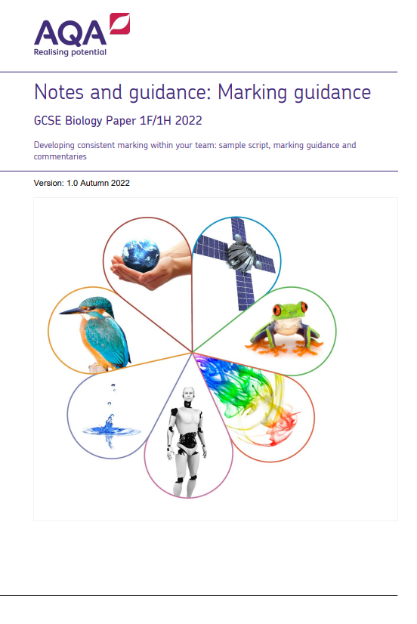
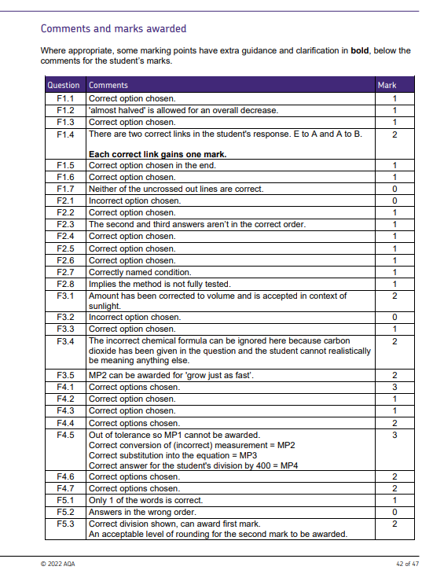
New resource to support marking mocks

Slide 15
Applying mark scheme consistently
Developing consistent marking: Marking guidance activity.
Mark scheme guidance and application:
  On-demand course gives expert instruction from a senior AQA examiner in how to apply mark schemes to key question types as well as providing the opportunity to take part in marking activities.
AQA | Professional development | Course details

Slide 16
Developing consistent marking: Aim of materials
To increase teachers’ understanding of, and increase their confidence in using the mark schemes.
To encourage discussion between teachers to develop a common understanding of the standards required and ensure consistency of marking across the team.
To help science departments feel confident they're consistently applying a mark scheme so have robust data on the cohort.

Slide 17
Robust and reliable
Scripts has been compiled from the materials the senior examiners used to ensure a common standard of marking across the whole AQA examining team for the paper.
Every response was discussed in depth by the senior examiners and marks and comments agreed before sharing with the wider examining team and producing the final version of the mark scheme.

Slide 18
Before your marking meeting
The person leading the training needs to:
read the introduction
read the introductory notes in a mark scheme – list rule etc
marked the script using the mark scheme held on centre services
compare their marking with the marks given in the Comments and marks awarded
print off the booklet, the grid (optional) and ensure teachers have access to the relevant mark scheme.
keep back the Comments and marks awarded pages till the end of the session.

Slide 19
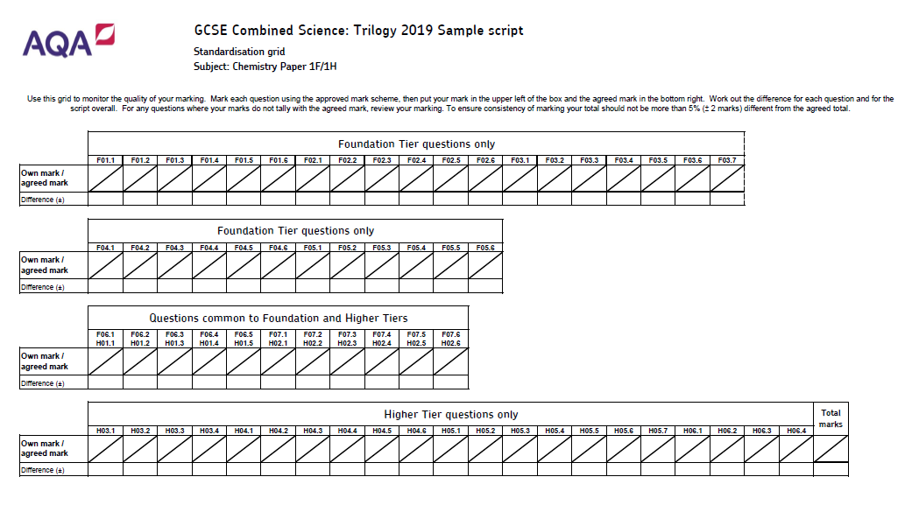
Record grid

Slide 20
Marking
The sample script has three sections:
Foundation Tier only questions.
Common questions Foundation and Higher Tiers.
Higher Tier only questions.
Ideally you want to cover all questions even the multiple choice to ensure consistency.
Silly mistakes can be made even when marking a 1 mark question.
Mark 1 full question at a time referring to the mark scheme.
Record the mark for each item in your individual grid.
Once a full question is completed check marks awarded using the Comments and marks awarded.

Slide 21
Marking
Record the mark for each item in your individual grid.
Once a full question is completed check marks awarded using the Comments and marks awarded.
Note down on the grid the mark awarded and compare with mark awarded.
Discuss any difference or difficulties with applying the mark scheme so as a department you can deal with any future similar responses.
The marks awarded for each item have already been agreed.
The point of this exercise is not to challenge them but for teachers to understand how the mark scheme has been applied.
Any response from a student however minimal and even if crossed out, should be treated as attempted.

Slide 22
Resources

Slide 23
Focus on success
Bring out the best in your students with our free assessment training packs.
Download all six packs for free.
AQA | GCSE | Combined Science: Trilogy | Planning resources
Each pack includes notes, ideas for group discussion, an activities booklet and handouts. They cover:
Disciplinary language.
Extended response questions.
AO2.
Practical questions.
AO3.
Maths in Science.

Slide 24
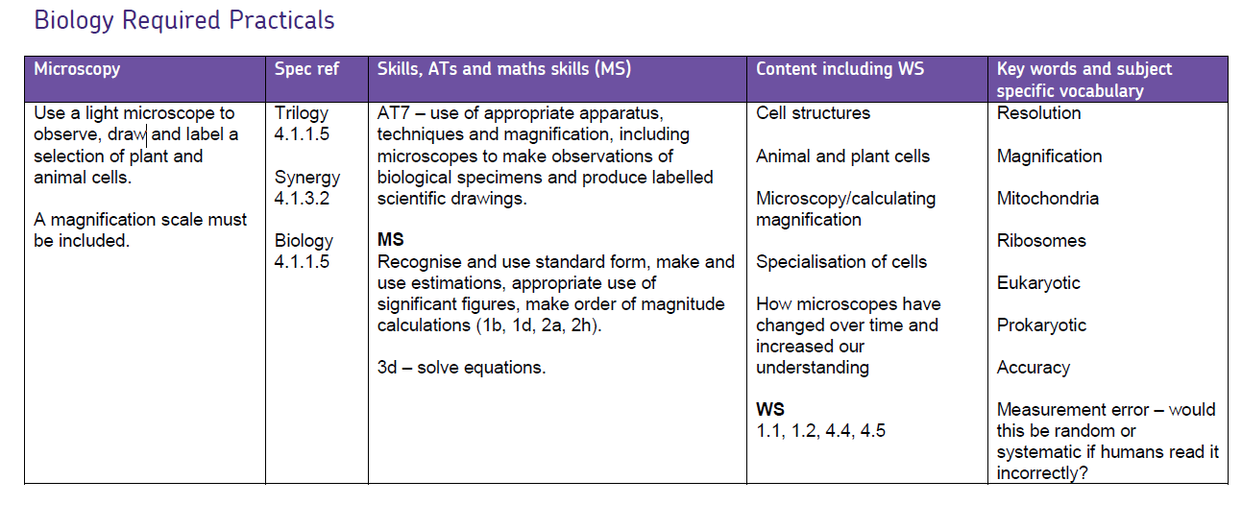
Practical questions guide: Planning summary

Slide 25
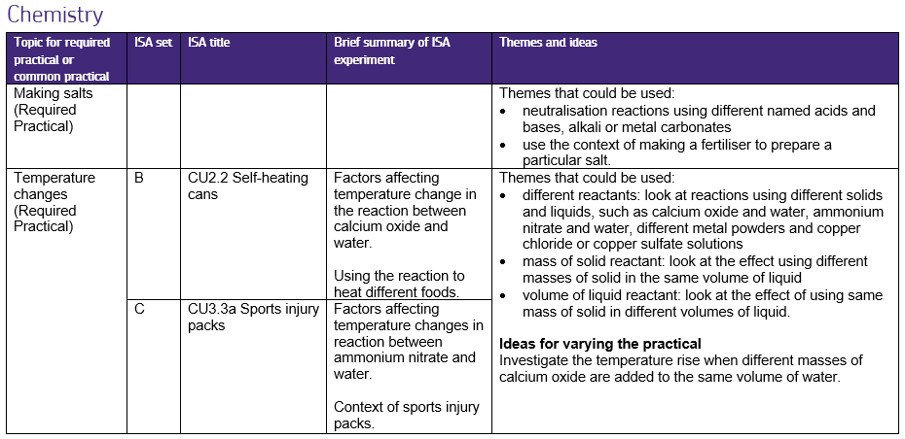
AO2: Practicals in a context

Slide 26

AO3 guide: Data source booklets
Title and context.
Method sheet.
ISA Section 2 questions:
  Question 1 relates to the method.
  Question 2 relates to the case studies.
Case studies.

Slide 27
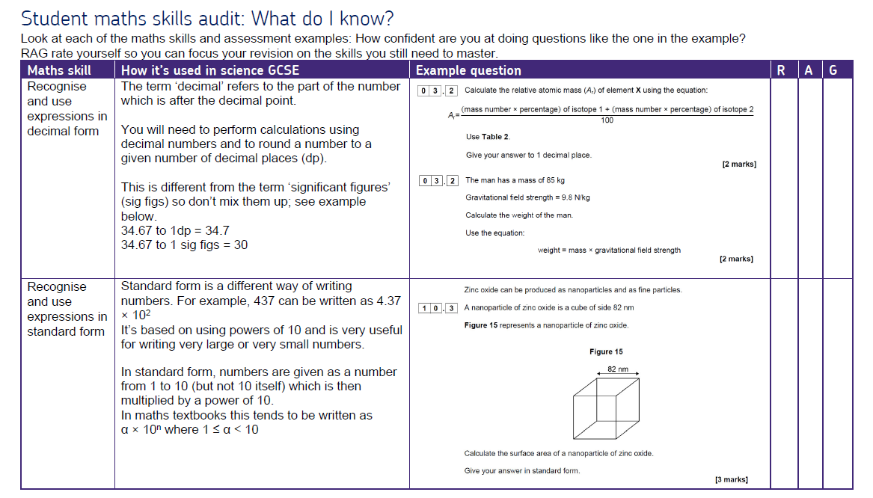
Maths guide: Student audit

Slide 28
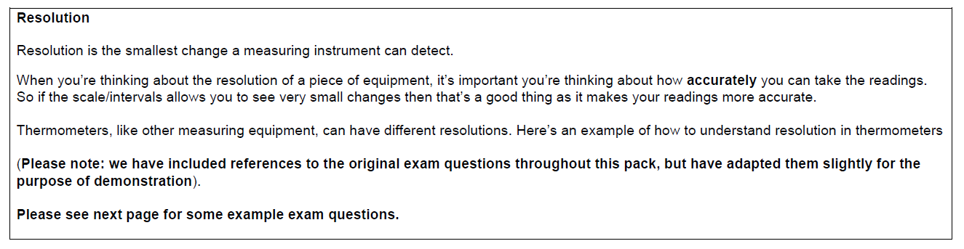
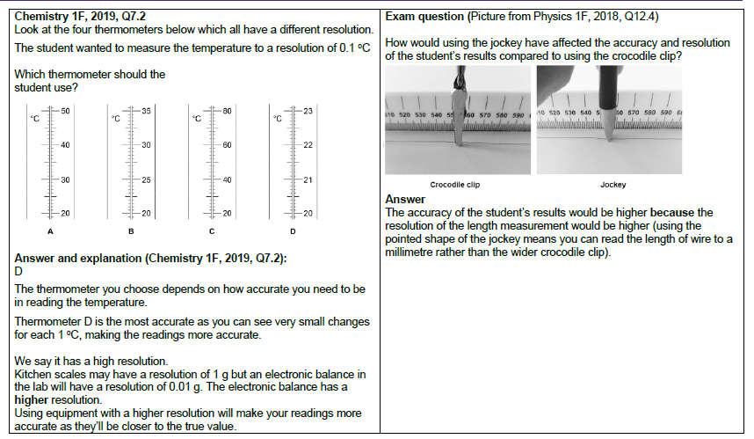
Working scientifically vocabulary

Slide 29

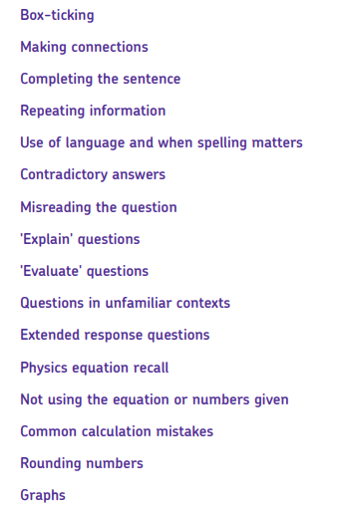
Common misunderstanding in science assessments
Student/teacher guide
Question types and exam techniques
Explanations
and Top tips
Post Mocks

Slide 30

Any questions?

Slide 31
Get in touch
Our friendly team will be happy to support you between 8am and 5pm, Monday to Friday.
Tel: 01483 477756
Email: gcsescience@aqa.org.uk
Twitter: @AQA
aqa.org.uk
Notes:
Our relevant Twitter accounts are:
@AQAEnglish (English subjects)
@AQAMaths (Maths subjects)
@AQA (Any other subjects).

Slide 32
Thank you

