Slide 1
ASE 2023: Supporting Early Career Teachers
Elise Reece and Natalie Vlachakis
Spring 2023

Slide 2
Welcome

Slide 3
Focus of session
The specification
Assessment objectives
Structure of the paper
Applying a mark scheme

Slide 4
The specification
Specification layout
Assessed content and skills

Slide 5
Trilogy (8464) specification
https://filestore.aqa.org.uk/resources/science/specifications/AQA-8464-SP-2016.PDF
Notes:
Each of our qualifications has its own landing page and for GCSE you will see two combined and three separate sciences.
This session is specifically discussing the combined Trilogy sped 8464 which is the most common GCSE taken, but the layout and principles are the same for all of our GCSE qualifications.
I have put the link in the chat if you do want it open while I talk through it.
Starting with the landing page, this is a really useful place to come if you are looking for supporting documents. It is divided into a number of Tabs: sec , planning, teaching and assessment. Towards the end of this part we’ll look at resources in a bit more detail.
For now we are focusing on the specification itself and how you should be using it in your teaching

Slide 6
Trilogy (8464) specification
Notes:
A question for you - What do you, as a classroom teacher, use a specification for?
The specification lists the content that can be assessed, the skills that students need in assessment and, importantly, HOW the content and skills are assessed.
Depending on the school or trust that you work for you may be given a scheme of work to follow, possibly sets of PowerPoints to teach from and worksheets for the students to do. All of these resources would have been developed using the specification so if ever you want to drill down to the core content, you can align the scheme of work with the spec to see where it is listed. Many SOWs list the spec point adjacent to the learning objective for easy cross referencing.
The point of showing the contents page is to highlight what you already know – the content makes up the bulk of the document, and this is, of course, the main focus “what do they need to know?”
But the other aspects of the specification are just as important namely the skills students need to proficient in and HOW students are assessed.
I’m going to briefly treat each of the skills separately in the following slides.

Slide 7
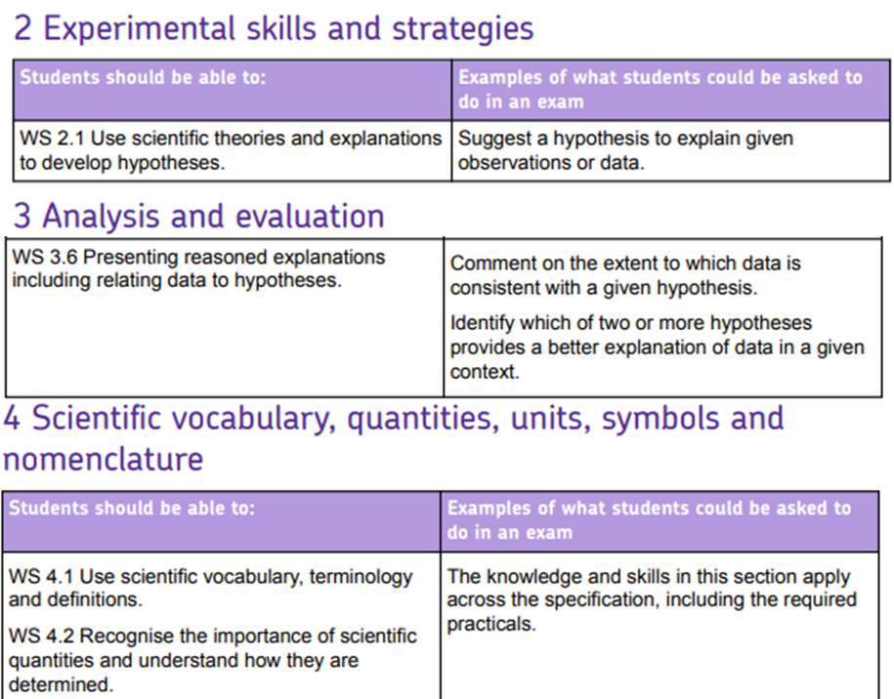
Working scientifically
Notes:
Working scientifically is the sum of all the activities that scientists do. We feel it is so important that we have woven it throughout our specification and written papers.
We have identified 4 main WS skill areas that naturally come out of teaching science, and in this section of the spec we set them out and give examples of what students may be asked to do in an exam.
If you have a SOW, it may be worthwhile looking at the activities in it and mapping them onto it so that you can see where in the course students are getting opportunities to develop these skills

Slide 8
Assessing maths in GCSE science
Notes:
Maths skills are of course key in science with physics having the highest maths requirement, then chemistry followed by biology.
On a Foundation tier paper, maths skills will not be lower than KS3 expectations and, on a higher tier paper, will not be lower than Foundation tier maths.
If you look at our papers, you will see certain skills that are assessed every year (e.g. graphing questions for 4 marks are not uncommon) so it is just as important to prepare your students in maths skills as subject knowledge

Slide 9
Assessing practical in GCSE science
Notes:
Questions on Practical skills count for 15% of the papers.
Students are required to carry out the 21 RPs (7 each BCP) over the course and, although the practicals are not assessed directly in the classroom, they are indirectly assessed in the exams. Your headteacher will sign a centre declaration form at the end of the course stating that all students were offered the opportunity to carry out the practicals.
If you look at our papers you will see that we assess the RPs - we are assessing is the student’s knowledge of the described apparatus and techniques. Sometimes the RP is set in a slightly different context to that carried out in the classroom so it is important to remember that you are teaching the skill NOT the specifics of the RP. For example, if a student is taught chemistry AT5 “measurement of rates of reaction by a variety of methods” they can apply the skill to a question on any practical involving rates, RP or not.
We also ask practical questions that are not based on the RP but on unfamiliar investigations so students should be equipped to recognise the Ats in exam questions and apply their knowledge of the skill to the new context.

Slide 10
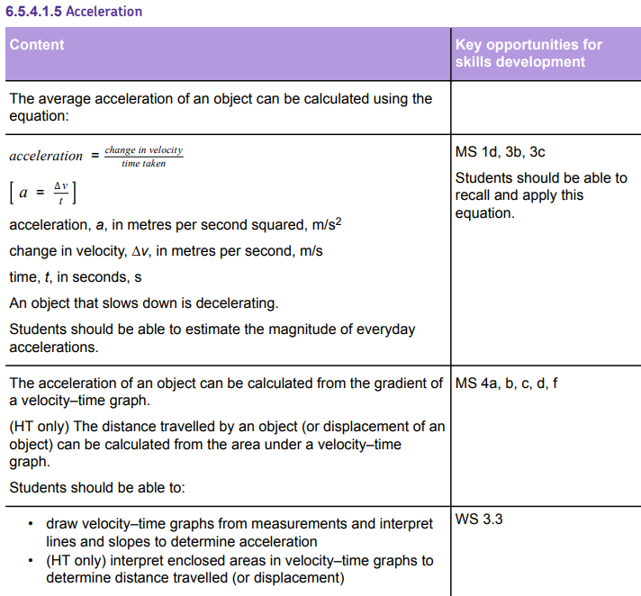
Specification layout
Notes:
How does this all hang together in the specification.
You can turn to any page in the specification for examples of WS, AT, MS and RPs. The content is presented in two columns, the first is SK and the 2nd is key opportunities for skills development.
The content is organised into a series of sub-headings with specification point numbering. This is the numbering that was used in describing the AI and, for some teachers who do not consult the spec often, this proved problematic in interpretation. I mention this because if we ever have AI again, it is vital that you are referring to the spec points in this document, not a textbook, SOW or other knowledge provider (eg bitesize).
For paper 1 we listed 4.2.2 animal tissues, organs and organ systems which included 4.2.2.6 The effect of lifestyle on some non-communicable disease which some people didn’t realise because they weren’t suing the spec (check this).

Slide 11
Exam papers

Slide 12
Assessment objectives
How many science GCSE assessment objectives (AOs) are there?
What does each AO cover?
What percentage of the award is assigned to each AO?
Why are AOs important to teachers?

Slide 13
GCSE Science Assessment objectives (AOs)

Slide 14
Can you identify the AO?
Trilogy C2H 2018​
3.1 AO2
3.2 AO3
3.3 AO1
3.4 AO1
3.5 AO2

Slide 15
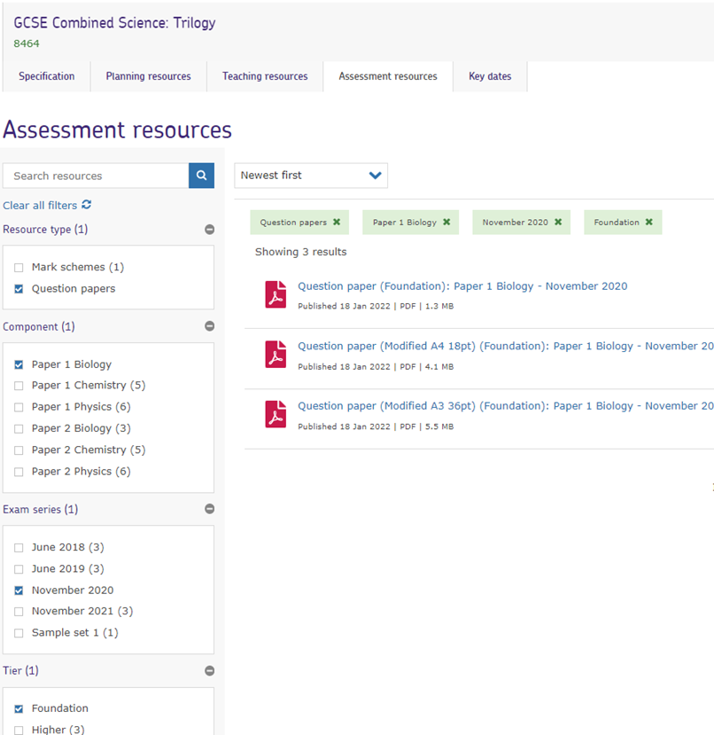
Website resources

Slide 16
Website resources

Slide 17
Practical handbook

Slide 18
Centre services: Secure resources

Slide 19
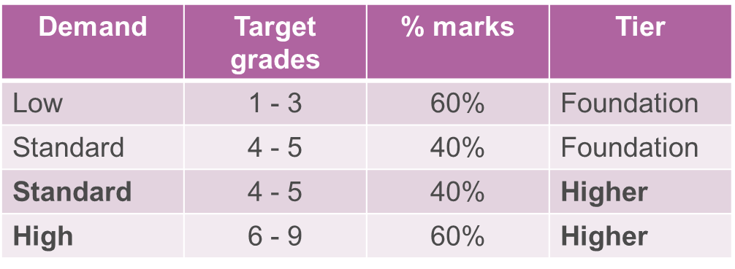
Structure of the papers
Approx 7 questions on Combined and 10 for Separate science.
Questions are made up of several ‘items’.
Each question covers an area of science. The stem introduces it.
Papers are ramped and tiered.
Common questions make up 30% of marks.

Slide 20
Types of questions
Different question types
multiple choice, link boxes: 1 or 2 marks
short answer: 1–3 marks
calculations: 1–4 marks (compensatory marks)
extended response: 4–6 marks (levels of response mark scheme)
multistep calculation: 4–6 marks
graphs: 3 marks (plots, axis, scale, line of best fit)
diagrams.
Page 5 of handbook.
Questions cover several AOs (eg Trilogy P2 2018 standard demand).

Slide 21
Applying a mark scheme
Marking questions in the ASE ECT booklet

Slide 22
Marks awarded on the responses

Slide 23
Marks awarded on the responses
Example 1 0 marks

Slide 24
Marks awarded on the responses
Example 1 0 marks
Example 2 0 marks

Slide 25
Marks awarded on the responses
Example 1 0 marks
Example 2 0 marks
Example 3 1 mark

Slide 26
Marks awarded on the responses
Example 1 0 marks
Example 2 0 marks
Example 3 1 mark
Example 4 2 marks

Slide 27
Marks awarded on the responses
Example 1 0 marks
Example 2 0 marks
Example 3 1 mark
Example 4 2 marks
Example 5 2 marks

Slide 28
Marks awarded on the responses
Example 1 0 marks
Example 2 0 marks
Example 3 1 mark
Example 4 2 marks
Example 5 2 marks
Example 6 0 marks

Slide 29
Marks awarded on the responses
Example 1 0 marks
Example 2 0 marks
Example 3 1 mark
Example 4 2 marks
Example 5 2 marks
Example 6 0 marks
Example 7 2 marks

Slide 30
Marks awarded on the responses
Example 1 0 marks
Example 2 0 marks
Example 3 1 mark
Example 4 2 marks
Example 5 2 marks
Example 6 0 marks
Example 7 2 marks
Example 8 1 mark

Slide 31
Marks awarded on the responses
Example 1 0 marks
Example 2 0 marks
Example 3 1 mark
Example 4 2 marks
Example 5 2 marks
Example 6 0 marks
Example 7 2 marks
Example 8 1 mark
Example 9 3 marks

Slide 32
Marks awarded on the responses
Example 1 0 marks
Example 2 0 marks
Example 3 1 mark
Example 4 2 marks
Example 5 2 marks
Example 6 0 marks
Example 7 2 marks
Example 8 1 mark
Example 9 3 marks
Example 10 0 marks

Slide 33
Marks awarded on the responses
Example 1 0 marks
Example 2 0 marks
Example 3 1 mark
Example 4 2 marks
Example 5 2 marks
Example 6 0 marks
Example 7 2 marks
Example 8 1 mark
Example 9 3 marks
Example 10 0 marks
Example 11 1 marks and 0 marks

Slide 34
Marks awarded on the responses
Example 1 0 marks
Example 2 0 marks
Example 3 1 mark
Example 4 2 marks
Example 5 2 marks
Example 6 0 marks
Example 7 2 marks
Example 8 1 mark
Example 9 3 marks
Example 10 0 marks
Example 11 1 marks and 0 marks
Example 12 0 marks and 0 marks

Slide 35
Graphs
Students may be asked to:
plot the data from a table
(ideally) use a sharp pencil
cross (x) or dots can be used (but cross (x) easier to see)
label the axis – use the headings in the data table
draw the scale – use most of the graph paper given
draw a line of best fit – lines of best fit can be straight or curved, look at the pattern in the data first to decide.
They are marked for accuracy (divisions of scales depend on demand).

Slide 36
Graph commentaries
Example 14: The student has labelled the axis instead of adding the scale so cannot get this marking point. They have correctly drawn 2 of the bars. The examiner has used Nylon which was given as a reference point. 2 marks
Example 15: The student has correctly plotted all the points from the table of data, although the crosses could have been clearer. They have attempted to draw a curved line of best fit, but it has not been drawn through all the points and is quite rough. As such, the mark for lobf cannot be awarded. 2 marks
Example 16: The student has plotted five of the six points correctly, within the tolerance allowed, so gains 1 mark for the plotting. The line of best fit is incorrect, so the mark for this cannot be awarded. 1 mark
Example 17: This is a straight line of best fit but is to untidy to gain the mark, students should use a ruler. Make sure if 0,0 is asked to be plotted the line goes through the origin. 1 mark

Slide 37
Extended response
Assessment criterion to write an answer that is ‘coherent, relevant, substantiated and logically structured’.
Marked using ‘levels of response’ mark schemes.
When a student writes their answer they can:
write in paragraphs
use short sentences in bullet points
use labelled diagrams
use tables with headings for compare and evaluate questions.
Don't need to fill all the space.
Have a go!

Slide 38
Implications
AO2: unfamiliar contexts
Required practicals
Maths skills

Slide 39
Area of challenge: AO2 unfamiliar context

Slide 40
Area of challenge: AO2 unfamiliar context

Slide 41
Supporting assessment in class
Explain to students that they need to expect these types of questions.
use examples in your lessons
case studies in AO3 data source books
practical examples in activity 4 of AO2 focus on success
change names of chemicals used in practicals in homework questions
look at physics examples already used in physics questions.
Model identifying the science behind the questions.

Slide 42
Area of challenge: Required practicals
Didn’t fully understand why they had carried out each step in the practical.
Lack understanding about the science underlying the practicals.
Identifying control variables and independent and dependent variables.
Difference between a control and a control variable.
Use of vague terms such as ‘same amount’, ‘fair test’ , ‘it’ ‘they’.
Types of errors.
Subject specific vocabulary.
Notes:
Areas of working scientifically in the context of the RPs
repeatable or its significance
identify control variables and other variables term ‘fair’ is always inadequate unless suitably qualified types of errors how to improve accuracy - improves inaccuracy is insufficient for a type of experimental error, human error is insufficient

Slide 43
Supporting assessment in class
How can you support your students in your teaching and their learning to access the assessment of practical skills and the RPs.
Take more than one lesson to cover the practical.
Use a holistic approach covering:
why they are doing each step
explaining science behind the practical
include working scientifically skills eg variables, errors, improvements
construct graphs and interpreting them
setting the practical in a different context
discuss errors and improvement using correct scientific language.

Slide 44
Area of challenge: Maths in Science
Unit conversions: g to kg, dm³ to cm³
Use of prefixes and powers of ten for order of magnitude
Percentages eg percentage change is challenging
SA: Volume ratio
Significant figures
Selecting numbers in the diagrams that are needed in the calculations
Not using a calculator

Slide 45
Supporting assessment in class
Are you familiar with the maths skills assessed in science?
Which ones would you be confident in teaching students if they don’t know how to use them in a calculation?
Where would you go for support?
Do you understand how calculations are marked?
What piece of advice would you give all your students concerning calculation questions?
Focus on success; maths in science.

Slide 46
GCSE science resources
Six self-guided modular training packs
AQA | GCSE | Combined Science: Trilogy | Planning resources
Helping teachers to better understand the assessment requirements
Each pack includes notes, ideas for group discussion, an activities booklet and handouts.
They cover:
Disciplinary language
Extended response questions
AO2
Practical questions
AO3
Maths in Science.

Slide 47
Get in touch
Our friendly team will be happy to support you between 8am and 5pm, Monday to Friday.
Tel: 01483 477 756
Email: gcsescience@aqa.org.uk
Twitter: @AQA
aqa.org.uk
Notes:
Our relevant Twitter accounts are:
@AQAEnglish (English subjects)
@AQAMaths (Maths subjects)
@AQA (Any other subjects).

Slide 48
Thank you

