Slide 1
ASE 2023: Developing A-level assessment skills through practical
Natalie Vlachakis
Spring 2023
Notes:
Today I’m going to be looking at how we can develop some of the assessment skills that we see in A-level science exams through the practical work that we do in class. Essentially, as set out in the agenda, we're looking at exam skills through a practical lens.
We all know that we have to assess CPAC for the RPs in the moment in the classroom when doing practical work. For every required practical there are associated apparatus and techniques and these apparatus and techniques are assessed in the exams. There is also a list of practical skills that students need to have in order to be able to access the practical questions in the exams.
Include a research slide for ASE : Calibrate, Gatby, Ofsted review

Slide 2
Agenda
Apparatus and techniques
Practical exam questions
Method
Understanding the science
Maths
Implications
Notes:
Today I’m going to bring together these aspects of assessment and think about how we can best prepare students for these types of questions while running practical sessions over the 2 years
I will look at some 2022 exemplar material and ask you to think about how students might improve their responses.
I need to let you know that as an ex-A-level biology teacher I am not a subject expert across all sciences but the focus here is on skills, not the detail of the content.
We fully acknowledge the difficulties that Covid presented to students and teachers and the obvious answer to that question would be that "they would’ve had more time" which they didn’t.
Let's try to discount the effects of reduced teaching time when looking at the student answers and think about practical steps we can take to help students improve.
As part of this presentation I have produced a supporting booklet that lists CPAC, AT, PS and AOs from the specification for reference purposes.
It also contains student responses, MS and brief examiner commentary if appropriate.
For each theme, I have selected a BC and P question so you can choose to work on the question on the screen and/or your subject specific question in the booklet.
It is in the chat for you to access. If you are sharing a device perhaps you can email it to one another to access on your phones.
No env sci examples as there is no link to CPAC but principles are similar (methodologies and sampling techniques)
This is the agenda - we will

Slide 3
How are practical skills in science qualifications assessed?
Indirectly (100% terminal exam)
Required practicals and a list of apparatus and techniques, ATs.
Directly
Common Practical Assessment Criteria
(CPAC) and the ability to use ATs
The direct assessment is the non-examined assessment (NEA), part of our A-level Science qualifications only.
Notes:
A quick reminder...
15%

Slide 4
How are practical skills in science qualifications assessed?
Teacher assesses student's abilities in practical work through a set of competencies. Holistic judgement at the end of a two-year course.
12 required practical activities
Teacher devised practical experiences
Students’ practical skills in at least 12 practicals
Five competencies:
1. Follows written instructions
2. Applies investigative approaches and methods when using instruments and equipment
3. Safely uses a range of practical equipment and materials
4. Makes and records observations
5. Researches, references and reports
Endorsement of practical skills
Notes:
If needed:
In order to be awarded a Pass endorsement of GCE science practical skills, a student must consistently and routinely meet the standard expected of each of the Common Practical Assessment Criteria (CPAC) by the end of the course. A student may demonstrate the CPAC in any practical activity undertaken during the course of study. Students may undertake practical activities in groups; however, the evidence generated by each student must demonstrate that they have independently met the criteria.
After two years the students should have met all of the competencies, recorded by the teacher, and a Pass grade will be entered into centre services by mid-May of awarding year.
If the student has not sufficiently demonstrated the evidence required to pass the competencies, they are Not Awarded the endorsement.
Students who may not be able to access all of the CPAC (e.g. visual impairment) may be awarded an Exemption

Slide 5
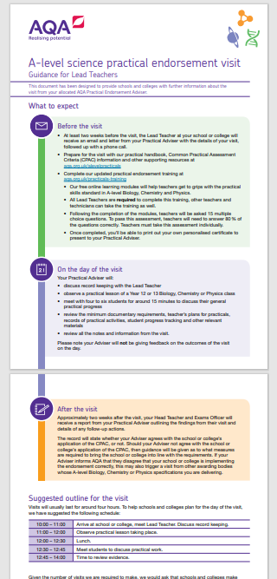
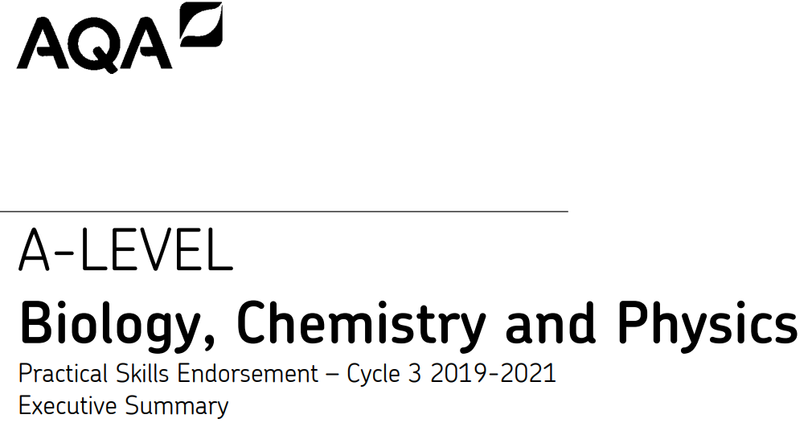
The monitoring visit – what to expect
How often?
What do I need to prepare?
What will happen on the day?
What happens next?
All the information you need can be
found here
The Executive summary can be found here
Notes:
If needed: Executive summary: Summary of CPAC assessment strategies to date prior to lockdown pg 6

Slide 6
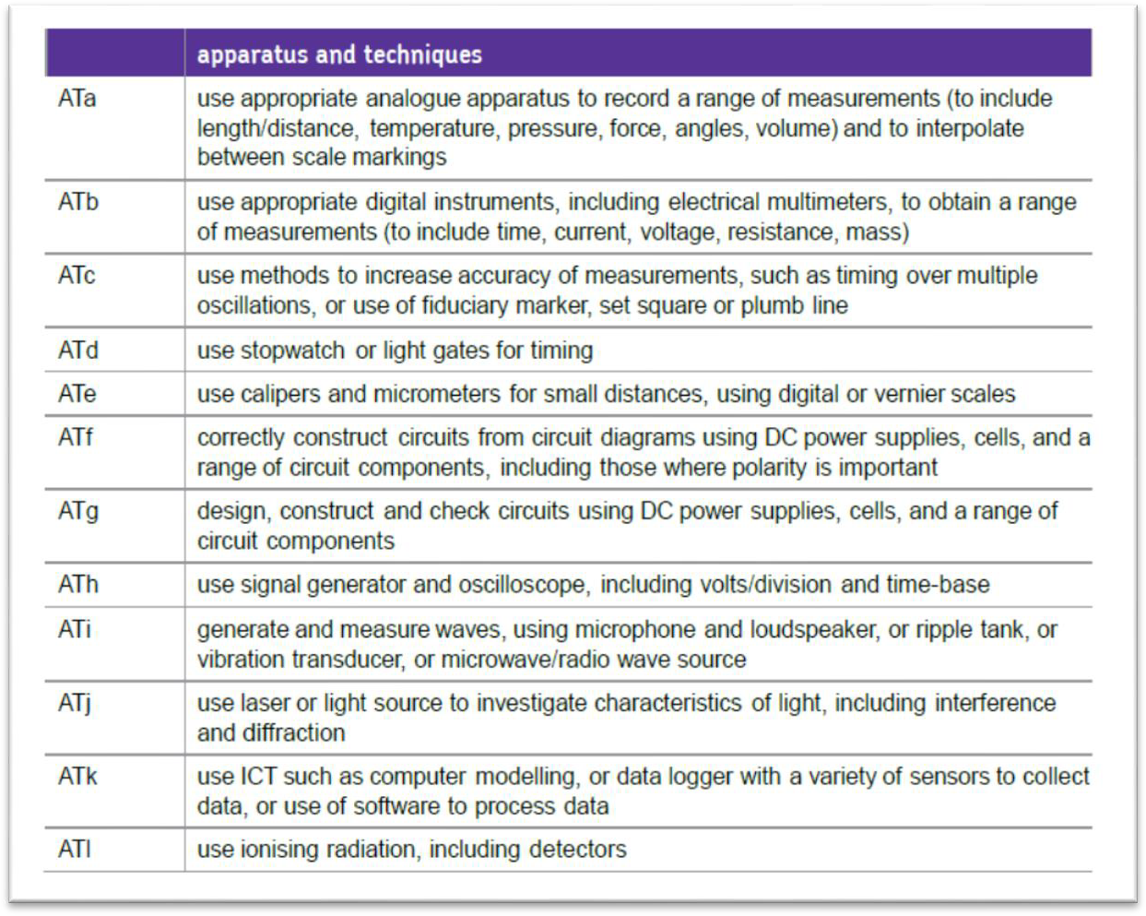
Apparatus and techniques
In addition to the five Common Practical Assessment Criteria (CPAC) there area number of apparatus and techniques which must also be addressed.
Notes:
Lets spend a minute reminding ourselves of the AT.
There are a number of apparatus and techniques which must also be addressed. These are specific to each subject and are listed in the AQA CPAC tracker if you use that.
The RP's have been devised so that they cover all of the AT's and if you look at a list of the RPs (next slide)

Slide 7
12 required practicals
Notes:
(e.g. see specification: A-level physics 12 required practicals) you can see that most of them have a number of AT's against them.
Some ATs are specific to subject content and are only seen once e.g. ATj waves and ATl radiation. Others are generic around use of apparatus eg ATa. It is these ATs that are being assessed in practical exam questions whether they are directly about the RP or, as many exam questions are, set in an unfamiliar context.

Slide 8
A-level practical skills assessment
12 required practicals per subject
12 apparatus and techniques per subject
8 of 30
Notes:
Then of course there are the PS which are the same for all sciences in which students need to be competent in order to be able to answer exam questions. It is these elements that are assessed in the exam.
Remembering that CPAC are not assessed in the exam but let's think about how we can use them to prepare students for the above

Slide 9
Using CPAC to develop assessment skills
CPAC
are assessed for endorsement
aren't assessed in exams but...
are about the ATs
reflect the PS.
Develop a holistic approach to teaching laboratory and assessment skills over the two years.
Notes:
Assessment of CPAC can sometimes been seen as a tick box exercise but these competencies are of course here because they are fundamental to being a good scientist. We want our students to be able to plan and carry out safe investigations and evaluate them as they go along. We want them to collect accurate results and use them to reach conclusions.
We also want them to be able to take this good practice into the exams with them. As much as CPAC aren't assessed in the exams they reflect the PS and are about the ATs.
The idea behind this session is to think about how we can use in class assessment of CPAC doing the RPs to develop assessment skills. It's looking at trying to find a holistic approach to practical teaching that naturally leads to an outcome of confidence in exams.
To help think about this, we will be looking at 2022 BCP PS exam questions. I have chosen three types of questions: those requiring a description of a method, those requiring an explanation of science and those requiring an element of calculation.
(That's why, in today's session we are looking at how in class assessment of CPAC can be used to actively develop and improve the skills that they need for assessment
Develop a holistic approach to teaching laboratory and assessment skills over the two years.)

Slide 10
Practical skills: Methods
Questions about methods, apparatus or techniques
Booklet page 10
Also refer to CPAC, AT and PS
Notes:
The first question is a biology question which, even if you are not a biologist, I hope is accessible. There are other subject questions in the booklet

Slide 11
Method: Biology P1 (AO3)
5.19% didn't attempt
Which ATs?
Which PS?
Which CPAC?
What could you do in practical lessons to prepare students for this type of question?
Notes:
For all of these questions I have also listed the assessment objective (for interest only) so that you can get an idea of the range of AOs used to assess PS. The AOs are also listed in the booklet. If you feel you need to remind yourself about AOs, it may be useful later for you to look back on the AO list to remind yourself of what makes this AO3.
I have chosen this biology question which should be accessible to all subjects but if you would rather look at C or P please see q4.4 and 2.2 below it in the booklet. If you add to the chat please put a C or a P in front of your response
The command term here is describe and it is asking for description of a method. 5% of students didn't attempt it. This is clearly an osmosis practical in an unfamiliar context. This student, despite being on the right track did not score any marks.
Can you identify the ATs and PS that are being assessed? Can you identify any CPAC that you might assess? If you can, please put them in the chat. (1-2 min)
Thinking of your own students, looking at this question and using your own experience, discuss with the person next to you....What could you do in practical lessons to prepare students for this type of question? e.g. Question says access to laboratory equipment but doesn’t state which. Are students not answering because they don’t know which equipment to use? What can be done in lessons to prepare for that
The mark scheme and a brief commentary are in the booklet. Please add to the chat.
2c. Identifies and controls significant quantitative variables where applicable, and plans approaches to take account of variables that cannot readily be controlled.
AT a Use appropriate apparatus to record a range of quantitative measurements (to include mass, time, volume, temperature, length and pH).
AT c Use laboratory glassware apparatus for a variety of experimental techniques to include serial dilutions.
PS 1.1 Solve problems set in practical contexts
PS 4.1 Know and understand how to use a wide range of experimental and practical instruments, equipment and techniques appropriate to the knowledge and understanding included in the specification

Slide 12
CPAC, AT and PS
AT a Use appropriate apparatus to record a range of quantitative measurements (to include mass, time, volume, temperature, length and pH).
AT c Use laboratory glassware apparatus for a variety of experimental techniques to include serial dilutions.
PS 1.1 Solve problems set in practical contexts.
PS 4.1 Know and understand how to use a wide range of experimental and practical instruments, equipment and techniques appropriate to the knowledge and understanding included in the specification.
CPAC 2c. Identifies and controls significant quantitative variables where applicable, and plans approaches to take account of variables that cannot readily be controlled.
2c Describe an investigation that you could do to...
Notes:
Thanks for the feedback.
Some very interesting and useful suggestions about how things you may do in class
Really, what we want to be doing is finding a link between the CPAC we have chosen to assess and the relevant PS or AT and setting a task to help develop that skill.

Slide 13
Method: Chemistry P1 (AO3) and Physics P3 (AO3)
37% 0 marks, 38% 1mark
Question showed full range of marks
Notes:
4.4. AT a c e f
CPAC 2
PS 1.2 4.1
37% scored 0. How is buffer made? What would you do in practical lessons to ensure that students can answer this type of a question
2.2 AT ace
CPAC 2 5
PS 1.1 2.1 3.1 4.1
The physics question asks for an explanation as to what the student might do given a specific set up.

Slide 14
Practical skills: Understanding the science
Booklet page 15
Also refer to CPAC, AT and PS
Notes:
Examiner reports often comment on students not understanding the science behind their practical work. They don't always appear to know why they do what they do, what will happen if they change things or what the results actually mean.
A-level students may still approach practical work in a recipe fashion, following steps without knowing why. And I remember that question "is this the right result?"

Slide 15
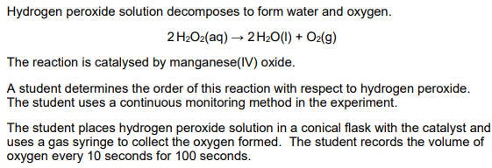
Understanding: Chemistry P3 (AO1)
34% scored 0
Which CPAC?
What could you do in practical lessons to prepare students for this type of question?
Notes:
CPAC 5
ATs abk
PS 2.3 3.1
Again, there are other subjects in the booklet but this chemistry question is quite accessible. Read through the answer – what would you say is the main problem with this response? In the chat pls
What could you do in practical sessions to help prepare students for this type of a question. What CPAC would you be assessing?
(Ans: Why did this student score no marks? Not A-level standard. No comparative statement. Laking scientific terminology. Not at A-level standard)

Slide 16
Using CPAC 5 to develop PS 2.3
CPAC 5: Draw the graph of your results. Explain the shape of your graph with respect to the amount of reactant and product.
What terminology do we need to use to make this an A-level answer?

Slide 17
Understanding: Physics P3 (AO1/3)
34% scored 0
Which CPAC?
Notes:
Student scored the AO1 mark but did not score for the second part about changes needed to get an accurate result.
They did not follow instruction (include numerical detail)
What CPAC would you be targeting to improve this skill?

Slide 18
Using CPAC 2 and 5 to develop PS 2.1
CPAC 2b Explain any changes you need to make to get an accurate result.
CPAC 5 What conclusion can you make about the effect of changing (length).

Slide 19
Explain: Biology P2 (AO2) and Chemistry P3 (AO3)
Question showed full range of marks
43% scored 0

Slide 20
Explain: Physics P3 (AO3/2) and Biology P3 (AO3)
50% 0 marks
67% 0 marks, 4.75% full marks
Notes:
Physics explanations are more likely to need some calculation. Clearly students struggled with this.
Is there something that you can build into CPAC 5 to prepare them for this type of an explanation.
Biology, is there an opportunity to ask for suggestions when assessing CPAC 5?

Slide 21
Explain at A-level
A-level explanation? Must be beyond GCSE content.
Use of A-level scientific terminology.
Follow instructions eg, 'use figure 1' or 'include...’
Look at number of marks.
Use of linking words/terms if two command words to give reason.
Why? eg, 'describe and explain’:
Because
So
Therefore
The reason for this is...
Notes:
From agenda - Explain: a look at what makes a good A-level explanation
We are focusing on practical questions today but this applies to all explain questions
Classic examples biology enzymes, physics current, chemistry ….
Developing good explanations in practical work will develop good explanations for all questions

Slide 22
Practical skills: Maths
Questions on calculations in a practical context
Booklet page 22
Notes:
From agenda:
Maths: what are the common maths skills that all A-level science students need to develop?

Slide 23
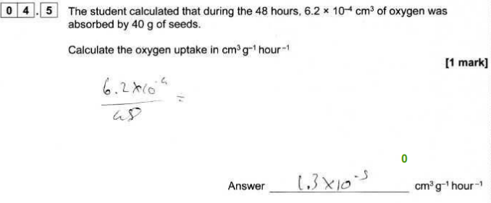
Maths: Biology P2 (AO2)
Which CPAC?
What could you do in practical lessons to prepare students for this type of question?
Notes:
This is a very simple calculation but 30% of students scored 0.
You will have the idea of linking to AT PS and CPAC now. Biology has the lowest maths requirement of the 3 sciences so what can you do in a pract session when assessing CPAC 5 to ensure that your students know how to calculate units and work with standard form?

Slide 24
Maths: Physics P3 (AO2) and Chemistry P2 (AO2/3)
52% 0 marks
Question showed full range of marks.
13% 0 marks
3% no attempt
Notes:
For the chemists and physicists when assessing CPAC 5, are you using every possible opportunity to get students to do a multi step calculation? Is there an opportunity to give them secondary data to work? Potentially work the calculation backwards? Or, as many of you already do, give them a multistep exam question that directly links to the RP or AT that you are working on.

Slide 25
Chemistry P2 Q4.2
Notes:
This is the kind of graph that may be generated in class. All sciences need to be able to work out rate with a tangent. If we look at the MS from the spec....

Slide 26
Maths skills: Tangents
Biology
Chemistry
Physics
Notes:
We can see that it is described with examples for all sciences. The level of demand reflects the science with physics having the highest. We can se that it is a PS (3.1) and would be assessed with CPAC 5. This would provide an opportunity to draw and calculate tangents but also get students to explain what the graph means (as in previous eg)

Slide 27
Maths skills: Uncertainties
Biology
Chemistry
Physics
Notes:
Another MS that the physicists do well is determining uncertainty. There is a section in the prac handbook that details AQA expectation and there are always questions. There are always measurements to be made in prac so most RPs give an opportunity to develop this skill. It could form part of assessment of CPAC 2d collecting accurate data or CPAC 5a process data

Slide 28
Maths skills: Logarithms
Biology
Chemistry
Physics

Slide 29
Implications
Look at the CPAC and the Practical skills in the booklet.
Can you think of any generic questions or tasks that you could set for each CPAC that would support practical assessment skills? Eg:
CPAC 2: Describe a method
CPAC 4: Explain number of repeats.
Notes:
Let's think about the implications for teaching - how can assessment of CPAC (and ATs) be used to develop better assessment skills, specifically the PS around the ATs.
With a partner, look at the CPAC and for each holistic one, can you come up with generic activities/ questions/ tasks that you can routinely give your students in lessons, when you are specifically assessing that CPAC, that will ultimately serve as preparation for the exam. We are trying to find the link between CPAC and exam skills so that students holistically build up the skills they need over two years and know how to reach the higher level in their answers because it's what they do for their endorsement.
For example, one that you will all do 'Describe a method for..'
This is not a right/wrong exercise. It's only about getting you to think about the link between assessment of CPAC and assessment skills.
Breakout? Or chat?

Slide 30
Using CPAC to develop assessment skills
CPAC 1: Preparation for reading the stem of the question and interpreting diagrams.
CPAC 2:
Describe a method.
Describe and explain why adjustments might be made.
State variables.
Describe and explain experimental control.
Explain equipment choice (with respect to accuracy).
With these restriction, explain what you must do to get x.

Slide 31
Using CPAC to develop assessment skills
CPAC 3: Describe and explain measures to minimise risk.
CPAC 4:
Explain why record data to a certain number of decimal places or sig fig.
Explain number of repeats.
Explain why results are considered accurate/precise.
State/calculate the units.
Draw.

Slide 32
Using CPAC to develop assessment skills
CPAC 5:
Do appropriate calculations.
Describe sources of error.
Calculate uncertainty.
Plot and draw graphs.
Draw tangents (rate calculations).
Evaluate the investigation with explanations.
Use secondary data in evaluation.
Use own and secondary data to justify conclusions.
Suggest why results are different to other groups.
Notes:
Uncertainty esp biologists. Build it into your CPAC assessment. It's difficult to bolt it on at the end of the course
You could also think about AOs when generating these question e.g. calculation is AO2 and evaluating is AO3

Slide 33
Using ATs to develop assessment skills
Describe how to:
set this up
use this apparatus/instrumentation
carry out this technique
take an accurate reading
make this more accurate.
Notes:
Then, you could turn it around... do the same thing for your subject AT list. Of course they are linked to the CPAC but it gives us another way of identifying skills needed.
Just a question here - if you are using off the shelf lab books where everything is set out, would they getting enough of these opportunities?

Slide 34
Using ATs to develop assessment skills
Explain why:
you chose to use this apparatus/instrument
you set it up this way
you carry out the steps in this order
your chosen technique is accurate
you record this many significant figures.

Slide 35
Equipment and apparatus
Images have been removed for copyright purposes but can be accessed by following this link:
AS and A-level Physics practicals: Equipment set up (Practical 10)
Notes:
Have a look at our equipment set ups in our teaching resources. Could they be useful in helping students scaffold a description and, importantly, an explanation of a method?

Slide 36
Practical lessons and assessment skills: PS
Notes:
You can always come back to these criteria if you want to be sure that you have fully prepared the students for practical exam questions.
It's possible that I didn't tell you anything that you didn't know today but I'm hoping that I have given you a slightly different perspective on how you can take a holistic approach to your practical teaching and use assessment of CPAC as a means of developing high quailty descriptions, explanations and maths skills that will prepare students, not just for practical questions, but generally help to hone assessment skills across the paper.

Slide 37
Resources

Slide 38
Get in touch
Our friendly team will be happy to support you between 8am and 5pm, Monday to Friday.
Tel: 01483 477756
Email: alevelscience@aqa.org.uk
Twitter: @AQA
aqa.org.uk
Notes:
Our relevant Twitter accounts are:
@AQAEnglish (English subjects)
@AQAMaths (Maths subjects)
@AQA (Any other subjects).

Slide 39
Thank you

