Slide 1

ASE Annual Conference:
Support for your first years in teaching
Julian Clarke
Spring 2020

Slide 2
Welcome

Slide 3
This meeting will be recorded
Exam boards have an Ofqual requirement to record event audio.
Recordings are kept for the lifetime of the specification and not shared as an accompaniment to session resources.
The recording will begin now.

Slide 4
Outline for the session
Structure of secondary assessment in England
What is a specification?
Recent reform of qualifications
Overview of awarding
Our Science papers and mark schemes
Our resources

Slide 5
Structure of secondary assessment in England

Slide 6
Secondary assessment in England
‘The Office of Qualifications and Examinations Regulation (Ofqual) regulates qualifications, examinations and assessments in England.’*
Independent of government and reports directly to Parliament.
In October 2018, there were over 150 awarding organisations recognised by Ofqual.
Which awarding organisations are involved with GCSE Science in England?
*This information is available from: gov.uk/government/organisations/ofqual/about
This contains public sector information licensed under the Open Government License v.3.0
Notes:
Accountancy/Management
Ballet
Canoeing
Beauty Therapy
Equestrian
First Aid
Dance
Sign Language
Prince’s Trust
RHS
Swim England
Gemmological Association
Farriers
Spectacle makers

Slide 7
GCSE Awarding Organisations in England
AQA
Edexcel
Eduqas
OCR
Notes:
AOs are independent of each other and operate in a competitive environment
Previously lots of small regional exam boards…merged
However specs are not as different as you may think
Main differentiator is support
Talk about franchising - Scotland SQA – NI – CCEA – Wales - WJEC

Slide 8
Joint Council for Qualifications (JCQ)
Umbrella organisation for all four English Awarding Organisations.
Determines the general rules and regulations which are applied to the conduct of all assessments.

Slide 9
Regulation
Department for Education (DfE)
‘…is responsible for children’s services and education, including higher and further education policy, apprenticeships and wider skills in England.’
Overall responsibility for setting national policy with regard to education:
    national curriculum (KS1-4)
    types of qualifications (GCSE’s, A-levels, Tech Awards etc) including subjects.
This information is from gov.uk/government/organisations/department-for-education/about
This contains public sector information licensed under the Open Government License v.3.0
Notes:
Examiners who provide CPD meetings
Teachers that set live assessments

Slide 10
Regulation
Ofqual
Set criteria for qualifications (eg types and duration of assessment).
Regulate the day-to-day activity of the Awarding Organisations:
    awarding and standards
    malpractice
    ensuring that what we are telling centres is fair and equitable
    conflicts of interest (eg examiners who write text books/teachers that write assessments).
Notes:
Examiners who provide CPD meetings
Teachers that set live assessments

Slide 11
DfE subject content
Subject content is the minimum content that must be in a subject specification; for GCSE science, this:
  considers overlaps with Science PoS (KS1-4)
  provides continuity and progression to AS/A-level.
Subject content is owned by the DfE.
DfE subject content for GCSE and A-level Science was produced in consultation with Ofqual, all four AOs and key stakeholders (ASE, RSB, RSC, IOP etc).
Version 3.0
Notes:
Also mention public consultation DfE operates and the role that teachers can play in this.
Try to give a feel for timescales in creation of Subject Content and specs. Ofqual received 2012 letter for A-level (first taught in 2015) and 2013 letter for GCSE (technically first taught 2016 for two year GCSE)

Slide 12
DfE subject content
If any organisation wishes to produce a GCSE or A-level Science qualification which is recognised for performance table points, they must:
  use the DfE subject content
  be accredited by Ofqual (subject level guidance).
Version 3.0
Notes:
Also mention public consultation DfE operates and the role that teachers can play in this.
Try to give a feel for timescales in creation of Subject Content and specs. Ofqual received 2012 letter for A-level (first taught in 2015) and 2013 letter for GCSE (technically first taught 2016 for two year GCSE)

Slide 13
What is a specification?

Slide 14
What is a specification?
Each Awarding Organisation creates its own unique subject specification.
Specifications for a subject must be based on the DfE subject content.

Slide 15
What is a specification?
The specification outlines:
    details of the assessments
    subject content to be taught
    administration relating to the specification.
Ofqual:
    accredit the specification for teaching in England
    regulate the operation of the specification.

Slide 16
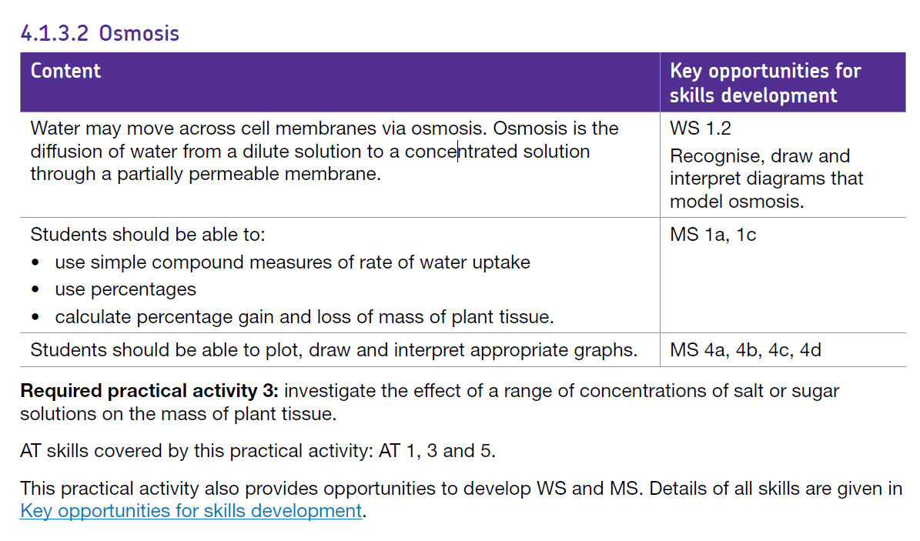
Our specification
This is what must be taught This is for exemplification
Notes:
This is for the separates and Trilogy only - Synergy's layout is three column and everything is examinable, unlike here.
Reminder that what will be assessed is in the specification, explain the role of the additional information
The resources (including text books) will support the specification
Text books are produced by independent publishers and not the Aos

Slide 17
Our specification
For teaching purposes:
the specification is the definitive document
all content will be covered over a set period of time
assessments are based on the content of the specification only.
Notes:
IF they only take away one message – make sure it’s those three bullet points!!
Reminder that what will be assessed is in the specification, explain the role of the additional information
The resources (including text books) will support the specification
Text books are produced by independent publishers and not the AOs

Slide 18
Recent reforms of qualifications

Slide 19
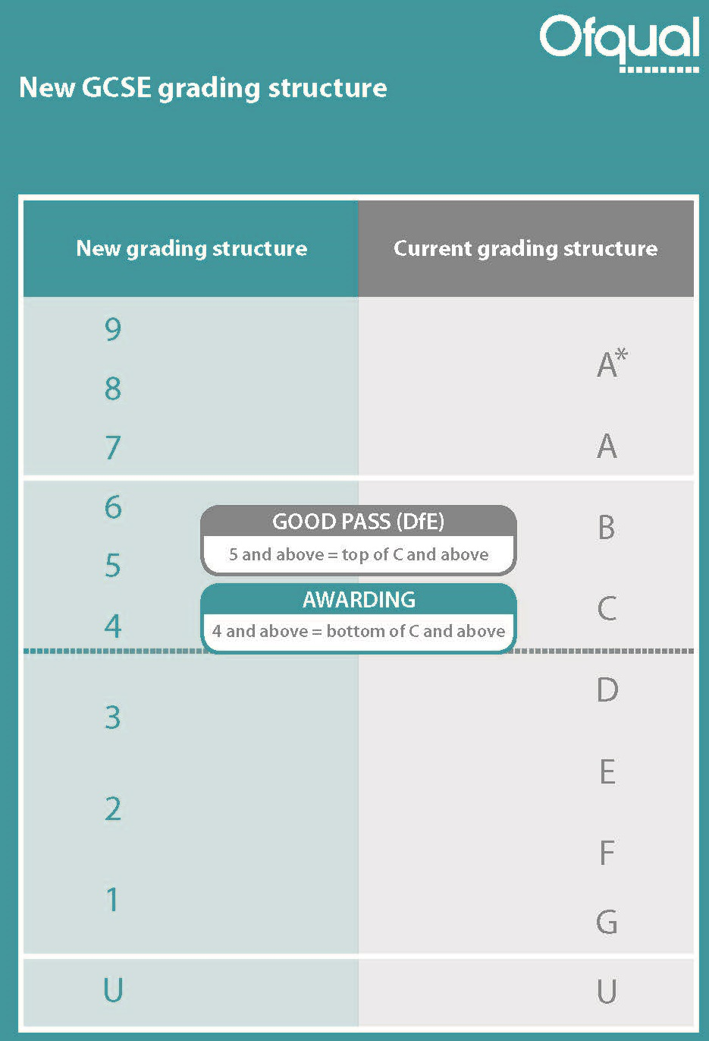
New GCSE grading
Grade 4 equivalent to bottom of a C; grade 7 equivalent to an A
Grade 5 around the top third of a C and bottom third of a B
Bottom of grade 1 aligned with bottom of a G
New Foundation Tier: grades 1–5 available
New Higher Tier: grades 4–9 available with a few marks for a grade 3 as a safety net

Slide 20
New GCSE grading
No mixed tiering in the Combined Science papers
Can enter for different tier in each of the separate sciences but must be the same tier for each of the two papers within the award

Slide 21

Grading in Combined Science
Sequential numbering on a 1–17 point scale
Total mark on all papers combined determines both grades
Individual grades not dependent on individual paper/subject performance
Notes:
Students get two grades for Combined Science – for the award as a whole. Means that won’t be able to separate out grades for each subject within the papers . However, marks for individual papers will be available on ERA so will be able to do some analysis
Will be calculated on the overall marks for the specification
Grades will be either two numbers the same, or two adjacent numbers – so only 1 number apart. you couldn’t get a 9-1
In schools we are recommending they don’t go down the granular route for reporting interim progress as to difficult. In formative topic tests they might want to record biology marks, chemistry and physics separatly as this will show if there is one area they are not doing well in so they can put some intervention into this science discipline as all the sciences will be added together for the final award.
Teacher need to rely on their professional experience as to where students are along with the interim tests and our end of year 10 exam and analysis which we will be supplying on SKM

Slide 22
Grading in Combined Science
Either two numbers the same:
  9-9, 8-8, 7-7, 6-6, 5-5, 4-4, 3-3,
  2-2, 1-1
or one number different:
  9-8, 8-7, 7-6, 6-5, 5-4, 4-3, 3-2, 2-1
No zero, so no 1-0 or 1-U
No other grades available
Notes:
Students get two grades for Combined Science – for the award as a whole. Means that won’t be able to separate out grades for each subject within the papers . However, marks for individual papers will be available on ERA so will be able to do some analysis
Will be calculated on the overall marks for the specification
Grades will be either two numbers the same, or two adjacent numbers – so only 1 number apart. you couldn’t get a 9-1
In schools we are recommending they don’t go down the granular route for reporting interim progress as to difficult. In formative topic tests they might want to record biology marks, chemistry and physics separately as this will show if there is one area they are not doing well in so they can put some intervention into this science discipline as all the sciences will be added together for the final award.
Teacher need to rely on their professional experience as to where students are along with the interim tests and our end of year 10 exam and analysis which we will be supplying on SKM

Slide 23
GCSE Sciences: 2019 question paper delivery
No security breaches this summer.
No question paper errors.
Allowances made in 2018 to prevent large proportions of Higher Tier students from failing are no longer in place.
  The Higher Tier allowed Grade 3 (separate sciences) and Grade 4-3 (combined sciences) were set as intended this summer.
  No Grade 3-3 on Higher Tier Combined Science.
Notes:
Some AQA GCSE Science information here about this summer:
BP1 – (despite a couple of scares on Twitter).
This will have had an impact on grade boundaries for Trilogy Chemistry 1F and for Trilogy Foundation Tier subject award in particular
BP2 – papers were error free (although we fielded a number of queries about some questions)
BP2 – This is what Ofqual said would happen.
Tier of entry shift towards F tier on all GCSE Sciences (more on this on next slide) seems to have been instrumental in mitigating the impact of this on outcomes – centres clearly listened to our messaging and took action to appropriately tier students
BP3 – this means that these grades were set at half a grade boundary width below the Grade 4 or Grade 4-4 respectively

Slide 24
The awarding process

Slide 25
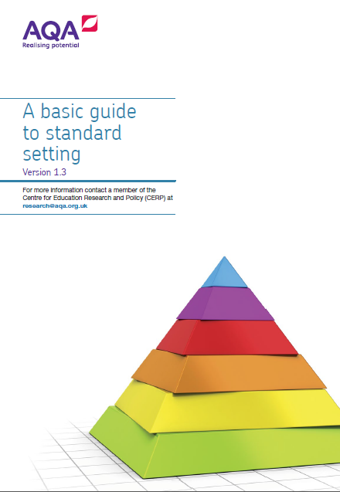
What exactly is awarding?
Awarding is the process by which the grade boundary marks are determined at subject level.
We do this in a way that ensures the standard will be comparable with previous series and with that of other awarding organisations.

Slide 26
Getting the right grade – assessments
Every answer in a written exam paper is marked by us.
Papers are either traditionally marked (the examiner sees a full script) or electronically marked (the examiner marks single questions).
We employ over 23,000 examiners during the summer period.
We mark over 2,000,000 scripts each year.
Marking starts in late April and must be completed by 7 August.

Slide 27
Getting the right grade – awarding
Every year an awarding committee meet to determine the grade boundaries for a qualification.
The determination is based on statistical evidence and examiner judgement.
Statistics are collected across all awarding organisations for a subject; this ensures that the subject outcomes are comparable.

Slide 28
Getting the right grade – awarding
Decisions are made on key boundaries:
  GCSE: 7, 4 and 1
  GCE: A and E.
Written exam marks can fluctuate year on year; this allows us to deal with differences in demand of the written assessment.

Slide 29
How is a grade boundary decided?
The ‘statistical’ element
Our Centre for Education Research and Compliance (CERP) use a range of statistics to make predictions which suggest the most appropriate statistically recommended grade boundaries. These are based on how comparable students have performed in previous series, KS2 data and matched data.

Slide 30
How is a grade boundary decided?
The ‘judgemental’ element
The awarding meeting uses a balance of judgemental and statistical evidence to make recommendations. The committee will look at a range of scripts for each ‘judgemental grade boundary’ (7, 4 and 1 for GCSE).

Slide 31
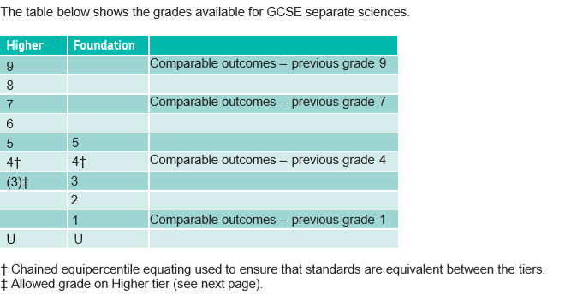
New GCSE grading

Slide 32
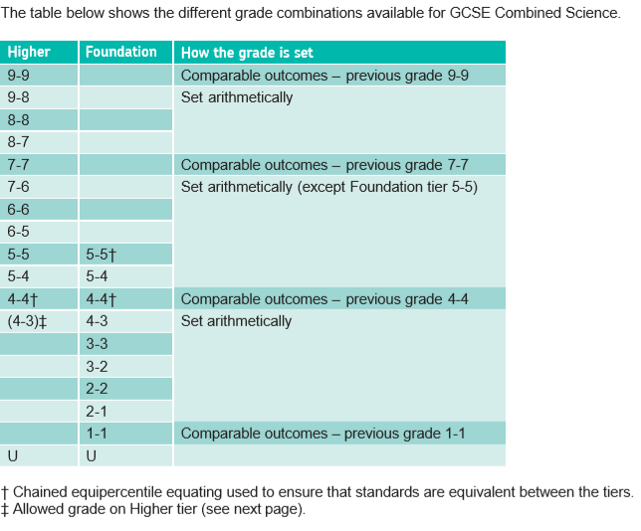
New GCSE grading

Slide 33
Our Science papers and mark schemes

Slide 34
Key points for successful assessment design
Good mark schemes are at the heart of the validity of the assessment and the reliability of marking.
When writing questions it is important to consider how to avoid mark compression, for example by ensuring questions are distinct and by encouraging examiners to use the full mark range.
Avoid double jeopardy (ie students must know the answer to one question in order to answer the next).
Notes:
Explain what mark compression is Mark compression: a poor spread of marks across the mark range which makes discriminating between students difficult. This happens for a number of reasons.
Questions being too easy or too difficult
Students not able to discern the level of detail required in their response – common in ‘explain’ type questions
Low maximum marks, makes it difficult to spread students adequately across the mark range
Questions which are not sufficiently distinct, means more able students do not see the opportunity to gain access to the full mark allocation
Examiners not being willing to use the full range of marks available, especially in essay style questions
A poor spread of marks – this makes grade boundaries difficult to set and potentially be very close together

Slide 35
Key points for successful assessment design
Question content must be mapped to the specification.
Questions should be perfectly aligned with their mark schemes.
Students should be able to access all available marks.
Notes:
Explain what mark compression is Mark compression: a poor spread of marks across the mark range which makes discriminating between students difficult. This happens for a number of reasons.
Questions being too easy or too difficult
Students not able to discern the level of detail required in their response – common in ‘explain’ type questions
Low maximum marks, makes it difficult to spread students adequately across the mark range
Questions which are not sufficiently distinct, means more able students do not see the opportunity to gain access to the full mark allocation
Examiners not being willing to use the full range of marks available, especially in essay style questions
A poor spread of marks – this makes grade boundaries difficult to set and potentially be very close together

Slide 36
GCSE Science Assessment Objectives
 | Description | %
AO1 | Demonstrate knowledge and understanding of: scientific ideas; scientific techniques and procedures. | 40
AO2 | Apply knowledge and understanding of: scientific ideas; scientific enquiry; techniques and procedures. | 40
AO3 | Analyse information and ideas to: interpret and evaluate; make judgements and draw conclusions; develop and improve experimental procedures. | 20
36
Copyright © AQA and its licensors. All rights reserved.
Notes:
Explain what AOs are, why are they important.
How they are used to create assessment (eg in 20% NEA, 18% AO3, 2% AO2) so same practical will have to be assessed in exams.
All AOs use the same AOs to create their assessments …differences come in the interpretation of the AOs

Slide 37
Level of demand in GCSE Science papers
H
Assessment structure of the Trilogy, Synergy and Separate sciences specs
9
6
High demand
60%
Foundation Tier:
60% low demand
40% standard demand
Higher Tier:
40% standard demand
60% high demand
15% of marks assess practical skills
F
5
4
5
4
40%
Standard demand
30% common marks
40%
3
1
60%
Low demand
Combined Science: 20% of marks assess maths skills – covering all 3 levels of demand
B-10%, C-20%, P-30%
37

Slide 38
Assessing equations at different demand levels
  Recall
  Application
  Recall and application
  Use of Physics Equations Sheet
38
Notes:
We are required to assess students’ ability to recall, apply and ‘recall and apply’ equations at all levels of demand.
In this session I’ll go through how we do this, and look at some examples of how students are tackling these questions
Include some points for discussion of what you could do with this information to help students understanding and skills
Most of the equations are in Physics, although there is one equation students must recall and be able to apply in Biology (the magnification equation) and one in Chemistry (calculation of Rf values). The principles discussed here apply to all three subjects.
Remind teachers of the original guidance given in Spring 2017 Hubs ‘Managing formative assessment (structure of the new papers)’ (https://www.aqa.org.uk/subjects/science/hub-schools-network/science-meeting-materials-archive ). There have been small refinements since then, and the information given here is the most up to date following this summer’s exams.
Excellent set of resources on Teachit to support assessment of equations. An example is in the delegate pack – strongly encourage to look further.

Slide 39
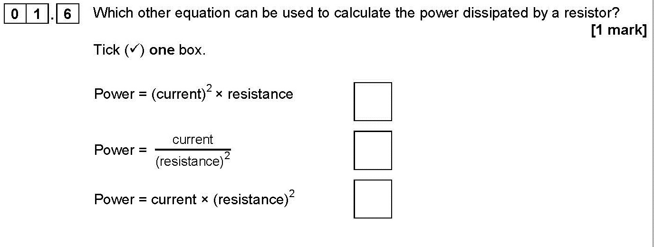
Assessing equations at low demand
To address AO1, students may be asked to recall an equation (eg by multiple choice, link boxes). Likely to only be worth 1 mark.
Example: Trilogy Physics 1F Q1.6.
Notes:
less than a third of students were able to answer this correctly.
There is a further example in Synergy 2F Q1.5.
Will not be many of these in any one series. Counts as AO1 in isolation so that’s why – need AO1 for other stuff
In biology there is only one equation to recall (the magnification equation), and in chemistry also only the Rf calculation, so students will usually be given equations to apply for calculations

Slide 40
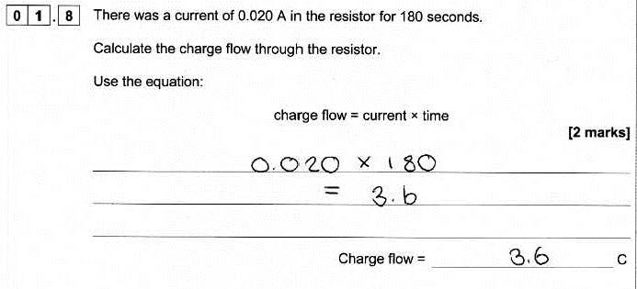
Assessing equations at low demand
To address AO2, students will be given the equation. These will be simple equations with substitution of two numbers, no transformations.
Example: Trilogy Physics 1F Q1.8.
Notes:
This is a full-mark answer. Laid out beautifully, exactly as we would wish to see it. Unfortunately, these model answers are rare!
Examples 10 and 11 (booklet page XX) show common things students were doing incorrectly in response to all of these types of question:
Not using the equation as given – rearranging or using different mathematical functions – common for this one was to divide the two numbers rather than simply multiply
Not using the numbers as given – for this question a number of students attempted to convert seconds to minutes
Not showing their working out – if a question is worth more than one mark it’s a good idea to do this so that if you make a mathematical error then you might still gain 1 mark
Not being able to do the sum itself – perhaps an issue of not having a calculator?
Point to think of when looking at mocks
Work with students to understand why they felt they needed to do something with the equation or numbers.
There is a list of other questions teachers may want to look at later on pages XXXXX.

Slide 41
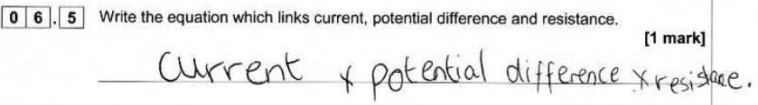


Assessing equations at standard demand
To access AO1, students will be given the prompt ‘Write down the equation that links…’. Terms will be given in alphabetical order.
Example: Trilogy Physics 1F Q6.5.
Notes:
This is a common SD question (HT Q1.5) on the FT paper, about a third of students got the mark. On the HT paper, nearly three quarters could recall the equation correctly
Students should know that we will always list the operators in alphabetical order, so there is no suggestion of the correct order
These examples show some of the common things students doing here (demonstrating not knowing the equation)
Most commonly listing the elements as given in the question and simply inserting mathematical operators. The example here used multiplication but a mixture of multiplying and division was also seen
Not giving as an equation (ie no = sign) – so couldn’t gain mark (again, mostly on FT). The first example also shows this.
Using their own symbols – eg P, C, R - we accept symbols instead of words, but they must be correct (or at least recognisable)
Using lower case symbols – in this instance were allowed
Giving in a form not in the specification (eg R = V/I) as long as this is correct it gains the mark
On the HT paper, more students getting it right, but often students were trying to put the equation in the order of the words given in the question, and therefore rearringing – but unfortunately often incorrectly. They don’t need to give the equation in the order given in the question – we do alphabetically to avoid giving too many clues.
A number of HT students were giving V = I²R – confusing the equation wanted with the one for power.
On HT Far fewer examples of students just putting their own operators into the three terms.
From summer 2020, we will put the symbols in brackets after the words, which is intended to help students focus
There is a further example in the booklet (example 12)

Slide 42
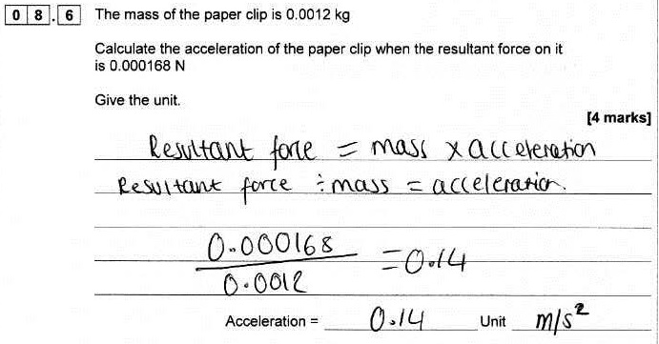
Assessing equations at standard demand
Calculations will involve something ‘extra’ (eg simple transformation or unit conversion).
Example: Synergy 3F Q8.6/3H Q2.6.
Notes:
At levels of demand below HD, when students need to use an equation from the Physics Equations Sheet we will also give the prompt ‘Use the Physics Equations Sheet’.
High demand questions will not give the prompt: students will be expected to decide for themselves which equations to use – whether from recall or from the Equations Sheet.
Example here is from Synergy paper 3F/3H.
SD application of recalled equation f = ma.
The ‘something extra’ was rearrangement to find acceleration. On the FT just over half of students gained no marks; on the HT over half got the three calculation marks, but only 17% also got the unit correct.
This is a full mark answer – different points highlighted on successive clicks:
student has shown good practice in reiterating the equation from the previous part of the question
has correctly rearranged it
substituted correctly
evaluated the answer correctly and given the correct unit.
Some examples of common problems with this type of question (all papers):
Simply multiplying the numbers given together
Even if they had been able to recall the equation correctly they seemed unable to rearrange it correctly
Not showing any working so impossible to allocate compensation marks if answer wrong
Examples 13 and 14 in booklet also cover this skill.

Slide 43
Assessing equations at high demand
No prompt is given about which equation to use.
There are no marks simply for writing the equation down without doing something with it (so no AO1).
Questions will involve transformations or ‘something extra’.
At highest demand (target grades 8−9) questions will include complex equations, transformations and multiple steps.
Notes:
No AO1 (straight recall) for equations at LoD above SD: students need to know what they’re doing.
Let’s now have a look at two examples from this summer and see how students have been coping.
There are a number of further examples in the booklet.

Slide 44
Our Science papers and mark schemes
Making questions clear
Command words
Avoiding repetition or unnecessary information
Answer line prompts
Use of bold

Slide 45
Our Science papers and mark schemes
Our exams explained
Ramping of demand
Question scaffolding
Multiple choice
Calculations
Extended response

Slide 46
Resources

Slide 47
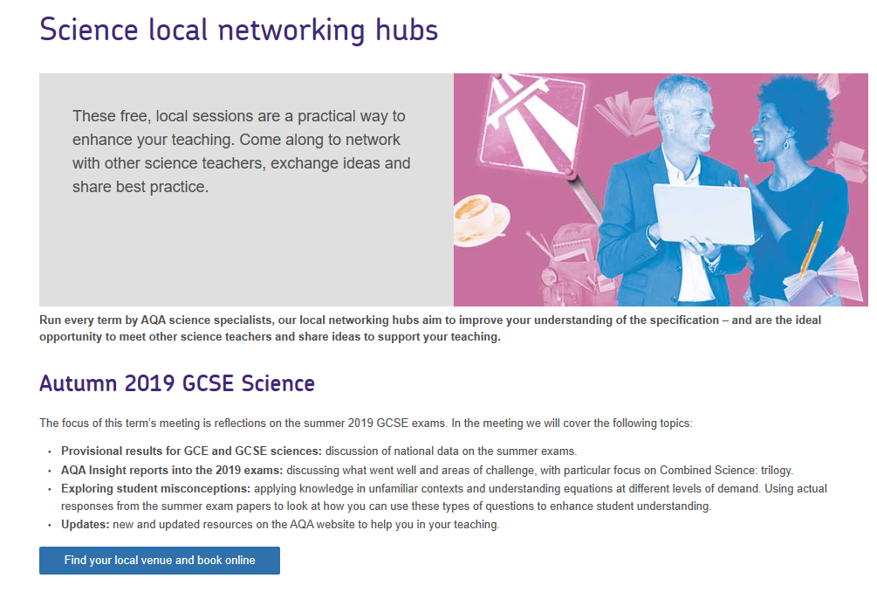
Science hub network
Notes:
Link back to subject content and the fact that teachers should be collecting resources from wherever

Slide 48
Resources
Visit our website for a range of science resources, including:
specifications
past papers
schemes of work
practical Handbooks.
Notes:
Link back to subject content and the fact that teachers should be collecting resources from wherever

Slide 49
Become an examiner/moderator
Complements your teaching
Boost your career/CV while increasing your personal development
Gain a clearer understanding of our mark schemes and assessment process
Inspire your teaching
Network with fellow professionals
Raise your students’ attainment
Earn extra income with all the convenience of home working
Notes:
One full year’s teaching required before you can apply

Slide 50
Enhanced Results Analysis
Free service, available through e-AQA
Review school, class and individual student performance
Make comparisons with whole AQA cohort
Identify skills or topics that were challenging so that you can address this with later year groups
Download data for your own analysis

Slide 51
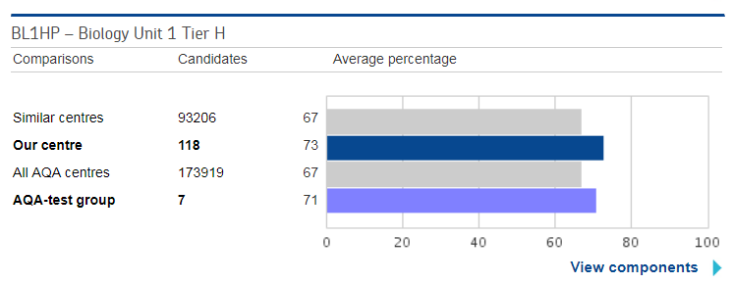
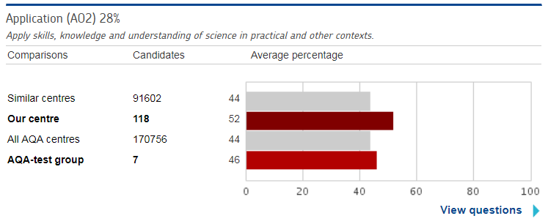
Managing groups facility
ERA will also show group data:
Notes:
How might this be useful - Did your targeted student intervention support work , pupils premium groups performance , tier of entry for your predicted 5s
Data for each group will appear as it’s own bar on the graph.
You can compare groups against each other
Remember you can view up to 10 groups on each of these screens
Only drawback is that the mark distribution screens do not work at group level, these will continue to show marks for the whole school – you can access this data if you download the group data into an excel file and select ‘include question marks’ for the component/paper you are looking into.
Can use this to look at performance in particular skill areas and see if one group performed better than another in a particular skill area – is there good practice to share? Did interventions work?

Slide 52
Updates
Updates to GCSE specifications on website:
  minor corrections and clarifications
  copy of amendments list given in booklet.
Assessment resources on Exampro:
  2018 papers now in question bank
  2019 Extended response question highlights
  MERiT analysis for 2019 mocks
  KS3-4 transition tests.
A-level Environmental Science Practical Handbook.
GCSE Science modular training materials.
Notes:
BP1 – small changes made to the GCSE specifications now on website
Should have gone up mid-September – make sure check
Communication sent out to all schools October 2019
There is a list in the back of the booklet of the changes that have been made.
BP2
In back of booklet is a list of resources currently available from Exampro.
Timeline for MERiT in pack. In the back of the booklet is a list of resources currently available from Exampro.
BP3 – Will be on the website by Christmas. Communication to teachers sent out about this in September.
BP 4 Mention this briefly here – we are currently working on a series of modular materials that teachers can use – repurposing of some of the Hub and other presentations to get them out to a wider audience. The first one will be on Extended response (includes understanding requirements of the command words and levels of response mark schemes). Further one this term will be on AO2. Building up a bank of materials for teachers to use as training back in school. Comms will be going out shortly.

Slide 53



New GCSE science resources
Five self-guided modular training packs being released over the next year
Helping teachers to better understand the assessment requirements
Pack 1: Extended response questions – help your students master the extended response
Pack 2: AO2 – prepare students to manage scientific knowledge in an unfamiliar context
Pack 3: Practical questions coming Spring 2020
Pack 4: AO3 coming Spring 2020
Pack 5: Maths in science coming Summer 2020

Slide 54
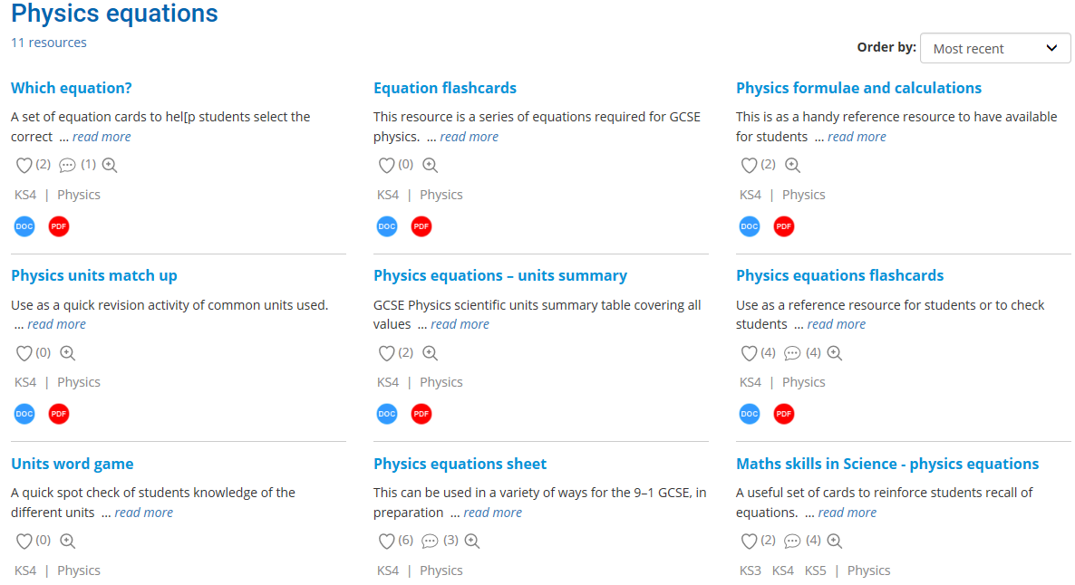
Teachit resource on equations
www.teachitscience.co.uk/ks4-physics/physics-equations/tags/4282
Notes:
Quick plug for Teachit.
The resource bank shown here is what is currently available to support learning and application of the Physics equations.
I have included a printout of the Flashcards resource in your pack as an example.
The PDF resources are generally free to download.
Subscriptions are available that give access to adaptable resources: individual fees £30 per year and department fees (up to 15 log-ins) £150 per year

Slide 55

Any questions?

Slide 56
How did we do?
Please rate this session on the Sched Conference app.
Using the postcards provided, please write:
  one thing you enjoyed about our session or will take away for your teaching
  one thing you feel could be improved.
Please hand your postcard in as you leave.

Slide 57
Get in touch
For qualification information, resources and support, please visit: aqa.org.uk/science
Enquiries:
Tel: 01483 477 756
Email:
gcsescience@aqa.org.uk
alevelscience@aqa.org.uk

Slide 58
Thank you

