Slide 1
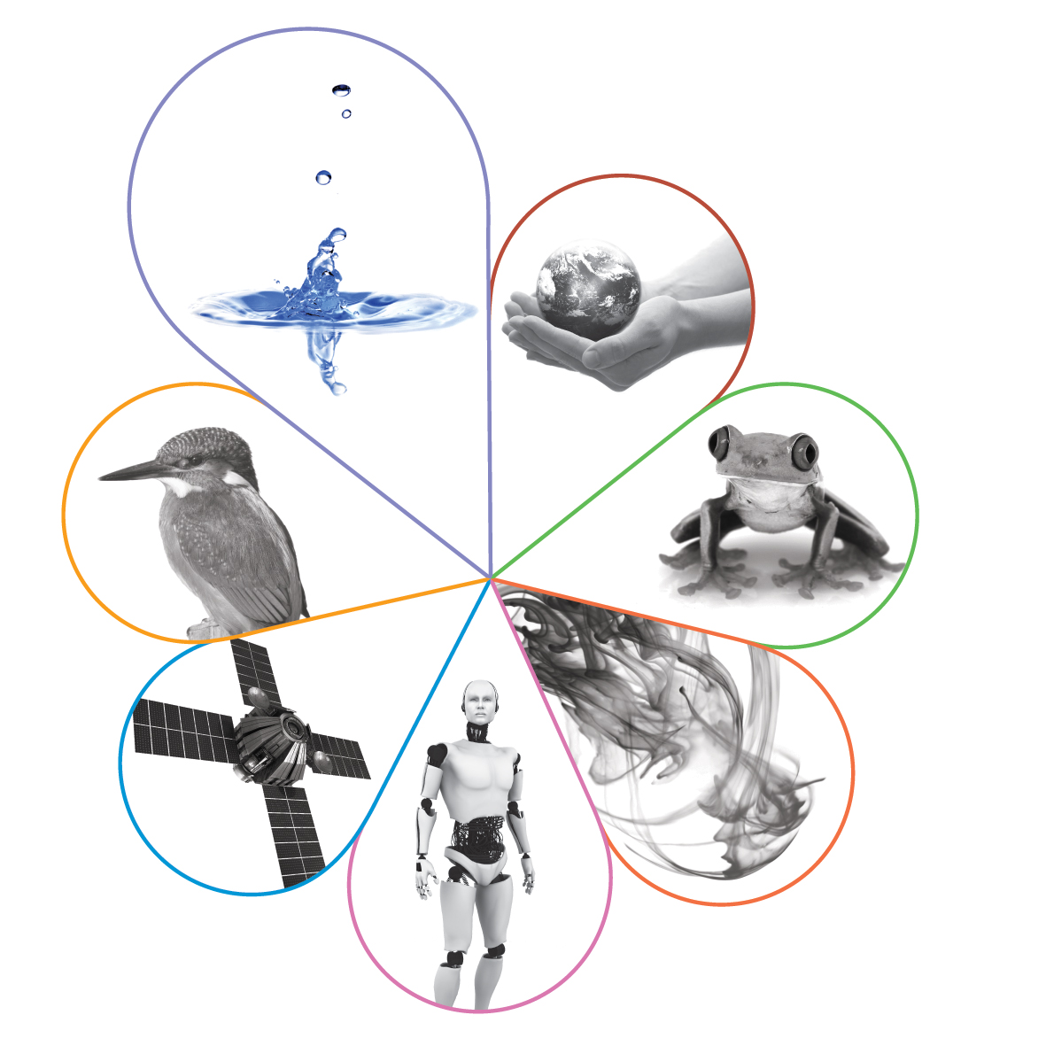
ASE Annual Conference: A-level student performance in practical work related items
Catherine Witter
Spring 2020

Slide 2
Welcome

Slide 3
This meeting will be recorded
Exam boards have an Ofqual requirement to record event audio.
Recordings are kept for the lifetime of the specification and not shared as an accompaniment to session resources.
The recording will begin now.

Slide 4
Outline of the session
Background
AQA practical work advisers have now worked face to face with teachers from over 2500 schools and colleges since monitoring visits started in January 2016. We have also been analysing how the questions on our A-level science exam papers have performed since reform, with particular focus on questions that have been designed to assess practical work indirectly.

Slide 5
Outline of the session
We would like to share:
what we are actively doing to support A-level science teachers as they deliver practical science in the laboratory
our methodology behind this current and ongoing research.

Slide 6
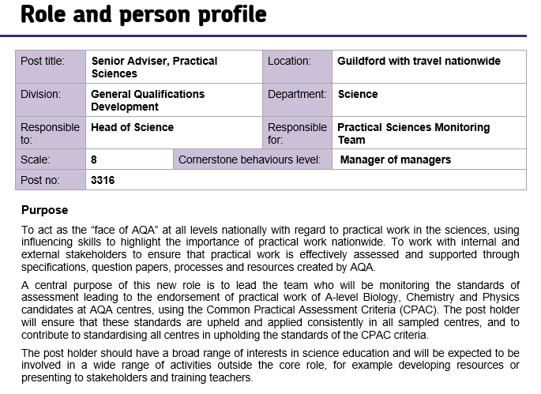
My role at AQA – operational with a need for science expertise
Notes:
AQA invests in practical science expertise

Slide 7
How are practical skills in science qualifications assessed?
Indirectly (100% terminal exam)
Required practicals and a list of apparatus
and techniques, ATs
Directly
Common Practical Assessment Criteria
(CPAC) and the ability to use ATs
The direct assessment is the non-examined assessment (NEA), part of our A-level Science qualifications only
Notes:
Quick verbal indication of how practical work is assessed in items – we have a practical handbook to support teachers – standard practical work but teachers do teach outside their subject area at this level. No more than 5 mins as main interest to HE colleagues is the A-level/KS5 qualifications.

Slide 8
Ofqual rules for the current A-level Sciences
AS and A-level decoupled.
Both courses are linear.
 | AS | A-level
Minimum assessment time | 3 hours | 6 hours
Maximum number of components | 2 | 3
Coursework/controlled assessment | No | No
Endorsement | No | Yes
Practical marks | 15% | 15%
Maths marks | 10%(B), 20%(C), 40%(P)
8

Slide 9
What is practical work and why is it so important?
It supports and consolidates scientific knowledge and understanding.
It develops investigative skills.
It builds mastery of practical skills.
9

Slide 10
Assessment: For endorsement
Teacher assesses students’ abilities in practical work through a set of competencies. Holistic judgement at the end of a two-year course.
10

Slide 11
Assessment: For endorsement
12 required practical activities
Teacher devised practical experiences
Students’ practical skills in at least 12 practicals
Five competencies:
1. Follows written instructions
2. Applies investigative approaches and methods when using instruments and equipment
3. Safely uses a range of practical equipment and materials
4. Makes and records observations
5. Researches, references and reports
Endorsement of practical skills
11

Slide 12
The monitoring visit
12
Copyright © AQA and its licensors. All rights reserved.
Notes:
Note that the four AOs collectively do approximately 3500 monitoring visits every cycle. The pass enables them to report on the practical endorsement of their students.

Slide 13
We have now completed our second monitoring cycle

Slide 14
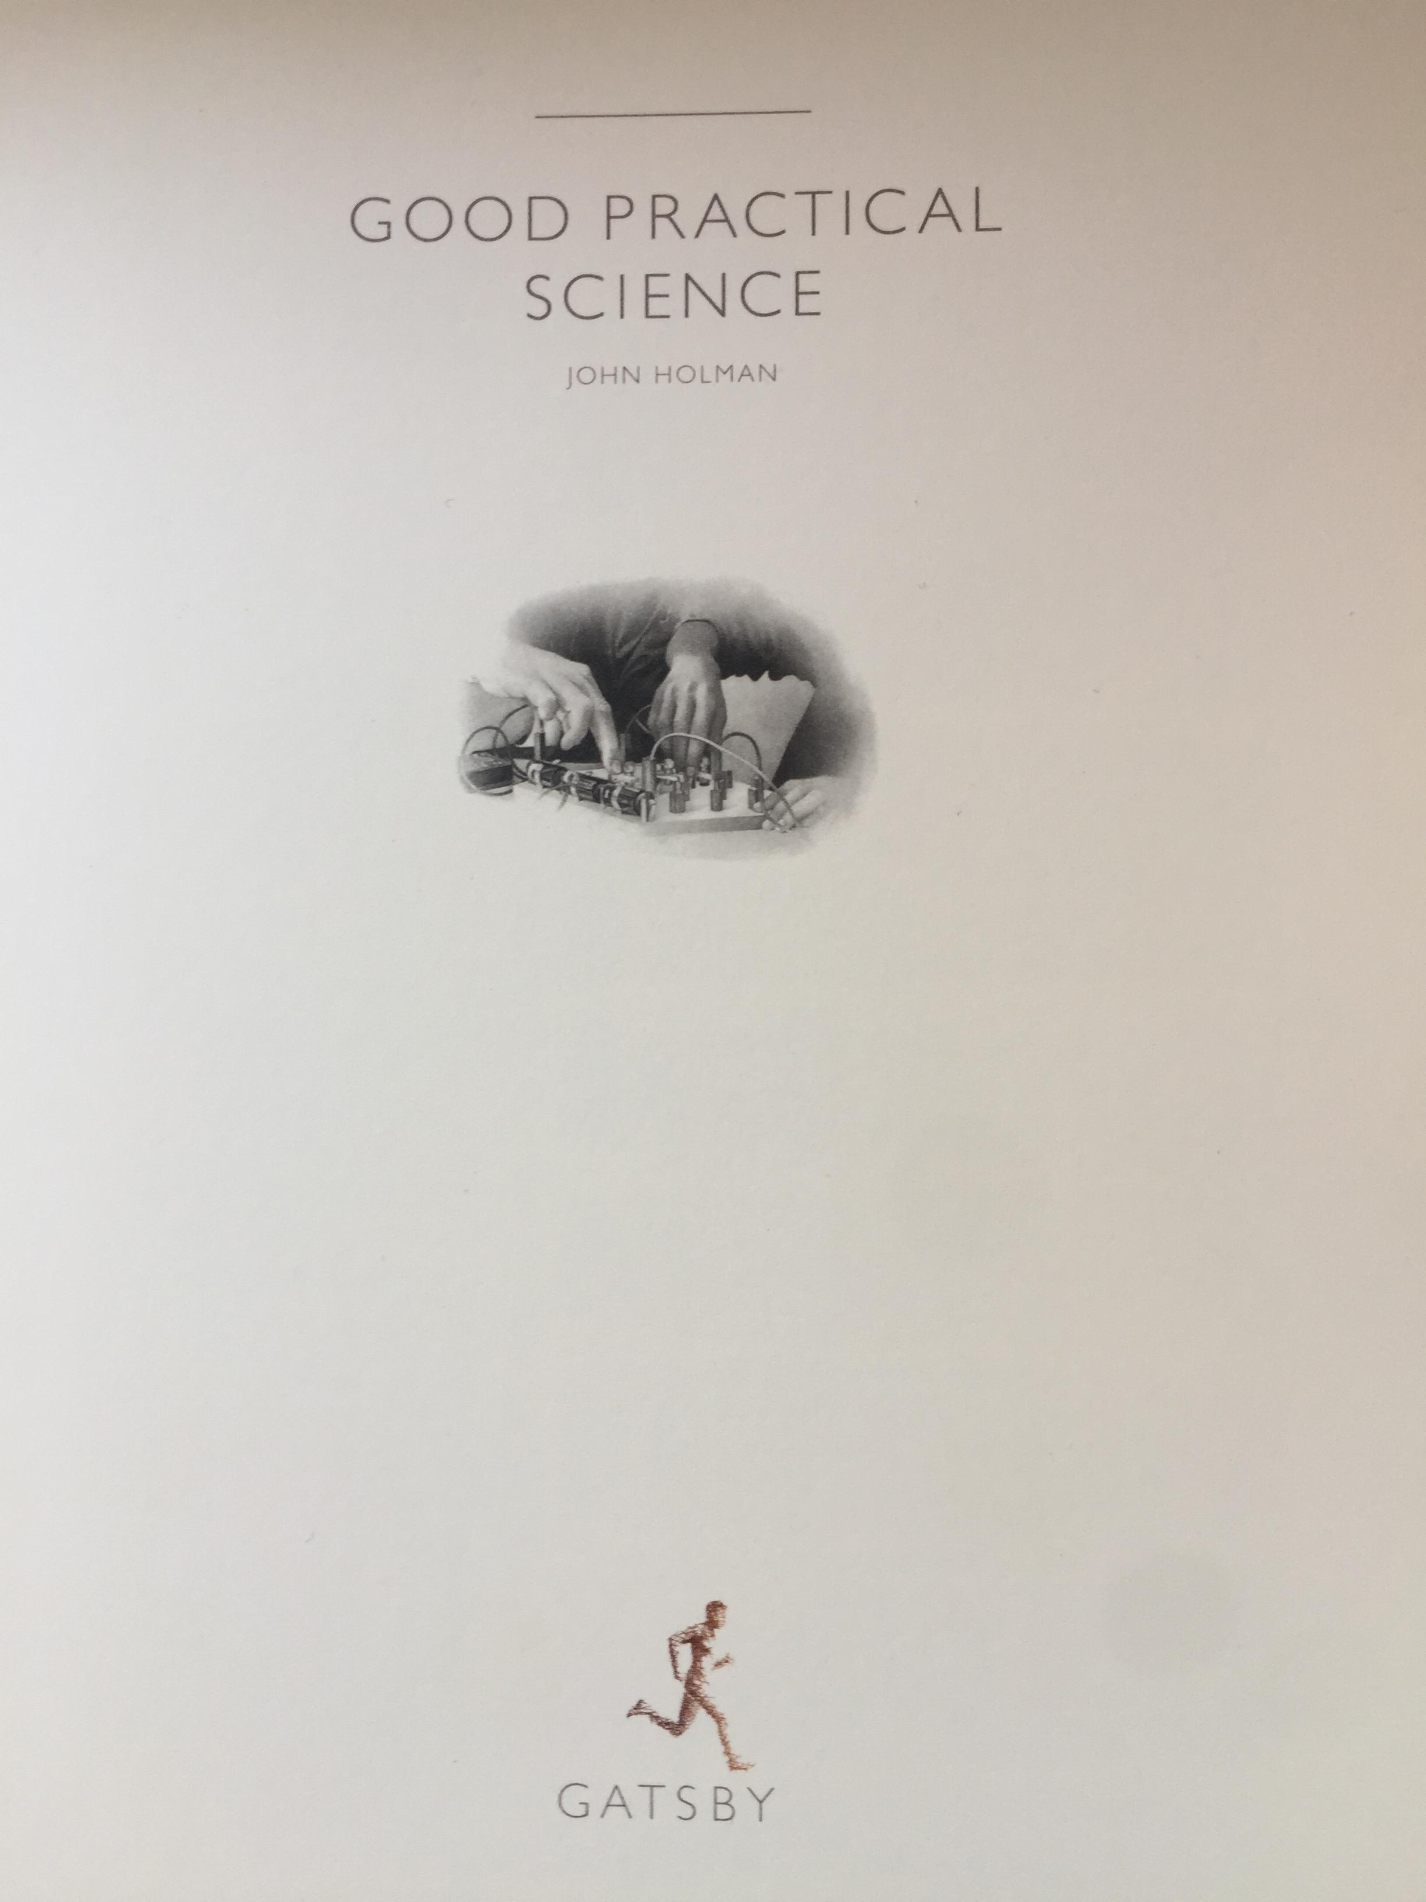
Activity
What CPD might A-level Science teachers need in order to effectively and confidently assess practical science skills directly in the laboratory?
10 minutes
©istock.com/vladcirin
Credit: John Holman and the Gatsby Foundation available for the teachers to freely download from: gatsby.org.uk/education/programmes/support-for-practical-science-in-schools

Slide 15
Useful resources
We’ve developed a range of resources that support our teachers and advisers to deliver A-level practical work well and directly assess their students’ practical skills.

Slide 16
Useful resources
These resources are available at:
aqa.org.uk/resources/science/as-and-a-level/teach/practicals
16

Slide 17
Our monitoring model – Cycle 2 (2017-19)
119 Teacher monitors, 8 Team Leaders, 6 Senior Practical Advisers and 4 Science Technicians make up the team of AQA associates.
Source: Good Practical Science by John Holman and the Gatsby Foundation. Available for the teachers to freely download from: gatsby.org.uk/education/programmes/support-for-practical-science-in-schools
17

Slide 18
Activity
How can teachers use the Common Practical Assessment Criteria and Required Practical Activities to support student outcomes in the terminal exams?
10 minutes
Source: Good Practical Science by John Holman and the Gatsby Foundation. Available for the teachers to freely download from: gatsby.org.uk/education/programmes/support-for-practical-science-in-schools

Slide 19
A-level practical skills assessment
12 required practicals per subject
12 apparatus and techniques per subject
How do we assess this in our exam papers?
19 of 30

Slide 20
Assessment objectives (AOs)
These apply to both AS and A-level:
AO1 | Demonstrate knowledge and understanding of scientific ideas, processes, techniques and procedures.
AO2 | Apply knowledge and understanding of scientific ideas, processes, techniques and procedures: in a range of theoretical and practical contexts when handling qualitative and quantitative data.
AO3 | Analyse, interpret and evaluate scientific information, ideas and evidence, including in relation to issues, to: make judgements and reach conclusions develop and refine practical design and procedures.
20

Slide 21
Practical skills questions in papers
Questions set in a practical context, where the question centres on the science, not the practical work.
Questions that require specific aspects of a practical procedure to be understood in order to answer a question about the underlying science.
Questions directly on the required practical procedures.
Questions applying the skills from the required practical procedures and the apparatus and techniques list.
21

Slide 22
Practical skills assessment – Chemistry Paper 2
• N/A – 0.3%
• 0 marks – 6.4%
• 1 marks – 93.2%

Slide 23
Practical skills assessment – Chemistry Paper 2
• N/A – 1.6%
• 0 marks – 66.7%
• 1 marks – 31.7%

Slide 24
Practical skills assessment – Chemistry Paper 2
24
Copyright © AQA and its licensors. All rights reserved.

Slide 25
Practical skills assessment – Chemistry Paper 2
25
Copyright © AQA and its licensors. All rights reserved.

Slide 26
Preliminary research
Summer 2018 A-level Biology, Chemistry and Physics data
LAW tagged practical work items versus non-practical work items
26

Slide 27
Preliminary research
Senior researcher generated spreadsheet - the practical total (0-1) and non-practical total (0-1) in the spreadsheets are the centre’s mean proportion of available marks for the practical and non-practical items
27

Slide 28
Identifying centres
28

Slide 29
Identifying centres
Then a lot of sophisticated statistics were used to check the variance around the raw mark mean achieved by candidates at the centre…
‘at first we simply used arithmetic to calculate the lowest possible difference and highest possible difference between the practical and non-practical performances using the 95% confidence intervals around each mean – this is a very ‘rough and ready’ approach and doesn’t take account of the underlying statistics; the correct way to do it is to take half of the square root of the sum of the squares of the standard errors to calculate a new standard error in the difference in means’
Steve Wooding, AQA Senior Researcher
29

Slide 30
Interviewing teachers to look for common themes

Slide 31
We asked them to talk to us about
School context
Their department personnel
Leadership of the department
Resources
Curriculum planning
How they manage the A-level practical skills endorsement
If they used our website resources or were an AQA practical work adviser
What they think of our exam papers
Other practical work experiences they offer

Slide 32
We asked them to talk to us about
The trends that we can see at this very early stage are limited due to the numbers of teachers we have spoken to, however what is key is that the monitoring visit report for all these centres, for this subject, indicated outstanding practical work was being carried out at the centre at that time.
Can we confirm that there is a link between the quality of teaching and learning of practical science in the lab and the outcomes students achieve through direct and indirect assessment? This research is ongoing in 2019-20.

Slide 33
Next steps – note a paraphrase of Appendix 5…
5a
Identified for indirect assessment and developed through teaching and learning ie through the required practicals and other practical work.
This includes problem solving, application of subject knowledge, experimental design and evaluation of a scientific method, presenting data and evaluating results so that conclusions can be made.
Graph plotting and interpretation, data processing and uncertainty calculation and consideration are also included.
The apparatus and techniques (ATs) are included.
Notes:
Page 18-23 of DfE Subject Level Conditions document

Slide 34
Next steps – note a paraphrase of Appendix 5…
5b
Identified for direct assessment and developed through teaching and learning ie the practical endorsement – CPAC are listed.
Investigative approach, following written instructions, making and recording observations, record keeping and presenting data in an appropriate way, using software or tools to process data and carry out research, citing sources are listed.
The apparatus and techniques (ATs) are included.
Notes:
Page 18-23 of DfE Subject Level Conditions document

Slide 35
Next steps – note a paraphrase of Appendix 5…
5c
Specific lists of ATs for each subject – so can be assessed indirectly or directly
Notes:
Page 18-23 of DfE Subject Level Conditions document

Slide 36
…having mapped the topic areas where Appendix 5 were assessed last summer…
Biology – Chromatography, Fieldwork sampling, Dissection, Calorimeter use, Physiological investigation and controls
Chemistry – Transition metal ions/Group 7 ions, TLC, Organic tests, Kinetics, Titration, Electrode potentials, Quickfit apparatus
Physics – Radioactive sources, measuring instruments, stationary waves, SHM

Slide 37
…having mapped the topic areas where Appendix 5 were assessed last summer…
…we will continue to consider the data we have by looking specifically at items assessing the use of apparatus and techniques that performed particularly well (across the grade range). We intend using that information to help us to identify centres that are most successful in translating the strong teaching and learning of practical skills into students’ performance in practical work related questions.
A report on our findings will be published before the end of this academic year.

Slide 38
Any questions?

Slide 39
New GCSE science resources
Five self-guided modular training packs being released over the next year
Helping teachers to better understand the assessment requirements
Pack 1: Extended response questions – help your students master the extended response
Pack 2: AO2 – prepare students to manage scientific knowledge in an unfamiliar context
Pack 3: Practical questions coming Spring 2020
Pack 4: AO3 coming Spring 2020
Pack 5: Maths in science coming Summer 2020

Slide 40
How did we do?
Please rate this session on the Sched Conference app.
Using the postcards provided, please write:
one thing you enjoyed about our session or will take away for your teaching
one thing you feel could be improved.
Please hand your postcard in as you leave.

Slide 41
Get in touch
For qualification information, resources and support, please visit: aqa.org.uk/science
Enquiries:
Tel: 01483 477 756
Email:
gcsescience@aqa.org.uk
alevelscience@aqa.org.uk

Slide 42
Thank you

