Slide 1
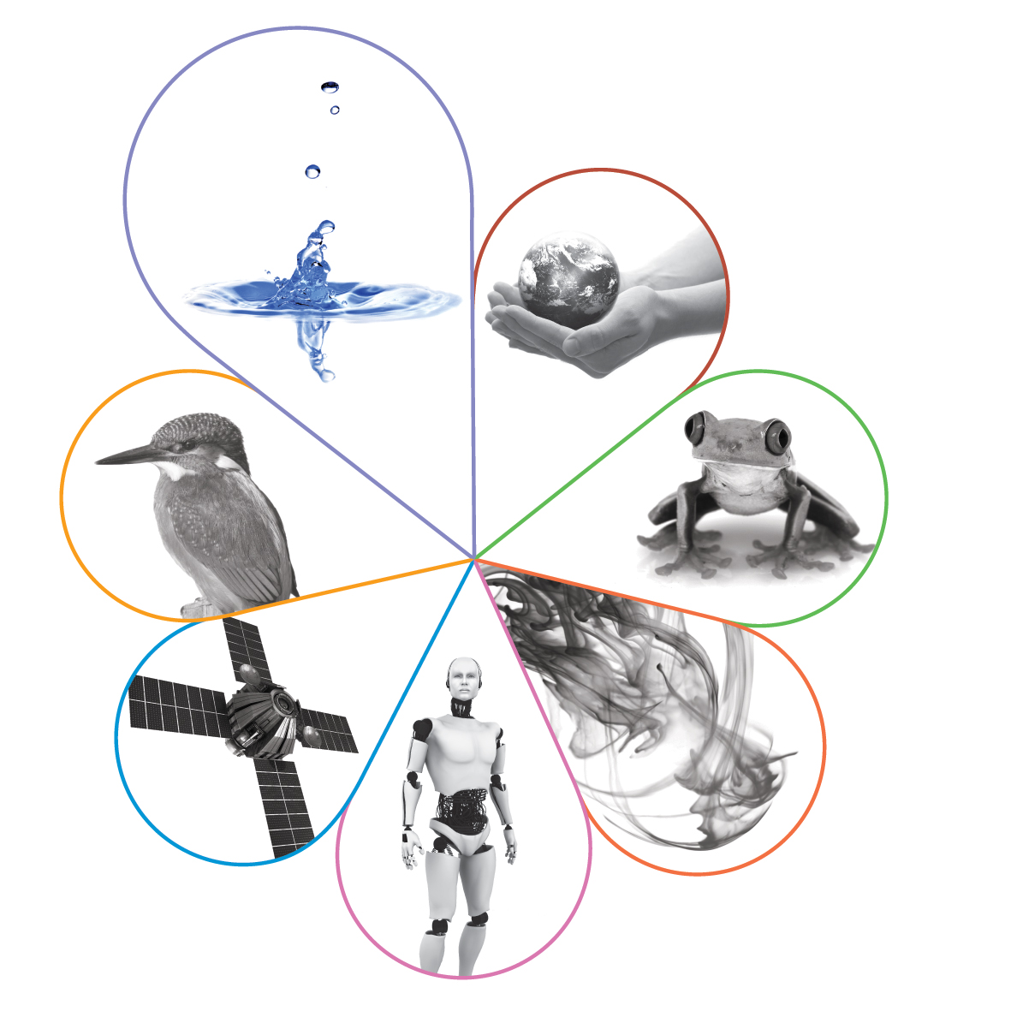
ASE Annual Conference: ‘Gender in GCSE Science’ research
Julian Clarke
Spring 2020

Slide 2
Welcome

Slide 3
This meeting will be recorded
Exam boards have an Ofqual requirement to record event audio.
Recordings are kept for the lifetime of the specification and not shared as an accompaniment to session resources.
The recording will begin now.

Slide 4
Outline for the session
The latest AQA research into outcomes by gender in GCSE sciences.
The features of this research.
The implications for future collaborative work.
Planned next steps by AQA.

Slide 5
AQA Science curriculum research 2018

Slide 6
Why was the research undertaken?
As an educational charity, AQA is keen to support the delivery of a rigorous, fair and valid assessment structure which enables all students to demonstrate their knowledge, understanding and skills.
The Science team are interested in evaluating the impact of change in provision on the ability of all students to demonstrate their learning through effective assessment, including the opportunities for, and take up of, progression throughout a student’s learning journey.

Slide 7
Why was the research undertaken?
The issue of gender outcome variation is one of several aspects that we are currently exploring.

Slide 8
Please note…
The research we are sharing today doesn’t seek to identify causal links.
It shouldn’t be used to draw conclusions about the curriculum pathway that students should follow.
It’s simply a factual statement of performance by a particular group of students in a particular set of exams in a particular year.
Extrapolation forward to predict outcomes in future years would be inappropriate and invalid.

Slide 9
Gender and GCSE Sciences
Are boys better at some aspects of science than girls?
Are girls better at other aspects of science than boys?
What is the situation nationally and in particular schools?
When and how does this situation make itself known?
What can we do about the gender gap? (What are you currently doing?)
Do similar issues apply to other student groups?

Slide 10
JCQ data for 2018 GCSE all UK candidates
GCSE Biology | Entry number | Grade 9 | Grade 7+ | Grade 5+ | Grade 4+
Male | 82131 | 10.8 | 39.3 | 77.3 | 88.7
Female | 83114 | 13.1 | 43.6 | 79.2 | 89.7
Male-female | (165245) | -2.3 | -4.3 | -1.9 | -1.0
GCSE Chemistry | Entry number | Grade 9 | Grade 7+ | Grade 5+ | Grade 4+
Male | 79543 | 12.3 | 42.3 | 76.9 | 89.1
Female | 78867 | 12.9 | 43.9 | 78.6 | 90.3
Male-female | (158410) | -0.7 | -1.6 | -1.7 | -1.2
GCSE Physics | Entry number | Grade 9 | Grade 7+ | Grade 5+ | Grade 4+
Male | 79097 | 13.9 | 45.3 | 79.9 | 91.0
Female | 77623 | 10.5 | 39.7 | 77.0 | 90.2
Male-female | (156720) | 3.4 | 5.6 | 2.9 | 0.8
Notes:
But 9-1 GCSE not offered in Scotland or Northern Ireland
NOT matched pupils – includes independent schools and others where all 3 GCSE sciences may not be entered.

Slide 11
Gender variation long established
There is no previous study of the outcomes of the same (matched) students across GCSE Biology, Chemistry and Physics.
There are several studies relating to A-level uptake but no previously matched progression to A-level from individual students at GCSE.
This report covers the initial stage of the first year of research – the plan is to track the students in our research forward into A-level, and possibly beyond.

Slide 12
Research methodology
The individual item level performance of the matched set of 99430 students (all students entered for Higher Tier papers 1 and 2 in AQA GCSE Biology, Chemistry and Physics examinations in Summer 2018) was aggregated by gender, there being 50547 female and 48883 male students.

Slide 13
Research methodology continued
For each group of students, the average mark achieved per available mark was calculated, giving a mark out of 1.0 per question item.
The difference between these marks was calculated by gender and shown for particular categories of question across the papers for that specification.

Slide 14
Research methodology continued
The data was aggregated by individual question item and categorised by question focus (fine categorisation of Assessment Objective) and question focus (blunt categorisation of assessment objective).
It was reported by science GCSE subject.

Slide 15
Research methodology continued
The question focus breakdown has the following categories:
maths marks
working scientifically marks
required practical marks
linking of ideas marks
AO1
AO2
AO3.

Slide 16
Research methodology continued
The fine categorisation of Assessment Objective has the following categories
(which are used as the variables on the x-axis of the first charts):
Maths marks
Working Scientifically marks: Scientific thinking
Working Scientifically marks: Exp. Skills
Working Scientifically marks: Analysis and evaluation
Required practical marks
Linking of ideas marks
AO1 ‒ Demonstrate knowledge and understanding of: Scientific ideas
AO1 ‒ Demonstrate knowledge and understanding of: Techniques and procedures
AO1 ‒ Demonstrate knowledge and understanding of: AO1 in isolation
AO2 ‒ Apply knowledge and understanding of: Scientific ideas
AO2 ‒ Apply knowledge and understanding of: Techniques and procedures
AO3 ‒ Analyse information and ideas to: Interpret and evaluate: Element 1A
AO3 ‒ Analyse information and ideas to: Interpret and evaluate: Element 1B
AO3 ‒ Analyse information and ideas to: Make judgements and draw conclusions: Element 2A
AO3 ‒ Analyse information and ideas to: Make judgements and draw conclusions: Element 2B
AO3 ‒ Analyse information and ideas to: Develop and improve exp. Procedures: Element 3A
AO3 ‒ Analyse information and ideas to: Develop and improve exp. Procedures: Element 3B

Slide 17
Average mark charts
The following charts, one for each science subject, show the ‘Average mark scored on the relevant marking point on all question of this type’.
These charts don’t show the total marks available for each type of question.

Slide 18
AQA GCSE Biology 2018 proportion of available marks gained by gender

Slide 21
What patterns did you observe?
What big picture patterns did you see across GCSE Biology, Chemistry and Physics in 2018?
What does this suggest about learning?
Are there any ways we can make use of these patterns to support further learning? (And if so, which groups of students might be supported?)

Slide 22
What were the gender differences in 2018?

Slide 23
Calculating the gender differences
The difference between the average mark scored on each marking point was calculated by subtracting the value for girls from that for boys.
The difference data was plotted on a bar chart according to the blunt categorisation of exam question focus; values above the line indicate that males performed better than females, values below the line indicate that females performed better than males in these exam papers.

Slide 24
Calculating the gender differences
Whilst the size of the average difference per mark available is small, the aggregation of these differences across both papers leads to the gender variation we see in the National GCSE outcomes.

Slide 28
Does the pattern change by grade outcome?

Slide 32
Is this pattern significant?
In GCSE in 2018, the average gender gaps for each specification were:
These are sufficient to affect the grade awarded to students, if their total was to fall at a grade boundary.
Subject | Average gap in marks by gender | Maximum mark achieved (200) | Mean mark achieved
Biology | - 0.81 marks | 185 | 100
Chemistry | - 0.46 marks | 197 | 111
Physics | +1.49 marks | 182 | 101

Slide 33
Commentary – no surprises (see exam reports)
Taken across the range of aspects assessed by the exams, the proportion of marks gained by both genders in any one subject is similar (less than about 1% variation in available marks overall); this suggests the assessment style for any one aspect doesn’t prevent access to questions in that aspect by one gender.
Across the three subjects, students achieve higher proportions of the marks allocated to AO1 – Demonstrate knowledge and understanding: AO1 in isolation. This is perhaps a reflection on the style of revision supported and encouraged in many schools.

Slide 34
Commentary – no surprises (see exam reports)
Across the three subjects, students achieve lower proportions of the marks allocated to assessments targeting the areas below, though there is some variation across the three subjects.
Experimental skills (including aspects of Working scientifically)
Required practicals
AO1 – knowledge and understanding of techniques and procedures
AO3 – Analyse information and ideas to develop and improve experimental procedures

Slide 35
Commentary – no surprises (see exam reports)
Students also achieve lower proportions of the marks allocated to linking ideas.

Slide 36
Summary by subject
In Physics, males achieve greater proportions of the available marks than female in every aspect assessed – the only science subject where this is the case.
In Biology, females achieve greater proportions of the marks in all aspects apart from Maths marks and AO2 (due to application of techniques and procedures).

Slide 37
Summary by subject
In Chemistry, the overall proportions of marks gained by males and females are quite balanced; females achieve greater proportions of the marks allocated to AO1 (all aspects), required practicals and linking ideas, whilst males achieve greater proportions of the marks allocated to Maths, AO2, and AO3 (most aspects).

Slide 38
Summary by question type
Maths: females achieve a smaller proportion of the available marks in all three subjects.
(Biology < Physics < Chemistry)
AO2: females achieve a smaller proportion of the available marks in all three subjects.
(Physics << Chemistry < Biology)
AO1: females achieve a greater proportion of the available marks in Biology and Chemistry and males achieve a greater proportion in Physics.

Slide 39
Summary by question type
AO3: females achieve a greater proportion of the available marks in Biology, whilst males achieve a greater proportion of the marks in Chemistry and Physics.
Working scientifically: males achieve a higher proportion of the available marks in all three subjects.
(Biology < Chemistry < Physics)
Linking of ideas: females achieve a higher proportion of the available marks in Biology and Chemistry whilst males achieve a higher proportion in Physics.

Slide 40
Summary by question type
Required practicals: females achieve a higher proportion of the available marks in Biology and Chemistry whilst males achieve a higher proportion in Physics.

Slide 41
Discussion opportunity

Slide 42
What can you do to close the gender gap?
Having considered the aspects of science in which GCSE students demonstrated a gender gap in 2018, how could you support your students to close the gaps?
What could you do to support younger students so the gap didn’t appear at GCSE?

Slide 43
What can you do to close the gender gap?
Do these patterns exist for your GCSE students? (ERA)
Do these patterns exist for your A-level students?
Is this a one-off set of data and patterns? What do you think?

Slide 44
Next steps
2019 and beyond…

Slide 45
Any questions?

Slide 46
New GCSE science resources
Five self-guided modular training packs being released over the next year
Helping teachers to better understand the assessment requirements
Pack 1: Extended response questions – help your students master the extended response
Pack 2: AO2 – prepare students to manage scientific knowledge in an unfamiliar context
Pack 3: Practical questions coming Spring 2020
Pack 4: AO3 coming Spring 2020
Pack 5: Maths in science coming Summer 2020

Slide 47
How did we do?
Please rate this session on the Sched Conference app.
Using the postcards provided, please write:
one thing you enjoyed about our session or will take away for your teaching
one thing you feel could be improved.
Please hand your postcard in as you leave.

Slide 48
Get in touch
For qualification information, resources and support, please visit: aqa.org.uk/science
Enquiries:
Tel: 01483 477 756
Email:
gcsescience@aqa.org.uk
alevelscience@aqa.org.uk

Slide 49
Thank you

