Slide 1
ASE Annual Conference: Focus on AO2
Elise Reece
Spring 2020

Slide 2
Welcome

Slide 3
This meeting will be recorded
Exam boards have an Ofqual requirement to record event audio.
Recordings are kept for the lifetime of the specification and not shared as an accompaniment to session resources.
The recording will begin now.

Slide 4
Outline of the session
What is Assessment Objective 2?
Understanding the Ofqual strand guidance
Identifying AOs on exam items
How to support students answering AO2 questions

Slide 5
Quiz
What does AO2 assess in general?
What percentage of marks are assigned to AO2?
Which of the following are assessed as AO2?
Graphs
Applying formulas
Writing a conclusion
Using Punnett squares
Starting the word equation for combustion
Using the particle model to explain changes in state
Identifying errors in a practical

Slide 6
Quiz answers
Answers
Application of knowledge and understanding of scientific ideas, scientific enquiry, technics and procedures. Applying knowledge and understanding of all sections of the specification, not just the content shown in section 3.
40% – this is across the award and not always a perfect 50:50 split across the two papers.
Graphs, applying formulas, using Punnett squares, using the particle model to explain changes in state.

Slide 7
Understanding the Ofqual guidance
Read through Ofqual’s subject level guidance document.
The guidance for each of the sciences is identical.
Highlight or underline the key points that AO2 covers that you think you should consider when planning your lessons or writing a scheme of work.

Slide 8
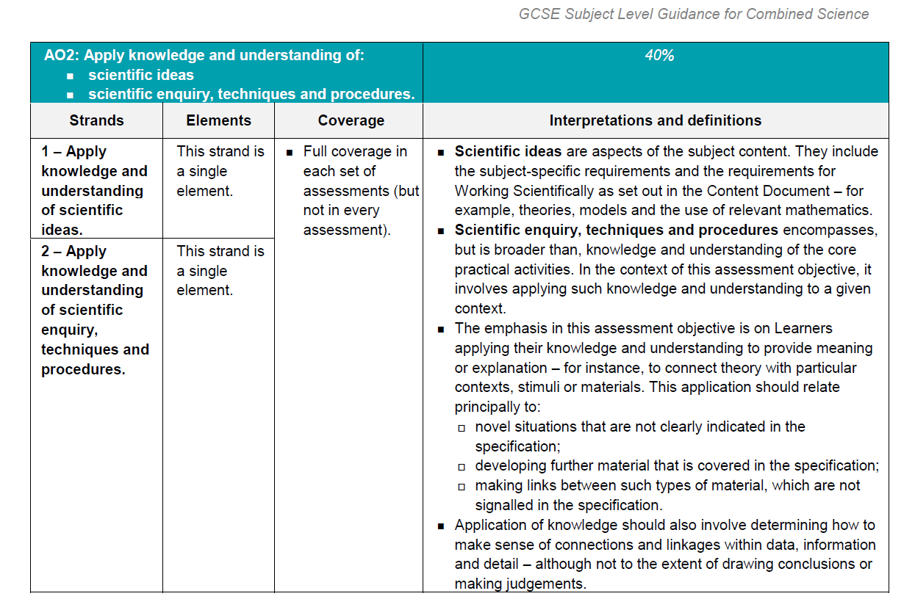
Understanding the Ofqual guidance
GCSE subject level guidance
This information is lifted directly from Ofqual’s GCSE Subject Level Guidance for Combined Science (July 2015) available in full here: gov.uk/government/uploads/system/uploads/attachment_data/file/443984/gcse-9-to-1-subject-level-guidance-for-combined-science.pdf
This contains public sector information licensed under the Open Government License v.3.0.

Slide 9
Summary of key assessment points of AO2
Apply knowledge and understanding of scientific ideas to both specific content and working scientifically requirements 1–3.
Apply knowledge and understanding of scientific enquiry, techniques and procedures.
Includes, but is broader than, the required practical's.
Apply knowledge and understanding to explain novel or unfamiliar situations not stated on the specification.
Develop further material covered in the specification.
Makes links between material on the specification.
Both strands 1 and 2 are covered in the assessment.

Slide 10
Questions for discussion
Has any of the assessment information surprised you?
Does the proportion/allocation of your teaching time reflect the ratio/proportion of mark allocation for AO2?

Slide 11
Identifying AOs on exam items
Look at questions in the booklet (page 7–25).
For each item, note down which AO it is addressing (AO1, 2 or 3).
If the item is addressing AO2, identify which strand (2/1 or 2/2).

Slide 12
Identifying AOs on exam items
The range of assessment items classified as AO2:
understanding the use of models and theories
most maths skills; calculations, using equations or formulae, plotting, interpreting and using graphs
practical skills, eg reading scales, taking measurements
understanding of variables, errors and uncertainties
using scientific vocabulary and terminology
using/interpreting specialist diagrams
applying knowledge from an area of the specification to a context (which may not be familiar) linking ideas.

Slide 13
Identifying AOs on exam items
Questions for discussion:
How many of the specification skills on the previous slide did you already know were related to AO2?
Which of these skills are you confident in teaching and improving students’ performance on through targeted intervention?
Considering the items in this activity, and using your understanding of the different elements that make up the AO, what are the challenges facing teachers and students when tackling AO2?

Slide 14
Identifying AOs on exam items
The following are challenges teachers have shared with us concerning planning AO2 opportunities into lessons:
time to cover all of the content as well as covering different aspects of AO2
setting the science, including practical's, in a different context than students have experienced in class
writing questions which link different parts of the specification together.

Slide 15
Identifying AOs on exam items
The following challenges have been identified as those that students face when answering AO2 questions:
recognising the science they need to apply to the question
recognising the practical when it’s slightly different to the one they are familiar with from the classroom
having the confidence to tackle a question when it appears unfamiliar to them.

Slide 16
Training guides: Self-guided module training packs
In the new training guides we have focused on the aspect of AO2 students find most challenging, that of tackling questions where the science is in a context.
The activities in the training look at your SOW to:
contextualise some of the content in lessons
review practical lessons and make them more AO2 friendly
discuss other areas to improve eg homeworks and intervention materials
discuss how to model exam techniques to access this type of AO2 question.

Slide 17
Student support for AO2
AO2 covers a wide variety of assessment types.
Students need to be explicitly told to expect questions in an unfamiliar context both for the content and practicals.
They should be given opportunities to experience the content being put in a context they aren’t familiar with.

Slide 18
Student support for AO2
Be asked questions about practicals they have done but that are changed slightly so they aren’t exactly the same as what they have experienced in class. For example, changing the variables being investigated, the chemicals being used, or the context the practical is set in.
Gain the confidence and techniques to identify the science behind the question by the teacher modelling this process with them.

Slide 19
Modelling the exam technique
Combined Trilogy Biology 1F common question
All increased during exercise but less
All increased during exercise

Slide 20
Modelling the exam technique
Command word
What’s the question saying
Think of the science I know to do with the question
so because
During exercise heart rate increases as need more oxygen and food for respiration to make energy.
My breathing increases to get more oxygen in.
If I take beta blockers my heart rate is slower so I am not going to get as much oxygen and food as I need
So I am going to get out of breath because I will be breathing really fast to get all the oxygen I need.

Slide 21
Any questions?

Slide 22
New GCSE science resources
Five self-guided modular training packs being released over the next year
Helping teachers to better understand the assessment requirements
Pack 1: Extended response questions – help your students master the extended response
Pack 2: AO2 – prepare students to manage scientific knowledge in an unfamiliar context
Pack 3: Practical questions – coming Spring 2020
Pack 4: AO3 – coming Spring 2020
Pack 5: Maths in science – coming Summer 2020

Slide 23
How did we do?
Please rate this session on the Sched Conference app.
Using the postcards provided, please write:
one thing you enjoyed about our session or will take away for your teaching
one thing you feel could be improved.
Please hand your postcard in as you leave.

Slide 24
Get in touch
For qualification information, resources and support, please visit: aqa.org.uk/science
Enquiries:
Tel: 01483 477 756
Email:
gcsescience@aqa.org.uk
alevelscience@aqa.org.uk

Slide 25
Thank you

